Slide 1



SMART INDIA HACKATHON 2024
KRISHI SAATHI
Problem Statement ID – 1691
Problem Statement Title- Adaption of Existing Command Area in Response to Shifting of Agricultural Practices
Theme- Miscellaneous
PS Category- Software
Team ID- 277
Team Name (Registered on portal)- Farm Visionaries

Slide 2
Adaption of ‘Existing Command Area in Response to Shifting of Agricultural Practices’
Farm Visionaries
Detailed Explanation of the Proposed Solution
Infrastructure Upgrades: Modernize dams with advanced technologies to boost capacity and efficiency.
Climate Modelling: Forecast water needs and adjust distribution using climate models.
Support Agricultural Adaptation: Align water management with modern farming techniques and support farmer adoption.
Real-Time Monitoring: Use sensors and predictive analytics for data-driven decisions.
How it addresses the problem
Infrastructure Upgrades: Enhances dam and reservoir efficiency to meet current water demands.
Optimized Water Management: Adjusts water distribution based on climate forecasts to improve availability.
Decision Support Systems: Provides real-time data and predictive insights for effective water management.
Innovation and uniqueness of the solution
The solution uses advanced technology and adaptive models to optimize water management, ensuring the resilience of dams and agriculture against climate change.
Modern Infrastructure
Climate-Adaptive Management
Precision Agriculture
Advanced Decision Systems
@SIH Idea submission- Template
2

Slide 3
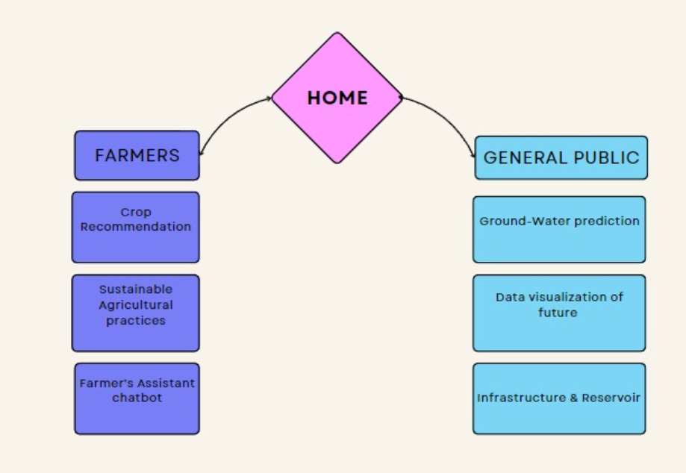
Farm Visionaries
TECHNICAL APPROACH
Farmers:
Crop Recommendation
Sustainable Agricultural practices
Soil Fertility prediction and techniques to replenish them.
Farmer's Assistant chatbot
General Public:
Ground-Water prediction
Data visualization of future
Infrastructure & Reservoir (prediction and information)
News
Chatbot for personal assistance
Technologies used:
Django framework, python, machine learning, power bi, html, css, javascript
@SIH Idea submission- Template
3

Slide 4
Farm Visionaries
FEASIBILITY AND VIABILITY
Problem Overview
Aging dams and reservoirs face reduced efficiency from siltation, altered water availability due to climate change, and evolving agricultural water needs..
These issues lead to reduced water storage capacity, misaligned water distribution, and increased structural stress, heightening the risk of damage to aging infrastructure.
Technical Challenges
Upgrading infrastructure and ensuring accurate data from monitoring systems..
Economic Risks: High costs and securing funding.
Environmental Risks: Potential adverse effects on ecosystems and risk of resource overuse.
Social/Regulatory Risks: Stakeholder resistance and navigating complex regulatory requirements.
Strategies for overcoming these challenges
Upgrade Technology: Modernize infrastructure with advanced monitoring systems for accurate data.
Secure Funding: Seek government grants and private investments for infrastructure upgrades.
Environmental Assessments: Conduct thorough assessments and adopt sustainable practices.
Stakeholder Engagement: Involve communities and stakeholders early, addressing regulatory needs proactively.
@SIH Idea submission- Template
4

Slide 5
Farm Visionaries
IMPACT AND BENEFITS
Potential impact on the target audience
Improved Water Availability: Enhanced water management will ensure more reliable and efficient water supply for agriculture and other uses.
Increased Agricultural Productivity: Adapting infrastructure to meet new agricultural practices will boost crop yields and support more sustainable farming.
Economic Benefits: Optimized water usage can reduce costs and increase economic stability for farmers and local communities.
Enhanced Resilience: Improved infrastructure and adaptive practices will better protect communities from climate-related water shortages and infrastructure failures.
Benefits of the solution
Social: Boosts food security and fosters community engagement.
Economic: Enhances crop yields and reduces long-term costs.
Environmental: Promotes sustainable water use and protects ecosystems.
Resilience: Improves climate adaptation and extends infrastructure longevity.
@SIH Idea submission- Template
5

Slide 6
Farm Visionaries
RESEARCH AND REFERENCES
1. Climate Change and Its Impact on Water Resources in India
Source: Journal of Earth Science & Climatic Change
Link: https://www.nwda.gov.in/upload/uploadfiles/e-book/S-3/Impact-of-Climate-Change-on-Water-Bodies.pdf
Summary: Discusses the effects of climate change on water resources in India, focusing on changing precipitation patterns and water availability.
2. Sedimentation in Indian Dams: A Review
Source: Water Resources Management
Link: https://link.springer.com/article/10.1007/s00027-023-00960-0
Summary: Provides a comprehensive review of sedimentation issues in Indian dams and their impacts on water storage and management.
3. The Social and Economic Impact of Soil Degradation in India: A Survey of Literature
Source: Indian Journal of Soil Conservation
Link: 10.13140/RG.2.2.28629.17128
Summary: Soil degradation severely threatens India’s agriculture, economy, and environment. Addressing this issue requires systematic soil management, sustainable agricultural practices, and effective land use policies.
@SIH Idea submission- Template
6

