Slide 1
ChilternOak
Group no – 6
232 Testing Batch

Slide 2
Group Members
Utkarsh Maurya(Team Lead) (2576001)
Juttuga Kesavanagendra (2576775)
Sakshi Agrawal (2576909)
Abantika Padhy (2576228)
Male Jayadeep (2575966)
Lama Sravanthi (2576695)
Bommi Reddy Madhutejaswara Reddy (2576126)
Karthick M (2576264)

Slide 3
Content
Overview
Project Modules
Technologies Used
Test Scenario
Jira Project Structure
Extent Report
Demo
Conclusion

Slide 4
Overview
The website at https://www.chilternoakfurniture.co.uk/ is an e-commerce platform, developed by Mphasis, providing users with a range of shopping features. It includes functionalities such as user registration, login, search, subscription options, cart management, filtering, and a contact us section. The platform is designed for online shopping, specifically focusing on oak furniture.

Slide 5
PROJECT MODULES
Functionalities Performed
User is on the Home page of CHILTERNOAK
User navigates to Registration page and Creates account
User navigates to Login page and login to the account
User enters product in Search box and click on Search button
User apply Filter for the Product (colour and Price)
User add product to the cart (3 products)
User navigates to Subscribe window and enters email and clicks on Subscribe button
User Fills contact us form and click on submit button

Slide 6
Technology Used
Java
Selenium – WebDriver
TestNG
Cucumber - Java

Slide 7
What is java
Java is an object-oriented language with advanced and simplifies feature .
This language is free to access and is platform independent.
Java is concurrent where we can execute many statements instead of sequentially executing it.
Independent programming language that follows the logic of “ Write once , run anywhere” that means the compiled code can run on all the platforms which supports java.

Slide 8
Why We Use Java
Java offers a more comprehensive integrated development environment(IDE) that provides better debugging and testing capabilities compared to python’s IDE.
Java is better suited for enterprise-level projects that required high scalability and integration with other tools.
Java offers better performance and reliability compared to python in certain scenarios, especially when dealing with large data sets and complex algorithms.

Slide 9
Why We Implement Java
Java provides a framework called JUnit to perform the unit testing of java codes.
Java promotes the idea of “first testing then coding” , which emphasizes setting test data for piece of code that can be testes first and then implemented.
Junit increases the stability of the code .
Junit also increases the productivity of the programmer.

Slide 10

Selenium WebDriver
Selenium WebDriver is a “Popular Automation Tool” used for testing web applications. It allows testers to automate the interaction with a web browser, performing actions such as clicking buttons, filling forms, and navigating through pages. WebDriver also supports various programming languages, making it versatile for cross-browser and cross-platform testing.
Selenium WebDriver does not directly interact with web elements on a page. A browser-specific Selenium WebDriver connects the test script to the web browser. It is the main element that interacts with the web browser.

Slide 11
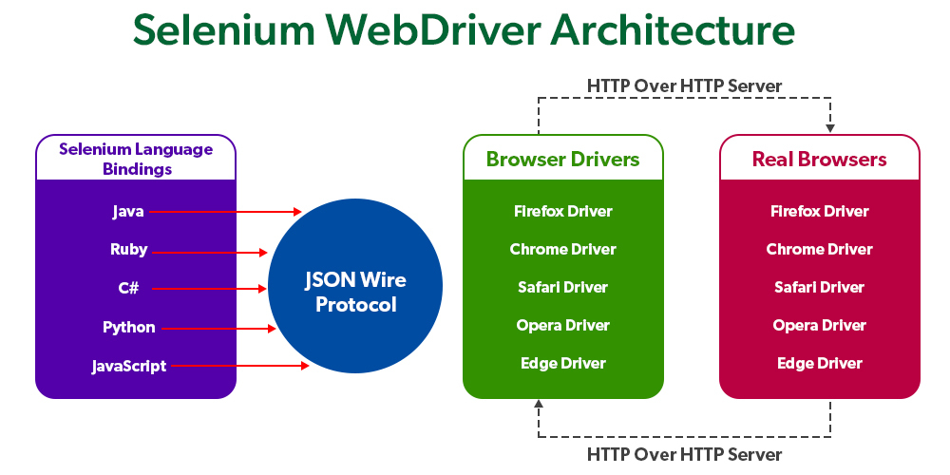

Slide 12
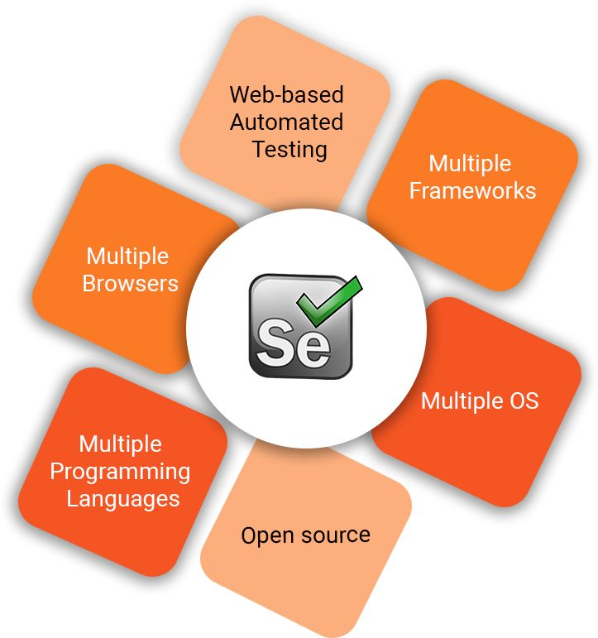
Why Automation Testing With Selenium WebDriver
Selenium WebDriver is implemented in projects for several reasons:
Open Source
Parallel Execution
Mouse Cursor and Keyboard Simulation
Multiple Language support
Work Across Multiple OS
Cross browser compatibility testing
Community Support and also Server Starting not required

Slide 13
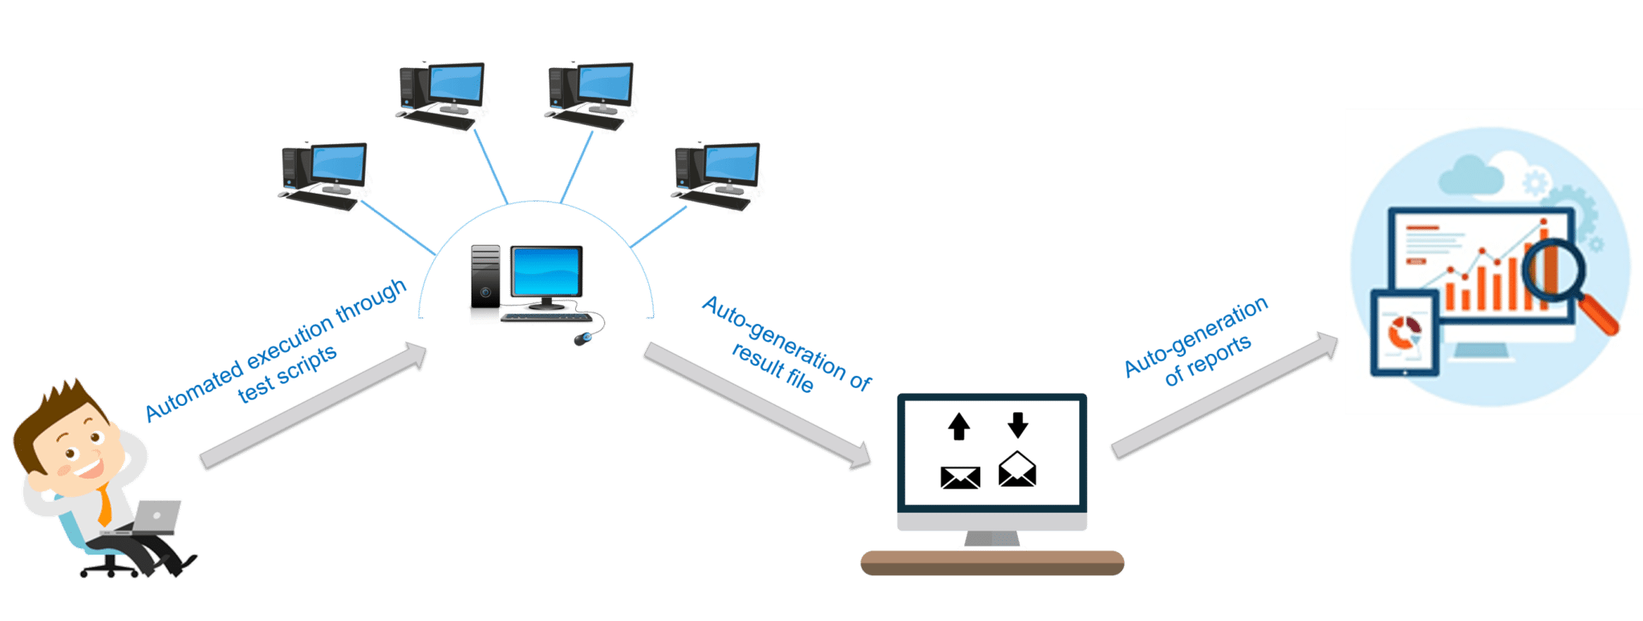
How Automation Testing With Selenium WebDriver ??
Setup
Create a project
Configure Selenium WebDriver
Write Test scripts
Interact with Web Elements
Perform Actions
Execute tests
Reporting

Slide 14
Features Of Junit
An open-source framework used to write and run tests.
For testing the expected result , junit provide the assertions.
To identify the test methods , it provides annotation.
For running the tests , it provides test runners.
It is very simple ,not so complex and required less time.

Slide 15
TestNG
TestNG is a testing framework for the Java programming language created by Cédric Beust and inspired by JUnit and NUnit.
The design goal of TestNG is to cover a wider range of test categories: unit, functional, end-to-end, integration, etc., with more powerful and easy-to-use functionalities.

Slide 16
TestNG & Its Role In Software Testing
Definition:
TestNG is an open source automated testing framework; where NG means NextGeneration. TestNG is similar to JUnit (especially JUnit 4), but it is not a JUnit extension. It is inspired by JUnit. It is designed to be better than JUnit, especially when testing integrated classes
TestNG is preferred by developers for its ability to write powerful test cases with the help of annotations, grouping, and parametrizing. It covers all classifications of test automation like Unit testing, Functional testing, End-to-End, and integration testing. It's available in the form of jar files.

Slide 17
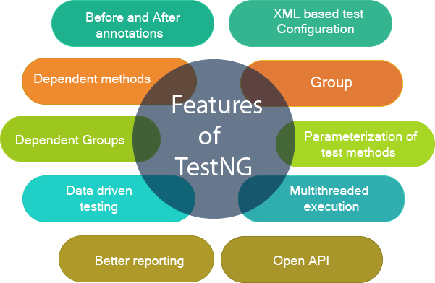
TestNG Features

Slide 18
Annotations In TestNG
This is the list of annotations that TestNG support in Selenium
BeforeSuite
BeforeTest
BeforeClass
BeforeMethod
AfterMethod
AfterClass
AfterTest
AfterSuite

Slide 19
Cucumber
Cucumber is a high level-testing framework that supports Behaviour Driven Development.
Cucumber is a software tool used by the testers to develop test cases for the testing of behaviour of the software.
Behaviour driven development framework to observe the behaviour of the software’s functionalities.
It runs automated acceptance tests on web applications.
Cucumber is a tool that executes plan-text functional descriptions as automated tests. The languages that cucumber is called gherkin.

Slide 20
Gherkin Language
Gherkin is the format for cucumber specifications. Technically speaking it is line based languages with a well-defined syntax, but it’s so simple that you don’t have to known how to program in order to use it.
Format-
Feature: Summary
Scenario: Title
Given
And
When
But
Then

Slide 21
Set Up For Cucumber TestNG
Feature File : feature file and write your first scenario using Gherkin syntax.
Step Definitions : java code that will execute the steps outlined in your feature file.
Runner : This class will be used to execute the feature files and step definitions.

Slide 22
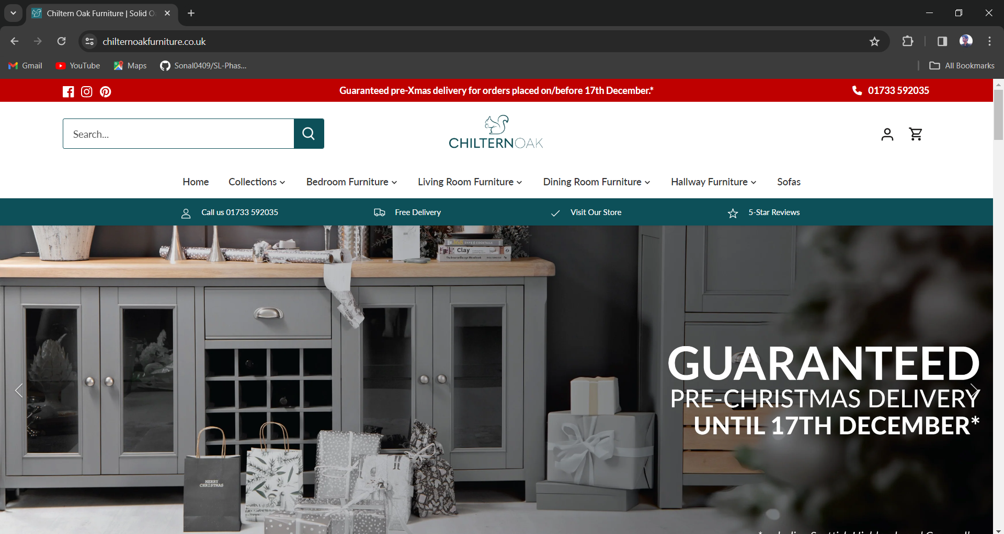
Welcome page

Slide 23
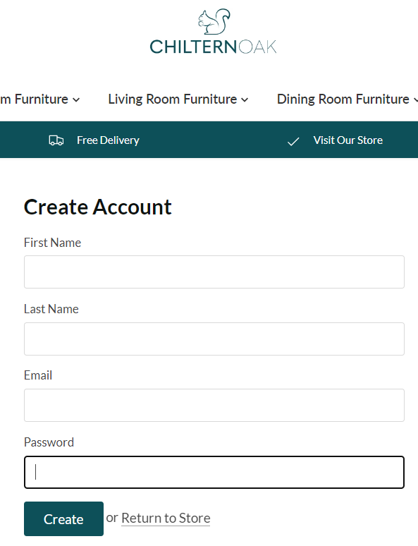
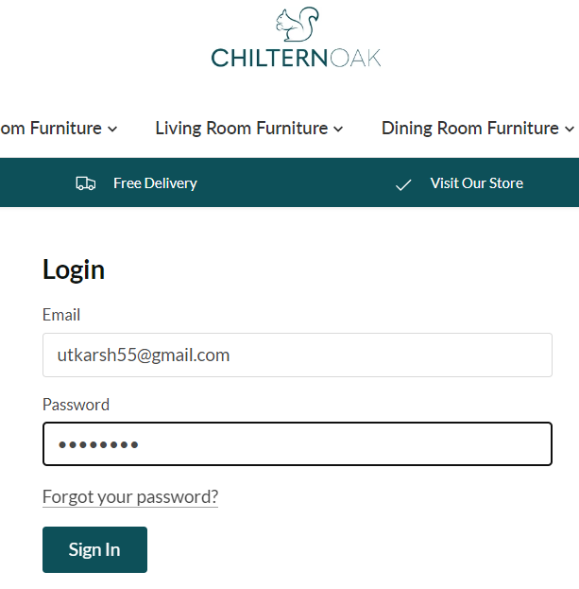
User Registers And Login As New User
1-Registration Page
2- Login Page

Slide 24
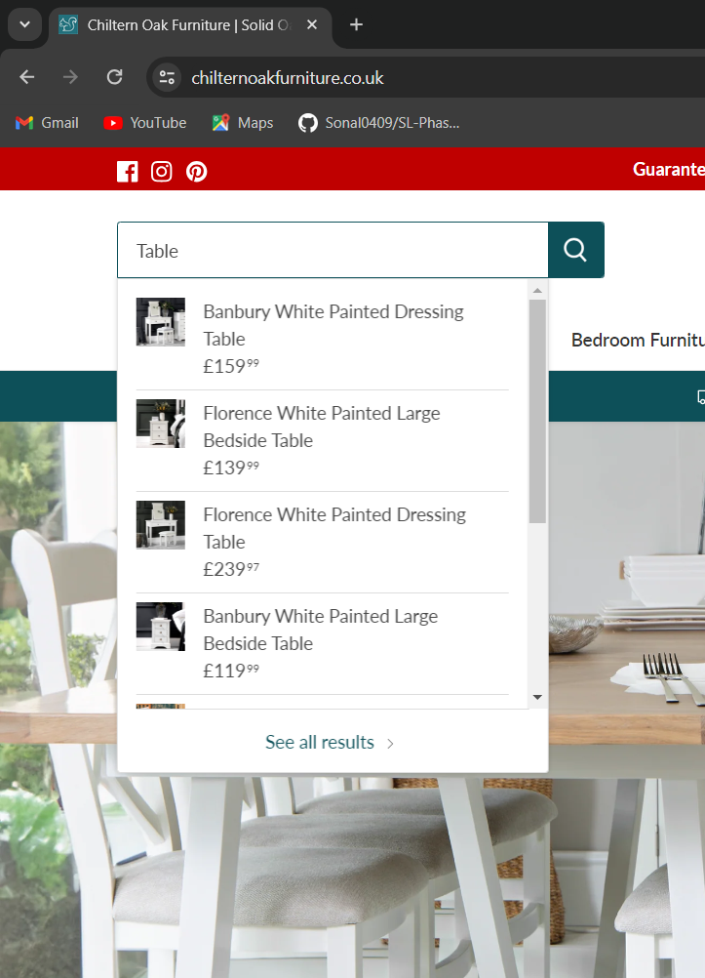
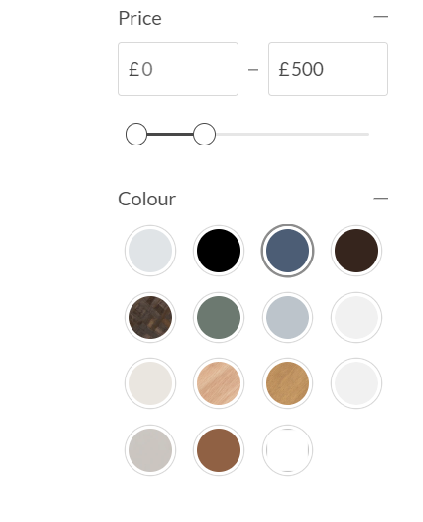
User Search For The Product And Apply Filter
3-Search Product
4- Apply filter

Slide 25
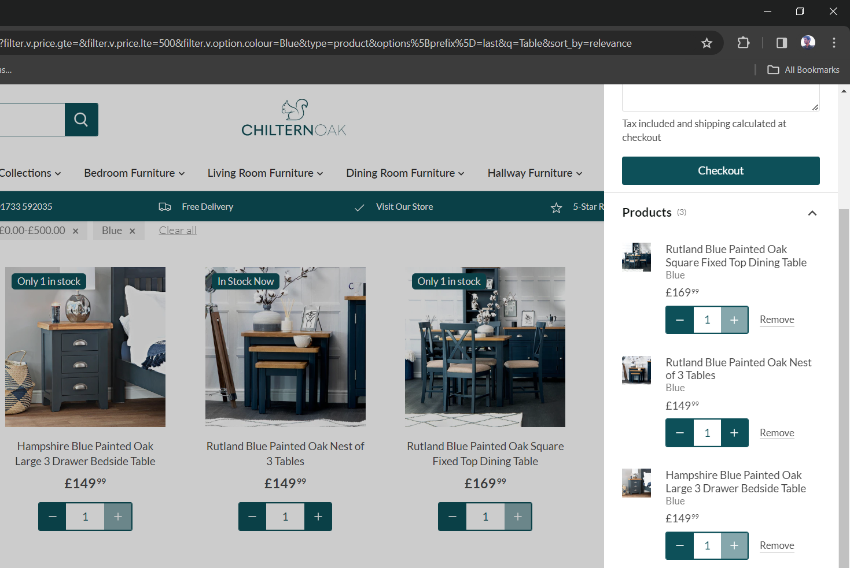
User Adds Products To Cart
5- Add to cart

Slide 26
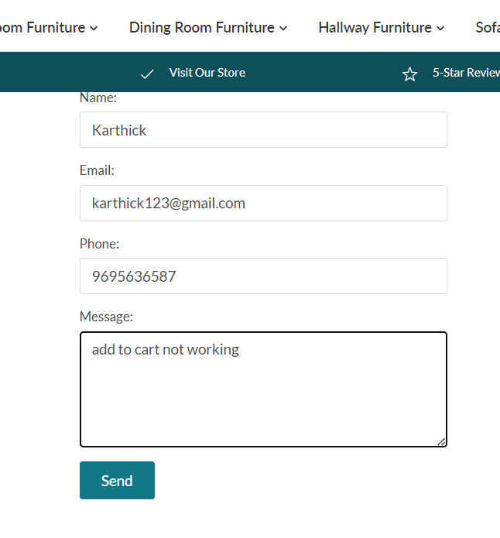
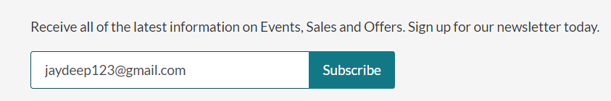
User Subscribes And Enter Detail In Contact Us Form
6- User subscribe
7- Contact-us form

Slide 27
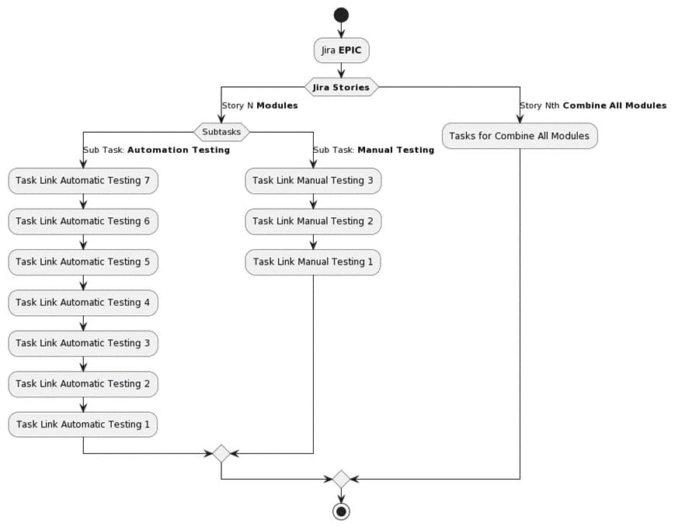
Jira Project Structure

Slide 28
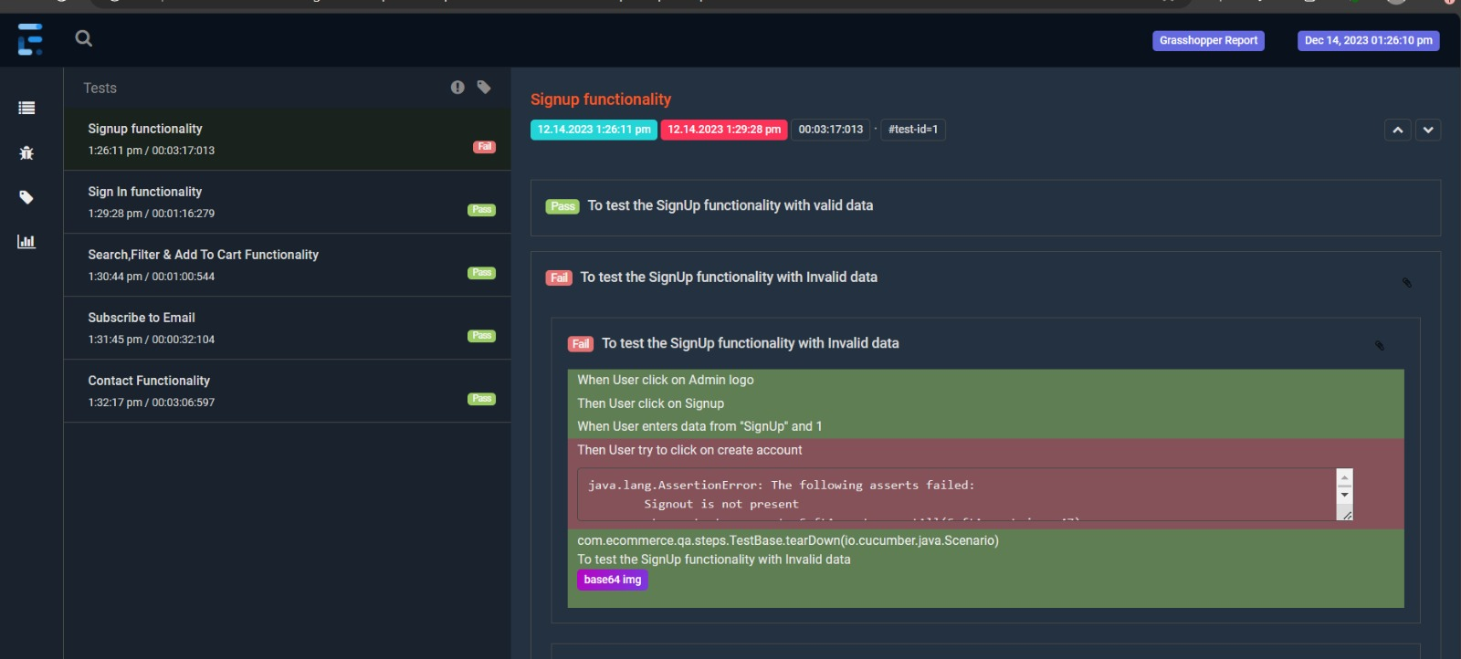
Report screenshot

Slide 29
DEmo

Slide 30
Thank You

