Slide 1


Slide 2
Exploratory data analysis

Slide 3
AGENDA
background
ANOVA
CORRELATION
Descriptive Statistical Analysis
Pranav A. Nerurkar

Slide 4
Dataset
Data Acquisition
There are various formats for a dataset, .csv, .json, .xlsx etc. The dataset can be stored in different places, on your local machine or sometimes online. In this section, you will learn how to load a dataset into our Jupyter Notebook. In our case, the Automobile Dataset is an online source, and it is in CSV (comma separated value) format. Let's use this dataset as an example to practice data reading.
data source: https://archive.ics.uci.edu/ml/machine-learning-databases/autos/imports-85.data
data type: csv
The Pandas Library is a useful tool that enables us to read various datasets into a data frame; our Jupyter notebook platforms have a built-in Pandas Library so that all we need to do is import Pandas without installing.

Slide 5
Background
Link - https://colab.research.google.com/drive/1S3hZ99_c-eCQmU3mDyjSHle4KX1j_tMW?usp=sharing
Information and background
UCI Machine Learning Repository: Automobile Data Set

Slide 6
Descriptive Statistical Analysis
This will show:
the count of that variable
the mean
the standard deviation (std)
the minimum value
the IQR (Interquartile Range: 25%, 50% and 75%)
the maximum value

Slide 7
Correlation and Causation
Correlation: a measure of the extent of interdependence between variables.
Causation: the relationship between cause and effect between two variables.
It is important to know the difference between these two and that correlation does not imply causation. Determining correlation is much simpler the determining causation as causation may require independent experimentation.

Slide 8
Pearson Correlation
The Pearson Correlation measures the linear dependence between two variables X and Y.
The resulting coefficient is a value between
-1 and 1 inclusive, where:
1: Total positive linear correlation.
0: No linear correlation, the two variables most likely do not affect each other.
-1: Total negative linear correlation.

Slide 9
P-value
What is this P-value? The P-value is the probability value that the correlation between these two variables is statistically significant. Normally, we choose a significance level of 0.05, which means that we are 95% confident that the correlation between the variables is significant.
By convention, when the
p-value is < 0.001: we say there is strong evidence that the correlation is significant.
the p-value is < 0.05: there is moderate evidence that the correlation is significant.
the p-value is < 0.1: there is weak evidence that the correlation is significant.
the p-value is > 0.1: there is no evidence that the correlation is significant.

Slide 10
ANOVA: Analysis of Variance
The Analysis of Variance (ANOVA) is a statistical method used to test whether there are significant differences between the means of two or more groups. ANOVA returns two parameters:
F-test score: ANOVA assumes the means of all groups are the same, calculates how much the actual means deviate from the assumption, and reports it as the F-test score. A larger score means there is a larger difference between the means.
P-value: P-value tells how statistically significant is our calculated score value.
If our price variable is strongly correlated with the variable we are analyzing, expect ANOVA to return a sizeable F-test score and a small p-value.

Slide 11
Binning
Why binning? Binning is a process of transforming continuous numerical variables into discrete categorical 'bins', for grouped analysis.
Example: In our dataset, "horsepower" is a real valued variable ranging from 48 to 288, it has 57 unique values.
What if we only care about the price difference between cars with high horsepower, medium horsepower, and little horsepower (3 types)? Can we rearrange them into three ‘bins' to simplify analysis?
We will use the Pandas method 'cut' to segment the 'horsepower' column into 3 bins

Slide 12
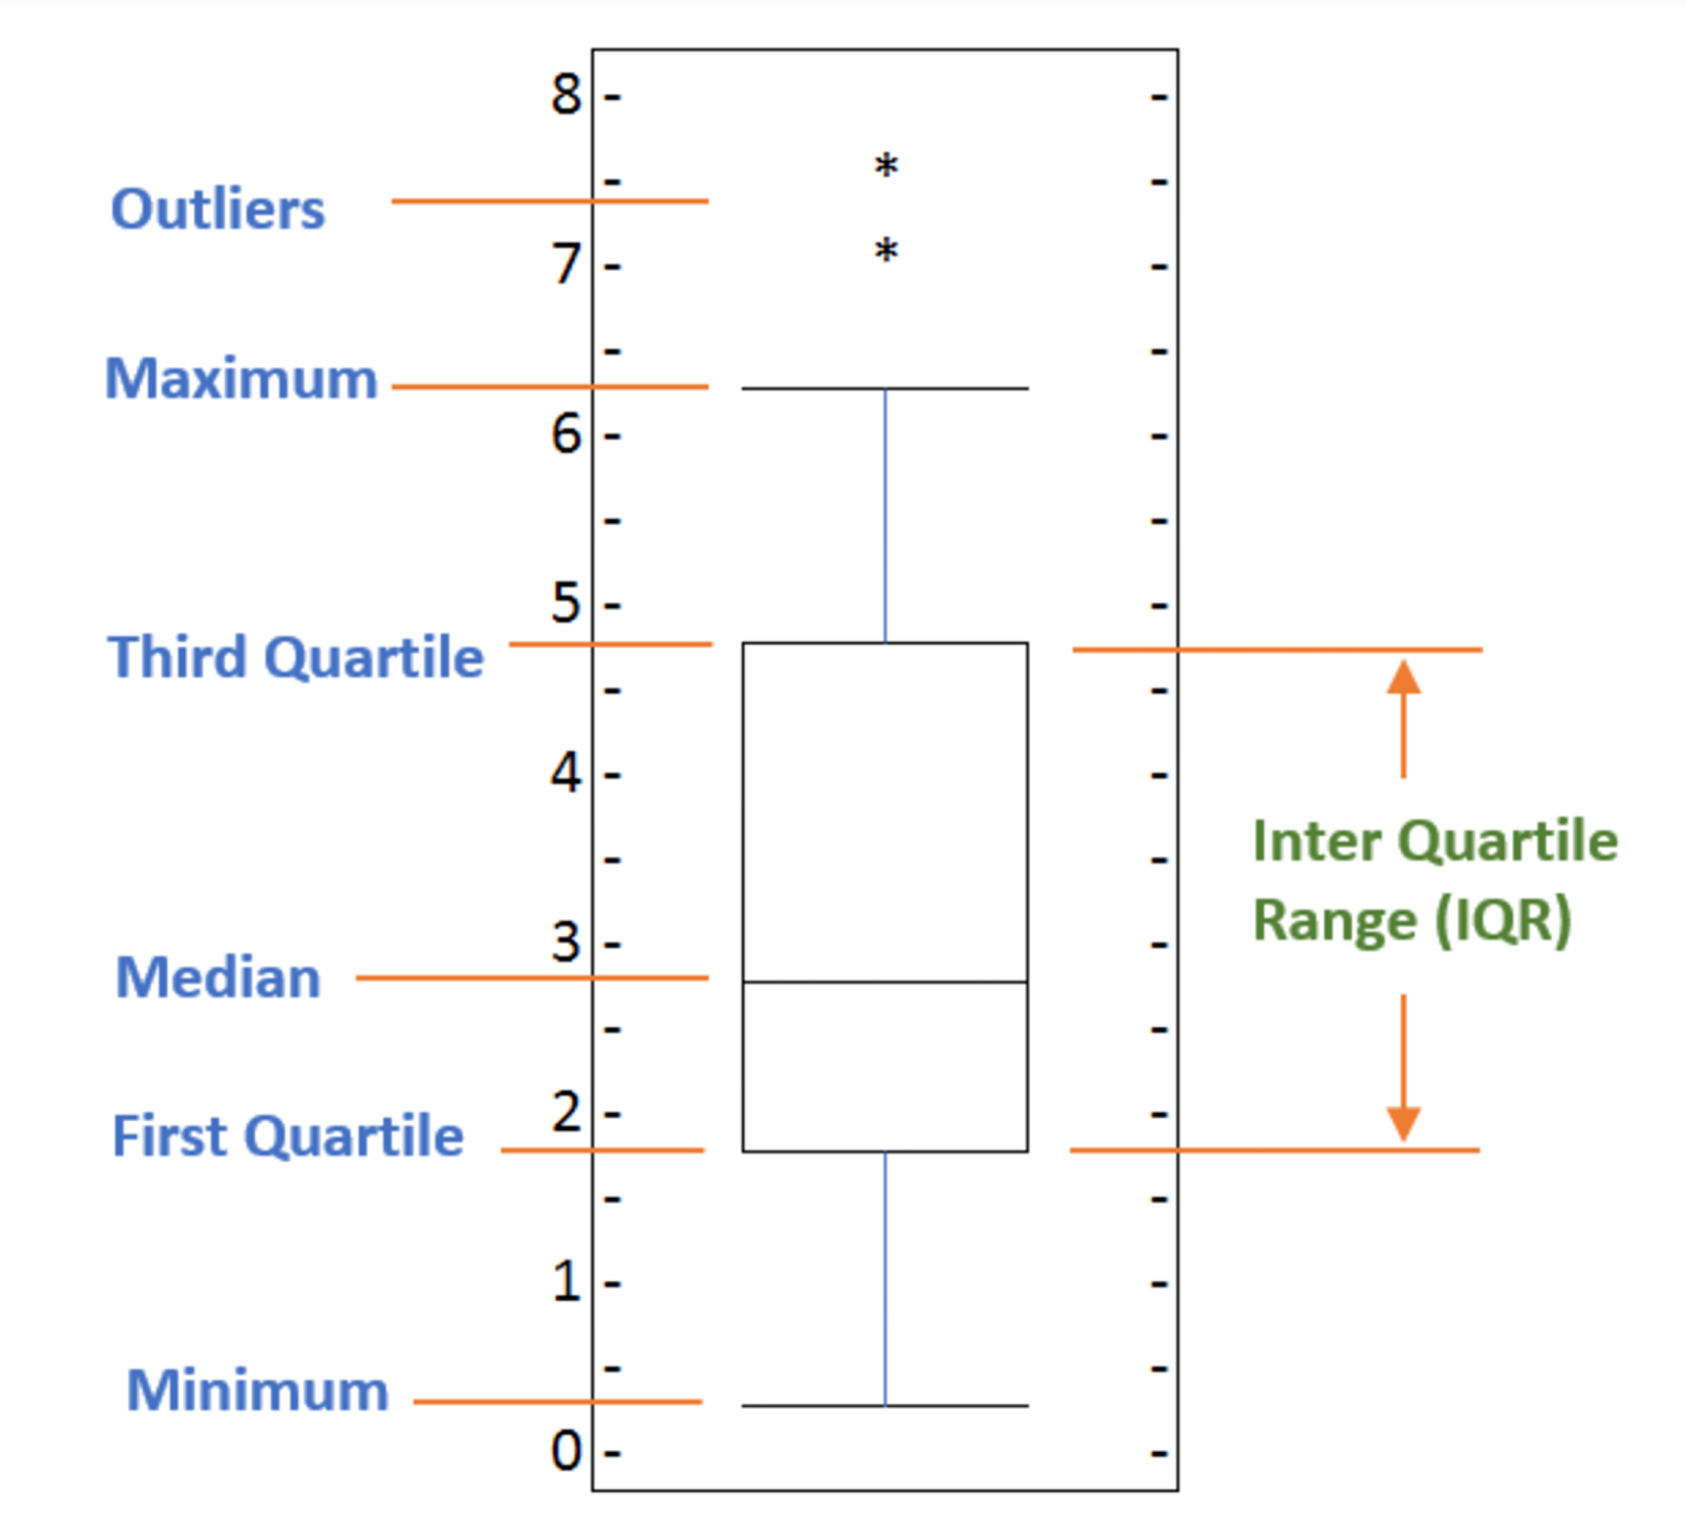
Box plot and outliers
The box plot scans the data and identifies the outliers. In order to be an outlier, the data value must be:
larger than Q3 by at least 1.5 times the interquartile range (IQR)
Smaller than Q1 by at least 1.5 times the IQR.
Using the definition of outlier, any value that is greater than Q3 by 1.5 times IQR will be flagged as outlier.

Slide 13
Notebook
Session-exploratory-data-analysis.ipynb - Colaboratory (google.com)
Important link
1. Data Wrangling | Python: Introduction
Python: Data Wrangling | 2. Correct data format
3. Data Normalization | 4. Exploratory Data Analysis
Python: Exploratory Data Analysis | 5. Basics of Grouping
6. Model Development | Python: Model Development
7. Model Evaluation and Refinement | Python: Model Evaluation and Refinement
Python: Feature Selection

