Slide 1
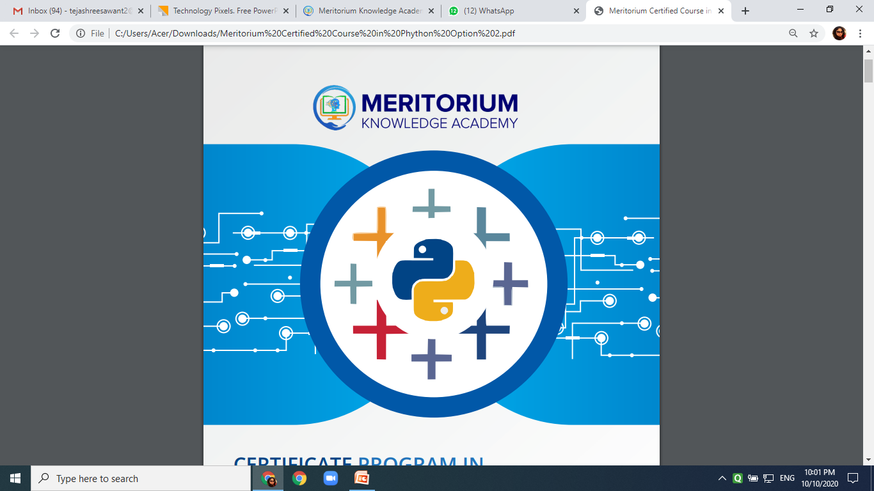

Slide 2
AGENDA Project-II
Dataset
Objectives
Reporting
Pranav A. Nerurkar

Slide 3
Dataset-I
Data Acquisition
There are various formats for a dataset, .csv, .json, .xlsx etc. The dataset can be stored in different places, on your local machine or sometimes online. In this section, you will learn how to load a dataset into our Jupyter Notebook. In our case, the Automobile Dataset is an online source, and it is in CSV (comma separated value) format. Let's use this dataset as an example to practice data reading.
data source: https://archive.ics.uci.edu/ml/machine-learning-databases/autos/imports-85.data
data type: csv
The Pandas Library is a useful tool that enables us to read various datasets into a data frame; our Jupyter notebook platforms have a built-in Pandas Library so that all we need to do is import Pandas without installing.

Slide 4
Objective for Dataset-I
Decide an appropriate machine learning or deep learning model to predict price.
Choose multiple techniques and compare results on test set.
Can you specific if over-fitting or under-fitting exists? Assume bayes error=0.85.
Steps to overcome bias or variance .
Steps to improve performance.
Can you use selected feature is it predicting?

Slide 5

Dataset-2 link (Forest cover)
PDF/dataset.csv at main · pranavn91/PDF (github.com)

Slide 6
Objective for Dataset-II
Decide an appropriate machine learning or deep learning model to predict cover type.
Choose multiple techniques and compare results on test set.
Can you specific if over-fitting or under-fitting exists? Assume bayes error.
Steps to overcome bias or variance .
Steps to improve performance.
Can you use selected feature is it predicting?

Slide 7
Thank you

