Slide 1


Slide 2
Table of contents
Related terms
Cases, scores, variables, values
Types of variables
Null and alternate hypothesis
Binomial test
Cohen g

Slide 3
Related Terms
Statistics in general What is statistics and what is the difference between a sample and population? Terms connected to data Statistics is all about data, so we need to get some terminology sorted Measurement level Depending on the measurement level, various statistical tools can be used. Significance The key term in so-called inferential statistics

Slide 4
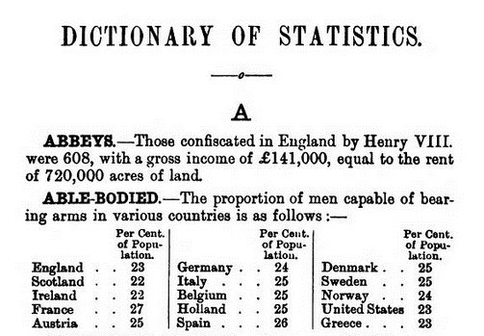
What is statistics?
Perhaps one of the oldest question humans have is ‘how many?’ or ‘how much?’.
How much food do we have, how many likes do I have, how many visitors, how much money, etc. etc.
Not surprisingly head of states (as in countries) were also very interested in the answer to a lot of these kind of questions.

Slide 5
Statistics
“the science of collecting, displaying and analysing data”
There are two main branches of statistics; descriptive and inferential (Wright & London, 2009, p. 55).
Descriptive statistics are: “methods for organizing, displaying, and describing data using tables, graphs and summary measures” (Mann, 1991, 2010, p. 3).
Descriptive statistics is the type of statistics most people encounter every day, often without realizing they are looking at statistics. In many video-games results or scores are often displayed in various charts or with various comparisons, advertisements try to show of fancy diagrams and in business reports the tables and diagrams also play often a key role.
When collecting data you are usually interested in a specific group of people, animals or things, but don’t have the time (or money) to collect data about all of them. The entire group is known as the population: “the complete set of objects of interest” (Upton & Cook, 2014, p. 332). The people/things you actually got data from is then known as a sample: “a subset of a population usually chosen in such a way that it can be taken to represent the population with respect to some characteristic” (Upton & Cook, 2014, p. 379).
Wouldn’t it be great if you could say something about the population based on just one sample? It would save a lot of time and/or money. A fancy word for making a statement about a population based on a sample is an inference: “a conclusion about a population based on logical reasoning from data gathered about a smaller sample” (Zedeck, 2014, p. 175).

Slide 6
Statistics
Descriptive statistics is the type of statistics most people encounter every day, often without realizing they are looking at statistics.
In many video-games results or scores are often displayed in various charts or with various comparisons, advertisements try to show of fancy diagrams and in business reports the tables and diagrams also play often a key role.

Slide 7
Statistics
When collecting data you are usually interested in a specific group of people, animals or things, but don’t have the time (or money) to collect data about all of them.
The entire group is known as the population: “the complete set of objects of interest” (Upton & Cook, 2014, p. 332).
The people/things you actually got data from is then known as a sample: “a subset of a population usually chosen in such a way that it can be taken to represent the population with respect to some characteristic” (Upton & Cook, 2014, p. 379).

Slide 8
Statistics
Wouldn’t it be great if you could say something about the population based on just one sample?
It would save a lot of time and/or money.
A fancy word for making a statement about a population based on a sample is an inference:
“a conclusion about a population based on logical reasoning from data gathered about a smaller sample” (Zedeck, 2014, p. 175).

Slide 9
Statistics
As it turns out, this is possible to do and therefore known as inferential statistics.
When mathematicians started developing probability theory around 1700 they lay the foundations for this and later around 1850 the techniques that we use today were developed.
Inferential statistics could therefore be defined as the field of statistics that tries to say something about a population, based on a sample from that population.

Slide 10
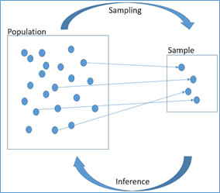
Statistics
It is important though how you obtain your sample.
Different methods exist to do this and these are known as sampling techniques: “the process of selecting a limited number of units from a larger set for a study” (Zedeck, 2014, p. 322).
Figure 2 shows how the terms population, sampling, sample, and inference relate to each other.

Slide 11
Statistics
Especially in the inferential statistics a lot of calculations are done, and with it come many formulas.
These formulas are also implemented in various statistical software programs (like R, SPSS, MiniTab, and also Excel).
I would call Statistics that deals with the formula itself, the calculation and the proof, mathematical statistics, while if the focus is on the interpretation of the result, I’d call it applied statistics.

Slide 12
Statistical terms
The first term is used to indicate what or whom you are collecting data about, and known as cases (or sometimes units, or observations).
With a survey you collect data about respondents, so respondents will be your cases.
If you would collect the average daily temperature in your city, then every day will be a case, if you collect the revenue of various companies in your industry in 2016, then every company is a case.
Cases are therefore a more general term than respondents. Respondents are always cases, but cases are not always respondents.

Slide 13
Statistical terms
From each case we want to know a few things. These things we want to know are called variables: the things we would like to know from each case.
To illustrate this, let’s imagine we have the following survey:
What is your gender? O Male O Female
In this survey each question is a variable. Usually the variable is given an abbreviation, in the example survey these might be gender, age, name and opinion.

Slide 14
Statistical terms
Note that a variable is something that can vary. The possible variations of a variable are known as the values.
For the variables in the example survey the values for gender would be ‘male’ and ‘female’, for age any number above 0, for name all possible names and for opinion the options ‘very boring’, ‘boring’, ‘interesting’ and ‘very interesting’.
These values are often assigned a letter or a number, e.g. m = male and f = female, or 0 = male and 1 = female. This is known as coding: assigning a letter(s) or number(s) to represent the value. For open ended questions no coding is required.

Slide 15
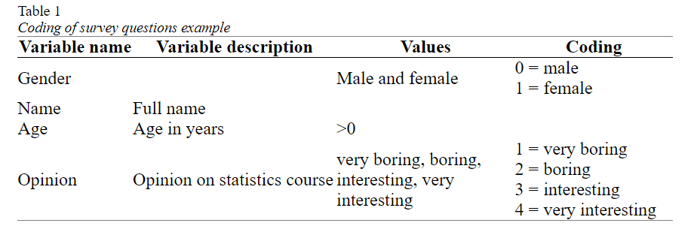
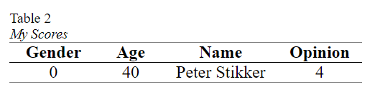
Statistical terms
In Table 1 the conversion of the example survey into variables, values and coding. This is sometimes referred to as a codebook.
Note that the variable description is either a longer description of the name of the variable, or sometimes the entire question as it was asked on the survey.
The last term connected to this is a score. A score is the value (or assigned code) for a single case on a single variable.

Slide 16
Statistical terms
Stevens (1946) classified variables based on which basic operations can be performed on them, and created four so-called measurement levels: nominal, ordinal, interval and ratio.
I will combine interval and ratio into one category called scale (which is something SPSS also does).
A variable is said to have a nominal measurement level, if the values are non-numeric and have no logical order (besides perhaps alphabetical). The variable gender for example has a nominal measurement level, since the order of the possible values can be in any way you want (although there are many discussions sometimes about it :-)). Also open questions that ask for text are nominal, for example first name.

Slide 17
Statistical terms
If the values are non-numerical, but do have a logical order to them, the measurement level is ordinal.
For example a variable that uses the options 'fully disagree', 'disagree', 'agree', 'fully agree', is ordinal. Note that it is about the original values being non-numerical.
Often with ordinal variables the values are coded with numbers (e.g. 1 = fully disagree to 5 = fully agree), but this would still be ordinal, since the original values are non-numerical.
Also numbers that have been categorized create an ordinal measurement level, so for example age category (e.g. 0 < 20, 20 < 30, etc.) would be ordinal.

Slide 18
Statistical terms
In case you do have real numbers the measurement level will be scale (interval and ratio). So for example when asked to fill out your age, the variable age will have a scale measurement level.
With 'real' numbers I mean that a phone number for example is not really a number on which you can perform calculations (adding the digits of a phone number might be fun but there it has no meaningful interpretation), so a phone number would be considered nominal since there is not really a logical order.
For example if we ask people their phone number, then although we could calculate an average phone number, it would not make any sense. There is also not any particular order in these phone numbers, so the measurement level would be nominal.

Slide 19
Statistical terms
A special type of variable is a binary variable, also known as dichotomous (Warner, 2013; Weinberg & Abramowitz, 2008), or Bernoulli (Nelson, Coffin, & Copeland, 2003) .
A variable is binary if it only has two possible outcomes (e.g. pass/fail, on/off, male/female, right/wrong, etc.).
Note that strictly speaking a binary variable can be considered nominal, ordinal, interval, and ratio.
Since there are only two options to choose from. In most cases it is often considered as a nominal variable.

Slide 20
Statistical terms
Although the classification from Stevens (nominal, ordinal, interval and ratio) works well for many variables, there are some that are difficult to determine.
Especially cyclic measurements, like for example weekdays. Weekdays (Monday to Sunday) are not numbers, so it is not interval or ratio. There seems to be a logical ordering, so ordinal might actually be a good first guess.
However, what is this order then? Some will argue that a week starts on Monday, while others might say on Sunday. So, although there is an order, the starting point is not clear. Unfortunately, there is no consensus on what these cyclical types of variables should be. It can depend on the actual analysis that you want to perform with it.

Slide 21
Significance
significance, which can be defined as: the probability of a result as in the sample, or even more extreme, if the assumption about the population would be true
What is important here is that with a survey you only have taken one sample out of many possible samples that could have been taken out of a population.
What we would like to know is; what can be said about the entire population based on a single sample from that population (without having to take all possible samples)?
To answer this, one approach is to use the significance.

Slide 22
Significance example
I have two coins (A and B). I’ve flipped each coin 200 times. Coin A resulted in 190 times head (and 10 times tail), Coin B resulted in 92 times head (and 108 times tail). Which coin do you think might be fair (fair is an equal chance of head and tail)?
Our assumption about the population, is that the coin is fair. The 90 and 8 from point 4 were our ‘result as in the sample’. Now the chances for a deviation of exactly 90 is very low, and also the chance for a deviation of exactly 8 is very low. We are actually interested in the chance of a deviation of 90 or more, and of a deviation of 8 or more. This is the ‘or even more extreme’ in the definition of significance.

Slide 23
Significance example
How these chances are calculated is not so important right now, but the chance of a deviation of 8 or more is almost 30%, while the chance of a deviation of 90 or more is almost 0%.
The deviation of 8 or more is likely to occur if the coin is fair, but 90 or more isn’t. It does not mean that a deviation of 90 or more is completely not possible, it is just very unlikely if the coin is fair.
The chances (the 30% and near 0%) are the significances. It is the chance of a deviation as in the sample, or even more extreme, if the coin is fair.

Slide 24
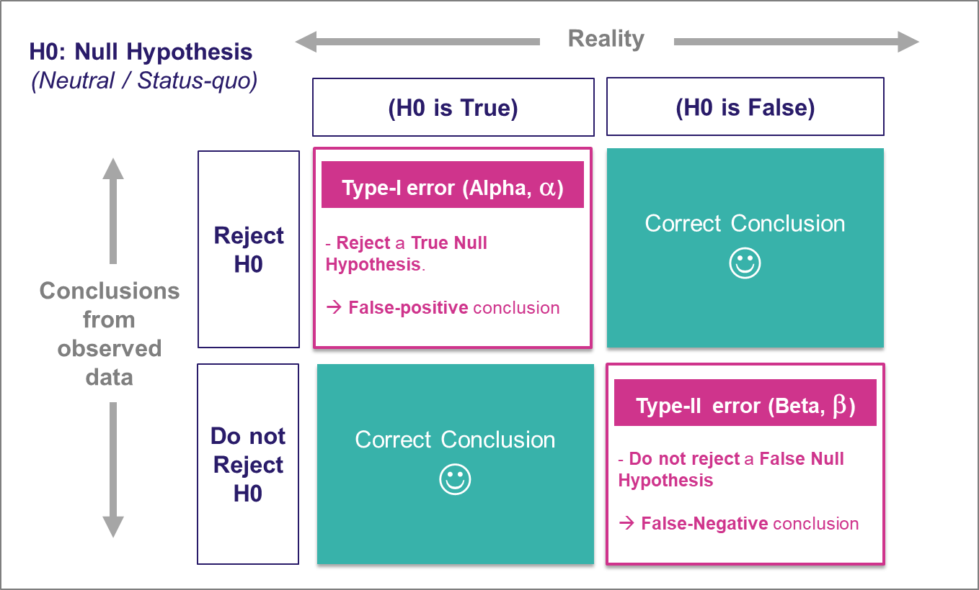
Significance example
Null Hypothesis (H₀): The lucky charm has no effect on your test scores.
Alternate Hypothesis (H₁): The lucky charm does have an effect, and your test scores are better when you use it.
In Hindi:
Significant: महत्वपूर्ण (Mahatvapurna)
In Marathi:
Significant: महत्त्वाचं (Mahattvach)

Slide 25
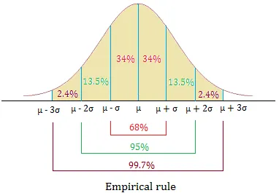
Empirical and Chebyshev rule

Slide 26
Empirical and Chebyshev rule
The Empirical rule
Approximately 68% of the data lie within one standard deviation of the mean, that is, in the interval with endpoints x¯±s for samples and with endpoints μ±σ for populations; if a data set has an approximately bell-shaped relative frequency histogram.
Approximately 95% of the data lie within two standard deviations of the mean, that is, in the interval with endpoints x¯±2s for samples and with endpoints μ±2σ for populations; and
Approximately 99.7% of the data lies within three standard deviations of the mean, that is, in the interval with endpoints x¯±3s for samples and with endpoints μ±3σ for populations.

Slide 27
Empirical and Chebyshev rule
The Empirical Rule does not apply to all data sets, only to those that are bell-shaped, and even then is stated in terms of approximations. A result that applies to every data set is known as Chebyshev’s Theorem.For any numerical data set,
At least 3/4 of the data lie within two standard deviations of the mean, that is, in the interval with endpoints x¯±2s for samples and with endpoints μ±2σ for populations;
At least 8/9 of the data lie within three standard deviations of the mean, that is, in the interval with endpoints x¯±3s for samples and with endpoints μ±3σ for populations;
At least 1−1/k2 of the data lie within k standard deviations of the mean, that is, in the interval with endpoints x¯±ks for samples and with endpoints μ±kσ for populations, where k is any positive whole number that is greater than 1 .

Slide 28
Interpretation of significance
If this probability is very low it would mean that we have been either very 'lucky' and just picked one of the few samples that has this result or perhaps the assumption about the population is wrong. In statistics usually, we will assume the assumption is wrong, if the probability is below 5% (0.05). In some cases, the threshold is placed at another value (1% and 10% are also sometimes used).
Note that we allow ourselves a 5% risk of making the wrong decision. It could be that the assumption about the population is true but becomes unlikely. This would be known as a type I error; rejecting the assumption about the population, although it is actually true. We also have a risk the other way around. In case the probability is above 0.05 we could be not rejecting the assumption about the population, although it is actually false. This is known as a type II error.

Slide 29
Interpretation of significance
The 'assumption about the population' is also known as the 'null hypothesis' and should always be formulated in such a way that things are equal, or have no difference, or no relation. Referring back to the coin example, we cannot test if the coin is unfair (i.e. the deviation is not equal to 0), only if it is fair (i.e. the deviation is equal to 0). Strictly speaking we also never accept the assumption, we either claim 'there was insufficient evidence to reject the assumption', or to reject it.

Slide 30
Analysing a single variable
First get an impression of the table (by using a frequency table), then visualise the data, and then perform a test to say something about the population.
For a binary variable you can test if each of the two categories might have the same proportion in the population.
For a nominal variable you can test if each option might have been equally often chosen in the population.
For an ordinal variable you can test if for example the majority of people at least agree (or fully agree).
For a scale variable you can test if the average (mean) in the population would be a certain value (e.g. is the average age above 40?).

Slide 31
Analysing a single variable
If you have a single binary variable, you are probably interested to know what the percentage is of each of the two options, and perhaps if the are significantly different from each other.
Part 1: Descriptive statistics
Use descriptive statistics to get an impression of the data, using:
A frequency table to get an impression of the data.
Note that I’d not recommend to show a visualisation. There are only two categories, so simply mentioning the percentages and counts for each of the two categories should suffice.

Slide 32
Analysing a single variable
Part 2: Inferential statistics
After the first impression determine what can be said about the population based on your sample data by:
Performing a test to see if the percentages of the two categories are significantly different (one-sample binomial test)
Determine how big the difference is (effect size with Cohen’s g)

Slide 33
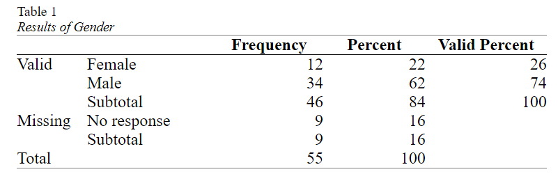
Analysing a single variable
Management was curious if the division of male/female was equal in the company.
The result of a small survey showed that out of the 46 respondents

Slide 34
Analysing a single variable
In the example we noticed that 26% of the respondents indicated to be Female, and 74% Male.
This might appear as a big difference, but is it a ‘significant’ difference, i.e. will there also be a difference in the population.
As discussed in the general section on significance, the significance is the probability of a result as in the sample or even more extreme, if the assumption about the population is true.

Slide 35
Binomial test
In short the binomial test has the following steps:
The assumption about the population (the null hypothesis (H₀)) is that the proportion of one of the two categories will be some amount (e.g. 0.5).
The alternative is that it isn't (H_{a}) (e.g. the proportion in the population is not 0.5). This would be the so-called two-tailed test.
Perform the binomial test and find the p-value (sig.).
If the p-value is less than .05, the chance of a result as in the sample or even rarer if the assumption is true, is considered so low, that the assumption is probably NOT true. The proportion in the population is then probably NOT the one assumed at step 1. This is then called a significant result.

Slide 36
Binomial test
If the p-value is .05 or more, the chance of a result as in the sample or even rarer if the assumption is true, is considered not low enough, that the assumption could be true. We don't have enough evidence to reject the assumption. This is then called a non-significant result.

Slide 37
Binomial test Effect size: Cohen's g
The one-sample binomial test can inform us if the percentage in the population will be significantly different from the 50%, but does not say anything on how big the difference is.
With only two categories we can simply leave it up to the reader to judge if he/she finds the difference in the two percentages big or small, but for many tests it is recommended to also give a so-called effect size measure.
Cohen’s g (Cohen, 1988) is specifically for the case where the expected proportion in the population is 0.5 (50%). It is then simply the difference of the sample proportion with this 0.5. In the example the female proportion was 0.26 (26%), so Cohen’s g is the difference with the expected proportion which is simply 0.26 – 0.50 = -0.24.

Slide 38
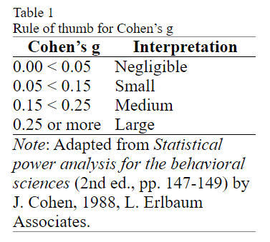
Binomial test Effect size: Cohen's g
Cohen’s g is therefor often reported with the absolute value (so without a negative sign, this is then known as a nondirectional Cohen’s g).
An exact binomial test indicated that the percentage of female (N_{f} = 12, 26%), was significantly different from the male percentage (N_{m} = 34, 76%), p = .002. Cohen’s g suggests that the difference can be classified as medium, g = .24.

Slide 39
Binomial test : Sample
In a school, 80 out of 100 students passed a math exam. The national average pass rate for this math exam is 50%. Can we conclude that the school has a significantly different pass rate than the national average?
Suppose you are interested in testing whether the percentage of customers who make a purchase after viewing a product on an e-commerce website is significantly different from the industry average of 25%. You collected data from a sample of 80 customers, and 30 of them made a purchase. You want to perform a one-sample binomial test to assess whether the website's conversion rate is significantly different from the industry average.

Slide 40
Solution
from scipy.stats import binom_test
# Number of students who passed in the school
num_passed_school = 80
# Total number of students in the school
total_students_school = 100
# National average pass rae
national_avg_pass_rate = 0.50
# Perform the one-sample binomial test
p_value = binom_test(num_passed_school, total_students_school, national_avg_pass_rate)

Slide 41
Solution
from scipy.stats import binom_test
# Number of customers who made a purchase
num_purchases = 30
# Total number of customers in the sample
total_customers = 80
# Industry average conversion rate
industry_avg_conversion_rate = 0.25
# Perform the one-sample binomial test
p_value = binom_test(num_purchases, total_customers, industry_avg_conversion_rate)

Slide 42
One sided (directional) binomial test
Let's consider a scenario where you want to test whether the proportion of students passing a difficult exam at a particular school is significantly higher than the national average of 60%. You have data from a sample of 100 students, and you want to perform a one-sided binomial one-sample test.

Slide 43
One sided (directional) binomial test
Null Hypothesis (H₀): The proportion of students passing the difficult exam at the school is equal to the national average (p = 0.60).
Alternate Hypothesis (H₁): The proportion of students passing the difficult exam at the school is significantly higher than the national average (p > 0.60).

Slide 44
One sided (directional) binomial test
from scipy.stats import binom_test
# Number of students who passed the difficult exam at the school
num_passed_school = 70
# Total number of students in the sample
total_students_school = 100
# National average pass rate
national_avg_pass_rate = 0.60
# Perform the one-sided binomial one-sample test with 'alternative="greater"'
p_value = binom_test(num_passed_school, total_students_school, national_avg_pass_rate, alternative="greater")

Slide 45

Utkarsh Minds
Mirjam Nilsson

Slide 46
Contact us: helpdesk@utkarshminds.com +91 961-999-7797 Thank you

