Slide 1


Slide 2
Table of contents
Revision
Analysing a single nominal variable

Slide 3
Statistics
“the science of collecting, displaying and analysing data”
There are two main branches of statistics; descriptive and inferential (Wright & London, 2009, p. 55).
Descriptive statistics are: “methods for organizing, displaying, and describing data using tables, graphs and summary measures” (Mann, 1991, 2010, p. 3).
Descriptive statistics is the type of statistics most people encounter every day, often without realizing they are looking at statistics. In many video-games results or scores are often displayed in various charts or with various comparisons, advertisements try to show of fancy diagrams and in business reports the tables and diagrams also play often a key role.
When collecting data you are usually interested in a specific group of people, animals or things, but don’t have the time (or money) to collect data about all of them. The entire group is known as the population: “the complete set of objects of interest” (Upton & Cook, 2014, p. 332). The people/things you actually got data from is then known as a sample: “a subset of a population usually chosen in such a way that it can be taken to represent the population with respect to some characteristic” (Upton & Cook, 2014, p. 379).
Wouldn’t it be great if you could say something about the population based on just one sample? It would save a lot of time and/or money. A fancy word for making a statement about a population based on a sample is an inference: “a conclusion about a population based on logical reasoning from data gathered about a smaller sample” (Zedeck, 2014, p. 175).

Slide 4
Statistics
When collecting data you are usually interested in a specific group of people, animals or things, but don’t have the time (or money) to collect data about all of them.
The entire group is known as the population: “the complete set of objects of interest” (Upton & Cook, 2014, p. 332).
The people/things you actually got data from is then known as a sample: “a subset of a population usually chosen in such a way that it can be taken to represent the population with respect to some characteristic” (Upton & Cook, 2014, p. 379).

Slide 5
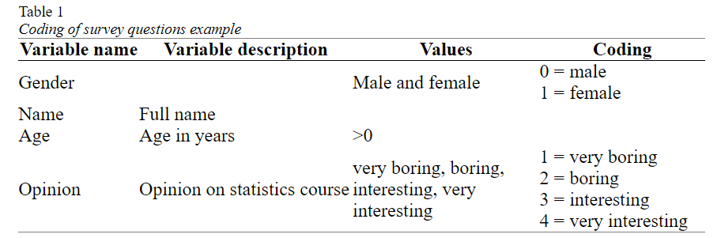
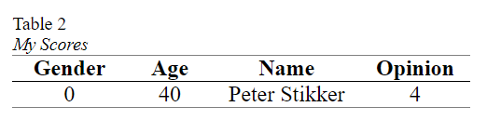
Statistical terms
In Table 1 the conversion of the example survey into variables, values and coding. This is sometimes referred to as a codebook.
Note that the variable description is either a longer description of the name of the variable, or sometimes the entire question as it was asked on the survey.
The last term connected to this is a score. A score is the value (or assigned code) for a single case on a single variable.

Slide 6
Statistical terms
Stevens (1946) classified variables based on which basic operations can be performed on them, and created four so-called measurement levels: nominal, ordinal, interval and ratio.
I will combine interval and ratio into one category called scale (which is something SPSS also does).
A variable is said to have a nominal measurement level, if the values are non-numeric and have no logical order (besides perhaps alphabetical). The variable gender for example has a nominal measurement level, since the order of the possible values can be in any way you want (although there are many discussions sometimes about it :-)). Also open questions that ask for text are nominal, for example first name.

Slide 7
Significance
significance, which can be defined as: the probability of a result as in the sample, or even more extreme, if the assumption about the population would be true
What is important here is that with a survey you only have taken one sample out of many possible samples that could have been taken out of a population.
What we would like to know is; what can be said about the entire population based on a single sample from that population (without having to take all possible samples)?
To answer this, one approach is to use the significance.

Slide 8
Significance example
I have two coins (A and B). I’ve flipped each coin 200 times. Coin A resulted in 190 times head (and 10 times tail), Coin B resulted in 92 times head (and 108 times tail). Which coin do you think might be fair (fair is an equal chance of head and tail)?
Our assumption about the population, is that the coin is fair. The 90 and 8 from point 4 were our ‘result as in the sample’. Now the chances for a deviation of exactly 90 is very low, and also the chance for a deviation of exactly 8 is very low. We are actually interested in the chance of a deviation of 90 or more, and of a deviation of 8 or more. This is the ‘or even more extreme’ in the definition of significance.

Slide 9
Significance example
How these chances are calculated is not so important right now, but the chance of a deviation of 8 or more is almost 30%, while the chance of a deviation of 90 or more is almost 0%.
The deviation of 8 or more is likely to occur if the coin is fair, but 90 or more isn’t. It does not mean that a deviation of 90 or more is completely not possible, it is just very unlikely if the coin is fair.
The chances (the 30% and near 0%) are the significances. It is the chance of a deviation as in the sample, or even more extreme, if the coin is fair.

Slide 10
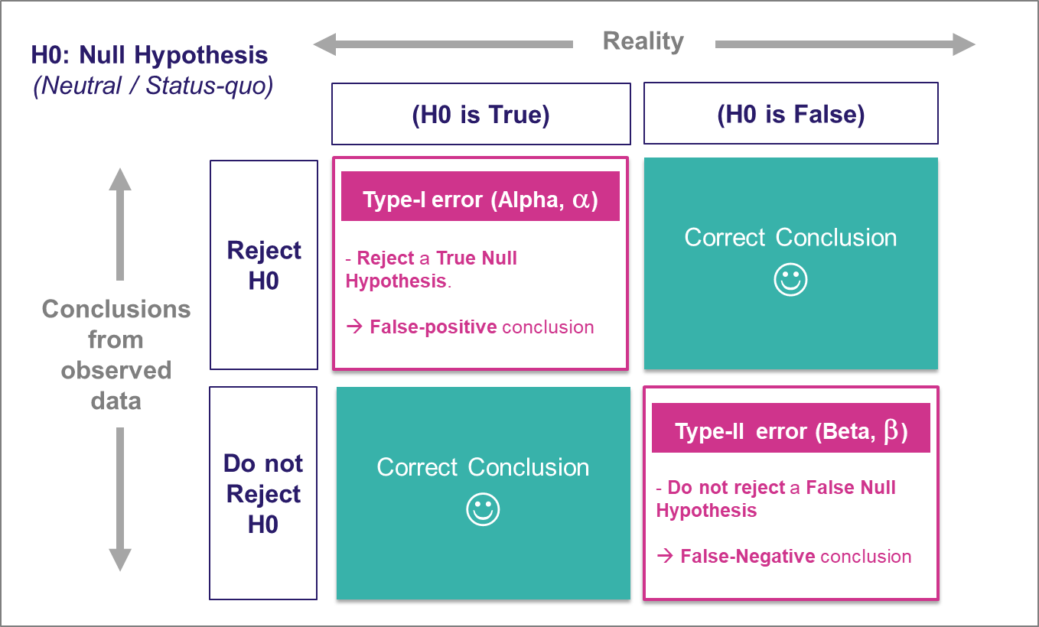
Significance example
Null Hypothesis (H₀): The lucky charm has no effect on your test scores.
Alternate Hypothesis (H₁): The lucky charm does have an effect, and your test scores are better when you use it.
In Hindi:
Significant: महत्वपूर्ण (Mahatvapurna)
In Marathi:
Significant: महत्त्वाचं (Mahattvach)

Slide 11
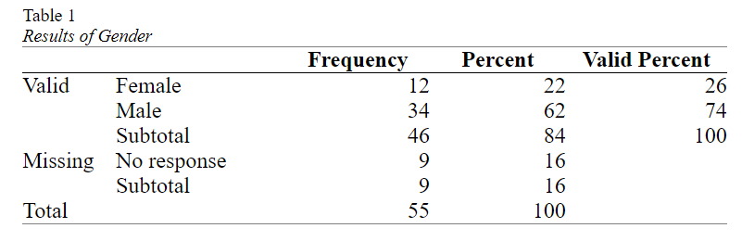
Analysing a single variable
Management was curious if the division of male/female was equal in the company.
The result of a small survey showed that out of the 46 respondents

Slide 12
Binomial test
In short the binomial test has the following steps:
The assumption about the population (the null hypothesis (H₀)) is that the proportion of one of the two categories will be some amount (e.g. 0.5).
The alternative is that it isn't (H_{a}) (e.g. the proportion in the population is not 0.5). This would be the so-called two-tailed test.
Perform the binomial test and find the p-value (sig.).
If the p-value is less than .05, the chance of a result as in the sample or even rarer if the assumption is true, is considered so low, that the assumption is probably NOT true. The proportion in the population is then probably NOT the one assumed at step 1. This is then called a significant result.

Slide 13
Binomial test
If the p-value is .05 or more, the chance of a result as in the sample or even rarer if the assumption is true, is considered not low enough, that the assumption could be true. We don't have enough evidence to reject the assumption. This is then called a non-significant result.

Slide 14
Binomial test Effect size: Cohen's g
The one-sample binomial test can inform us if the percentage in the population will be significantly different from the 50%, but does not say anything on how big the difference is.
With only two categories we can simply leave it up to the reader to judge if he/she finds the difference in the two percentages big or small, but for many tests it is recommended to also give a so-called effect size measure.
Cohen’s g (Cohen, 1988) is specifically for the case where the expected proportion in the population is 0.5 (50%). It is then simply the difference of the sample proportion with this 0.5. In the example the female proportion was 0.26 (26%), so Cohen’s g is the difference with the expected proportion which is simply 0.26 – 0.50 = -0.24.

Slide 15
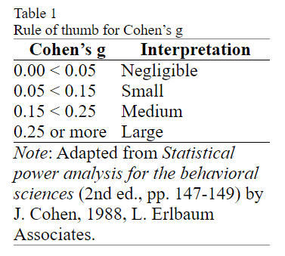
Binomial test Effect size: Cohen's g
Cohen’s g is therefor often reported with the absolute value (so without a negative sign, this is then known as a nondirectional Cohen’s g).
An exact binomial test indicated that the percentage of female (N_{f} = 12, 26%), was significantly different from the male percentage (N_{m} = 34, 76%), p = .002. Cohen’s g suggests that the difference can be classified as medium, g = .24.

Slide 16
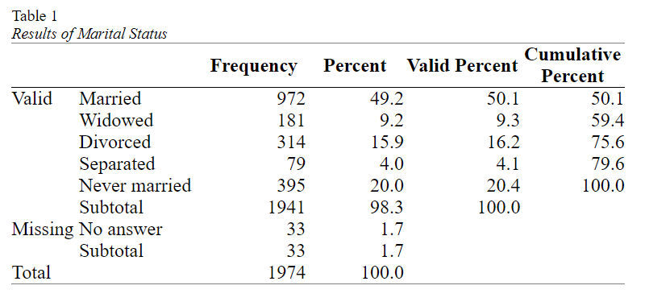
Analysing a single nominal variable
When you have a single nominal variable (e.g. marital status) you might be interested in how many respondents selected each of the options (e.g. how many are married, how many widowed, etc.).
Then to visualise these results and last but not least to determine if any of the categories is chosen more often than the others (also in the population).

Slide 17
Analysing a single nominal variable
Center and dispersion (mode and variation ratio)
A measure of central tendency attempts to let one number represent the data as good as possible.
The most commonly used measure of central tendency for a nominal variable is the mode.
If there is only one mode the set is sometimes called unimodal, if there are two it is called bimodal, with three trimodal, etc. For two or more, the term multimodal can also be used.

Slide 18
Analysing a single nominal variable
Center and dispersion (mode and variation ratio)
One small controversy exists if all categories have the same frequency.
In this case none of them has a higher occurence than the others, so none of them would be the mode (see for example Spiegel & Stephens, 2008, p. 64, Larson & Farber, 2014, p. 69).
On a rare occasion someone might argue that if all categories have the same frequency, then all categories are part of the mode since they all have the highest frequency.
A third interpretation was found on this site, where if the frequency is one for each category, then there is no mode, and if the frequency is more than one but the same, then all of them are the mode.

Slide 19
Analysing a single nominal variable
Measurement of dispersion (Variation Ratio)
The easiest method is most likely the Variation Ratio (VR) (Freeman, 1965). This is simply the proportion that does not belong to the modal category (Zedeck, 2014, p.406). So in the example in Table 1, we can see that 50.1% falls into the modal category of Married, and hence 49.9% does not. The Variation Ratio is therefor 49.9%

Slide 20
Analysing a single nominal variable
Pearson chi-square goodness-of-fit test
One question you might have with a nominal variable, is if each category had the same number of respondents (i.e. the same percentage).
With the marital status example from the previous paragraphs, we might expect each of the five categories to have (100% / 5 =) 20%. This would mean that we’d expected 20% of 1941 = 388.2 people in each category. This is known as the expected count or expected frequency.
Our observed frequencies are different from the expected ones. The Pearson chi-square test of goodness-of-fit (Pearson, 1900) can determine if the differences between the observed and expected counts is signficant. If the test result is a p-value below .05 it is usually considered signficant, indicating that there are some significant differences between some categories in frequencies.

Slide 21
Analysing a single nominal variable
Pearson chi-square goodness-of-fit test
One problem though is that the Pearson chi-square test of goodness-of-fit should only be used if not too many cells have a low so-called expected count. For this test it is usually set that all cells should have an expected count of at least 5 (see for example Peck & Devore, 2012, p. 593) (note that for a Pearson chi-square test of independence the conditions are different). If you don't meet this criteria, you could use an exact multinomial test of goodness-of-fit.
Once you have checked the conditions and looked at the results, you can report the test results. You will need the significance, but also the chi-square value itself, the sample size (number of respondents that answered this question), and the so-called degrees of freedom. This last one is simply for this test the number of categories minus 1
The test results could then be reported as something like
A chi-square test of goodness-of-fit was performed to determine whether the marital status were equally chosen. The marital status was not equally distributed in the population, χ²(4, N = 1941) = 1249.13, p < .001.

Slide 22
Analysing a single nominal variable
Pearson chi-square goodness-of-fit test
In short the Pearson chi-square test of goodness-of-fit has the following steps:
The assumption about the population (the null hypothesis (H₀)) is that the observed and expected counts will be the same. This implies that the two variables are independent (i.e. one has no influence on the other).
The alternative is that they aren't (H_{a}). This implies that the two variables are dependent (i.e. one has an influence on the other)
Perform the test and find the p-value (sig.).
If the p-value is less than .05, the chance of a result as in the sample or even rarer if the assumption is true, is considered so low, that the assumption is probably NOT true. We would then reject H₀ and conclude H_{a}. This is then called a significant result.
If the p-value is .05 or more, the chance of a result as in the sample or even rarer if the assumption is true, is considered not low enough, that the assumption could be true. We don't have enough evidence to reject the assumption. This is then called a non-significant result.

Slide 23
Analysing a single nominal variable
Which percentages are different? (post-hoc pairwise binomial test)
We would now also like to know which categories are then different:
Is the percentage of Married significantly different from Widowed? Is the percentage of Married significantly different from Divorced?
Bonferroni procedure (Bonferroni, 1935). He simply suggested to divide the 5% by the number of tests that are being done, and use that then as the criteria. In this example that would mean we divide 5% by 10 and the new threshold will be 0.5% (i.e. 0.005). In general if you have c categories, the number of pairs you can create is c x (c - 1)/ 2 (in this example 5 x (5 - 1)/2 = 10).

Slide 24
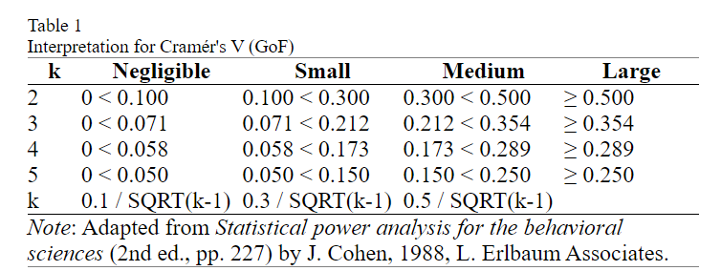
Analysing a single nominal variable
Effect size (Cramér's V and Relative Risks)
Effect size for the pairwise tests: Cohen g

Slide 25

Utkarsh Minds
Mirjam Nilsson

Slide 26
Contact us: helpdesk@utkarshminds.com +91 961-999-7797 Thank you

