Slide 1


Slide 2
Table of contents
Revision
Analysing a single nominal variable
Analysing a single ordinal variable
Analysing a single scale variable

Slide 3
Statistics
“the science of collecting, displaying and analysing data”
There are two main branches of statistics; descriptive and inferential (Wright & London, 2009, p. 55).
Descriptive statistics are: “methods for organizing, displaying, and describing data using tables, graphs and summary measures” (Mann, 1991, 2010, p. 3).
Descriptive statistics is the type of statistics most people encounter every day, often without realizing they are looking at statistics. In many video-games results or scores are often displayed in various charts or with various comparisons, advertisements try to show of fancy diagrams and in business reports the tables and diagrams also play often a key role.
When collecting data you are usually interested in a specific group of people, animals or things, but don’t have the time (or money) to collect data about all of them. The entire group is known as the population: “the complete set of objects of interest” (Upton & Cook, 2014, p. 332). The people/things you actually got data from is then known as a sample: “a subset of a population usually chosen in such a way that it can be taken to represent the population with respect to some characteristic” (Upton & Cook, 2014, p. 379).
Wouldn’t it be great if you could say something about the population based on just one sample? It would save a lot of time and/or money. A fancy word for making a statement about a population based on a sample is an inference: “a conclusion about a population based on logical reasoning from data gathered about a smaller sample” (Zedeck, 2014, p. 175).

Slide 4
Statistics
When collecting data you are usually interested in a specific group of people, animals or things, but don’t have the time (or money) to collect data about all of them.
The entire group is known as the population: “the complete set of objects of interest” (Upton & Cook, 2014, p. 332).
The people/things you actually got data from is then known as a sample: “a subset of a population usually chosen in such a way that it can be taken to represent the population with respect to some characteristic” (Upton & Cook, 2014, p. 379).

Slide 5
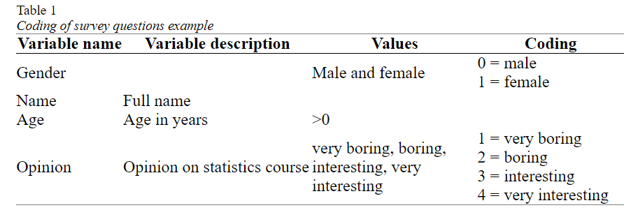
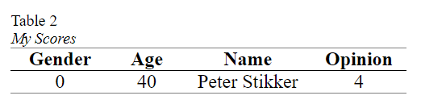
Statistical terms
In Table 1 the conversion of the example survey into variables, values and coding. This is sometimes referred to as a codebook.
Note that the variable description is either a longer description of the name of the variable, or sometimes the entire question as it was asked on the survey.
The last term connected to this is a score. A score is the value (or assigned code) for a single case on a single variable.

Slide 6
Statistical terms
Stevens (1946) classified variables based on which basic operations can be performed on them, and created four so-called measurement levels: nominal, ordinal, interval and ratio.
I will combine interval and ratio into one category called scale (which is something SPSS also does).
A variable is said to have a nominal measurement level, if the values are non-numeric and have no logical order (besides perhaps alphabetical). The variable gender for example has a nominal measurement level, since the order of the possible values can be in any way you want (although there are many discussions sometimes about it :-)). Also open questions that ask for text are nominal, for example first name.

Slide 7
Significance
significance, which can be defined as: the probability of a result as in the sample, or even more extreme, if the assumption about the population would be true
What is important here is that with a survey you only have taken one sample out of many possible samples that could have been taken out of a population.
What we would like to know is; what can be said about the entire population based on a single sample from that population (without having to take all possible samples)?
To answer this, one approach is to use the significance.

Slide 8
Significance example
I have two coins (A and B). I’ve flipped each coin 200 times. Coin A resulted in 190 times head (and 10 times tail), Coin B resulted in 92 times head (and 108 times tail). Which coin do you think might be fair (fair is an equal chance of head and tail)?
Our assumption about the population, is that the coin is fair. The 90 and 8 from point 4 were our ‘result as in the sample’. Now the chances for a deviation of exactly 90 is very low, and also the chance for a deviation of exactly 8 is very low. We are actually interested in the chance of a deviation of 90 or more, and of a deviation of 8 or more. This is the ‘or even more extreme’ in the definition of significance.

Slide 9
Significance example
How these chances are calculated is not so important right now, but the chance of a deviation of 8 or more is almost 30%, while the chance of a deviation of 90 or more is almost 0%.
The deviation of 8 or more is likely to occur if the coin is fair, but 90 or more isn’t. It does not mean that a deviation of 90 or more is completely not possible, it is just very unlikely if the coin is fair.
The chances (the 30% and near 0%) are the significances. It is the chance of a deviation as in the sample, or even more extreme, if the coin is fair.

Slide 10
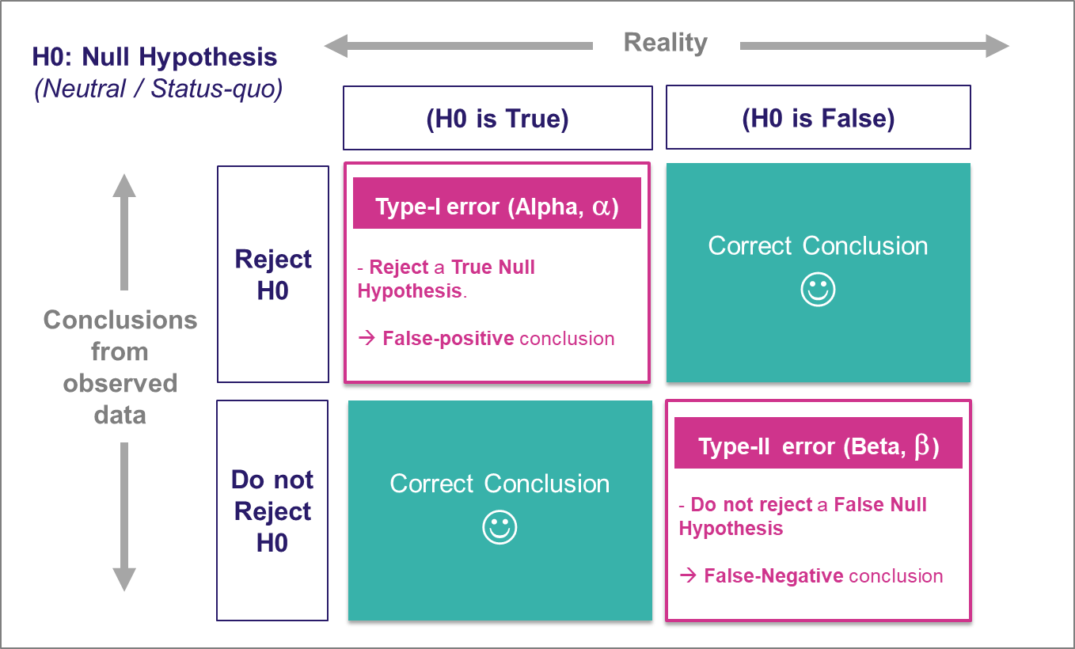
Significance example
Null Hypothesis (H₀): The lucky charm has no effect on your test scores.
Alternate Hypothesis (H₁): The lucky charm does have an effect, and your test scores are better when you use it.
In Hindi:
Significant: महत्वपूर्ण (Mahatvapurna)
In Marathi:
Significant: महत्त्वाचं (Mahattvach)

Slide 11
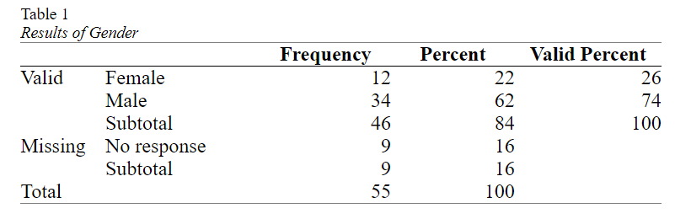
Analysing a single variable
Management was curious if the division of male/female was equal in the company.
The result of a small survey showed that out of the 46 respondents

Slide 12
Binomial test
In short the binomial test has the following steps:
The assumption about the population (the null hypothesis (H₀)) is that the proportion of one of the two categories will be some amount (e.g. 0.5).
The alternative is that it isn't (H_{a}) (e.g. the proportion in the population is not 0.5). This would be the so-called two-tailed test.
Perform the binomial test and find the p-value (sig.).
If the p-value is less than .05, the chance of a result as in the sample or even rarer if the assumption is true, is considered so low, that the assumption is probably NOT true. The proportion in the population is then probably NOT the one assumed at step 1. This is then called a significant result.

Slide 13
Binomial test
If the p-value is .05 or more, the chance of a result as in the sample or even rarer if the assumption is true, is considered not low enough, that the assumption could be true. We don't have enough evidence to reject the assumption. This is then called a non-significant result.

Slide 14
Binomial test Effect size: Cohen's g
The one-sample binomial test can inform us if the percentage in the population will be significantly different from the 50%, but does not say anything on how big the difference is.
With only two categories we can simply leave it up to the reader to judge if he/she finds the difference in the two percentages big or small, but for many tests it is recommended to also give a so-called effect size measure.
Cohen’s g (Cohen, 1988) is specifically for the case where the expected proportion in the population is 0.5 (50%). It is then simply the difference of the sample proportion with this 0.5. In the example the female proportion was 0.26 (26%), so Cohen’s g is the difference with the expected proportion which is simply 0.26 – 0.50 = -0.24.

Slide 15
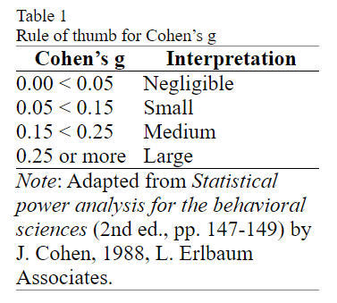
Binomial test Effect size: Cohen's g
Cohen’s g is therefor often reported with the absolute value (so without a negative sign, this is then known as a nondirectional Cohen’s g).
An exact binomial test indicated that the percentage of female (N_{f} = 12, 26%), was significantly different from the male percentage (N_{m} = 34, 76%), p = .002. Cohen’s g suggests that the difference can be classified as medium, g = .24.

Slide 16
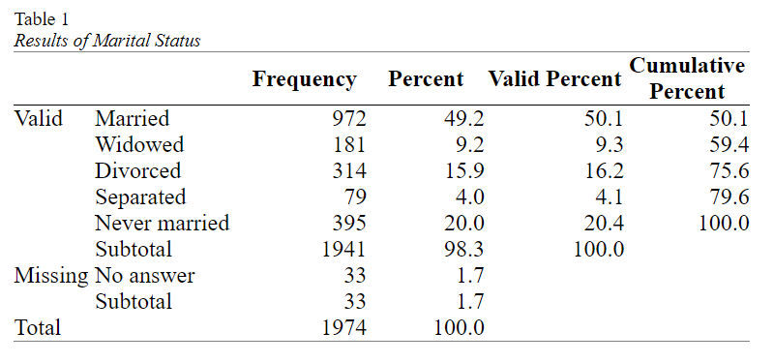
Analysing a single nominal variable
When you have a single nominal variable (e.g. marital status) you might be interested in how many respondents selected each of the options (e.g. how many are married, how many widowed, etc.).
Then to visualise these results and last but not least to determine if any of the categories is chosen more often than the others (also in the population).

Slide 17
Analysing a single nominal variable
Center and dispersion (mode and variation ratio)
A measure of central tendency attempts to let one number represent the data as good as possible.
The most commonly used measure of central tendency for a nominal variable is the mode.
If there is only one mode the set is sometimes called unimodal, if there are two it is called bimodal, with three trimodal, etc. For two or more, the term multimodal can also be used.

Slide 18
Analysing a single nominal variable
Center and dispersion (mode and variation ratio)
One small controversy exists if all categories have the same frequency.
In this case none of them has a higher occurence than the others, so none of them would be the mode (see for example Spiegel & Stephens, 2008, p. 64, Larson & Farber, 2014, p. 69).
On a rare occasion someone might argue that if all categories have the same frequency, then all categories are part of the mode since they all have the highest frequency.
A third interpretation was found on this site, where if the frequency is one for each category, then there is no mode, and if the frequency is more than one but the same, then all of them are the mode.

Slide 19
Analysing a single nominal variable
Measurement of dispersion (Variation Ratio)
The easiest method is most likely the Variation Ratio (VR) (Freeman, 1965). This is simply the proportion that does not belong to the modal category (Zedeck, 2014, p.406). So in the example in Table 1, we can see that 50.1% falls into the modal category of Married, and hence 49.9% does not. The Variation Ratio is therefor 49.9%

Slide 20
Analysing a single nominal variable
Pearson chi-square goodness-of-fit test
One question you might have with a nominal variable, is if each category had the same number of respondents (i.e. the same percentage).
With the marital status example from the previous paragraphs, we might expect each of the five categories to have (100% / 5 =) 20%. This would mean that we’d expected 20% of 1941 = 388.2 people in each category. This is known as the expected count or expected frequency.
Our observed frequencies are different from the expected ones. The Pearson chi-square test of goodness-of-fit (Pearson, 1900) can determine if the differences between the observed and expected counts is signficant. If the test result is a p-value below .05 it is usually considered signficant, indicating that there are some significant differences between some categories in frequencies.

Slide 21
Analysing a single nominal variable
Pearson chi-square goodness-of-fit test
One problem though is that the Pearson chi-square test of goodness-of-fit should only be used if not too many cells have a low so-called expected count. For this test it is usually set that all cells should have an expected count of at least 5 (see for example Peck & Devore, 2012, p. 593) (note that for a Pearson chi-square test of independence the conditions are different). If you don't meet this criteria, you could use an exact multinomial test of goodness-of-fit.
Once you have checked the conditions and looked at the results, you can report the test results. You will need the significance, but also the chi-square value itself, the sample size (number of respondents that answered this question), and the so-called degrees of freedom. This last one is simply for this test the number of categories minus 1
The test results could then be reported as something like
A chi-square test of goodness-of-fit was performed to determine whether the marital status were equally chosen. The marital status was not equally distributed in the population, χ²(4, N = 1941) = 1249.13, p < .001.

Slide 22
Analysing a single nominal variable
Pearson chi-square goodness-of-fit test
In short the Pearson chi-square test of goodness-of-fit has the following steps:
The assumption about the population (the null hypothesis (H₀)) is that the observed and expected counts will be the same. This implies that the two variables are independent (i.e. one has no influence on the other).
The alternative is that they aren't (H_{a}). This implies that the two variables are dependent (i.e. one has an influence on the other)
Perform the test and find the p-value (sig.).
If the p-value is less than .05, the chance of a result as in the sample or even rarer if the assumption is true, is considered so low, that the assumption is probably NOT true. We would then reject H₀ and conclude H_{a}. This is then called a significant result.
If the p-value is .05 or more, the chance of a result as in the sample or even rarer if the assumption is true, is considered not low enough, that the assumption could be true. We don't have enough evidence to reject the assumption. This is then called a non-significant result.

Slide 23
Analysing a single nominal variable
Which percentages are different? (post-hoc pairwise binomial test)
We would now also like to know which categories are then different:
Is the percentage of Married significantly different from Widowed? Is the percentage of Married significantly different from Divorced?
Bonferroni procedure (Bonferroni, 1935). He simply suggested to divide the 5% by the number of tests that are being done, and use that then as the criteria. In this example that would mean we divide 5% by 10 and the new threshold will be 0.5% (i.e. 0.005). In general if you have c categories, the number of pairs you can create is c x (c - 1)/ 2 (in this example 5 x (5 - 1)/2 = 10).

Slide 24
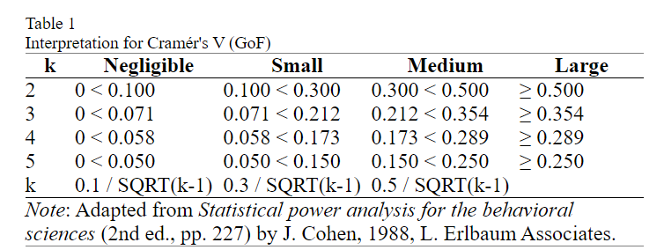
Analysing a single nominal variable
Effect size (Cramér's V and Relative Risks)
Effect size for the pairwise tests: Cohen g

Slide 25
Analysing a single ordinal variable
When you have a single ordinal variable (e.g. opinion on something with fully disagree to fully agree) you might be interested in how many respondents selected each of the options (e.g. how many fully disagree, how many disagree, etc.), then visualise these results and last but not least determine if overall they tended more towards one end of the scale or the other (also in the population).

Slide 26
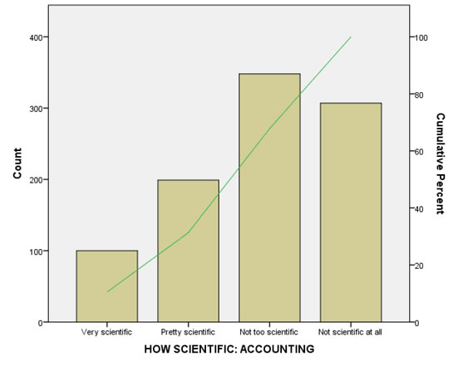
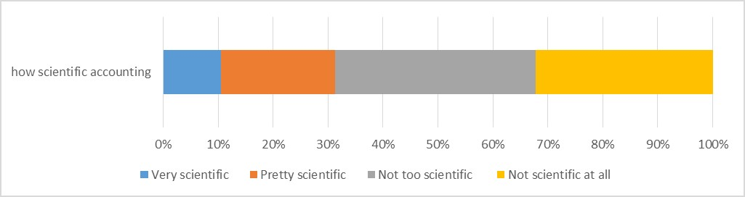
Analysing a single ordinal variable
Visualization

Slide 27
Analysing a single ordinal variable
Center and dispersion for an ordinal variable
Measures of central tendency try to establish somewhat of the ‘most typical’ value for the data
The median is the score at the middle of all scores, or more formally defined “the middle value in a distribution, below and above which lie values with equal total frequencies or probabilities” (Porkess, 1991, p. 134). This means that 50% of the respondents scored equal or higher to the median, and also 50% of the respondents scored lower or equal. If for example at a school exam the results indicate that the median is a 70 (out of 100, with 55 or more being a pass), then we know that at least 50% of the students passed.

Slide 28
Analysing a single ordinal variable
The dispersion
The centre alone does not give a good picture. If your head is in the oven and your feet in a refrigerator you’d be doing fine on average, but the deviation from the average is too high. That’s why besides a measure of centre, you should also report a measure of dispersion.
One such measure of dispersion is called consensus (Tastle & Wierman, 2007; Tastle, Wierman, & Rex Dumdum, 2005). This measure ranges from 0 to 1. A zero would indicate a complete lack of consensus, the number of people that tend towards one end of the ordinal variable (i.e. fully disagree) is then the same as the number of people who tend to the other end (i.e. fully agree), while consensus of one would indicate all respondents gave the same answer.

Slide 29
Analysing a single ordinal variable
The dispersion
The centre alone does not give a good picture. If your head is in the oven and your feet in a refrigerator you’d be doing fine on average, but the deviation from the average is too high. That’s why besides a measure of centre, you should also report a measure of dispersion.
One such measure of dispersion is called consensus (Tastle & Wierman, 2007; Tastle, Wierman, & Rex Dumdum, 2005). This measure ranges from 0 to 1. A zero would indicate a complete lack of consensus, the number of people that tend towards one end of the ordinal variable (i.e. fully disagree) is then the same as the number of people who tend to the other end (i.e. fully agree), while consensus of one would indicate all respondents gave the same answer.

Slide 30
Analysing a single ordinal variable
Test for median (one-sample Wilcoxon signed rank test)
Would the majority of people in the population also not see accounting as very scientific? The majority would be more than 50% of the people, so in other words, is the median (the score in the middle) in the population significantly different from 2.5 (since 2 = pretty scientific, and 3 = not scientific)?
The significance of the Wilcoxon signed rank test will tell us how likely it is to have a result as in our sample, or even more extreme if the median in the population is indeed a certain value (in the example we use 2.5). If this chance is very low, the population mos likely has another median than the one expected.

Slide 31
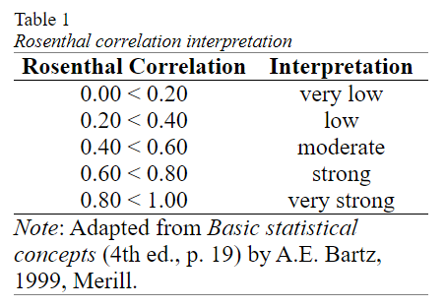
Analysing a single ordinal variable
Effect size
One possible effect size measures that could be suitable for this test, is dividing the z-value by the square root of the sample size (Fritz et al., 2012, p. 12; Mangiafico, 2016; Simone, 2017; Tomczak, M., & Tomczak, E., 2014, p. 23; ).
The formula can be found in Rosenthal book (1991, p. 19) , so I will refer to as the Rosenthal correlation coefficient (as to differentiate it with other correlation coefficients). Probably the original was Cohen (1988, p. 275) who calls it 'f', but all other authors label it 'r'

Slide 32
Analysing a single scale variable
When you have a single scale variable (e.g. age of respondent) you might be interested in the average and the variation, then visualise these results and last but not least determine what the sample result might say about the entire population. The analysis therefor breaks down into
Part 1: Descriptive analysis
Part 2: Inferential statistics
Part 3: Reporting
As the last step, you will need to write up all the results

Slide 33
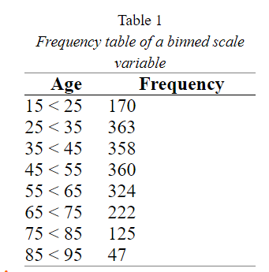
Analysing a single scale variable
All the frequency types discussed for a nominal and ordinal variable, can also be applied for a scale variable. One complication however is that for a scale variable, there are often so many options that the table becomes very long.
The table shows that there were 170 respondents in the age bin of 15 < 25. The symbol '<' is used for 'but under', so someone of the age of 25 would fit into 25 < 35, but not in 15 < 25. Sometimes = is used, which stands for 'equal or less than'. A more technical method is the use of [ or ] to indicate ‘including’ and ( or ) to indicate smaller than. The interval 15 < 25 is then the same as [15,25), and the interval 15 = 24 is the same as [15,24].

Slide 34
Analysing a single scale variable
There are also various formulas to help on deciding how many bins you should use, or how wide each bin should be. This is important because depending on how the bins are setup the results might look different. There are some formulas that can be used to determine the number of bins (e.g. Sturges’ rule (Sturges, 1926, p. 65), or Square Root Choice (Duda & Hart, 1973), and some authors simply use ‘a rule of thumb. One such rule of thumb is from Herkenhoff and Fogli (2013, p. 58) who recommend between 5 and 15 bins. Anything more than 15 might cause the table to become unclear (which is exactly what we are trying to avoid) and with anything less than 5 we might lose too much information

Slide 35
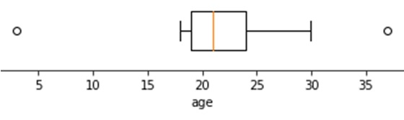
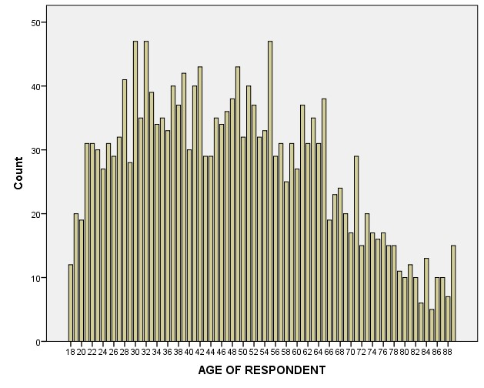
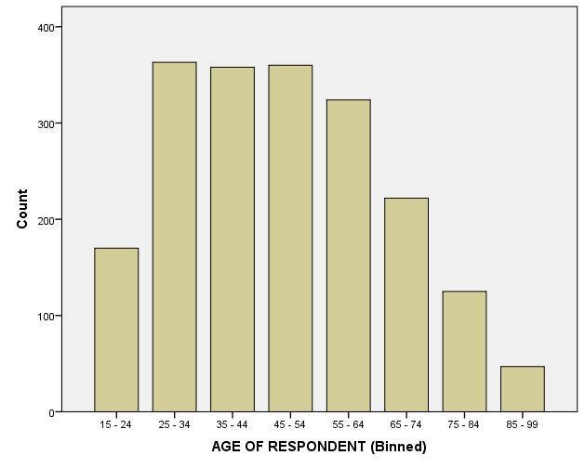
Analysing a single scale variable
Box-and-Whiskers Plot

Slide 36
Analysing a single scale variable
Box-and-Whiskers Plot
It shows the five quartiles (e.g. minimum, 1st quartile, median, 3rd quartile, and maximum). It can also be adjusted to show so-called outliers.
The first quartile is the point for which 25% of all scores is less or equal, the median is 50% and the third quartile 75%. Note that for the calculation of the quartiles various methods exist (see https://mathworld.wolfram.com/Quartile.html).
To create the box plot, a 'box' is drawn with the 1st and 3rd quartile at either end. A line in the box is drawn at the median. Then from the middle of each end a line (whisker) is drawn to the maximum and minmum. This was actually a 'range chart' (Spear, 1952, p. 166) but somehow it is these days referred to as a box-and-whisker plot as named by Tukey (1977, p. 39)
Often values that are more than 1.5 times the inter-quartile range (iqr) above the 3rd quartile, or below the 1st are shown as a dot or asterisks, and the whiskers are then drawn till the first value that still falls within this 1.5 times iqr limit.
The inter-quartile range is simply the 3rd quartile minus the first.

Slide 37
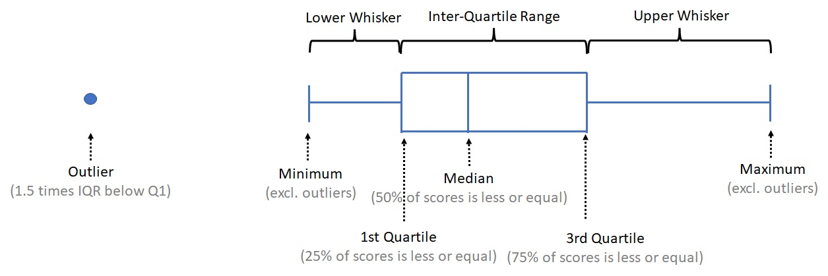
Analysing a single scale variable

Slide 38
Analysing a single scale variable
Center and dispersion (mean and standard deviation)
The most common measure of central tendency for a scale measure is the mean. Note that when people say ‘average’ they most often refer to the mean, although the term ‘average’ could refer to any measure of central tendency.
Dispersion or variety (standard deviation)
With a scale variable the most commonly used measure of dispersion is known as the standard deviation.
The standard deviation gives information about the diversity of the scores. It could indicate how well people agreed with each other, how much variation there was, or how stable something is. Chebyshev’s inequality (Tchébychef, 1867) states that 75% of all scores will fall within two standard deviations from the mean, and almost 89% within 3 standard deviations. If for example the mean age is 23 and the standard deviation is 3, then we can expect that 75% of the respondents have an age between (23 – 2 x 3 =) 17 and (23 + 2 x 3 =) 29, and almost 88% between (23 – 3 x 3 =) 14 and (23 + 3 x 3 =) 32.

Slide 39
Analysing a single scale variable
Test for specific mean
We can either obtain a confidence interval for the population mean (average). This will be an interval (i.e. the population mean will most likely be somewhere between... and ....), and/or if we had a hypothesized average, we can test if the data shows a significance difference.
If we'd expect the population mean to be a certain value we can also perform a statistical test for this, known as a one-sample t-test. In the example perhaps HRM thinks that the average age is 50, we can then use a one-sample t-test (Student, 1908) to test if this might be true based on the sample. If our sample mean is close to the expected population mean then our population mean might be correct, but if it is very different it might be wrong.

Slide 40
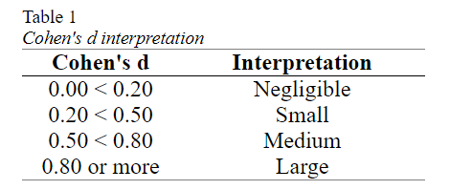
Analysing a single scale variable
Effect size
To determine the size of the difference, we can use a so-called effect size measure and the one that goes well with the one-sample t-test is known as Cohen's d (Cohen, 1988). The calculation is fairly easy, it is the difference between the sample mean and the expected population mean (the test value or hypothesized mean), divided by the standard deviation. Note that there is also a Cohen's d_{s}, but that is used for an independent samples t-test.

Slide 41
Analysing a single scale variable
Test question
sample_scores = [78, 82, 76, 79, 85, 70, 74, 81, 77, 83, 79, 80, 75, 78, 76, 82, 73, 80, 81, 77]
you have the average exam score of 20 students from a particular school. You know from historical data that the population mean exam score for all students in that school is 75.

Slide 42

Utkarsh Minds
Mirjam Nilsson

Slide 43
Contact us: helpdesk@utkarshminds.com +91 961-999-7797 Thank you

