Slide 1


Slide 2
Table of contents
Revision
Analysing two variables –
1) Two nominal variables 2) A nominal and an ordinal variable 3) A nominal and a scale variable 4) Two ordinal variables 5) An ordinal and a scale variable 6) Two scale variables

Slide 3
Statistics
“the science of collecting, displaying and analysing data”
There are two main branches of statistics; descriptive and inferential (Wright & London, 2009, p. 55).
Descriptive statistics are: “methods for organizing, displaying, and describing data using tables, graphs and summary measures” (Mann, 1991, 2010, p. 3).
Descriptive statistics is the type of statistics most people encounter every day, often without realizing they are looking at statistics. In many video-games results or scores are often displayed in various charts or with various comparisons, advertisements try to show of fancy diagrams and in business reports the tables and diagrams also play often a key role.
When collecting data you are usually interested in a specific group of people, animals or things, but don’t have the time (or money) to collect data about all of them. The entire group is known as the population: “the complete set of objects of interest” (Upton & Cook, 2014, p. 332). The people/things you actually got data from is then known as a sample: “a subset of a population usually chosen in such a way that it can be taken to represent the population with respect to some characteristic” (Upton & Cook, 2014, p. 379).
Wouldn’t it be great if you could say something about the population based on just one sample? It would save a lot of time and/or money. A fancy word for making a statement about a population based on a sample is an inference: “a conclusion about a population based on logical reasoning from data gathered about a smaller sample” (Zedeck, 2014, p. 175).

Slide 4
Statistics
When collecting data you are usually interested in a specific group of people, animals or things, but don’t have the time (or money) to collect data about all of them.
The entire group is known as the population: “the complete set of objects of interest” (Upton & Cook, 2014, p. 332).
The people/things you actually got data from is then known as a sample: “a subset of a population usually chosen in such a way that it can be taken to represent the population with respect to some characteristic” (Upton & Cook, 2014, p. 379).

Slide 5
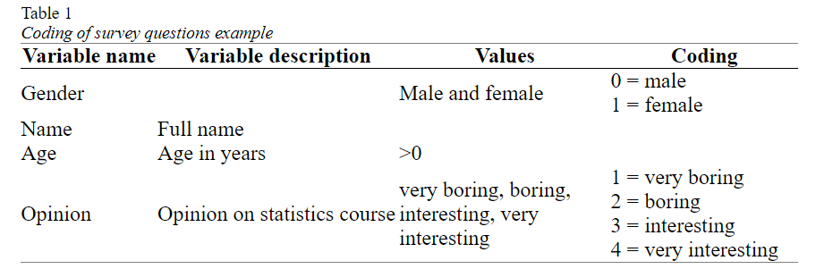
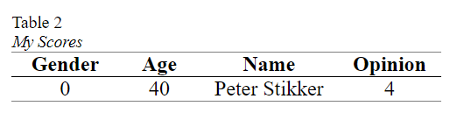
Statistical terms
In Table 1 the conversion of the example survey into variables, values and coding. This is sometimes referred to as a codebook.
Note that the variable description is either a longer description of the name of the variable, or sometimes the entire question as it was asked on the survey.
The last term connected to this is a score. A score is the value (or assigned code) for a single case on a single variable.

Slide 6
Statistical terms
Stevens (1946) classified variables based on which basic operations can be performed on them, and created four so-called measurement levels: nominal, ordinal, interval and ratio.
I will combine interval and ratio into one category called scale (which is something SPSS also does).
A variable is said to have a nominal measurement level, if the values are non-numeric and have no logical order (besides perhaps alphabetical). The variable gender for example has a nominal measurement level, since the order of the possible values can be in any way you want (although there are many discussions sometimes about it :-)). Also open questions that ask for text are nominal, for example first name.

Slide 7
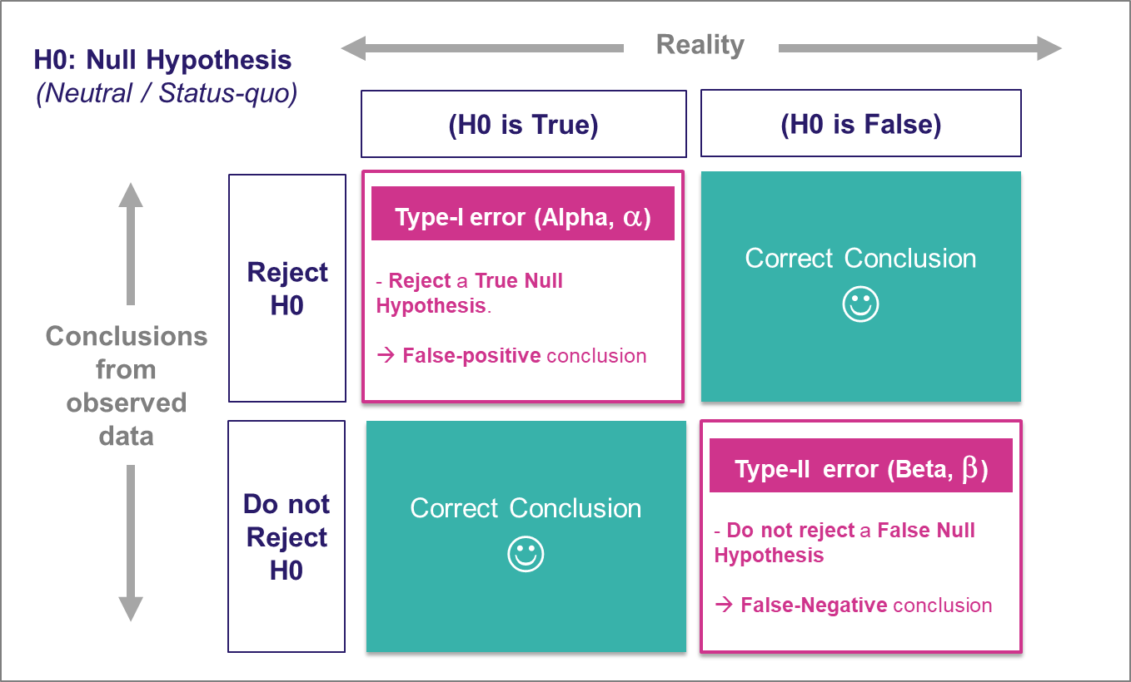
Significance example
Null Hypothesis (H₀): The lucky charm has no effect on your test scores.
Alternate Hypothesis (H₁): The lucky charm does have an effect, and your test scores are better when you use it.
In Hindi:
Significant: महत्वपूर्ण (Mahatvapurna)
In Marathi:
Significant: महत्त्वाचं (Mahattvach)

Slide 8
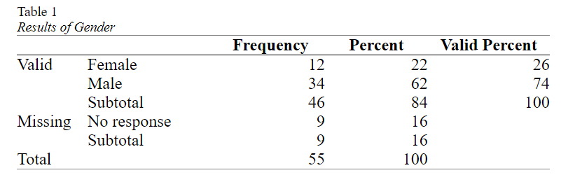
Analysing a single variable
Management was curious if the division of male/female was equal in the company.
The result of a small survey showed that out of the 46 respondents

Slide 9
Binomial test Effect size: Cohen's g
The one-sample binomial test can inform us if the percentage in the population will be significantly different from the 50%, but does not say anything on how big the difference is.
With only two categories we can simply leave it up to the reader to judge if he/she finds the difference in the two percentages big or small, but for many tests it is recommended to also give a so-called effect size measure.
Cohen’s g (Cohen, 1988) is specifically for the case where the expected proportion in the population is 0.5 (50%). It is then simply the difference of the sample proportion with this 0.5. In the example the female proportion was 0.26 (26%), so Cohen’s g is the difference with the expected proportion which is simply 0.26 – 0.50 = -0.24.

Slide 10
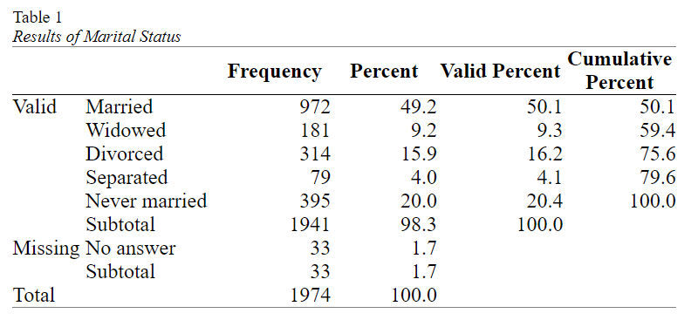
Analysing a single nominal variable
When you have a single nominal variable (e.g. marital status) you might be interested in how many respondents selected each of the options (e.g. how many are married, how many widowed, etc.).
Then to visualise these results and last but not least to determine if any of the categories is chosen more often than the others (also in the population).

Slide 11
Analysing a single nominal variable
Center and dispersion (mode and variation ratio)
A measure of central tendency attempts to let one number represent the data as good as possible.
The most commonly used measure of central tendency for a nominal variable is the mode.
If there is only one mode the set is sometimes called unimodal, if there are two it is called bimodal, with three trimodal, etc. For two or more, the term multimodal can also be used.

Slide 12
Analysing a single nominal variable
Measurement of dispersion (Variation Ratio)
The easiest method is most likely the Variation Ratio (VR) (Freeman, 1965). This is simply the proportion that does not belong to the modal category (Zedeck, 2014, p.406). So in the example in Table 1, we can see that 50.1% falls into the modal category of Married, and hence 49.9% does not. The Variation Ratio is therefor 49.9%

Slide 13
Analysing a single nominal variable
Pearson chi-square goodness-of-fit test
One question you might have with a nominal variable, is if each category had the same number of respondents (i.e. the same percentage).
With the marital status example from the previous paragraphs, we might expect each of the five categories to have (100% / 5 =) 20%. This would mean that we’d expected 20% of 1941 = 388.2 people in each category. This is known as the expected count or expected frequency.
Our observed frequencies are different from the expected ones. The Pearson chi-square test of goodness-of-fit (Pearson, 1900) can determine if the differences between the observed and expected counts is signficant. If the test result is a p-value below .05 it is usually considered signficant, indicating that there are some significant differences between some categories in frequencies.

Slide 14
Analysing a single nominal variable
Pearson chi-square goodness-of-fit test
In short the Pearson chi-square test of goodness-of-fit has the following steps:
The assumption about the population (the null hypothesis (H₀)) is that the observed and expected counts will be the same. This implies that the two variables are independent (i.e. one has no influence on the other).
The alternative is that they aren't (H_{a}). This implies that the two variables are dependent (i.e. one has an influence on the other)
Perform the test and find the p-value (sig.).
If the p-value is less than .05, the chance of a result as in the sample or even rarer if the assumption is true, is considered so low, that the assumption is probably NOT true. We would then reject H₀ and conclude H_{a}. This is then called a significant result.
If the p-value is .05 or more, the chance of a result as in the sample or even rarer if the assumption is true, is considered not low enough, that the assumption could be true. We don't have enough evidence to reject the assumption. This is then called a non-significant result.

Slide 15
Analysing a single nominal variable
Which percentages are different? (post-hoc pairwise binomial test)
We would now also like to know which categories are then different:
Is the percentage of Married significantly different from Widowed? Is the percentage of Married significantly different from Divorced?
Bonferroni procedure (Bonferroni, 1935). He simply suggested to divide the 5% by the number of tests that are being done, and use that then as the criteria. In this example that would mean we divide 5% by 10 and the new threshold will be 0.5% (i.e. 0.005). In general if you have c categories, the number of pairs you can create is c x (c - 1)/ 2 (in this example 5 x (5 - 1)/2 = 10).

Slide 16
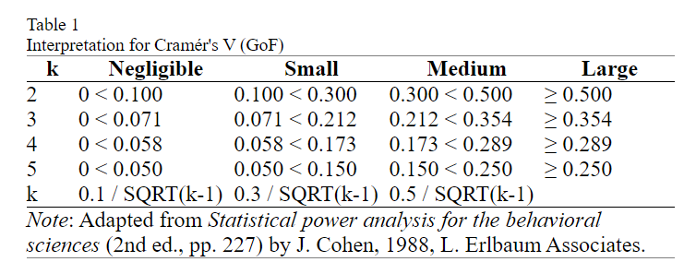
Analysing a single nominal variable
Effect size (Cramér's V and Relative Risks)
Effect size for the pairwise tests: Cohen g

Slide 17
Analysing a single ordinal variable
When you have a single ordinal variable (e.g. opinion on something with fully disagree to fully agree) you might be interested in how many respondents selected each of the options (e.g. how many fully disagree, how many disagree, etc.), then visualise these results and last but not least determine if overall they tended more towards one end of the scale or the other (also in the population).

Slide 18
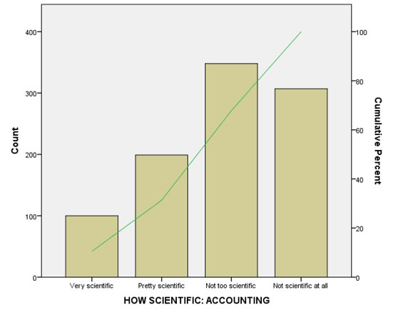
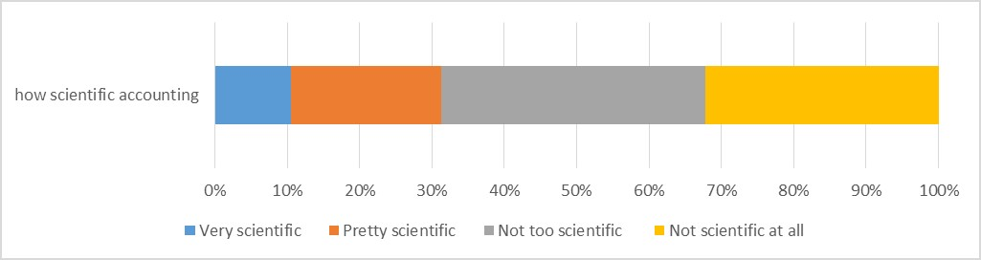
Analysing a single ordinal variable
Visualization

Slide 19
Analysing a single ordinal variable
Center and dispersion for an ordinal variable
Measures of central tendency try to establish somewhat of the ‘most typical’ value for the data
The median is the score at the middle of all scores, or more formally defined “the middle value in a distribution, below and above which lie values with equal total frequencies or probabilities” (Porkess, 1991, p. 134). This means that 50% of the respondents scored equal or higher to the median, and also 50% of the respondents scored lower or equal. If for example at a school exam the results indicate that the median is a 70 (out of 100, with 55 or more being a pass), then we know that at least 50% of the students passed.

Slide 20
Analysing a single ordinal variable
The dispersion
The centre alone does not give a good picture. If your head is in the oven and your feet in a refrigerator you’d be doing fine on average, but the deviation from the average is too high. That’s why besides a measure of centre, you should also report a measure of dispersion.
One such measure of dispersion is called consensus (Tastle & Wierman, 2007; Tastle, Wierman, & Rex Dumdum, 2005). This measure ranges from 0 to 1. A zero would indicate a complete lack of consensus, the number of people that tend towards one end of the ordinal variable (i.e. fully disagree) is then the same as the number of people who tend to the other end (i.e. fully agree), while consensus of one would indicate all respondents gave the same answer.

Slide 21
Analysing a single ordinal variable
Test for median (one-sample Wilcoxon signed rank test)
Would the majority of people in the population also not see accounting as very scientific? The majority would be more than 50% of the people, so in other words, is the median (the score in the middle) in the population significantly different from 2.5 (since 2 = pretty scientific, and 3 = not scientific)?
The significance of the Wilcoxon signed rank test will tell us how likely it is to have a result as in our sample, or even more extreme if the median in the population is indeed a certain value (in the example we use 2.5). If this chance is very low, the population mos likely has another median than the one expected.

Slide 22
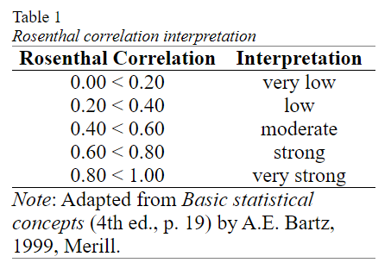
Analysing a single ordinal variable
Effect size
One possible effect size measures that could be suitable for this test, is dividing the z-value by the square root of the sample size (Fritz et al., 2012, p. 12; Mangiafico, 2016; Simone, 2017; Tomczak, M., & Tomczak, E., 2014, p. 23; ).
The formula can be found in Rosenthal book (1991, p. 19) , so I will refer to as the Rosenthal correlation coefficient (as to differentiate it with other correlation coefficients). Probably the original was Cohen (1988, p. 275) who calls it 'f', but all other authors label it 'r'

Slide 23
Analysing a single scale variable
When you have a single scale variable (e.g. age of respondent) you might be interested in the average and the variation, then visualise these results and last but not least determine what the sample result might say about the entire population. The analysis therefor breaks down into
Part 1: Descriptive analysis
Part 2: Inferential statistics
Part 3: Reporting
As the last step, you will need to write up all the results

Slide 24
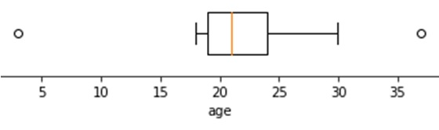
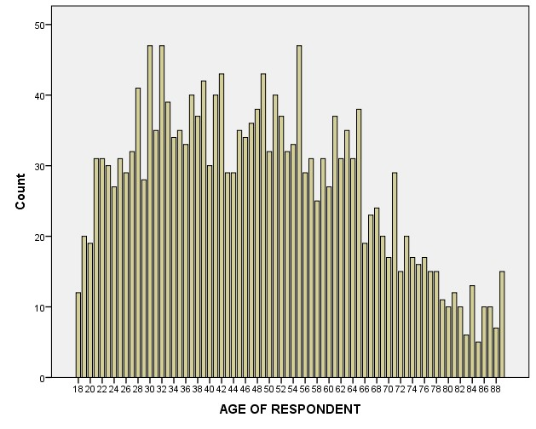
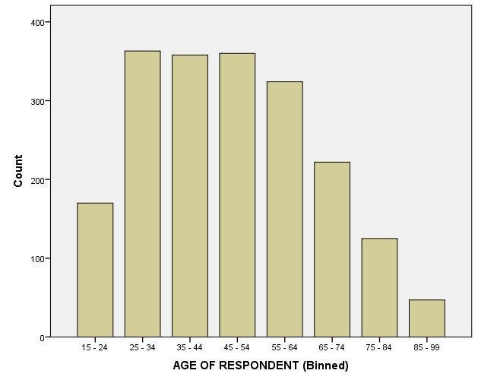
Analysing a single scale variable
Box-and-Whiskers Plot

Slide 25
Analysing a single scale variable
Center and dispersion (mean and standard deviation)
The most common measure of central tendency for a scale measure is the mean. Note that when people say ‘average’ they most often refer to the mean, although the term ‘average’ could refer to any measure of central tendency.
Dispersion or variety (standard deviation)
With a scale variable the most commonly used measure of dispersion is known as the standard deviation.
The standard deviation gives information about the diversity of the scores. It could indicate how well people agreed with each other, how much variation there was, or how stable something is. Chebyshev’s inequality (Tchébychef, 1867) states that 75% of all scores will fall within two standard deviations from the mean, and almost 89% within 3 standard deviations. If for example the mean age is 23 and the standard deviation is 3, then we can expect that 75% of the respondents have an age between (23 – 2 x 3 =) 17 and (23 + 2 x 3 =) 29, and almost 88% between (23 – 3 x 3 =) 14 and (23 + 3 x 3 =) 32.

Slide 26
Analysing a single scale variable
Test for specific mean
We can either obtain a confidence interval for the population mean (average). This will be an interval (i.e. the population mean will most likely be somewhere between... and ....), and/or if we had a hypothesized average, we can test if the data shows a significance difference.
If we'd expect the population mean to be a certain value we can also perform a statistical test for this, known as a one-sample t-test. In the example perhaps HRM thinks that the average age is 50, we can then use a one-sample t-test (Student, 1908) to test if this might be true based on the sample. If our sample mean is close to the expected population mean then our population mean might be correct, but if it is very different it might be wrong.

Slide 27
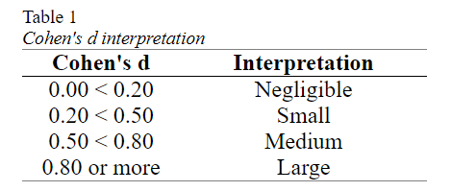
Analysing a single scale variable
Effect size
To determine the size of the difference, we can use a so-called effect size measure and the one that goes well with the one-sample t-test is known as Cohen's d (Cohen, 1988). The calculation is fairly easy, it is the difference between the sample mean and the expected population mean (the test value or hypothesized mean), divided by the standard deviation. Note that there is also a Cohen's d_{s}, but that is used for an independent samples t-test.

Slide 28
Analysing Binary vs. Binary (unpaired/independent) variables
When you have a two binary variables you might be interested if there is an association (relation) between the two.
For example if the gender (male/female) has an influence on where students had their secondary school (The Netherlands, or somewhere else).

Slide 29
Analysing Binary vs. Binary (unpaired/independent) variables
Part 1: Descriptive analysis Use descriptive statistics to get an impression of the data, using:
A cross table of the two variables
A visualisation of the data with a clustered bar chart
Part 2: Inferential statistics After the first impression determine what can be said about the population based on your sample data by:
Determine if there is a significant association using a Fisher Exact test
determine the effect sizes (Odds Ratio)
Part 3: Reporting As the last step, you will need to write up all the results.

Slide 30
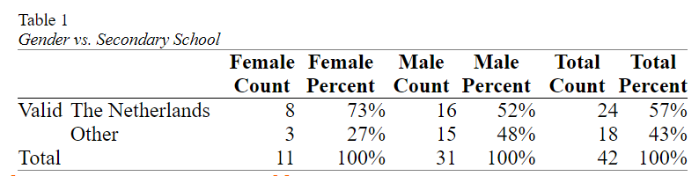
Analysing Binary vs. Binary (unpaired/independent) variables
To begin analysing a potential association between two binary variables, we can start by getting an impression from the sample data using a so-called cross table, or also known as a contingency table.
From the table we can tell that for example there were 8 Female students who had their secondary school in The Netherlands. This is 73% of the female students in the survey.

Slide 31
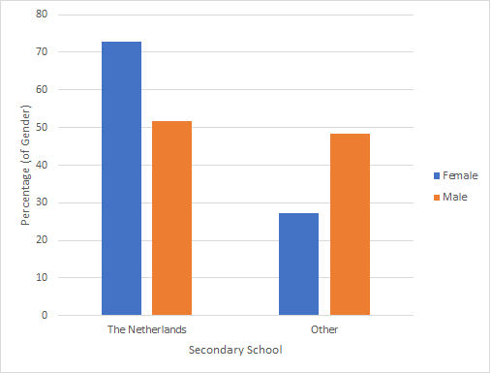
Analysing Binary vs. Binary (unpaired/independent) variables
Visualisation
A multiple bar-chart can be defined as: “a bar chart for comparing the frequencies of a categorical variable in two or more situations” (Upton & Cook, 2014, p. 283)..
The term 'clustered' is used for example by SPSS.

Slide 32
Analysing Binary vs. Binary (unpaired/independent) variables
Test – If gender has association with location of secondary school?
Perhaps the most commonly used test when you have two binary variables is the Fisher (Exact) Test (Fisher, 1922).
It tests if "the relative proportions of one variable are independent of the second variable; in other words, the proportions at one variable are the same for different values of the second variable" (McDonald, 2014, p. 77)

Slide 33
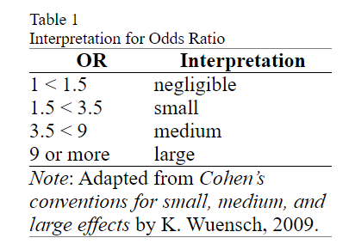
Analysing Binary vs. Binary (unpaired/independent) variables
Effect Size
Odds ratio
Odds can sometimes be reported as 'a one in five odds', but sometimes as 1 : 4. This later notation is less often seen, but means for every one event on the left side, there will be four on the right side.

Slide 34
Analysing Binary vs. ordinal (unpaired/independent) variables
The variable that defines the groups is then a binary variable, while the variable with the scores could either be ordinal or scale. In this chapter we’ll look at the situation where the scores are ordinal. If you have more than two groups you want to compare, then see the nominal vs. ordinal section.
The analysis can then be done using the following steps:
Part 1: Descriptive statistics.
Use descriptive statistics to get an impression of the data, using:
A cross table to show the sample results.
Visualise the data with a multiple compound bar charts.

Slide 35
Analysing Binary vs. ordinal (unpaired/independent) variables
Part 2: Inferential statistics
After the first impression determine what can be said about the population based on your sample data by:
Performing a test to see if the medians in the population (Mann-Whitney U test)
Determine how big the difference will be (effect size with Rosenthal coefficient)
The example used in this chapter will be using as a binary variable gender (which had the options male or female), and the ordinal variable ‘5.3 The amount of online activities (Blackboard: video’s, online resources, exercise generator, forums) was …’, which had the options 1 = far too little to 5 = far too many.

Slide 36
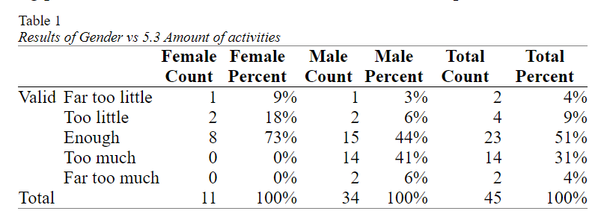
Analysing Binary vs. ordinal (unpaired/independent) variables
Impression of the data (cross table)
A table showing the results of two variables in one, is known as a cross table or sometimes called a contingency table or a cross tabulation. The term contingency table was introduced by Pearson (1904, p. 34), using the term contingency as an alternative for association (relation).

Slide 37
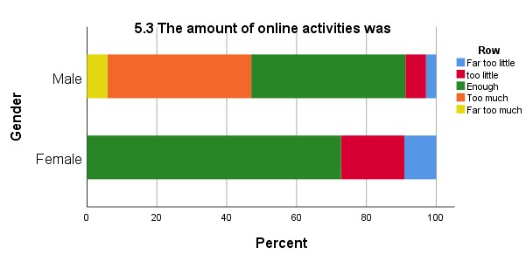
Analysing Binary vs. ordinal (unpaired/independent) variables
Visualisation (multiple compound bar-chart)
To visualise an ordinal variable, it often makes sense to stack the results. This was also done in the case of a single ordinal variable. Stacking the results creates a compound bar chart, or sometimes stacked bar chart (Wilkinson, 2005, p. 157) or component bar chart (Zedeck, 2014, p. 54). It can be defined as: “a bar chart showing multiple bars stacked at each x-axis category, each representing a value of the stacking variable” (Upton & Cook, 2014, p. 88).

Slide 38
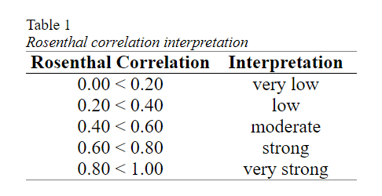
Analysing Binary vs. ordinal (unpaired/independent) variables
Test (Mann-Whitney U test)
A check is done if the two groups might have the same distribution.
An exact Mann-Whitney U test indicated that the mean ranks for male and female were significantly different, U(n₁ = 11, n₂ = 34) = 285.5, p = .008.
Effect size (Rosenthal correlation)
The Rosenthal correlation is a generic one that simply divides the standardized test statistics, by the square root of the sample size (Rosenthal, 1991, p. 19)

Slide 39
Analysing a binary vs. scale variable
Part 1: Descriptive statistics.
Use descriptive statistics to get an impression of the data, using:
Statistical measures. The mean for central tendency, and standard deviation for dispersion
Visualise the data with a split histogram.
Part 2: Inferential statistics
After the first impression determine what can be said about the population based on your sample data by:
Performing a test to see if the means in the population will be equal (Welch t-test)
Determine how big the difference will be (effect size Cohen’s d)

Slide 40
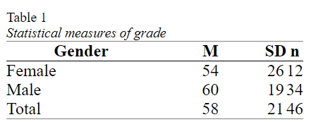
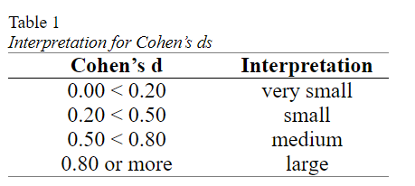
Analysing a binary vs. scale variable
Impression of data: Mean and Standard Deviation
The most commonly used test is probably the Student t-test (Student, 1908). However, this test does not perform well if the variances in each group are different. The Welch test (Welch, 1938, 1947) is designed to use if the variances are not equal, and does not differ much from the Student t-test if the variances are the same. Ruxton (2006) compared the Welch t-test and the Student’s t-test and concluded that: “the unequal variance t-test should always be used in preference to the Student's t-test” (p. 690).
An appropriate effect size in case of a binary and scale variable is Cohen’s d_{s}

Slide 41
Analysing two nominal variables
If you have two nominal variables you might be curious if one of them has an influence on the other, in other words if there is an association between them. To find out the analysis will be done in the following steps.
1) Get an impression of the sample data by creating a cross table. 2) Visualise the sample data 3a) Test if there is an association (using a Pearson Chi-square test of independence) 3b) If there is determine what the influence is (using a post-hoc test) 3c) Determine the strength of the association (using Cramer's V) 4) Write up the report.

Slide 42
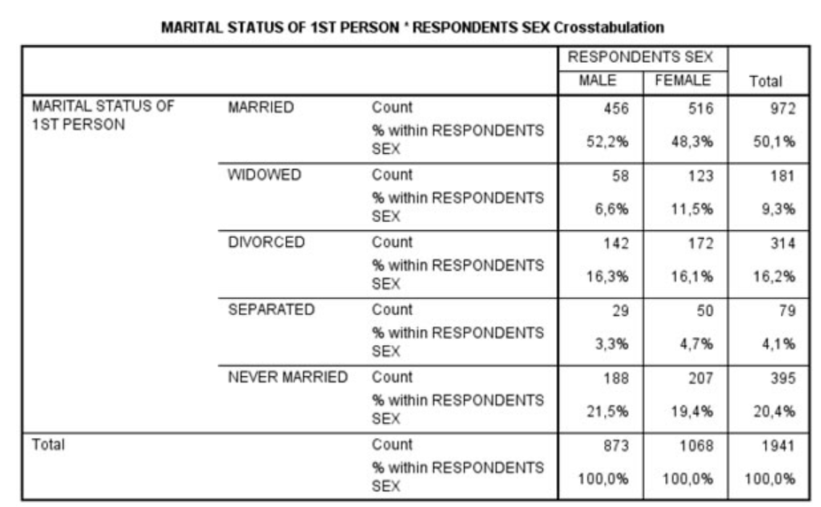
Analysing two nominal variables
1) Get an impression of the sample data by creating a cross table. 2) Visualise the sample data 3a) Test if there is an association (using a Pearson Chi-square test of independence) 3b) If there is determine what the influence is (using a post-hoc test) 3c) Determine the strength of the association (using Cramer's V) 4) Write up the report.

Slide 43
Analysing a nominal and ordinal variable
When you have one nominal and one ordinal variable you might be curious if any of the categories in the nominal variable, score different on the ordinal variable. To analyse this we go over the following steps.
1) Get an impression from the sample data by creating a cross table. 2) Visualise the sample data using a stacked bar-chart 3a) Determine if the nominal variable has an effect on the ordinal by performing a Kruskal-Wallis H test 3b) If it does, check which categories score different by using a post-hoc pairwise Mann-Whitney U test 3c) Also determine how strong the effect is using an effect size (Epsilon square) 4) Combine all the result into one report.

Slide 44
Analysing two ordinal variables
To analyse a potential relationship between two ordinal variables, the following steps are done.
1) Get an impression of the sample data by creating a cross table 2) Visualise the sample data by using a heat map. 3) Test if the relation might still be present in the population, and how strong this effect is by using Goodman-Kruskal Gamma. 4) Write up the report.

Slide 45
Analysing an ordinal and a scale variable
If you have an ordinal and a scale variable you might want to know if there is a relationship between the two. This can be done using the following steps:
1) Get an impression of the sample data by determining some measurements (means and standard deviations) 2) Visualise the sample data by using a split histogram or side-by-side box-plot. 3) Test if the relation might still be present in the population, and how strong this effect is by using Spearman's rho. 4) Write up the report.

Slide 46
Analysing two scale variables
With two scale variables there are two options. Either you might want to know if there is a relationship (correlation) between the two, or if there is a difference in average between the two.
To analyse two scale variables on a possible relationship the following steps will be taken:
1) Get an impression for each of the variables by determining the mean and standard deviation for each. 2) Visualise the results using a scatter plot. 3) Use the Pearson product-moment correlation coefficient to determine if, and the direction of a lineair relationship, and the determination coefficient for the strength. 4) Write all parts up in one report.

Slide 47
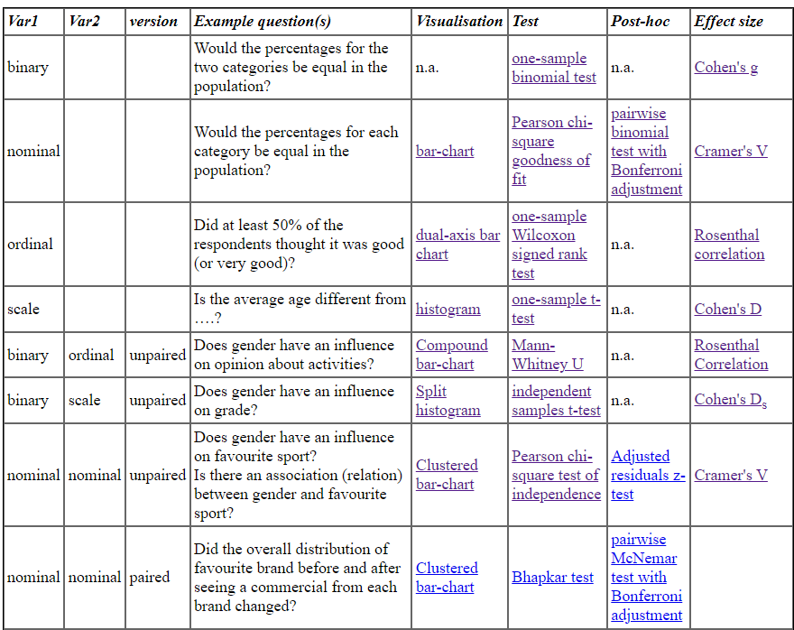

Slide 48
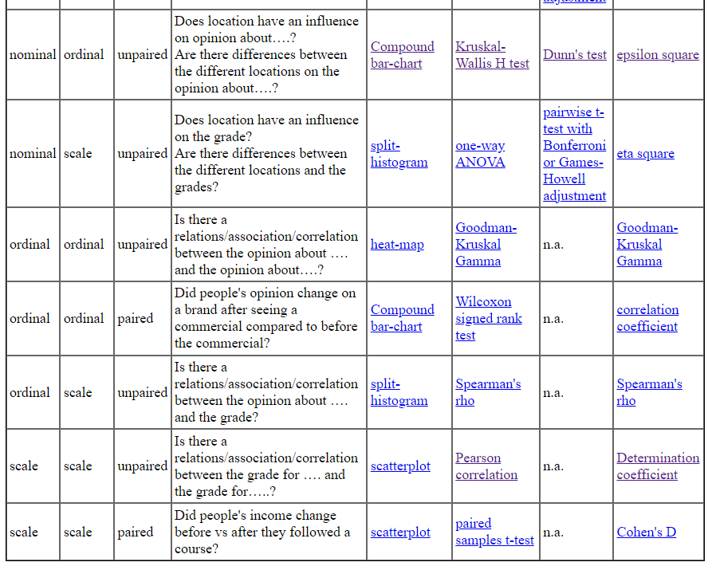

Slide 49

Utkarsh Minds
Mirjam Nilsson

Slide 50
Contact us: helpdesk@utkarshminds.com +91 961-999-7797 Thank you

