Slide 1


Slide 2
Table of contents
Revision
Analysing two variables –
1) Two nominal variables 2) A nominal and an ordinal variable 3) A nominal and a scale variable 4) Two ordinal variables 5) An ordinal and a scale variable 6) Two scale variables

Slide 3
Statistics
“the science of collecting, displaying and analysing data”
There are two main branches of statistics; descriptive and inferential (Wright & London, 2009, p. 55).
Descriptive statistics are: “methods for organizing, displaying, and describing data using tables, graphs and summary measures” (Mann, 1991, 2010, p. 3).
Descriptive statistics is the type of statistics most people encounter every day, often without realizing they are looking at statistics. In many video-games results or scores are often displayed in various charts or with various comparisons, advertisements try to show of fancy diagrams and in business reports the tables and diagrams also play often a key role.
When collecting data you are usually interested in a specific group of people, animals or things, but don’t have the time (or money) to collect data about all of them. The entire group is known as the population: “the complete set of objects of interest” (Upton & Cook, 2014, p. 332). The people/things you actually got data from is then known as a sample: “a subset of a population usually chosen in such a way that it can be taken to represent the population with respect to some characteristic” (Upton & Cook, 2014, p. 379).
Wouldn’t it be great if you could say something about the population based on just one sample? It would save a lot of time and/or money. A fancy word for making a statement about a population based on a sample is an inference: “a conclusion about a population based on logical reasoning from data gathered about a smaller sample” (Zedeck, 2014, p. 175).

Slide 4
Statistics
When collecting data you are usually interested in a specific group of people, animals or things, but don’t have the time (or money) to collect data about all of them.
The entire group is known as the population: “the complete set of objects of interest” (Upton & Cook, 2014, p. 332).
The people/things you actually got data from is then known as a sample: “a subset of a population usually chosen in such a way that it can be taken to represent the population with respect to some characteristic” (Upton & Cook, 2014, p. 379).

Slide 5
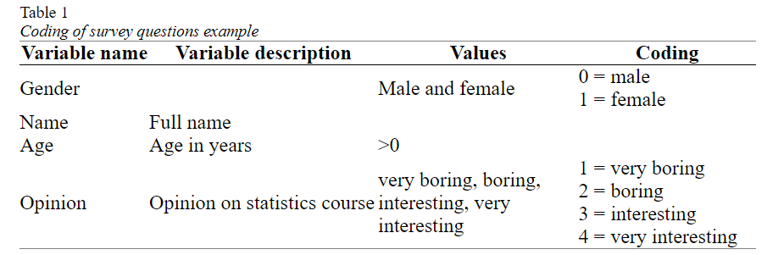
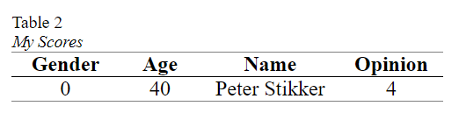
Statistical terms
In Table 1 the conversion of the example survey into variables, values and coding. This is sometimes referred to as a codebook.
Note that the variable description is either a longer description of the name of the variable, or sometimes the entire question as it was asked on the survey.
The last term connected to this is a score. A score is the value (or assigned code) for a single case on a single variable.

Slide 6
Statistical terms
Stevens (1946) classified variables based on which basic operations can be performed on them, and created four so-called measurement levels: nominal, ordinal, interval and ratio.
I will combine interval and ratio into one category called scale (which is something SPSS also does).
A variable is said to have a nominal measurement level, if the values are non-numeric and have no logical order (besides perhaps alphabetical). The variable gender for example has a nominal measurement level, since the order of the possible values can be in any way you want (although there are many discussions sometimes about it :-)). Also open questions that ask for text are nominal, for example first name.

Slide 7
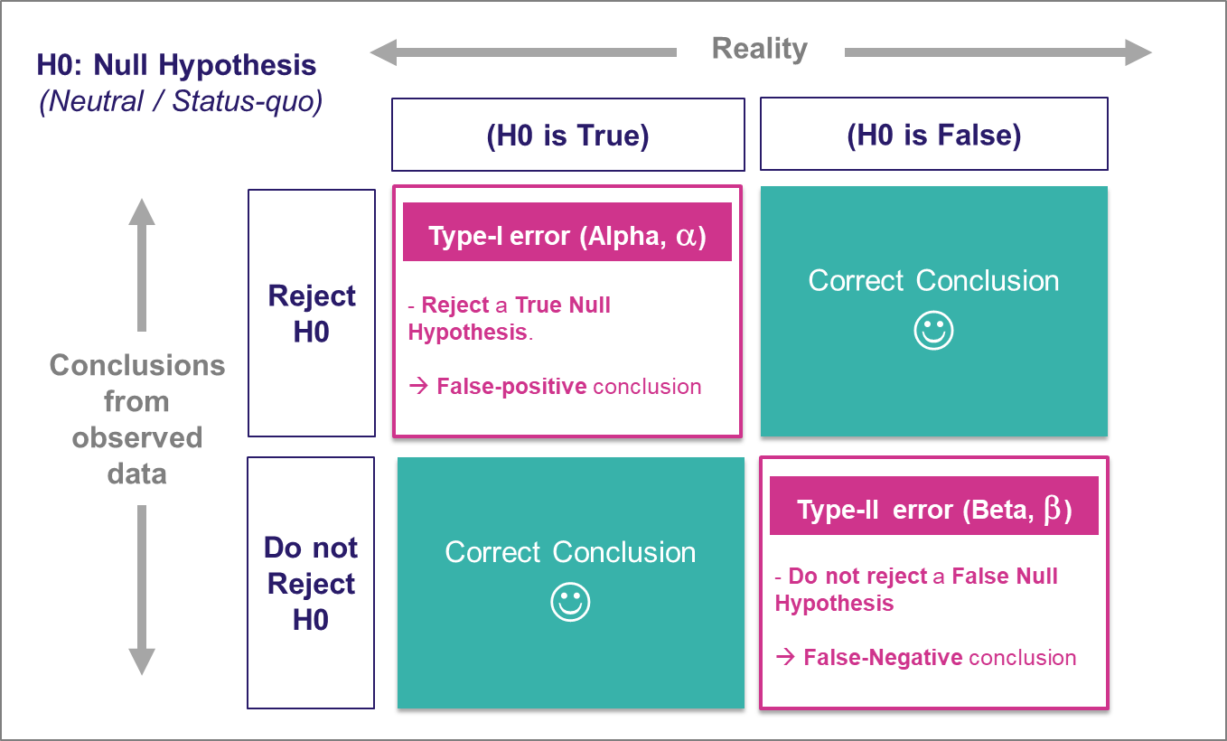
Significance example
Null Hypothesis (H₀): The lucky charm has no effect on your test scores.
Alternate Hypothesis (H₁): The lucky charm does have an effect, and your test scores are better when you use it.
In Hindi:
Significant: महत्वपूर्ण (Mahatvapurna)
In Marathi:
Significant: महत्त्वाचं (Mahattvach)

Slide 8
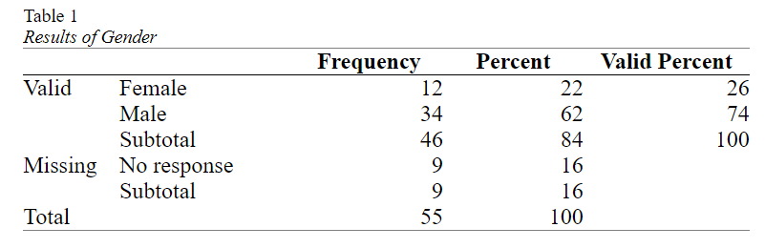
Analysing a single variable
Management was curious if the division of male/female was equal in the company.
The result of a small survey showed that out of the 46 respondents

Slide 9
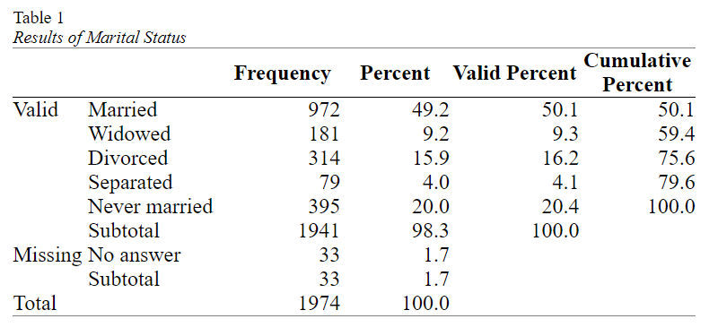
Analysing a single nominal variable
When you have a single nominal variable (e.g. marital status) you might be interested in how many respondents selected each of the options (e.g. how many are married, how many widowed, etc.).
Then to visualise these results and last but not least to determine if any of the categories is chosen more often than the others (also in the population).

Slide 10
Analysing a single nominal variable
Pearson chi-square goodness-of-fit test
One question you might have with a nominal variable, is if each category had the same number of respondents (i.e. the same percentage).
With the marital status example from the previous paragraphs, we might expect each of the five categories to have (100% / 5 =) 20%. This would mean that we’d expected 20% of 1941 = 388.2 people in each category. This is known as the expected count or expected frequency.
Our observed frequencies are different from the expected ones. The Pearson chi-square test of goodness-of-fit (Pearson, 1900) can determine if the differences between the observed and expected counts is signficant. If the test result is a p-value below .05 it is usually considered signficant, indicating that there are some significant differences between some categories in frequencies.

Slide 11
Analysing a single ordinal variable
When you have a single ordinal variable (e.g. opinion on something with fully disagree to fully agree) you might be interested in how many respondents selected each of the options (e.g. how many fully disagree, how many disagree, etc.), then visualise these results and last but not least determine if overall they tended more towards one end of the scale or the other (also in the population).

Slide 12
Analysing a single ordinal variable
Test for median (one-sample Wilcoxon signed rank test)
Would the majority of people in the population also not see accounting as very scientific? The majority would be more than 50% of the people, so in other words, is the median (the score in the middle) in the population significantly different from 2.5 (since 2 = pretty scientific, and 3 = not scientific)?
The significance of the Wilcoxon signed rank test will tell us how likely it is to have a result as in our sample, or even more extreme if the median in the population is indeed a certain value (in the example we use 2.5). If this chance is very low, the population mos likely has another median than the one expected.

Slide 13
Analysing a single scale variable
When you have a single scale variable (e.g. age of respondent) you might be interested in the average and the variation, then visualise these results and last but not least determine what the sample result might say about the entire population. The analysis therefor breaks down into
Part 1: Descriptive analysis
Part 2: Inferential statistics
Part 3: Reporting
As the last step, you will need to write up all the results

Slide 14
Analysing a single scale variable
Test for specific mean
We can either obtain a confidence interval for the population mean (average). This will be an interval (i.e. the population mean will most likely be somewhere between... and ....), and/or if we had a hypothesized average, we can test if the data shows a significance difference.
If we'd expect the population mean to be a certain value we can also perform a statistical test for this, known as a one-sample t-test. In the example perhaps HRM thinks that the average age is 50, we can then use a one-sample t-test (Student, 1908) to test if this might be true based on the sample. If our sample mean is close to the expected population mean then our population mean might be correct, but if it is very different it might be wrong.

Slide 15
Analysing Binary vs. Binary (unpaired/independent) variables
When you have a two binary variables you might be interested if there is an association (relation) between the two.
For example if the gender (male/female) has an influence on where students had their secondary school (The Netherlands, or somewhere else).

Slide 16
Analysing Binary vs. ordinal (unpaired/independent) variables
The variable that defines the groups is then a binary variable, while the variable with the scores could either be ordinal or scale. In this chapter we’ll look at the situation where the scores are ordinal. If you have more than two groups you want to compare, then see the nominal vs. ordinal section.
The analysis can then be done using the following steps:
Part 1: Descriptive statistics.
Use descriptive statistics to get an impression of the data, using:
A cross table to show the sample results.
Visualise the data with a multiple compound bar charts.

Slide 17
Analysing Binary vs. ordinal (unpaired/independent) variables
Part 2: Inferential statistics
After the first impression determine what can be said about the population based on your sample data by:
Performing a test to see if the medians in the population (Mann-Whitney U test)
Determine how big the difference will be (effect size with Rosenthal coefficient)
The example used in this chapter will be using as a binary variable gender (which had the options male or female), and the ordinal variable ‘5.3 The amount of online activities (Blackboard: video’s, online resources, exercise generator, forums) was …’, which had the options 1 = far too little to 5 = far too many.

Slide 18
Analysing a binary vs. scale variable
Part 1: Descriptive statistics.
Use descriptive statistics to get an impression of the data, using:
Statistical measures. The mean for central tendency, and standard deviation for dispersion
Visualise the data with a split histogram.
Part 2: Inferential statistics
After the first impression determine what can be said about the population based on your sample data by:
Performing a test to see if the means in the population will be equal (Welch t-test)
Determine how big the difference will be (effect size Cohen’s d)

Slide 19
Analysing two nominal variables
If you have two nominal variables you might be curious if one of them has an influence on the other, in other words if there is an association between them. To find out the analysis will be done in the following steps.
1) Get an impression of the sample data by creating a cross table. 2) Visualise the sample data 3a) Test if there is an association (using a Pearson Chi-square test of independence) 3b) If there is determine what the influence is (using a post-hoc test) 3c) Determine the strength of the association (using Cramer's V) 4) Write up the report.

Slide 20
Analysing a nominal and ordinal variable
When you have one nominal and one ordinal variable you might be curious if any of the categories in the nominal variable, score different on the ordinal variable. To analyse this we go over the following steps.
1) Get an impression from the sample data by creating a cross table. 2) Visualise the sample data using a stacked bar-chart 3a) Determine if the nominal variable has an effect on the ordinal by performing a Kruskal-Wallis H test 3b) If it does, check which categories score different by using a post-hoc pairwise Mann-Whitney U test 3c) Also determine how strong the effect is using an effect size (Epsilon square) 4) Combine all the result into one report.

Slide 21
Analysing two ordinal variables
To analyse a potential relationship between two ordinal variables, the following steps are done.
1) Get an impression of the sample data by creating a cross table 2) Visualise the sample data by using a heat map. 3) Test if the relation might still be present in the population, and how strong this effect is by using Goodman-Kruskal Gamma. 4) Write up the report.

Slide 22
Analysing an ordinal and a scale variable
If you have an ordinal and a scale variable you might want to know if there is a relationship between the two. This can be done using the following steps:
1) Get an impression of the sample data by determining some measurements (means and standard deviations) 2) Visualise the sample data by using a split histogram or side-by-side box-plot. 3) Test if the relation might still be present in the population, and how strong this effect is by using Spearman's rho. 4) Write up the report.

Slide 23
Analysing two scale variables
With two scale variables there are two options. Either you might want to know if there is a relationship (correlation) between the two, or if there is a difference in average between the two.
To analyse two scale variables on a possible relationship the following steps will be taken:
1) Get an impression for each of the variables by determining the mean and standard deviation for each. 2) Visualise the results using a scatter plot. 3) Use the Pearson product-moment correlation coefficient to determine if, and the direction of a lineair relationship, and the determination coefficient for the strength. 4) Write all parts up in one report.

Slide 24
Assignment
from sklearn.datasets import fetch_california_housing X, y = fetch_california_housing(return_X_y=True, as_frame=True) X y ''' Which column in X has significant relationship with y and calculate effect size and positive/negative/neutral

Slide 25
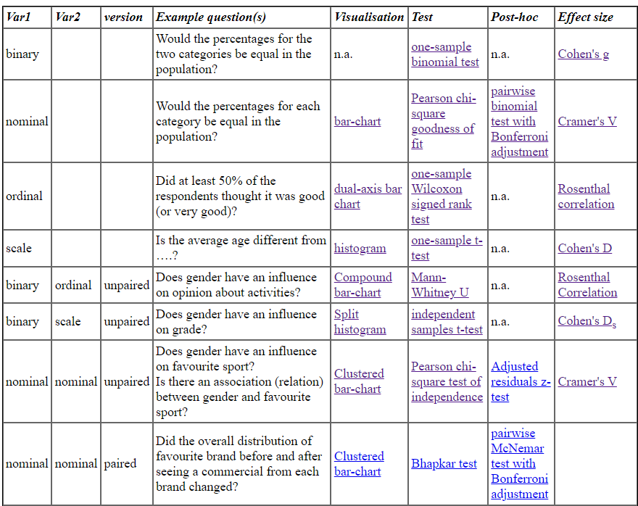

Slide 26
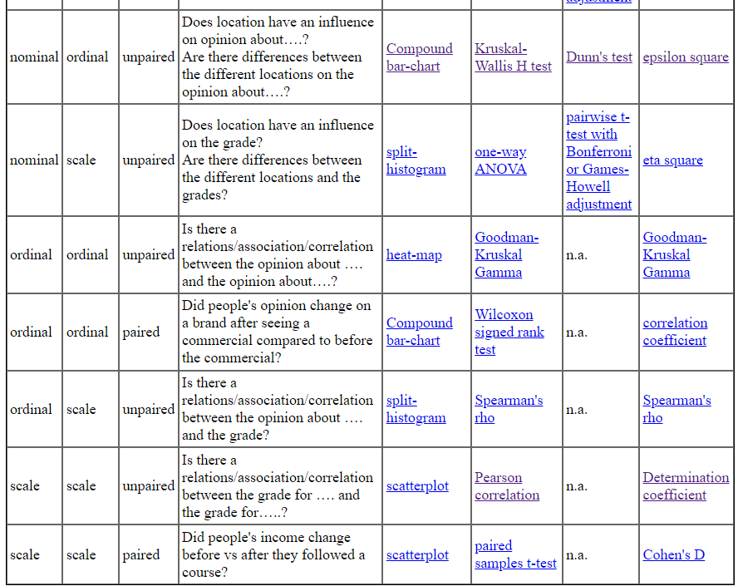

Slide 27
Paired tests - Nominal
Let's say you asked people which brand they prefer out of five (labelled A till E), then show them a commercial and ask the same question again.
Suppose you have data on the scores of the same group of students before and after the intervention
Does participation in a workshop significantly improve students' understanding of a particular subject?
a company asked customers to rate their image of the company on a scale of 0 to 100, then showed them a commercial and asked the same question again.
For example a company would like to know if there is a relation between the current salaries, and the beginning salaries.

Slide 28
Paired tests - Nominal
The analysis is split into a few different steps:
Get an impression of the sample data by creating a cross table
2) Visualise the sample data in a clustered bar-chart
3) Perform a test (Bhapkar or Bowker) to say something about the population.
4) Write up the findings.

Slide 29
Paired tests - Ordinal
If you have two ordinal variables that use the same categories you might either be
interested in knowing if there are changes (differences) between the two
(e.g. did many people agree with the first, but disagreed with the other).

Slide 30
Paired tests - Ordinal
To test for a difference we will use the following steps:
1) Start with getting an impression from the sample data by creating a cross table and determining the median for each variable. 2) Visualise the sample data 3a) Test if there are any differences perhaps also in the population using a Wilcoxon signed rank test and 3b) determine the magnitude of the difference using an effect size measure. 4) Combine the results to create a report.

Slide 31
Paired tests - Scale
If you have two scale variables you might either be interested if the average is different between the two.
To analyse if the means (averages) are different between two scale variables, we can go over the following steps:
1) Get an impression from the sample data by determining some descriptive measurements (mean and standard deviation). 2) Visualise the sample data by creating a scatterplot from the two variables and/or a histogram of the differences. 3) Test if there the difference in sample means could also occur in the population, and the effect size that goes with it. 4) Combine all the findings in one report.

Slide 32
Paired tests - Binary
McNemar’s Test is used to determine if there is a statistically significant difference in proportions between paired data.
This tutorial explains how to perform McNemar’s Test in Python.
Example: McNemar’s Test in Python
Suppose researchers want to know if a certain marketing video can change people’s opinion of a particular law. They survey 100 people to find out if they do or do not support the law. Then, they show all 100 people the marketing video and survey them again once the video is over.

Slide 33
3 or more binary variables - paired
If you allowed people to choose more than one option (e.g. which of the following music genres do you like?), each of the options becomes a no/yes variable in itself, which are binary variables.
As with any analysis, we'll start with getting an impression of the sample data, visualise the results, do a formal statistical test and end with reporting all the results.

Slide 34
3 or more ordinal variables- paired
Part 1: Descriptive analysis Use descriptive statistics to get an impression of the data, using:
1) A cross table with the percentages for each score from each variable 2) A visualisation of the data with a mutiple stacked bar-chart 3) Some statistical measures for central tendency (the median) and dispersion (concensus)
Part 2: Inferential statistics After the first impression determine what can be said about the population based on your sample data by:
1) Determine if there are any differences between any of the variables in the population (Friedman test) 2) If there are, then determine which variables differ significantly (a post-hoc Dunn, Wilcoxon or Sign test) 3) Determine the effect sizes (Kendall's W)

Slide 35
3 or more scale variables - paired
We are curious to see if the scores on multiple scale variables are different from each other. Although usually an impression of the data is done with a frequency table, or cross-table, with scale variables this might not be so effective (the table would get too large, and no longer give a good impression).
Instead some statistical measures might be more helpful. The mean (average) and standard deviation of each scale variable can be helpful.

Slide 36

Utkarsh Minds
Mirjam Nilsson

Slide 37
Contact us: helpdesk@utkarshminds.com +91 961-999-7797 Thank you

