Slide 1
School of Computer Science & Engineering
AI Application Development – IA1
NeuroWatch
~Smarter Exams. Safer Future

Slide 2
Team members & roles
Team member name | Role
Utkarsh Patil | Team Lead
Udbhav Pandey | Market Analyst
Suhaib Asrar | User Research & Feedback
Umar Owais | Technical Lead
Tarun Pal | Testing
Notes:
Talk about how they are managing their documents, how google docs does automatic versioning
As them what they know about Android and IoS versions

Slide 3
Problem Statement
Lack of intelligent monitoring in online exams enables malpractice and reduces assessment credibility.
Current systems fail to provide real-time, automated detection of suspicious activities.
Notes:
Talk about how they are managing their documents, how google docs does automatic versioning
As them what they know about Android and IoS versions

Slide 4
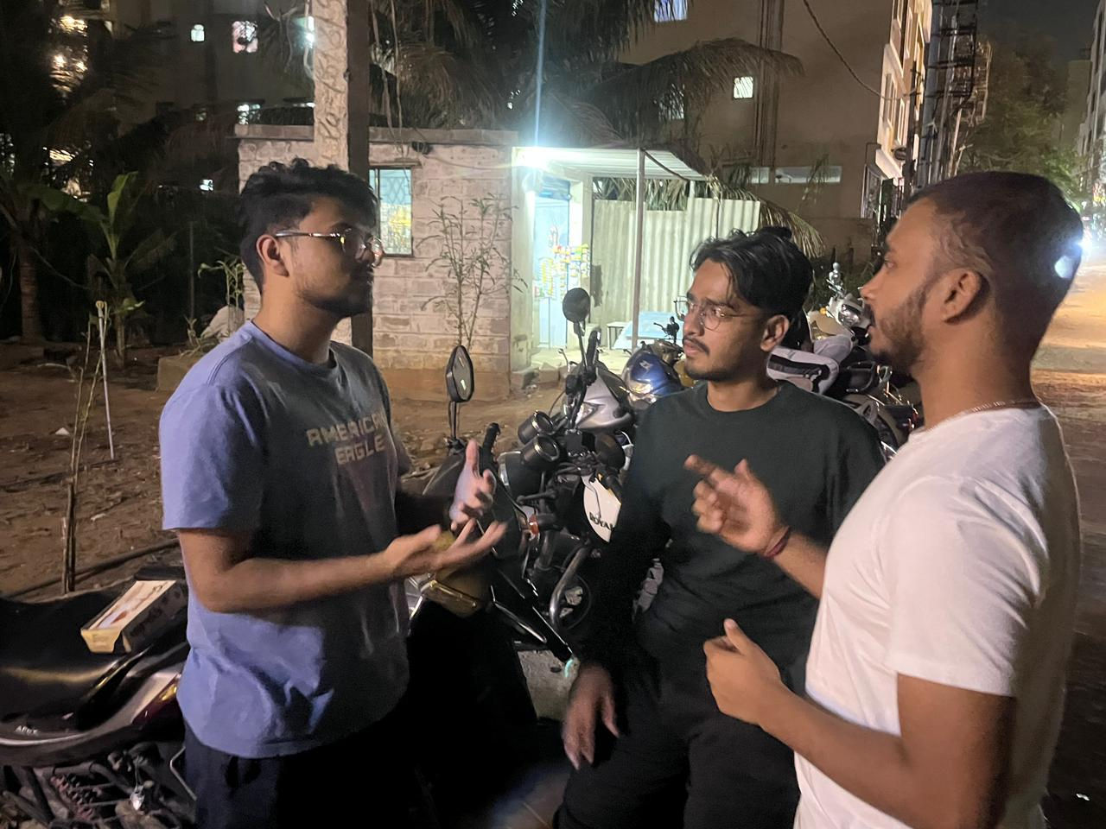
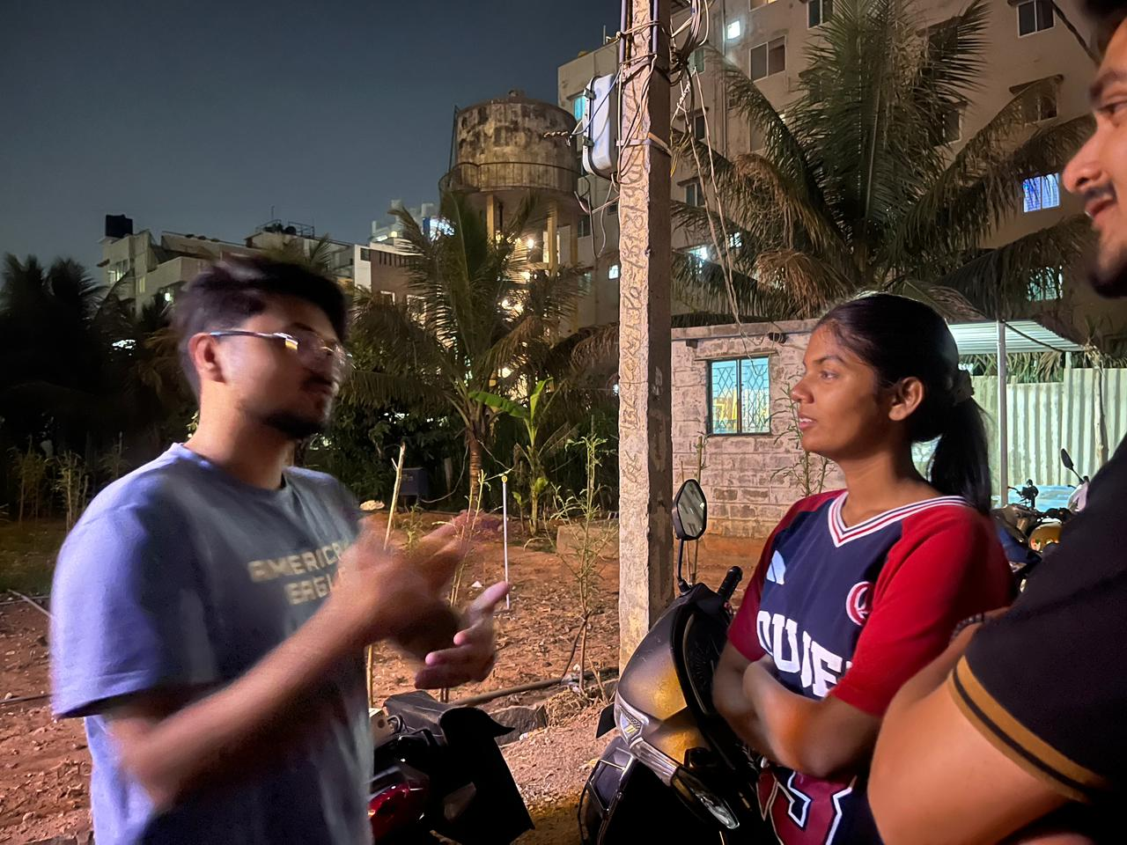
User/ Customer Understanding
Notes:
Talk about how they are managing their documents, how google docs does automatic versioning
As them what they know about Android and IoS versions

Slide 5
Ideal Customer Profile (ICP)
Demographic Profile
Educational Institutions (Colleges, Universities, Coaching Centers)
Students (18–30), Faculty/Admin (25–60)
Urban & Semi-Urban locations
Access to internet and devices
Medium to large exam-conducting bodies
Psychographic Profile
Concerned about cheating in online exams
Value fairness and transparency
Prefer automated monitoring systems
Open to AI-based solutions
Notes:
Only stress on the 1st sentence – the definition
Come back to the 2nd sentence in the end as part of revision

Slide 6
Customer Persona (CP)
Persona: Dr. Rajesh Sharma
Age: 45
Role: Examination Head (University)
Location: Urban area
Tech Usage: Moderate (uses LMS, online exam platforms)
Goals
Conduct fair and secure online exams
Reduce cheating and malpractice
Automate exam monitoring process
Notes:
Only stress on the 1st sentence – the definition
Come back to the 2nd sentence in the end as part of revision

Slide 7
Customer Persona (CP)
Pain Points
Cannot monitor all students manually
High chances of cheating during online exams
Existing tools are expensive or ineffective
Behavior & Mindset (Psychographic)
Values exam integrity and transparency
Open to using AI-based solutions
Prefers reliable and scalable systems
Cost-conscious but prioritizes quality
Notes:
Only stress on the 1st sentence – the definition
Come back to the 2nd sentence in the end as part of revision

Slide 8
Product USP
Real-time AI-based monitoring with instant detection of suspicious activities
Automated behavioral analysis (face, eye movement, multiple person detection)
Dynamic marking system that deducts marks based on detected suspicious behavior
Cost-effective & scalable solution compared to existing proctoring tools
Notes:
Only stress on the 1st sentence – the definition
Come back to the 2nd sentence in the end as part of revision

Slide 9
Use Cases & High level Requirements
Major Use Cases
User Authentication
Input: Student login credentials + webcam access
Output: Verified user identity
Live AI-Based Proctoring
Input: Live video feed during exam
Output: Real-time detection of suspicious activities
Behavior Analysis & Alerts
Input: Student movements (face, eye, multiple persons)
Output: Alerts/flags for abnormal behavior
AI-Based Dynamic Marking
Input: Detected violations during exam
Output: Automatic mark deduction / warning logs
Report Generation
Input: Exam session data
Output: Detailed report with violations and performance
Notes:
Only stress on the 1st sentence – the definition
Come back to the 2nd sentence in the end as part of revision

Slide 10
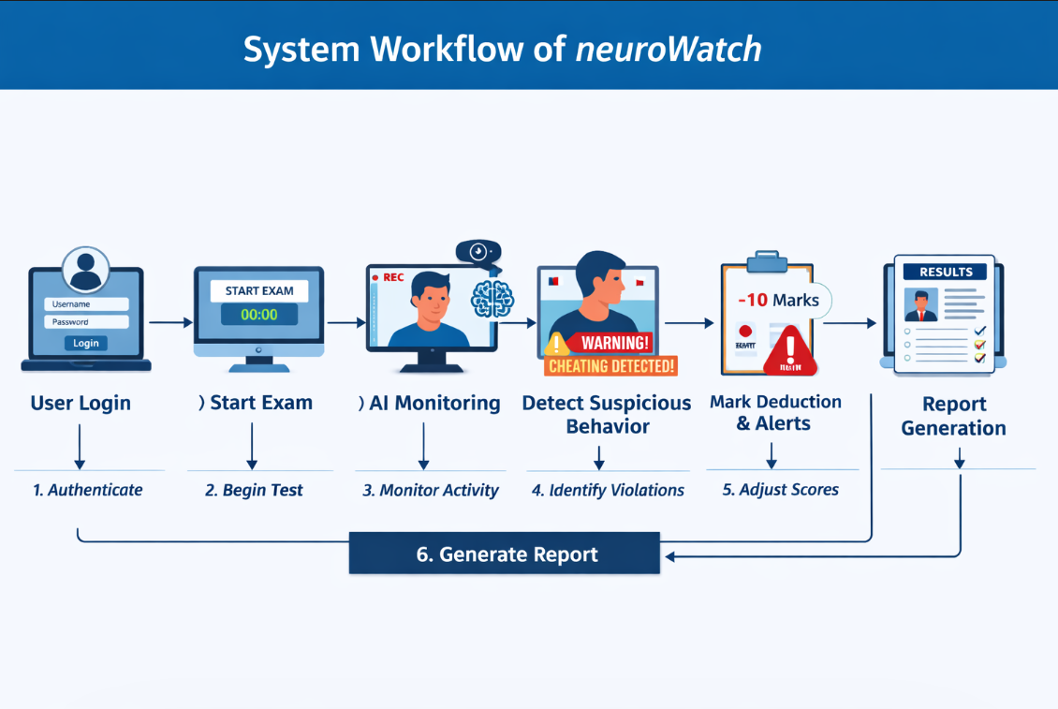
Proof of Concept (PoC)
Notes:
Only stress on the 1st sentence – the definition
Come back to the 2nd sentence in the end as part of revision

Slide 11
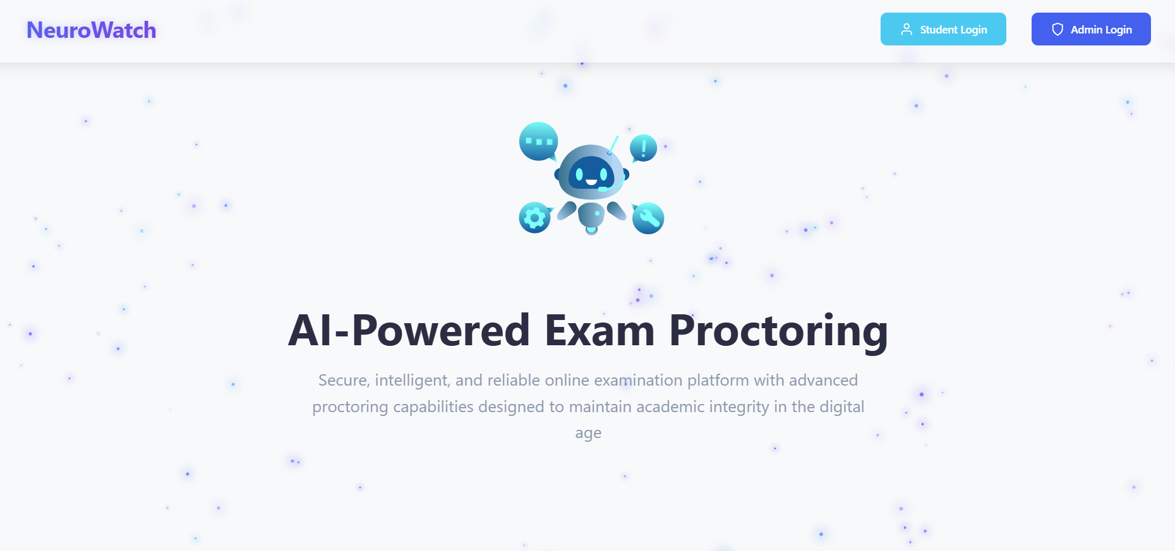
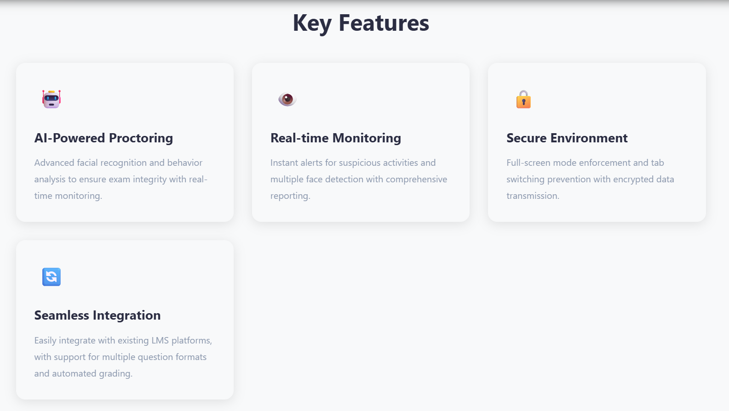
Proof of Concept (PoC) / Prototype Demo
Notes:
Only stress on the 1st sentence – the definition
Come back to the 2nd sentence in the end as part of revision

