Slide 1
An explainable hybrid job recommender
JobIntel
4
recommendation strategies
6
Recommendation Systems project: four strategies, cold-start handling, behaviour learning and an honest offline evaluation
ranking signals
3,079
real job postings
Notes:
One-sentence pitch: JobIntel ranks real job postings for a user with four strategies, explains every result, learns only from the user's real activity, and is evaluated honestly with a clearly labelled offline proxy. Inputs are job features from the NLP pipeline, the profile the user entered, and real interactions only; nothing is simulated. A second deck covers the text analytics that produce the features.

Slide 2




Too many jobs, too little guidance
A job feed must be relevant, explainable, and honest about what it does not know.
Cold start
Sparse features
Missing fields
Trust
A new user has no history to learn from.
Short snippets yield under two skills per job.
Salary, experience and work model are mostly unavailable.
Users need reasons, not only a ranked list.
Inputs: job features (skills, role, city, text, date), the user's profile, and real activity only. Nothing is simulated.
Design response: simple, explainable methods; missing data is never rewarded; every result carries its reasons.
Notes:
Four design challenges shape the whole system. Cold start: new users have no history. Sparse features: Adzuna snippets give under two skills per job. Missing fields: salary and experience are mostly unavailable, so we cannot score them. Trust: users need reasons, not just a ranked list. The ranker uses three real inputs: job features from the NLP pipeline, the user's profile, and real interactions only; nothing is simulated or seeded.

Slide 3
Four strategies, one ranking core
Each baseline is a single signal; the hybrid combines them. All share the same code.
Popularity
Skills
TF-IDF content
Hybrid
How it ranks
How it ranks
How it ranks
How it ranks
Newest first (recency percentile)
Share of the job's skills you have
Cosine similarity of profile text and job text
Weighted mix of all six signals
Strength
Strength
Strength
Strength
Works for anyone, even with no data
Precise and easy to explain
Uses the full wording of the posting
Robust when any one signal is missing
Weakness
Weakness
Weakness
Weakness
Not personalised; no interaction counts exist yet
Many postings have few or no extracted skills
Shares vocabulary with job titles
Weights are untuned starting values
Notes:
Four strategies. Popularity is a recency proxy because there are no interaction counts yet. Skills is the share of the job's skills that the user has. Content is TF-IDF cosine similarity between profile text and job text. Hybrid is a weighted mix. They all use one ranking implementation, which also guarantees the evaluation tests exactly what production runs.

Slide 4
Same user, four different top-3 lists
Demo profile: Data Analyst, skills SQL / Python / Machine Learning, prefers Bengaluru.
Popularity | Skills | TF-IDF content | Hybrid
Manager, Data Science · Mastercard · Pune (1.00) | Data Analyst (SQL) · Merito · Mumbai (1.00) | Data Analyst · Digital Twin · Pune (0.57) | data engineer · VY SYSTEMS PRIVATE LIMITED · Bengaluru (0.67)
Sr Software Engineer · Labcorp · Mumbai (1.00) | Data Analyst - SQL · Unnati · Mumbai (1.00) | Data Analyst · Recro · Bengaluru (0.50) | Data Engineer · Priceline · Mumbai (0.66)
Frontend Developer · Citigroup · Pune (1.00) | Senior Data Scientist · Flipkart · Bengaluru (1.00) | Data Analyst · Wissen Technology · Bengaluru (0.48) | Data Analyst · Amagi Media Labs · Bengaluru (0.66)
Popularity
Skills
Content
Hybrid
ignores the profile entirely
ties many jobs at a perfect 1.00
rewards wording matches
blends skills, wording, role, city
Notes:
A concrete illustration on real data, computed live from the database. Popularity ignores the user: its top job is a manager role in Pune. Skills ties many jobs at a perfect 1.0. Content picks title and wording matches. Hybrid blends skills, wording, role and location, so its top job is a Bengaluru role that matches Python and SQL.

Slide 5
Six signals, one weighted score
A signal that cannot be assessed is “unknown”, never a guess.
Score(u, j) = Σ wᵢ · sᵢ(u, j) ÷ Σ wᵢ over signals available for user u
Signal | How it is computed | Unknown when
Skill | matched ÷ the job's skills | job has no skills
Content | TF-IDF cosine: profile vs job text | no profile text
Role | 1 if preferred role matches title or category | only default category
Location | 1 if job city is preferred | job has no city
Recency | date percentile (newest = 1) | job has no date
Behaviour | affinity from your own activity | not enough activity
Default raw weights
Missing data is never rewarded: signals the user lacks are dropped and weights renormalised; a job lacking a skill, city or date earns 0 for it.
Notes:
The six signals are pure functions, each with a defined unavailable case. The hybrid score is a weighted average, but only over the signals the user actually has data for. The chart shows the configured raw weights. For a user with no activity the behaviour weight is dropped and the others renormalise, so skill becomes 41 percent, content 35, role 12, location 7 and recency 6. Missing data is never rewarded: if the user lacks a signal it is dropped for everyone, so it cannot favour any job; if a job lacks a skill, city or date it earns 0 for that signal. Ties are broken by job id so rankings are deterministic. Weights are starting values, not tuned.

Slide 6
Three honest states, learning from real activity
The API and the UI always say which state a user is in.
Cold start
Profile-based
Interaction-informed
No profile and no activity
Skills, roles, locations or text entered
Real saves, applies, views or skips
Newest first; the UI says it is not personalised.
Ranked from the profile signals only.
Behaviour signal joins the profile signals.
Weight per interaction
Per job: weights are summed and clamped to [−1.5, 2.0]
Liked jobs build skill, role and city preferences
Score = mean of skill, role, city, similarity to a liked job
Minus 0.5 × similarity to a skipped job; skipped jobs hidden
Activates only at evidence ≥ 1.0 (one save)
Notes:
The system never claims personalisation it has not done. A brand-new account is cold start: recency only, and the UI says so. Adding profile data makes the user profile-based. Real saves, applies, views and skips make them interaction-informed once evidence reaches 1.0, for example one save. The behavioural layer is deliberately simple: each action has a fixed weight, summed per job and clamped so spamming views cannot dominate; a save followed by a skip cancels out. From liked jobs we build preference tables over skills, role category and city, and measure similarity to the liked jobs, excluding the job itself. Similarity to a skipped job is a penalty, and skipped jobs are hidden. No collaborative filtering because there is no interaction volume to justify it.

Slide 7
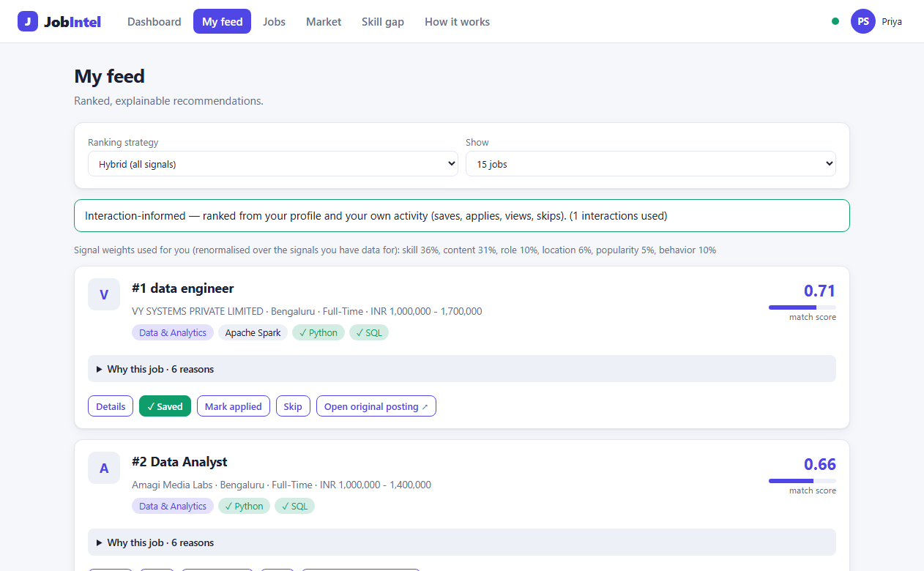
Every result explains itself
Reasons come only from signals that were active and non-zero. No boilerplate praise.
#1 data engineer
0.67
VY SYSTEMS PRIVATE LIMITED · Bengaluru
match score
Why this job
You have 2 of the 3 skills extracted from this posting (Python, SQL)
Matches your preferred role 'Data Analyst' (Data & Analytics)
Located in your preferred location (Bengaluru)
Posting text is similar to your profile (TF-IDF similarity 0.46)
Signal scores: skill 0.67 · content 0.46 · role 1.00 · location 1.00 · recency 0.87 · behaviour n/a
After one Save: interaction-informed banner, saved state, new reasons. One API call, about 0.6 s over 3,079 jobs.
Notes:
A real example from the database, and the live app. Each reason is generated from a signal that was both active for this user and positive for this job, so the explanation is a faithful summary of the score. The screenshot shows the same feed after one save: the banner says interaction-informed, the saved job shows its state, and new reasons such as similar to a job you saved appear. One endpoint serves this: it takes the strategy, a limit and optional weight overrides, and returns rank, score, per-signal scores, reasons and the personalization mode; a request takes about 0.6 seconds over 3,079 jobs because the TF-IDF corpus is cached.

Slide 8
How to evaluate without any users
There is no ground truth yet, so the evaluation uses a clearly labelled offline proxy.
1
2
3
4
5
6
Persona
Relevant set
Split
Profile
Rank
Score
One real search query, e.g. Data Analyst in Mumbai
Jobs Adzuna returned for that query
Half = seed history, half = hidden labels
Built from seed jobs only, by a fixed rule
Each strategy ranks the remaining jobs
Precision, Recall, NDCG@K, diversity; random floor
Winner rule, fixed before running and never changed
A clear winner needs: the highest mean NDCG@10, ahead in every persona, and a 95% bootstrap interval of its lead over the runner-up that excludes zero. Otherwise: no clear winner. This is not user feedback.
Notes:
Be upfront: there are zero real users and zero interactions, so there is no ground truth. The proxy uses the only real label available: which Adzuna search returned each job. A persona is one search query; jobs it returned are relevant; half are hidden as labels and the other half build the persona's profile. The strategies rank the rest. Metrics are Precision, Recall and NDCG at K, plus diversity, with a random ranking as the floor. The winner rule was fixed before the first run and never changed.

Slide 9
Results: Hybrid leads, but no overall winner
Mean NDCG@10. Scenario A = role + city persona, B = role only.
Run 1: original, 75 jobs
Run 2: live, 2,118 jobs
Run 1: Hybrid is the clear winner in B. In A it has the best mean but trails Popularity on 1 of 4 personas: no clear winner.
Run 2: Hybrid leads Content by +0.34 (A, CI 0.32 to 0.36) and +0.07 (B), best in 46/48 and 8/12 personas, not all: no overall winner.
Notes:
Two runs. Run 1, the original 75-job collection: in Scenario B, role only, Hybrid is the clear winner under the pre-declared rule; in Scenario A it has the highest mean but loses to Popularity on one persona, Data Scientist in Hyderabad. Run 2, the larger live collection of 2,118 jobs with 48 and 12 personas: Hybrid has the best average in both scenarios and its lead over Content is clear, with confidence intervals above zero, but it is best in 46 of 48 and 8 of 12 personas, not all, so the every-persona rule is not met and no overall winner is claimed. The rule was not relaxed after seeing results. Skills is weak in run 2 because most Adzuna snippets yield few skills. Popularity performs at or near random.

Slide 10
What the evidence supports, and what comes next
Say the limits before being asked.
Supported
Not supported
Next steps
Hybrid, Content (and Skills on run 1) beat random
Popularity performs at or near random
Hybrid wins the role-only scenario of run 1
Every result carries real, signal-backed reasons
A clear overall winner under the pre-declared rule
Claims about real users or production accuracy
Any claim about the behaviour layer: no real users yet
Proxy is circular: the query defines persona and label
Collect real interactions, then evaluate behaviour
Tune weights on real feedback
Collaborative filtering only if volume justifies it
Precompute vectors for larger corpora
Thank you. Questions welcome.
Notes:
The honest conclusion. Supported: Hybrid, Content and, on the first run, Skills beat a random ranking; Popularity does not; Hybrid wins the role-only scenario on the original data. Not supported: a clear overall winner under the pre-declared rule, anything about real users or production accuracy, and anything about the behavioural layer, which has not been evaluated on real users. Be ready to explain circularity: the query defines both the persona and the label, and location nearly gives the label away in Scenario A. Next steps answer each limitation: collect real interactions, tune weights on real feedback, consider collaborative filtering only if volume justifies it. Offer the live demo: sign up, build a profile, save a job, read the reasons. Questions welcome.

