Slide 1
Turning job postings into market intelligence
JobIntel
3,079
postings analysed
3
Text, Web & Social Media Analytics project, built on real postings collected from three web sources
web sources
108
skills in the dictionary
Notes:
Introduce the project in one sentence: JobIntel collects real job postings from the web, turns the unstructured text into structured features with transparent NLP, and summarises the market. Four questions drive it: which skills employers ask for, how skills differ by role and city, which skills appear together, and where the text misleads. A second deck covers the recommender.

Slide 2






One pipeline from web to insight
Every stage is rule-based and inspectable. There is no black-box model anywhere.
1. Collect
2. Clean
3. Extract
4. Classify
5. Analyse
6. Serve
APIs and public career boards, budgeted and audited
Strip markup, normalise locations, de-duplicate
Skills, degrees and experience years from the text
Weighted keyword rules into 10 role categories
Counts, shares, co-occurrence, text statistics
One API endpoint, cached dashboard
ingestion/
cleaner.py
nlp/
nlp/classifier
twsma_service
/analytics/twsma
Scope: the collected sample of postings, not the whole job market.
Notes:
Walk the pipeline left to right. Emphasise that each step is deterministic and testable: that is what makes the error analysis later in the deck possible. Raw responses are saved, so every number can be reproduced without calling the APIs again.

Slide 3
Three web sources, two kinds of text
Adzuna returns short snippets; company boards return complete postings.
Average description length (characters)
2,433
Adzuna API
Keyed search. About 500-character snippets: 1.77 skills per posting.
postings
393
Greenhouse boards
Public and keyless. Full descriptions: 7.67 skills per posting.
postings
253
Lever boards
Public and keyless. Full descriptions: 4.21 skills per posting.
postings
Notes:
Three sources. Adzuna is a search API with a published call limit, so collection is budgeted: 48 calls, 20 per minute. Greenhouse and Lever are public career boards, no key needed. The chart shows why they behave so differently: snippets are about 500 characters, full postings are 4,000 to 6,000. The same extractor yields 1.8 skills per Adzuna posting but 7.7 per Greenhouse posting, so source mix changes any skill ranking.

Slide 4
Cleaning and skill extraction
From escaped HTML to a list of skills, with rules you can trace.
Raw, as delivered
After cleaning
&lt;p&gt;(P-1490)&lt;/p&gt; &lt;p&gt;Databricks processes petabytes of data and billions of transaction events daily - every cluster launch, every …
(P-1490) Databricks processes petabytes of data and billions of transaction events daily - every cluster launch, every query executed, every dollar …
Also: normalise whitespace, map locations to cities, de-duplicate (source ID, title + company + city), keep missing fields missing.
Skill extraction rules
“Strong ml background, SQL and CI/CD experience; Excel a plus”
108-skill dictionary with aliases (ml → Machine Learning)
Whole-phrase, longest-first, word-boundary matching
Employer-name filter: MongoDB is no requirement at MongoDB
Microsoft Excel
CI/CD
SQL
Machine Learning
67.6%
2.72
postings have ≥1 skill
skills per posting
Notes:
Top row is real data: a Databricks posting as the board delivered it (HTML that is itself escaped) and after cleaning. Other cleaning steps: normalise whitespace, map locations to known Indian cities, de-duplicate by source ID and by title plus company plus city, and keep missing fields missing. Below: skills come from a 108-skill dictionary with aliases, matched as whole phrases, longest first, so ml maps to Machine Learning. An employer-name filter drops cases like MongoDB in MongoDB's own postings. Coverage is about two thirds of postings, 2.7 skills each.

Slide 5
Entities and roles: rules you can inspect
Regex patterns find experience and degrees; weighted keywords assign role categories.
Experience and qualifications
Role classification
Text | Minimum | Maximum
Minimum 3-5 years of experience in analytics | 3 yrs | 5 yrs
5+ years of relevant experience | 5 yrs | none
B.Tech/MBA preferred, 2+ years | 2 yrs | none
Title | Category
Senior Data Scientist | AI & Machine Learning
Data Quality Analyst | Data & Analytics
Account Executive | Sales & Marketing
HRBP_Bangalore | Operations & HR
Senior Technical Program Manager | Software Engineering (default, flagged)
23.5%
351
of postings state experience (median minimum 5 years)
postings name a degree (MBA, B.Tech, Master's …)
138 titles (4.5%)
match no rule: they get the default category, flagged and never used as evidence
Notes:
Two more extractors. Experience years come from regex patterns like 3 to 5 years or 5 plus years; about a quarter of postings state it, and we show it only as information. Role classification is weighted keyword rules with 10 categories. Titles that match nothing fall back to a default and are flagged, so they never count as evidence.

Slide 6
What employers ask for most
Share of 3,079 postings that mention each skill.
Reading the chart
Machine Learning (14.8%), Python and SQL form the technical core
AWS, Azure and GCP each appear in 7 to 11% of postings
Soft skills (light green) lead because full-text postings spell them out: “communication” is in 4.6% of Adzuna snippets but 55 to 70% of company-board postings
“Data Science” (amber) is a field label, not a tool skill
Notes:
Top skills. Communication and leadership lead because the full-text company-board postings spell out soft skills: communication appears in 4.6 percent of Adzuna snippets but 55 percent of Greenhouse and 70 percent of Lever postings. Machine learning, Python and SQL are the technical core; the three clouds each appear in 7 to 11 percent. Data science is a field label rather than a tool skill.

Slide 7
Each role has its own skill signature
Top 5 skills inside each role category. Sample mix: software 31%, data 21%, AI/ML 13%; Bengaluru 32%.
Data & Analytics
AI & Machine Learning
Software Engineering
651 postings
397 postings
962 postings
Notes:
Skills by role. Data and analytics is SQL, ETL and Python. AI and machine learning is dominated by machine learning itself at 65 percent, with NLP and statistics. Software engineering is JavaScript, Java and AWS, plus soft skills. These are shares within each role. Sampling effect: the sample is 31 percent software engineering, 21 percent data and analytics, 13 percent AI and ML, and Bengaluru is the largest city at 32 percent, because Adzuna was queried for 12 roles in 4 cities.

Slide 8
Skills that travel together
Pairs found together in postings, ranked by lift (how much more often than chance).
Lift = P(A and B) / (P(A) × P(B))
Above 1: more often together than chance would predict.
Cloud skills cluster: employers list several clouds together
Python + SQL appear together in 166 postings (5.39%)
Soft skills co-occur often (213 postings) but with a lower lift because both are common
Notes:
Co-occurrence with lift. Lift is the observed joint frequency divided by what independence would predict. Cloud skills have the highest lifts: employers list several clouds together. Python and SQL is the core data pair. Communication and leadership co-occur often, but with a lower lift because both are very common.

Slide 9
Where the text misleads
Error analysis: boilerplate fills the phrase counts, and “excel” is often a verb.
Top two-word phrases (postings)
boilerplate
content
194 “Excel” extractions by cue words
“… a diverse and inclusive culture where everyone can excel”
“You excel in analytical thinking and problem solving”
7 of the top 10 phrases are boilerplate. Fix: remove boilerplate before counting terms.
Cue-word audit, not hand-labelled data. Also known: “Data Science” is a field, not a tool; snippets cap recall.
Notes:
Two honest error analyses. Left: the most common two-word phrases in full postings; seven of the top ten are equal-opportunity and recruiting boilerplate, not job content, so raw term frequency needs boilerplate removal. Right: the word excel as a verb is extracted as the Microsoft Excel skill; of 194 Excel extractions, about half show verb cues like you excel in and no software cue. That is a heuristic cue-word audit, not hand-labelled ground truth, so treat the split as an estimate. The fix is a context rule or part-of-speech check; it is future work.

Slide 10
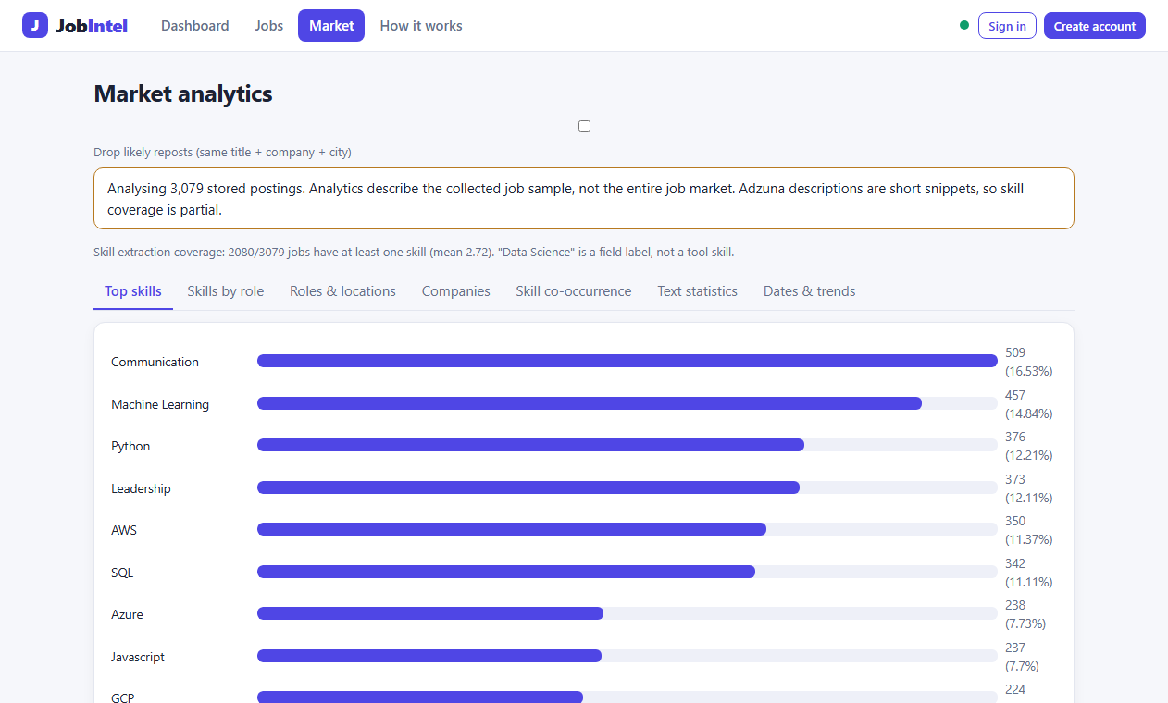
Delivered, and honest about scope
One endpoint feeds the dashboard; the claims match what the data can support.
Claims
Descriptive statistics of a real, collected sample; transparent rules; 67.6% of postings have at least one skill.
Does not claim
An extraction accuracy figure (no hand-labelled set yet), market-wide trends, or salary and experience analytics.
Next steps
Hand-label about 200 postings for precision and recall; context rules for “excel”; boilerplate removal; daily collection for trends.
GET /api/v1/analytics/twsma returns the whole report
Cached: 2.4 s down to about 12 ms
The trend tab refuses to claim a trend (two snapshots only)
Notes:
Close with delivery and scope. All analytics come from one service function and one endpoint; computing the report takes about 2.4 seconds, so it is cached and recomputed only when the job data changes. The trend tab refuses to claim a trend because there are only two collection snapshots. We claim descriptive statistics of a real sample with transparent rules. We do not claim an extraction accuracy figure, because we have not hand-labelled a test set, nor market-wide trends. Questions welcome; offer the live demo: dashboard, Market tab, and the API endpoint.

