Slide 1

Devi Ahilya Vishwavidhyalya
Facial Emotion Recognition Using Deep Learning
Department : School of Statistics
Course : B.Sc.(Hons) in Applied Statistics and Analytics
Semester : 6
Presentation By : Utkarsh Sen (ST4A-2106)

Slide 2

Content
Data Description
First-hand understanding of the data and various labels.
Background
Neural Network Model
Getting the gist of deep Learning activation functions, CNN and so on.
Building, Training, Evaluating, and Testing model.
Introduction
Face Detection and Model Deployment
Understanding the problem statement and objectives of the project.
Extracting face from the image using Haar Cascade. Deploying model
on the web.
Conclusion
Drawbacks, Applications, and Future aspects of the model.

Slide 3

Introduction
Facial expression recognition is a crucial aspect of computer vision and artificial intelligence, with applications ranging from human-computer interaction to psychological analysis. This project focuses on developing a deep learning model to classify facial expressions into seven categories: anger, sad, disgust, neutral, fear, happy, and surprise. By leveraging a deep neural network architecture and employing Haar Cascade classifiers for face detection, the project aims to create a robust system capable of accurately identifying facial expressions from images. Additionally, the model will be deployed to allow for practical, real-time applications in various domains, enhancing the interaction between humans and technology.

Slide 4

Background
Deep Learning
Activation Function
Optimizers
Haar Cascading
Convolution Neural Network

Slide 5

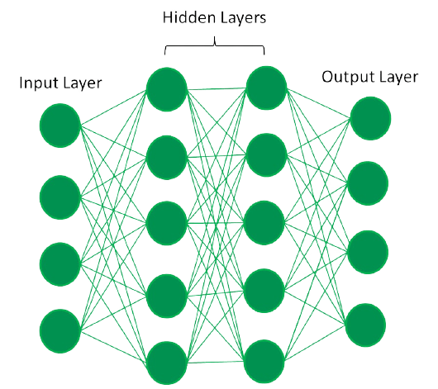
Deep Learning
Deep learning is a subset of machine learning that uses multi-layered artificial neural networks to model complex patterns and representations in large datasets. It excels in image recognition, natural language processing, and speech recognition. The networks learn hierarchical features through multiple layers, each capturing increasingly abstract information. Deep learning models are trained using backpropagation to minimize prediction errors.
Epoch: An epoch in machine learning is one complete pass through the entire training dataset by the learning algorithm. Backpropagation: Backpropagation is a training algorithm for neural networks that adjusts weights by propagating the error backward from the output to the input layer.

Slide 6

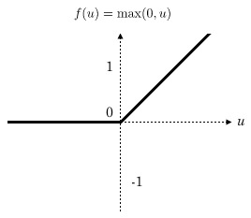

Activation Function
Activation functions in neural networks introduce non-linearity, allowing the model to learn complex patterns.
ReLU activation function: The ReLU (Rectified Linear Unit) activation function outputs the input directly if it is positive; otherwise, it outputs zero: f(x) = max(0,x)
SoftMax Activation function: The Softmax activation function converts a vector of raw scores into probabilities, with each value between 0 and 1 and the sum equal to 1
S(X)$={\frac{e^{X}}{\sum_{j=1}^{n}{e^{\text{x}\text{j} }}}}_{}$

Slide 7

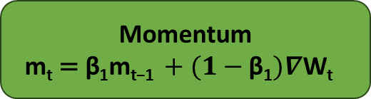
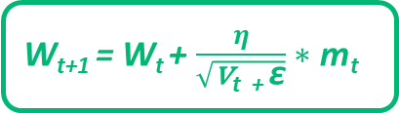
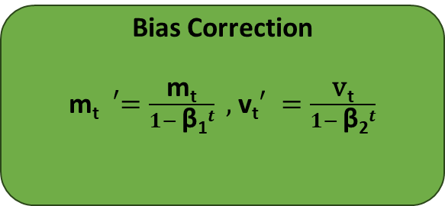
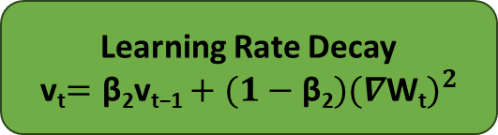
Optimization
The process of adjusting the parameters (weights and biases) of a neural network to minimize the loss function, which measures the difference between the model's predictions and the actual target values.
W_{t+1} = W_{t} + $\frac{η}{\sqrt{\text{v}\text{t}\text{ + }\text{ε}}}∗\text{m}\text{t}$
Adam Optimizer
Momentum
m_{t}$\text{= }\text{β}\text{1}\text{m}\text{t}\text{−1} {+ (1−\text{β}\text{1})∇\text{W}\text{t}}^{}$
Learning Rate Decay
v_{t}$=\text{β}\text{2}\text{v}\text{t}\text{−1}+(1−\text{β}\text{2}{)(∇\text{W}\text{t})}^{2}$
Bias Correction
m_{t}${}_{}^{′}=\frac{\text{m}\text{t}}{1− {\text{β}\text{1}}^{t}} ,$v_{t}$′ =\frac{\text{v}\text{t}}{1− {\text{β}\text{2}}^{t}}$
β₁ = 0.9
β₂ =0.999

Slide 8

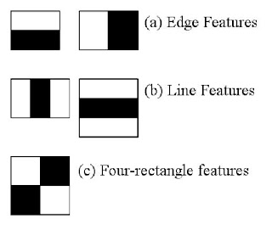
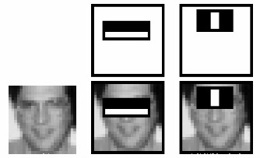
Haar Cascading
Haar cascade is an object detection algorithm that uses a series of increasingly complex classifiers (stages) applied sequentially to detect objects, such as faces, in images. It is based on Haar-like features, which are simple rectangular features used to encode the presence of specific intensity patterns in an image and is trained using AdaBoost to combine multiple weak classifiers into a strong one for robust detection.
Haar Features
Detection Using Features

Slide 9

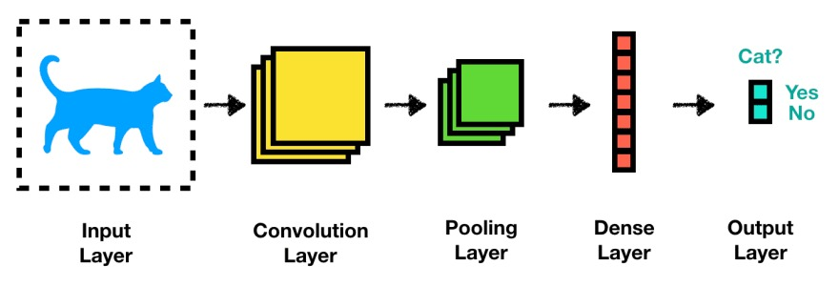
Convolution Neural Network
A Convolutional Neural Network (CNN) is a type of deep learning model specifically designed for processing structured grid data like images. It uses convolutional layers to automatically and adaptively learn spatial hierarchies of features from input images.
Architecture

Slide 10
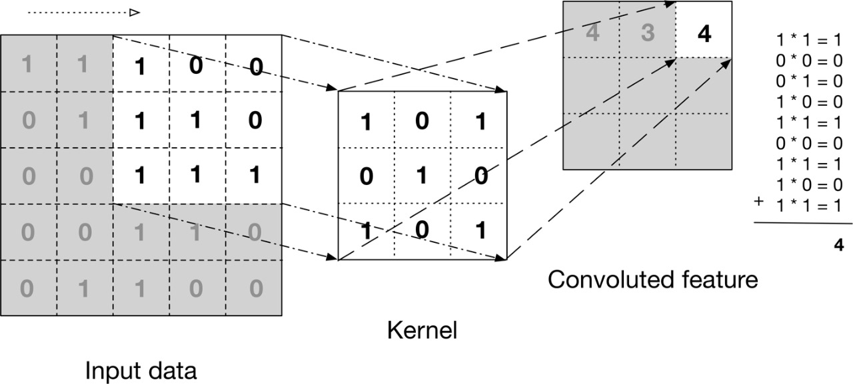
Convolution Neural Network
Key Components:
Convolutional Layers
Pooling Layers
Activation Functions
Fully Connected Layers

Slide 11

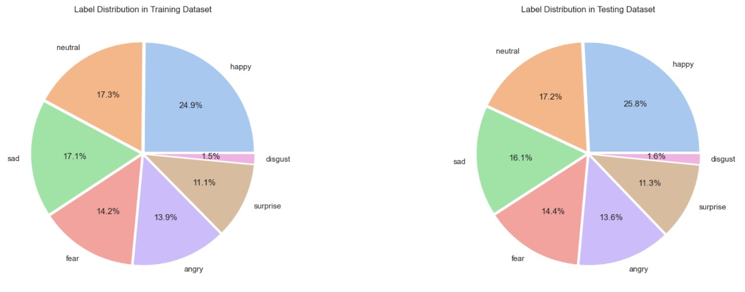
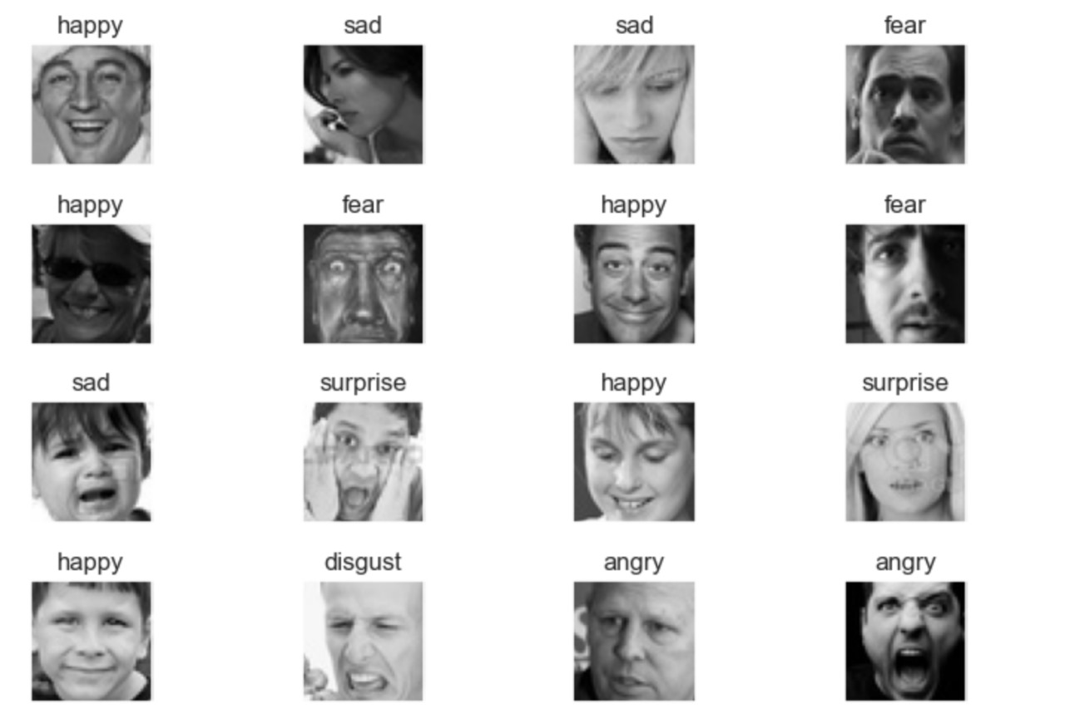
Data Description
Facial Expression Recognition (FER) (2013)
Classes: Anger, Sad, Disgust, Fear, Neutral, Surprise, Angry
Training Set: 28,821 images
Testing Set: 7,066 images
Example:

Slide 12
Neural Network Modeling
Model Building
Training
Evaluation
Testing

Slide 13
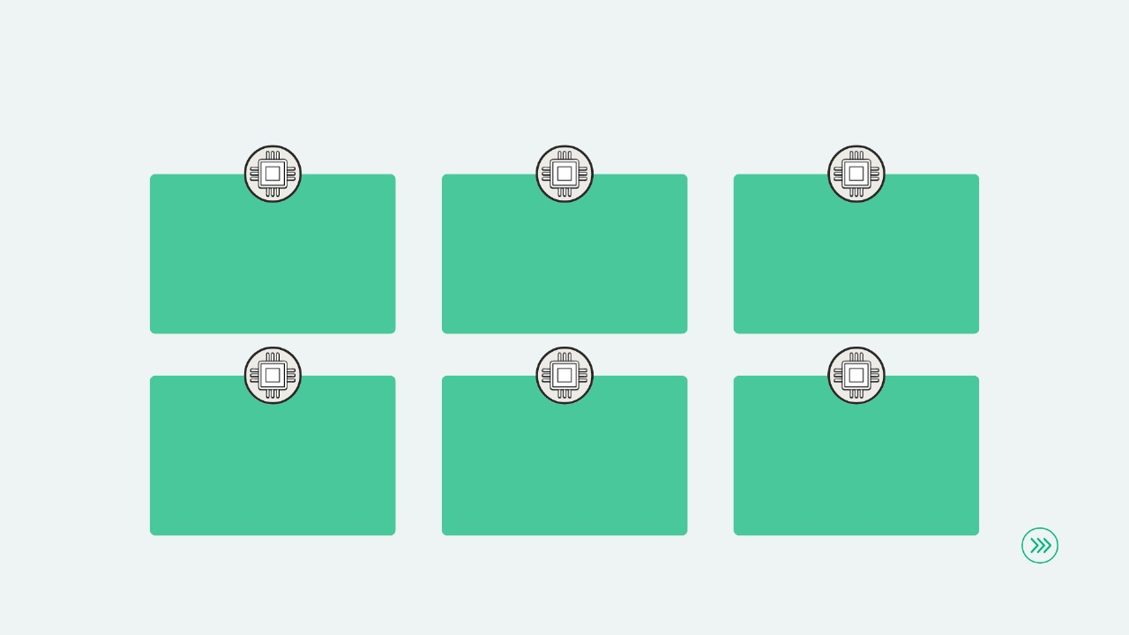
Model Building
Convolutional Layers
1st layer:64 kernel of size (5,5).2nd layer:128 kernel (3,3).3rd and 4th layer:215 kernel(3,3)
Pooling Layer and Dropout Rate
Method: Maxpoolingsize(2,2)
Rate: 0.3
Flatten
Flatten the multidimensional tensors into 1d tensors.
Fully Connected Layer
Activation function: ReLU:
1st layer: 256 unit
2nd layer: 512 units
Output
Activation function: SoftMax
Units: 7
Compiler
Optimizer: Adam
Loss: Categorical Cross Entropy
Metrics: Accuracy

Slide 14

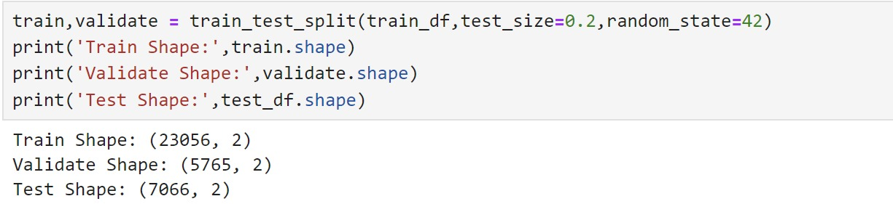
Training
Number of Epochs: 50
Train Set: 23,056
Validate Set: 5,765

Slide 15
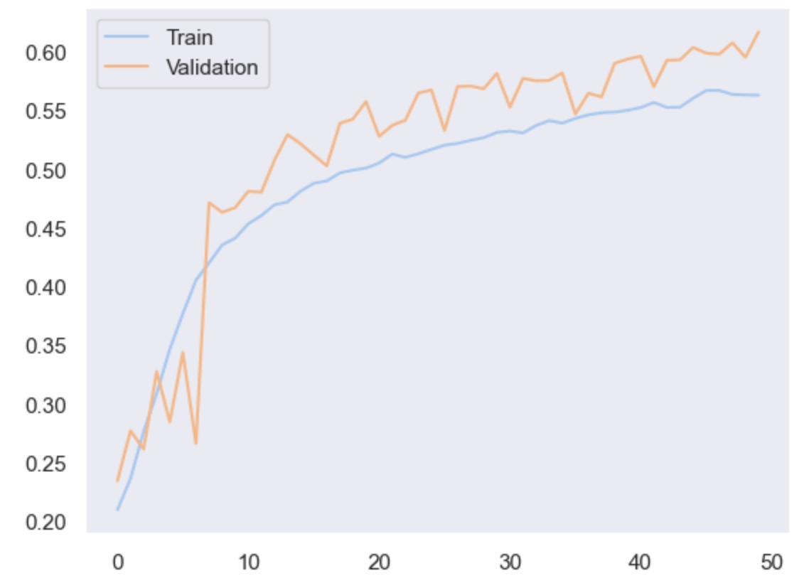
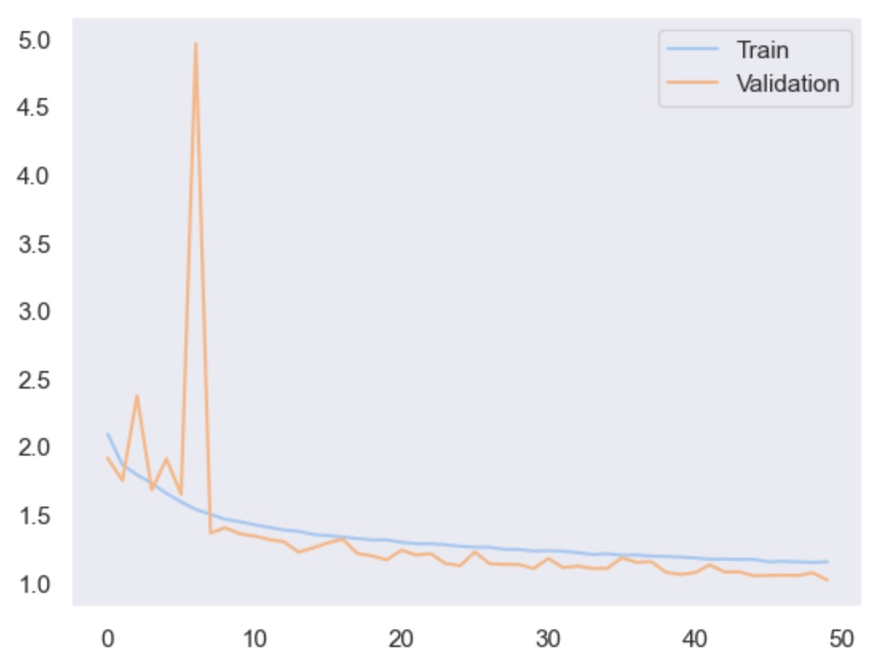
Evaluation
Accuracy(after 50 Epochs)
Train set: 56.28%
Validate Set: 61.67%
Loss(after 50 epochs)
Train set: 1.15
Validate Set: 1.01
Since the graph of validation loss is decreasing, we can conclude the model is not overfitted.

Slide 16
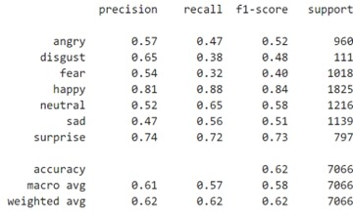
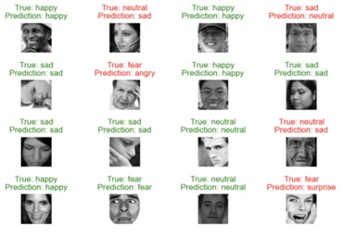
Testing
Classification Report
When the model was tested on unseen data.
It’s Loss was 1.01, and
It correctly predicted classes with an Accuracy Score of 62.5%.
Prediction

Slide 17

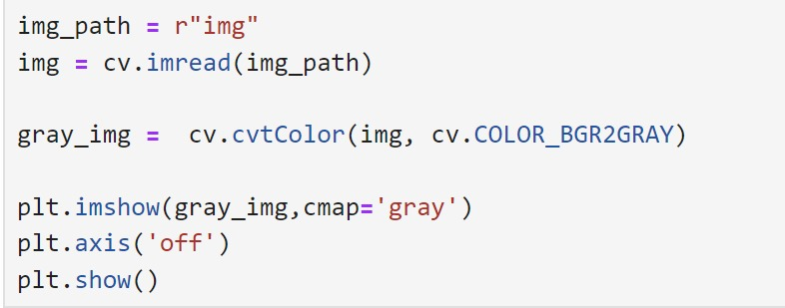
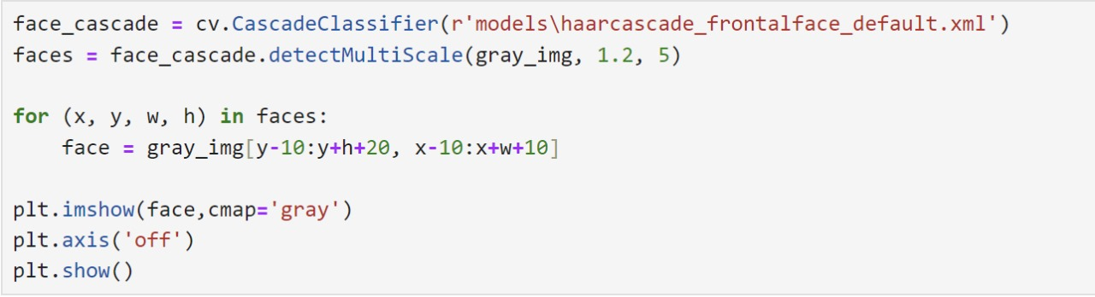

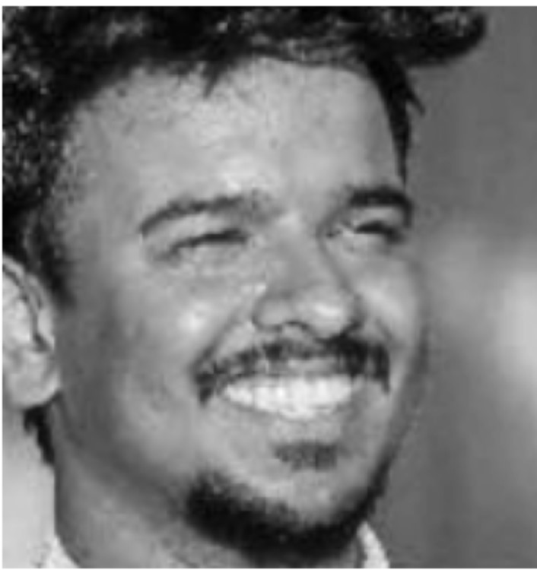
Face Detection and Model Deployment
Steps for Face Detection:
3. Applying Haar Cascade
4. Saving the coordinates in a variable
Loading Image
Converting the image into grayscale

Slide 18


Face Detection and Model Deployment
https://facial-emotion-recognition.streamlit.app/
User Friendly
Provides 3 Functionality
Pre-load images
Use web camera
Upload Image
Saves Data for Future Use
Pie chart showing the probability distribution of all emotions

Slide 19
Conclusion
This study outlines the FER pipeline: face detection, preprocessing, feature extraction, and CNN-based classification, demonstrating effective emotion capture and classification. The model's integration into a web platform allows real-time emotion recognition from images and live webcam feeds, enhancing interactive and personalized user experiences based on emotional states.
Applications
Drawbacks
Future Aspects
E-KYC.
Biometric attendance
Security systems
In the field of psychology
Fewer data.
Less accurate.
Does not work well if more than one face is available in a single image.
Cannot classify live images.
Using the collected data to train the model.
This will further increase the accuracy.
User friendly website.

Slide 20


