Slide 1
STM32 ARM Cortex-M Development Board for Teaching and Prototyping
Presented By:
Utkarsh Sethi
Shreyansh Sharma
Vivek Samtani
Project Supervisors:
Prof. Sashikant Patil
Prof. Kiran Sanlunkhe
SVKM’s NMIMS, Mukesh Patel School of Technology Management & Engineering

Slide 2
Outline
Survey
Problem Statement
Proposed Solution/New Features
Challenges
Existing controllers
Outcomes
Estimated Cost
Methodology
Block Diagram
Timeline
Bibliography

Slide 3
Survey
Feedback from various people working in embedded industry about what they expect from students
Talked about problems faced by batch mates, juniors as well as seniors about problems faced in understanding microcontrollers
Feedback from various acquaintances belonging to other colleges including IITs
32bit ARM based systems have started costing less compared to 8051 due to mass production and inbuilt peripherals, and reduced time to get it ready
STM microcontrollers are easily available, and have good documentation, support

Slide 4
Problem Statement
The kits used to teach microcontroller in universities gives little exposure to hardware and interfacing
With lower cost industry is leaning towards ARM over 8bit as it offers standardisation and faster production and lower lead times
While assembly is important to understand, products is the industry are made using C

Slide 5
Proposed Solutions/Features
Arm based boards will make it industry relevant
Board will be designed in such a way that students also learn hardware and interfacing not just assembly language
Separate PCBs to understand hardware components required
Attached sensor and drivers which will not only introduce the interfaces, but also provide hands on experience about how to use the interfaces
Debugging directly on the hardware will improve understanding

Slide 6
Challenges
ARM is complex architecture and will be difficult to introduce to beginners.
The documentation provided with latest processors is thousands of pages and often cannot be completed in 15labs, so it has to be provided in a concise manner.
Advanced protocols like usb/Ethernet cannot be covered
New µCs / ICs cannot be placed on breadboard which make them intimidating

Slide 7
Existing Products
8051 Development board
ARM Cortex-M3 NXP LPC1768 Development Board
ARM Cortex-M3 Mini Stm32 Stm32F103ZEt6 Cortex Development Board KG296
STM32 Nucleo-64 development board with STM32F103RB MCU

Slide 8
Outcome
Personal :
To gain in-depth knowledge and understanding about ARM ISA
Improving essential skills like Schematic, PCB design, SMD Soldering
General :
Board which helps solve the problem statements
Can also be later converted into a sellable product

Slide 9
Estimated Cost
STM32F103xx: Rs. 250-500
PCB fabrication: Rs. 1500-2000
Other peripherals: Rs. 1000-2000
EstimatedPrice: Rs. 4000-5000

Slide 10
Methodology
Learn about ARM ISA and Cortex-M specific documentation
Finalise Specifications
Create Schematics
Make PCBs
Ready concise documentation to be provided along the board

Slide 11
Block Diagram
DAC MODULE
(future)
ADVANCED CONNECTIVITY MODULE
(future)
STM32 CORTEX-M
MICROCONTROLLER
ADC MODULE
MINIMUM SYSTEM CONFIG
POWER CIRCUITRY
EXPANSION
MODULE
SWITCHES
USART MODULE
SWD,JTAG,ST-LINK INTERFACE MODULE
AND BREAKOUT
I²C MODULE
LCD MODULE
GPIO MODULE
(integrated)
PWM MODULEs
SPI MODULE

Slide 12
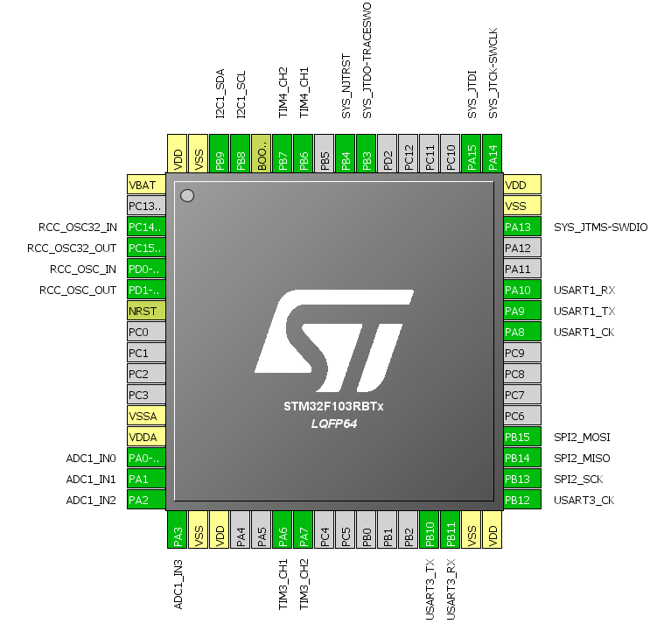
Config Diagram

Slide 13
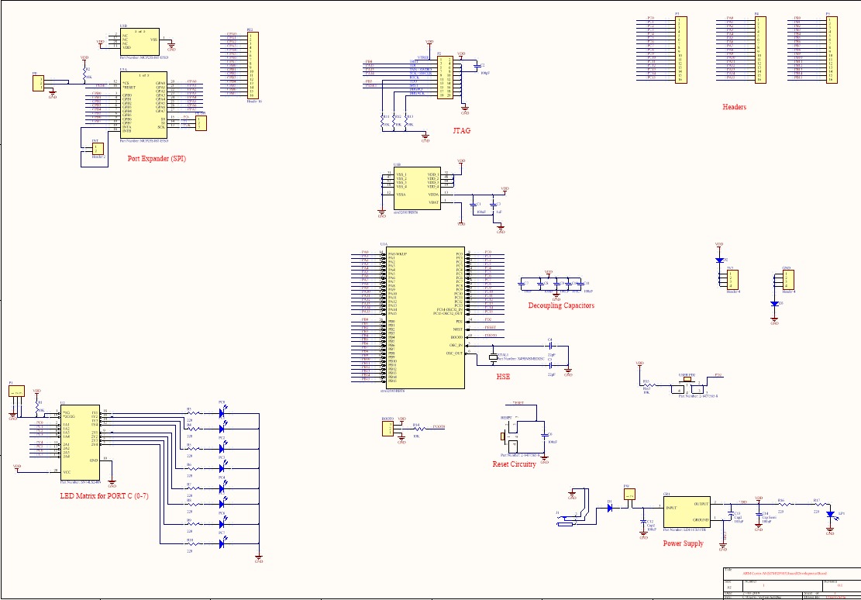
Schematic

Slide 14
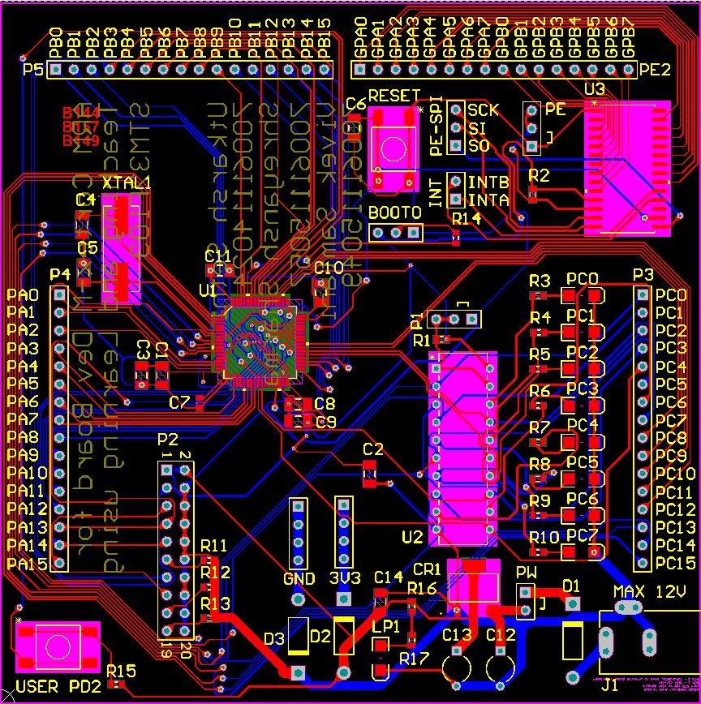
Routing

Slide 15
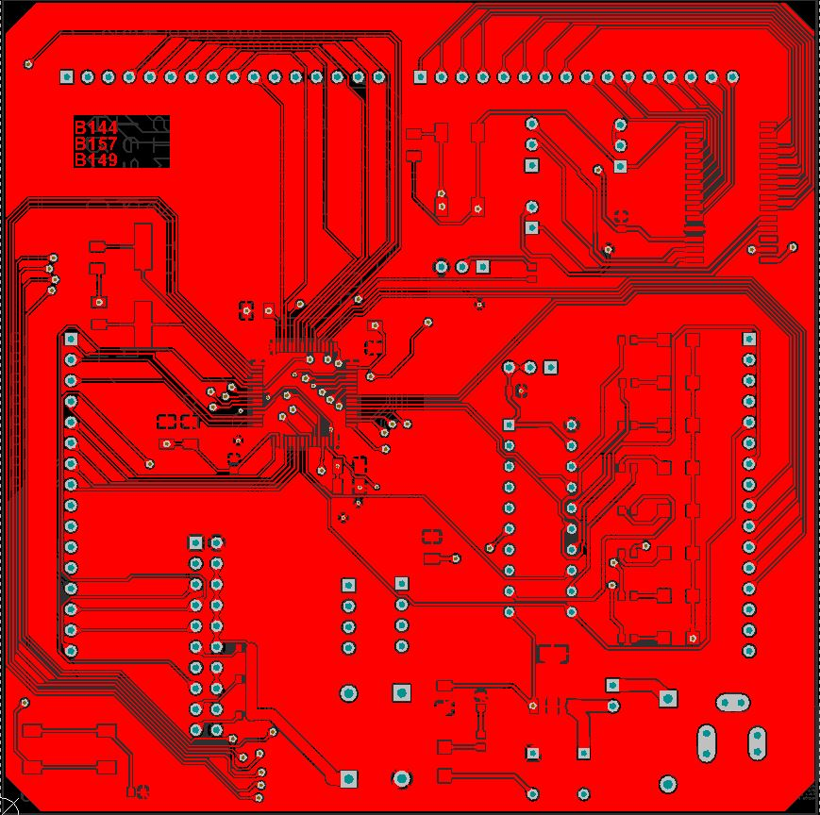
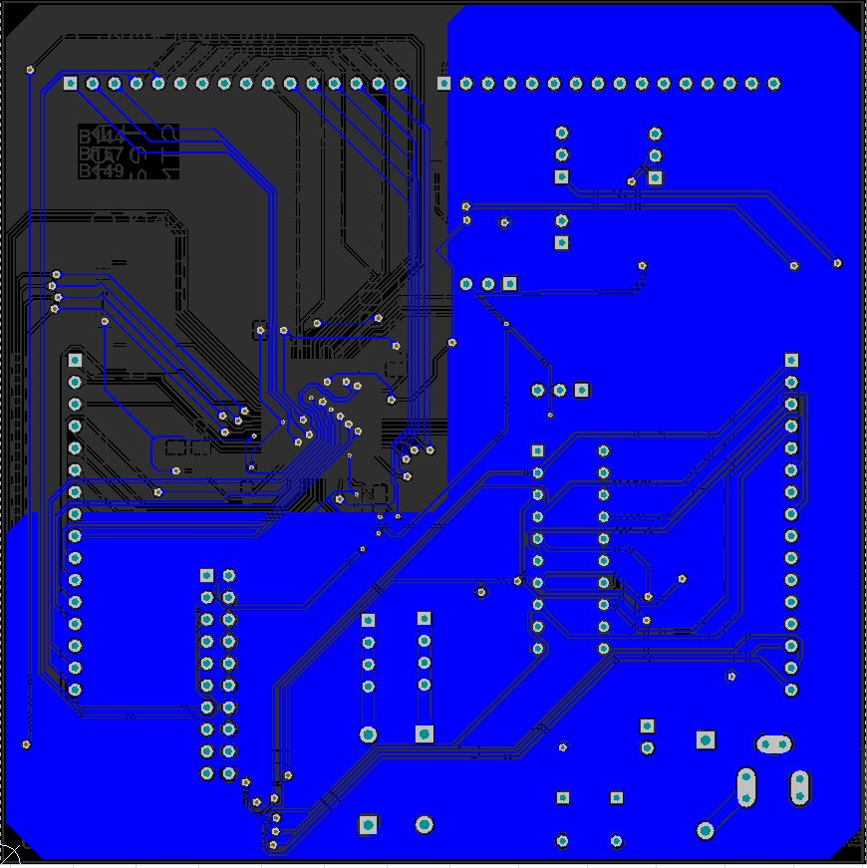
Routing

Slide 16
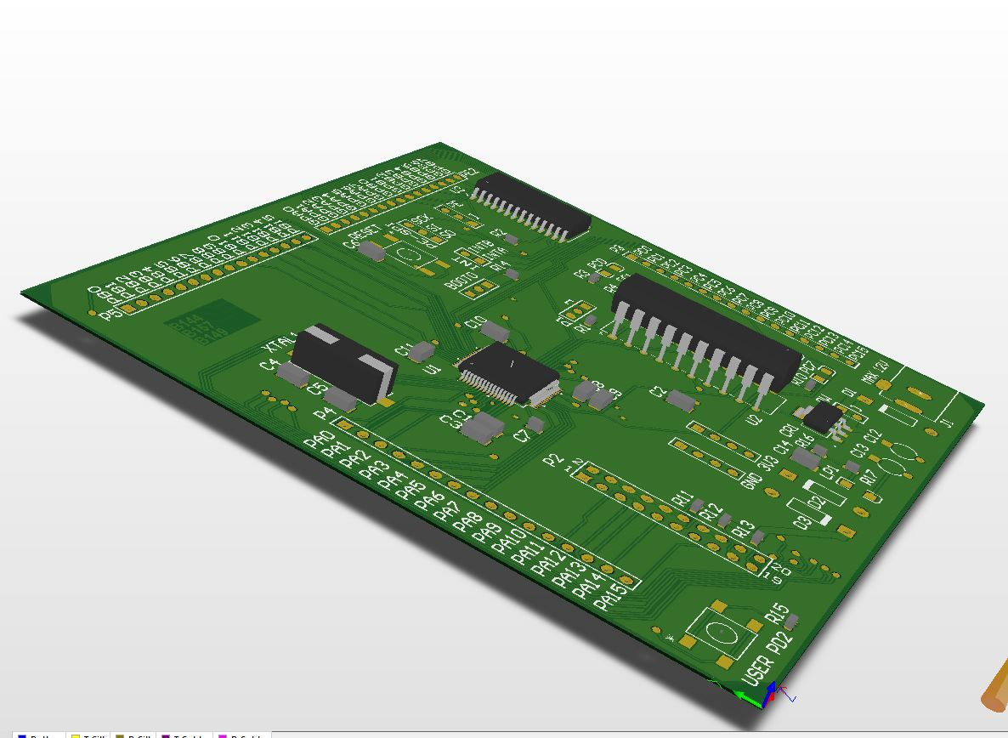
3D Model

Slide 17
Timeline (Sem7)
Week 1-3 : Discussions
Week 4-6:Explore the current products
Week 6-12:Understant the µC and go through documentation, app notes by manufacturer and ARM
Week 12-13: identify challenges and solutions, features. Finalise µC
Week 14-15: work on schematics
Winter Break: work on schematics
Semester 8 : schematics, further iterations and software + manuals

Slide 18
Bibliography
Whiteway, Alexander Keith . “PIC32 DEVELOPMENT for ECE4760” Electrical and Computer Engineering Projects: Masters of Engineering , May. 2015, people.ece.cornell.edu/land/courses/eceprojectsland/STUDENTPROJ/2014to2015/akw62/akw62_report_201505180311.pdf.
Ross, Michael David. “PIC32 DEVELOPMENT BOARD.” Electrical and Computer Engineering Projects: Masters of Engineering , Jan. 2014, people.ece.cornell.edu/land/courses/eceprojectsland/STUDENTPROJ/2013to2014/mdr87/mdr87_report_201312201016.pdf.
Mahbub , Syed Tahmid Mahbub, “Comparing the PIC32MX250F128B and Atmel AT91SAM3X8E for teaching” Electrical and Computer Engineering Projects: Masters of Engineering , Dec. 2013, people.ece.cornell.edu/land/courses/eceprojectsland/STUDENTPROJ/2013to2014/sm893/Independent%20Study%20Paper%20Final.pdf
ST-Microcontrollers, UM0986 User manual, ”Developing your STM32VLDISCOVERY application using the MDK-ARM software ”.
ST-Microcontrollers, UM1523 User manual, ” Getting started with software and firmware environments for the STM32F0DISCOVERY kit ”.
ST-Microcontrollers, UM1725 User Manual, ” Description of STM32F4 HAL and LL drivers ”.
ST-Microcontrollers, AN4488 Application note, ” Getting started with STM32F4xxxx MCU hardware development ”.
ST-Microcontrollers, PM0214 Programming manual, ” STM32F3 Series, STM32F4 Series, STM32L4 Series and STM32L4+ Series Cortex®-M4 programming manual ”.
ST-Microcontrollers, RM0090 Reference manual, ” STM32F405/415, STM32F407/417, STM32F427/437 and STM32F429/439 advanced Arm®-based 32-bit MCUs ”.
ST-Microcontrollers, STM32F405xx STM32F407xx Data Sheet, ” ARM Cortex-M4 32b MCU+FPU, 210DMIPS, up to 1MB Flash/192+4KB RAM, USB OTG HS/FS, Ethernet, 17 TIMs, 3 ADCs, 15 comm. interfaces & camera ”.
ST-Microcontrollers, STM32F407VG, https://my.st.com/content/my_st_com/en/products/microcontrollers/stm32-32-bit-arm-cortex-mcus/stm32-high-performance-mcus/stm32f4-series/stm32f407-417/stm32f407vg.html#design-scroll .
Various Other Open source Projects related to STM32 and other µCs.

Slide 19
Thank you

