Slide 1
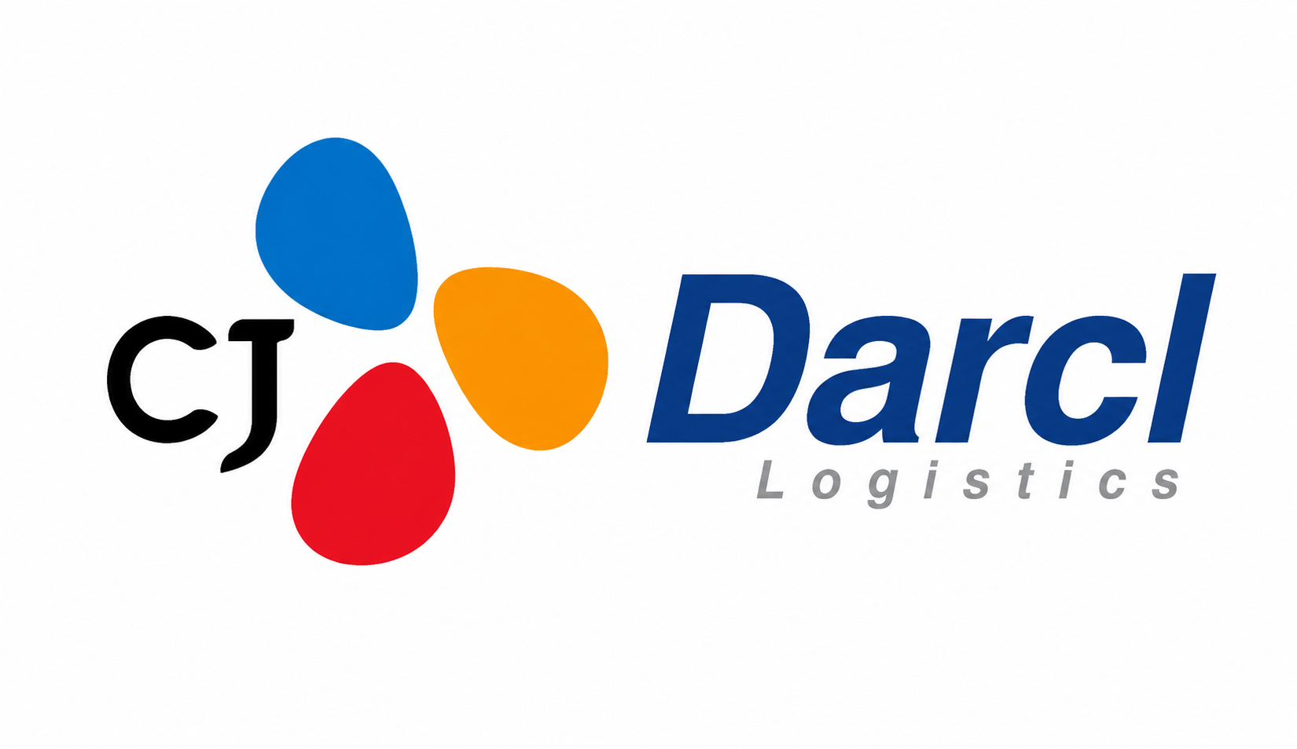
BUSINESS STRATEGY & DEVELOPMENT REVIEW
Indian FTL Market Competitive Deep Dive
Competitive Landscape Assessment of CJ Darcl Logistics
Prepared for: Manager – Business Strategy & Development
Presented by: Utkarsh Sinha
Strictly Private & Confidential

Slide 2
EXECUTIVE SUMMARY
Answering the Manager's Six Questions
EXECUTIVE DASHBOARD
~75%
₹5,161 Cr
5.20%
of CJ Darcl's FY24 revenue came from FTL transportation, with FTL share expected to moderate to ~65% over the next 2–3 years as multimodal, rail and warehousing scale up.
CJ Darcl FY25 Revenue
CJ Darcl FY25 EBITDA Margin
up from ₹4,216 Cr in FY23
up from 4.38% in FY23
KEY TAKEAWAYS
202
9.5L+
The Indian FTL market remains highly fragmented; few players compete directly with CJ Darcl in industrial freight
CJ Darcl's strongest position lies in Steel, Cement, Mining and Industrial transportation
Largest competitive threats: TCI Freight, Mahindra Logistics, Safexpress and TVS Supply Chain Solutions
Significant opportunity in dedicated transportation and industrial-corridor logistics
Branch Offices / 6,691 Locations
Partnered Fleet Vehicles
pan-India network, Mar 2025
asset-right operating model
Source: CJ Darcl DRHP (SEBI, Sep 2025); CRISIL Intelligence Industry Report; CJ Darcl company disclosures.
02

Slide 3







PROJECT SCOPE
Project Scope & Key Questions
Assess the FTL competitive landscape in India, identify CJ Darcl's true competitors, evaluate their financial performance, operating models, strengths and weaknesses — and determine where CJ Darcl is exposed and where it can win.
1. Who are CJ Darcl's true FTL competitors?
2. How do they win business?
CJ Darcl FTL
Competitive Assessment
3. How are they performing financially?
4. Where are they strong?
5. Where are they weak?
6. Where is CJ Darcl exposed?
7. Where can CJ Darcl win?
Source: CJ Darcl analysis framework, based on Business Strategy & Development team brief.
03

Slide 4
MARKET CONTEXT
Indian FTL Market Overview
USD 228.4 Bn
FTL Demand by End-Use Sector (Illustrative Mix)
MARKET TRENDS
Indian logistics market size, 2024 — growing at ~6.5% CAGR to USD 428.7 Bn by 2033
GST-driven formalization compresses fragmentation
Dedicated Freight Corridors & Bharatmala expand capacity
Digital freight platforms raise asset utilization
PLI-led manufacturing lifts contract freight volumes
USD 125.9 Bn
Indian FTL market size, 2025 — projected to reach USD 203.2 Bn by 2031 (8.29% CAGR)
73.1% Domestic
Share of FTL market from domestic lanes vs. international, 2025
*Manufacturing share per Mordor Intelligence (2025); remaining sector splits are illustrative estimates for structure.
Source: Mordor Intelligence, India Full-Truck-Load Market Report (Jan 2026); CJ Darcl DRHP / CRISIL Intelligence.
04

Slide 5


COMPETITIVE SET
Who Really Competes With CJ Darcl?
Defining the True Competitive Set
INDUSTRIAL FREIGHT FOCUS →
Direct Competitors
CJ Darcl
TCI Freight
Mahindra Logistics
Safexpress
TVS Supply Chain Solutions
DHL Supply Chain
TCI Freight
Indirect Competitors
TVS SCS
Delhivery (express/PTL-led)
Allcargo Gati (express-led)
VRL Logistics (LTL-led)
Mahindra Log.
Safexpress
DHL SC
Allcargo Gati
Key insight: many logistics companies are parcel- or express-focused and are not true industrial FTL competitors.
VRL Log.
Delhivery
SCALE →
Source: CJ Darcl strategic analysis based on company disclosures and public filings of listed peers.
05

Slide 6
COMPETITIVE LANDSCAPE
Competitor Profile Comparison
Company | Business Model | FTL Focus | Geographic Presence | Warehousing | Asset Ownership
CJ Darcl | Integrated multimodal + FTL | High | 202 offices / 6,691 locations | 14 facilities | Asset-right (partnered fleet)
TCI Freight | FTL + LTL surface transport | High | Pan-India + SAARC | 15+ Mn sq. ft. (Group) | Asset-owned + hired
Mahindra Logistics | 3PL contract logistics | Medium–High | Pan-India | 20.8 Mn sq. ft. | Managed / asset-light
Safexpress | Express distribution + 3PL | Medium | 340 offices / 847 gateways | 21.2 Mn sq. ft. | 14,076 GPS-enabled vehicles
TVS Supply Chain | ISCS + Network Solutions | Medium | India + global (N.A., Europe) | Global footprint | Managed / asset-light
DHL Supply Chain | Contract logistics (3PL) | Medium | Select India hubs | Not separately disclosed | Managed / asset-light
Source: CJ Darcl DRHP (Sep 2025); TCI/Mahindra Logistics company disclosures; Safexpress company updates (2026); TVS SCS Annual Report FY25; DHL Supply Chain public profile.
06

Slide 7
BENCHMARKING
How Strong Are Competitors Financially?
Company (FY25) | Revenue | EBITDA | EBITDA Margin | PAT / (Loss)
CJ Darcl | ₹5,161 Cr | ~₹268 Cr | 5.20% | ~₹93 Cr
TCI (Consol.) | ₹4,492 Cr | ₹461 Cr | 10.3% | n.a.
Mahindra Logistics | ₹6,105 Cr | ₹284 Cr | 4.65% | (₹36 Cr)
TVS Supply Chain | ₹9,996 Cr | n.a. | n.a. | (₹10 Cr)
Safexpress | Not publicly disclosed (private)
DHL Supply Chain | Not separately disclosed (global subsidiary)
Revenue Comparison (₹ Cr., FY25)
COMMENTARY
Largest by revenue: TVS Supply Chain (₹9,996 Cr) — majority international
Most profitable margin: TCI, at 10.3% EBITDA margin
Fastest growing: TCI Freight & Mahindra Logistics, both ~11% YoY
Source: CJ Darcl DRHP; TCI Q4 FY25 results; Mahindra Logistics FY25 press release; TVS SCS FY25 results (Annual Report, Allvest). All figures consolidated, FY2024-25.
07

Slide 8





PLAYBOOKS
How Competitors Win Business
TCI Freight
Mahindra Logistics
Safexpress
WINS THROUGH
WINS THROUGH
WINS THROUGH
Network density & scale
Relationship-driven sales
Competitive pricing
Enterprise contracts
Automotive expertise
Integrated logistics
Distribution network depth
Service reliability
Warehousing integration
TVS SCS
DHL Supply Chain
CJ Darcl
WINS THROUGH
WINS THROUGH
WINS THROUGH
Automotive specialization
OEM relationships
Premium service quality
Multinational customers
Heavy industrial freight expertise
Steel & mining specialization
Long-haul + customized solutions
Source: CJ Darcl strategic analysis, based on company disclosures, investor presentations and market positioning.
08

Slide 9
OPERATIONAL CAPABILITY
Who Has the Strongest Network?
Network Footprint Snapshot
Capability Radar — CJ Darcl vs. Peer Average
CJ Darcl
202 offices · 6,691 locations · 14 warehouses · 955K+ partnered fleet
Safexpress
340 area offices · 847 gateways · 21.2 Mn sq. ft. · 14,076 GPS vehicles
Mahindra Logistics
20.8 Mn sq. ft. warehousing under management (FY25)
TCI (Group)
15+ Mn sq. ft. warehousing · Group revenue >₹7,000 Cr
Indexed 0–100; a qualitative assessment based on publicly available network data (not a standardized industry index).
Source: CJ Darcl DRHP; Safexpress company updates (2026); Mahindra Logistics FY25 press release; TCI Group company website.
09

Slide 10



PRICING
How Competitors Price
CJ Darcl
TVS SCS
TCI Freight
DHL Supply Chain
Mahindra Log.
Safexpress
Premium
Mid-Premium
Competitive
Aggressive
Spot Market
Contract Logistics
Dedicated Fleet
Value-Added Services
Transactional, load-board driven pricing with high rate volatility; typically used by unorganized fleet owners and aggregators.
Multi-year, volume-committed pricing tied to service-level agreements; core to Mahindra Logistics, TVS SCS and DHL.
Fixed-capacity pricing for guaranteed availability — CJ Darcl's core model for steel, cement and mining accounts.
Premium pricing for tracking, multimodal integration, and customized handling of specialized/ODC cargo.
Source: CJ Darcl strategic analysis, based on qualitative assessment of publicly disclosed business models; not derived from published price data.
10

Slide 11
ASSESSMENT
Competitive Strengths & Weaknesses
Company | Strengths | Weaknesses
CJ Darcl | Industrial freight expertise; long-haul & heavy cargo capability | Lower brand visibility; smaller scale than national peers
TCI Freight | Network density; multimodal (road+rail+sea) integration | Freight segment margin structurally thin (~4%)
Mahindra Logistics | Enterprise & automotive relationships; strong 3PL brand | Persistent losses; Express segment still loss-making
Safexpress | Dense distribution network; fast transit times | Limited industrial/heavy-freight specialization
TVS SCS | Automotive OEM relationships; global ISCS scale | Thin consolidated margins; India ISCS under pressure
DHL Supply Chain | Premium service; multinational customer base | Limited India-specific industrial freight focus
CJ Darcl advantage: deep specialization in steel, cement & mining — a barrier few competitors can replicate at scale.
Source: CJ Darcl strategic analysis, based on company disclosures, investor presentations and FY25 financial results.
11

Slide 12
RISK ASSESSMENT
Where Is CJ Darcl Most Exposed?
Competitive Exposure by Sector
TCI
Mahindra
Safexp.
TVS
DHL
WHO THREATENS US, AND WHERE
Steel
Steel, Cement, Mining: CJ Darcl's core strongholds — low exposure across all five peers.
Chemicals: emerging medium risk as multiple players build specialized capability.
Automotive & Consumer: highest exposure — Mahindra, TVS SCS and DHL hold entrenched OEM/enterprise relationships CJ Darcl does not.
Cement
Mining
Chemicals
Automotive
Consumer
Low Risk
Medium Risk
High Risk
Source: CJ Darcl strategic analysis, based on competitor sector focus disclosed in company profiles and investor materials.
12

Slide 13


STRATEGY
Strategic White Spaces & Positioning
Where Can CJ Darcl Win?
Steel Logistics
Cement Logistics
Mining Logistics
Dedicated Fleet Contracts
Industrial Corridors
South India Expansion
Multimodal Solutions
Strategic Positioning Insight
On an Industrial Expertise vs. Scale matrix, CJ Darcl occupies a differentiated position: high industrial specialization with sub-scale reach relative to TCI and Mahindra. This is a defensible niche, not a weakness to fix by chasing scale alone.
Source: CJ Darcl strategic analysis.
13

Slide 14

RECOMMENDATIONS
Strategic Recommendations
Defend
Expand
Steel
Cement
Mining
South India
Dedicated transportation
Differentiate
Invest
Industrial expertise
Multimodal integration
Reliability
Technology
Key account management
Source: CJ Darcl strategic analysis and recommendations.
14

Slide 15
FINAL CONCLUSION
Where Does CJ Darcl Stand?
Who competes with us?
TCI Freight, Mahindra Logistics, Safexpress, TVS SCS, DHL Supply Chain (direct)
How do they win?
Network density, pricing, customer relationships and sector specialization
How are they performing?
Mixed: TCI leads on margin (10.3%); Mahindra & TVS SCS remain loss-making
Where are they strong?
Automotive, enterprise contracts and broad national network reach
Where are they weak?
Limited industrial/heavy-freight specialization and coverage gaps
Where are we exposed?
Automotive and large enterprise contract accounts
Where can we win?
Steel, Cement, Mining, Industrial Freight and Long-haul Transportation
CJ Darcl's strongest competitive advantage is its deep industrial freight expertise. While larger competitors possess broader networks, few have equivalent positioning in Steel, Cement and Mining logistics. The most attractive growth opportunity lies in strengthening industrial accounts and expanding dedicated transportation offerings.
Sources: CJ Darcl DRHP (SEBI, Sep 2025); CRISIL Intelligence Industry Report; Mordor Intelligence India FTL Market Report; company filings and press releases of TCI, Mahindra Logistics, TVS Supply Chain Solutions, Safexpress, Delhivery, VRL Logistics and Allcargo Gati.
15

