Slide 1
Customer Churn Prediction
using Artificial Neural Networks
Deep Learning Project Presentation
Ujjwal Kumar Ray | Shubham Kumar | Vikash Kumar | Utkarsh Tiwari

Slide 2




Project Overview
Goal: Identify customers likely to leave using advanced AI
86% model accuracy achieved
Explainable AI using SHAP
Interactive Streamlit Web Application

Slide 3


Problem Statement & Objectives
The Challenge
• Businesses struggle to identify at-risk customers
• Reduce customer acquisition cost
• Provide explainable predictions for stakeholders
• Enable real-time churn prediction
• Deliver actionable business insights

Slide 4

Dataset Description
10,000+
~20%
12
Total Records
Churn Rate
Features
Key Features:
CreditScore, Age, Balance, Geography, Activity Status, Products, Tenure, etc.
Data Preprocessing: One-Hot Encoding, Label Encoding, StandardScaler normalization

Slide 5

Methodology & Preprocessing
1
Removed irrelevant features: RowNumber, CustomerId, Surname
2
Applied One-Hot Encoding & Label Encoding
3
StandardScaler for feature normalization
4
Train-Test Split: 80-20 ratio
5
Built ANN-based Deep Learning model

Slide 6

Model Architecture
Input Layer
12 Features
Hidden Layer 1
64 neurons (ReLU)
Hidden Layer 2
32 neurons (ReLU)
Output Layer
Sigmoid activation
Optimizer: Adam | Loss: Binary Crossentropy

Slide 7

Results & Model Performance
86%
84%
79%
Accuracy
Precision
Recall
81%
0.88
F1 Score
AUC Score

Slide 8
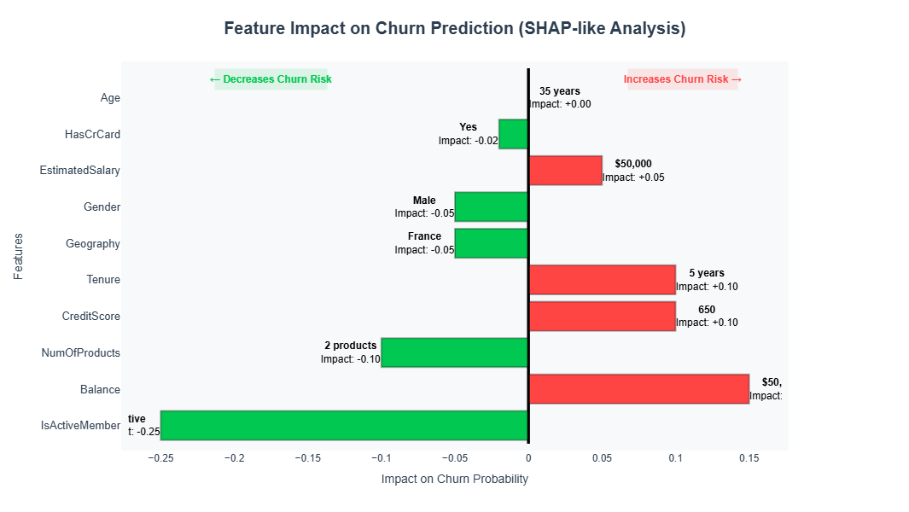
Explainability & Key Drivers
SHAP Analysis Insights
Top Factor: Age: Older customers show higher
Churn tendency
Product Count: Number of products significantly
impacts retention
Activity Status: Inactive users are more likely to
leave
Geography Impact: Germany region shows higher
churn rates
Balance Extremes: Very high or low balance
affects churn risk

Slide 9
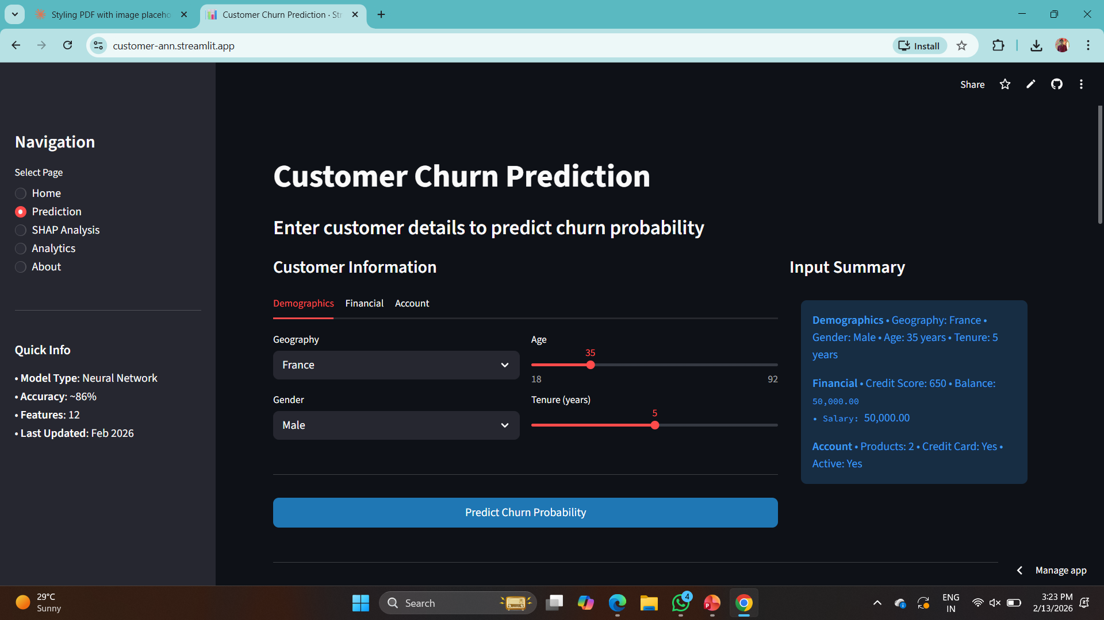
Deployment
Streamlit interactive web application
Real-time churn prediction capabilities
Comprehensive analytics dashboard
Interactive visualizations for insights
User-friendly interface for business teams

Slide 10

Technology Stack
Deep Learning
TensorFlow, Keras
Data Processing
Pandas, NumPy, Scikit-learn
Explainability
SHAP (SHapley Additive exPlanations)
Visualization
Plotly, Matplotlib, Seaborn
Monitoring
TensorBoard for model tracking

Slide 11

Business Impact
6.8%
Retention Rate Improvement
$1.56M
Estimated Annual Net Benefit
50%
Faster At-Risk Customer Identification
Reduced wasted retention spending through targeted interventions

Slide 12


Risks & Future Enhancements
Considerations
Planned Enhancements
• Data Drift & Bias Monitoring
• Ensemble Models
• Model retraining pipeline
• Hyperparameter Tuning
• CRM Integration & REST API
• Automated alert system
• Batch prediction support

Slide 13
Conclusion
ANN model successfully predicts customer churn with 86% accuracy
Explainable AI (SHAP) builds stakeholder trust and transparency
Scalable system ready for real-world deployment
Supports data-driven customer retention strategy
Thank You!

