Slide 1
Service
Server 1
Server
Process
Server 2
Client
Process
Load
Balancer
Server
Process
.
.
.
Server n
Server
Process

Slide 2

Sending Host
Mail Gateway
Receiving Host
Mail
Reader
Mail
Reader
MTA
MTA
MTA
SMTP
SMTP

Slide 3

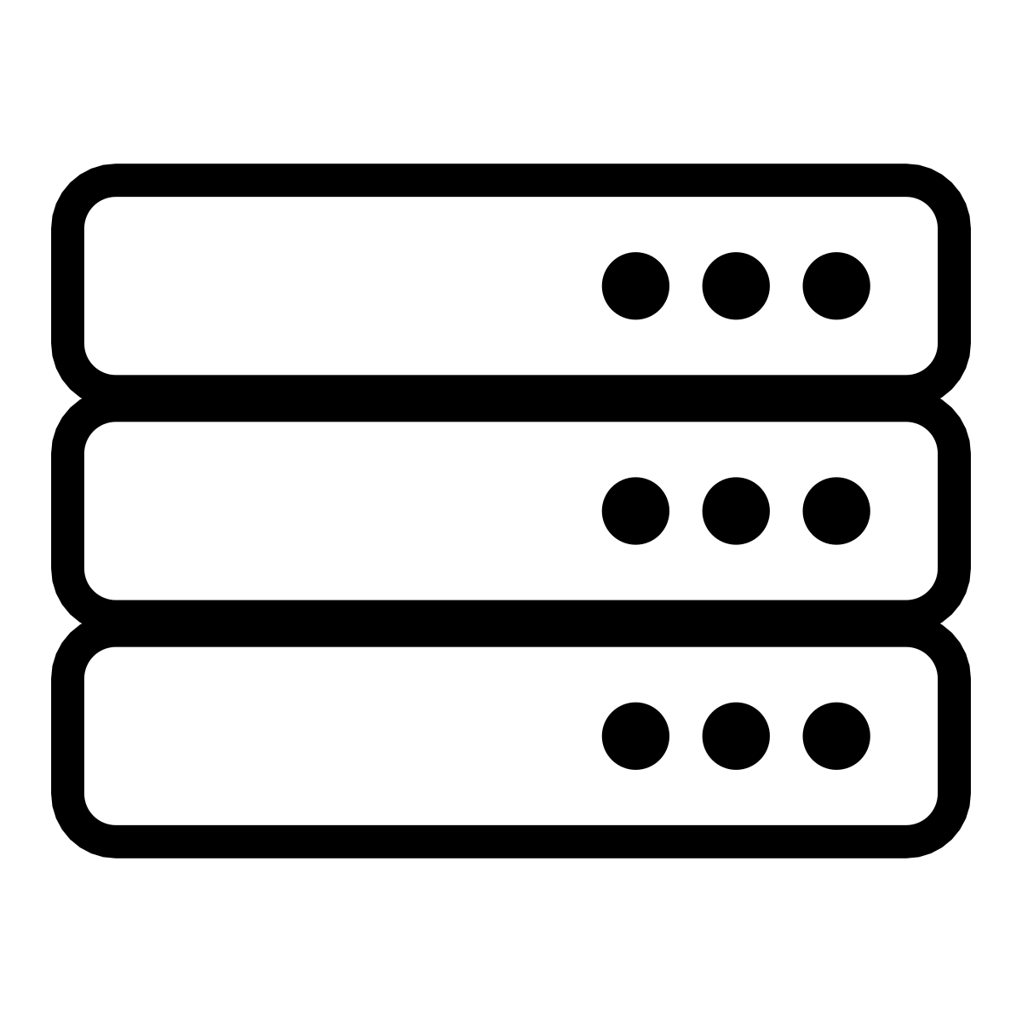

Slide 4

Private Cloud Backbone
Cloud
Datacenter
Cloud
Datacenter
Backbone Service Provider
IXP
IXP
Access
Network
Access
Network
West Coast
User
East Coast
User

Slide 5
Client
Server
TCP and TLS
Connection Setup
HTTP GET
HTTP Response
TCP and TLS
Connection Teardown

Slide 6
Video Player
Packets arrive at
variable intervals
Playback Buffer
Frames displayed
at a constant rate

