Slide 1







Calibri (16pt by default)
Calibri (16pt by default)
Darker Color 0070c0
Default Color 6a99d0
Lighter Color bdd7ee
WiFi
Access Point
Generic
Switch
Generic
Switch
User
UE
Phone
UE
Phone
UE
Phone
Generic Office
or Enterprise
5G
Basestation

Slide 2
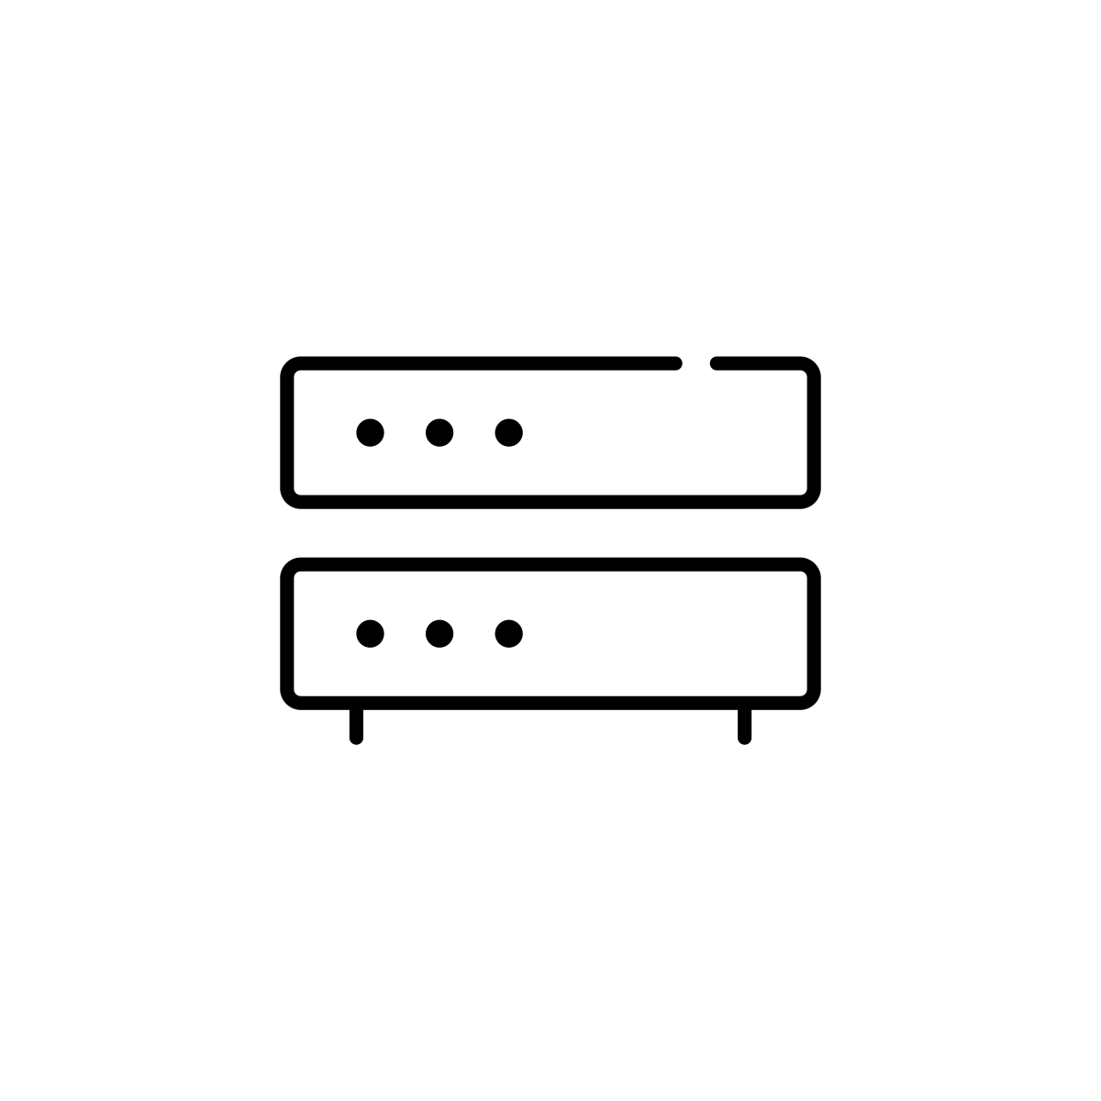





Query
Alt Client
Disk
Stable Store
Client
Server
Alt Server
Response
Router
Cloud
Network

Slide 3
Deficit
Pointer
100
500
300
500
200
250
400
0
400
100
300
0
250
100
600
0

Slide 4
Deficit
100
500
300
200
200
Pointer
250
400
500
400
100
300
0
250
100
600
0

Slide 5
10 Gbps
1 Gbps
Queue

Slide 6
Internet
Sender
Receiver
Home Router

Slide 7
Absorbing
Burst
Draining
Empty
Queue Length
Time
(a) Good Queue
Absorbing
Burst
Draining
Congestion
Queue Length
Time
(b) Bad Queue

Slide 8
Source 1
Receiver 1
Router
Source 2
Router
Router
Receiver 2
Source 3

Slide 9
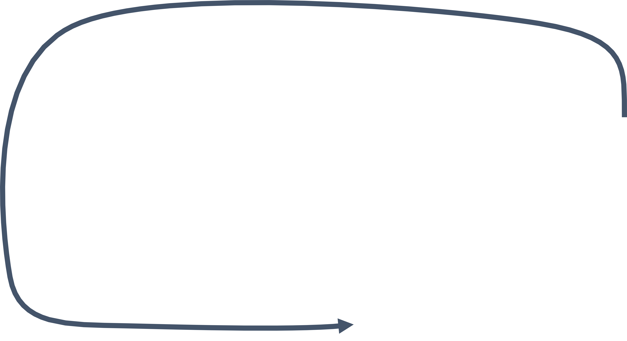


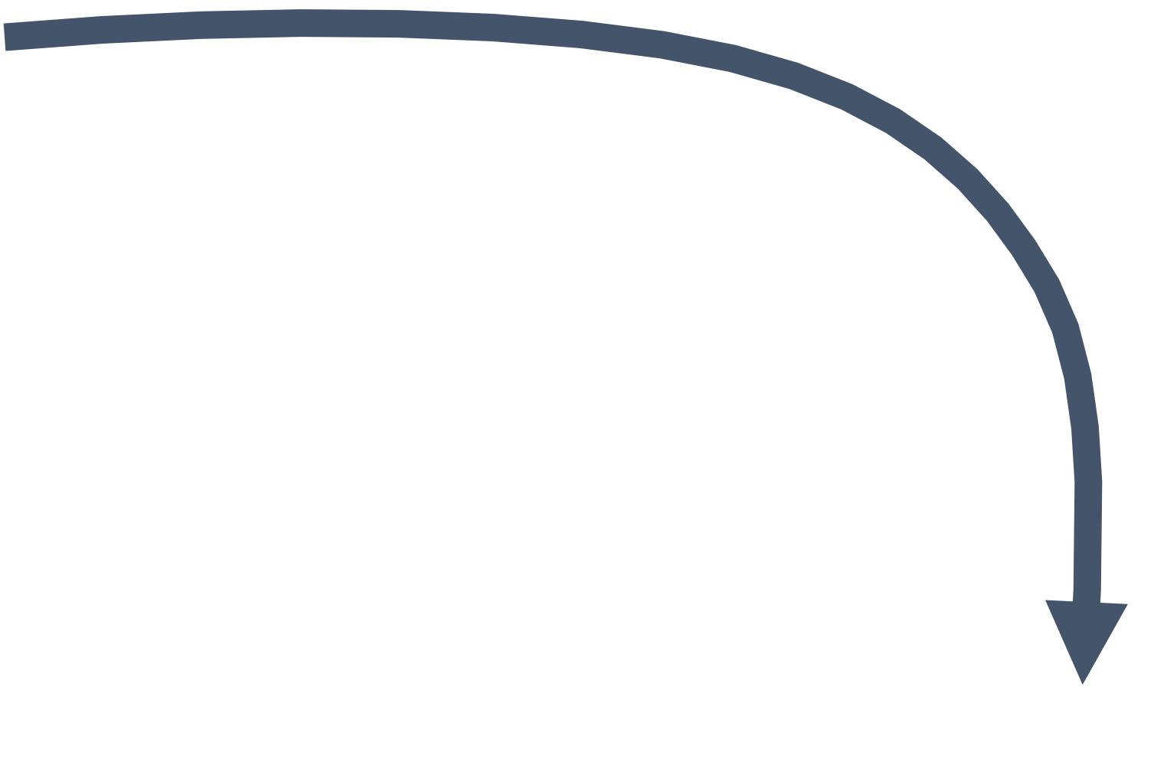


C
A
B
B
C
A

Slide 10
R1
R6
R7
R3
R2
R4
R5

