Slide 1

Network Operator
Intents, Alerts
Network Management System
Get / Set
Configuration
Variables
Poll / Stream
Telemetry
Data

Slide 2

model.yang
model.go, model.cc, model.java. ...
YANG Compiler
(e.g. ygot)
Network Management
System
gNMI Client
Language-Specific
Compiler
(e.g. go, gcc, javac)
Model-Independent
Runtime API
gNMI Server
Switch
Operating System

Slide 3
Operator
Inventory
Repo
Config
Repo
Image
Repo
Configuration
Manager
Operational
Network
Vendor

Slide 4

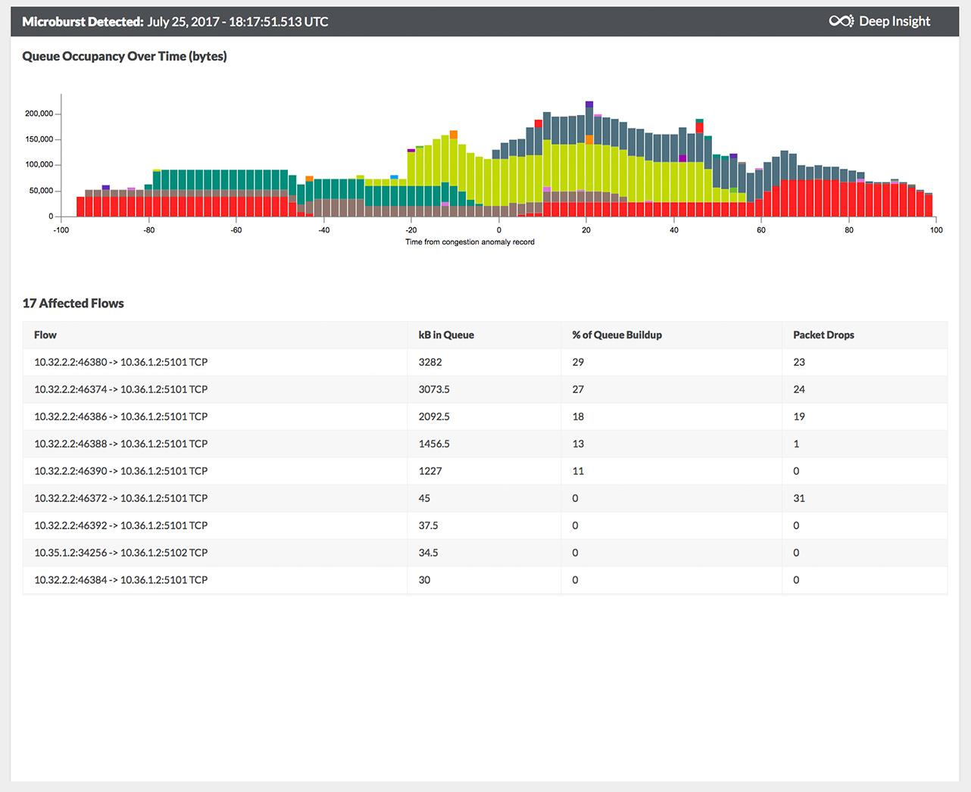

Add Switch ID, arrival time, departure, queue delay, etc.
Generate report with switch metadata
Header
Header
Metadata S1
Metadata S1
Metadata S2
Payload
S2
Payload
Header
Header
Payload
Payload
S1
S3
S5
Metadata S1
Metadata S2
S4
Metadata S5
Log, analyze, replay, visualize

Slide 5
Operator
Config
Repo
Inventory
Repo
Developer
Continuous Integration
(System)
Continuous Deployment
(System)
Code
Repo
Image
Repo
Operational
Cloud

Slide 6


Unicast to Server
DHCP
Relay
Broadcast
Other Networks
DHCP
Server
Host

