Slide 1
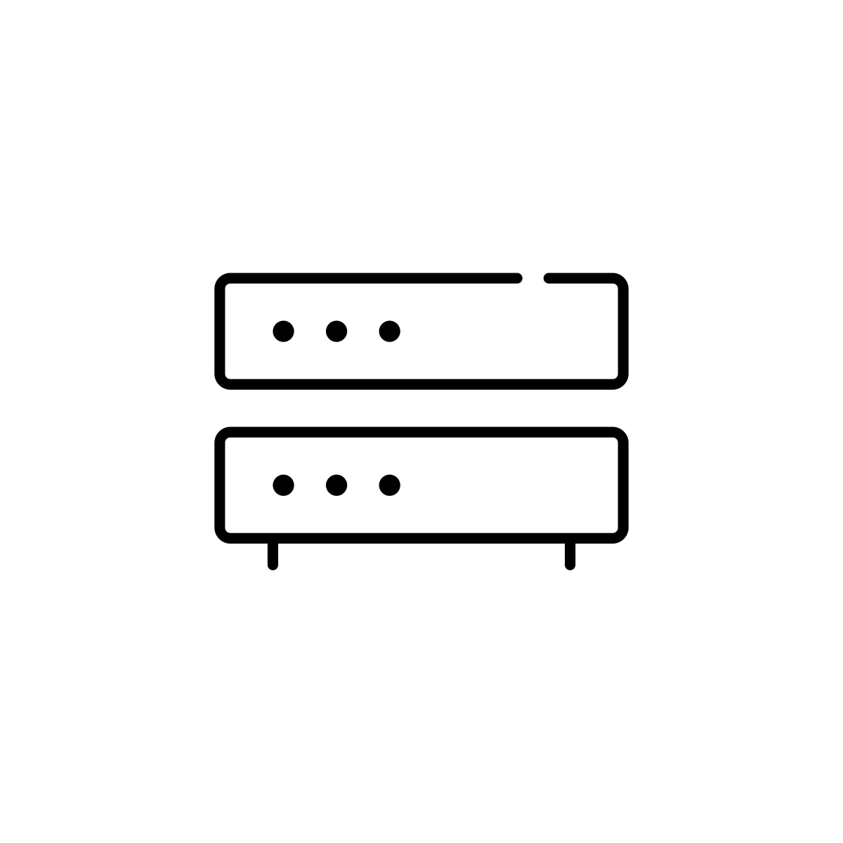





Query
Alt Client
Disk
Stable Store
Client
Server
Alt Server
Response
Router
Cloud
Network

Slide 2
1.
SAddr:192.168.68.10, Sport: 5333
2.
Saddr:203.0.113.22, Sport: 2934
Daddr:198.51.100.2, Dport: 80
Daddr:198.51.100.2, Dport: 80
Client
192.168.68.10
Router with NAT
External address 203.0.113.22
Server
198.51.100.2
4.
SAddr:198.51.100.2, Sport: 80
3.
SAddr:198.51.100.2, Sport: 80
Daddr:192.168.68.10 Dport: 5333
Daddr:203.0.113.22, Dport: 2934
NAT TABLE
192.168.68.10, 5333 → 203.0.113.22, 2934

Slide 3


R2
R3
Ethernet Backbone Link
(Network 3)
PON
(Network 2)
R1
H4
H5
.
.
.
Wi-Fi
(Network 1)
Datacenter Switching Fabric
(Network 4)
H1
H2
H3

Slide 4
H1
R1
R2
R3
H5
TCP
TCP
IP
IP
IP
IP
IP
Wi-Fi
Wi-Fi
PON
PON
ETH
ETH
ETH
ETH

Slide 5
192.96.34.15
192.96.34.139
192.96.33.14
H1
H2
H3
192.96.34.1
192.96.33.1
R1
R2
192.96.34.130
192.96.34.129
Subnet Mask: 255.255.255.128
Subnet Number: 192.96.34.0
Subnet Mask: 255.255.255.128
Subnet Number: 192.96.34.128
Subnet Mask: 255.255.255.0
Subnet Number: 192.96.33.0

Slide 6
Autonomous System 1
Autonomous System 2
R3
R6
R2
R4
R1
R5

Slide 7
Large Corporation
“Consumer” ISP
Peering
Point
Peering
Point
Backbone Service Provider
“Consumer” ISP
“Consumer” ISP
Large Corporation
Small Corporation

Slide 8
Consumer P
(AS 4)
128.96
192.4.153
Regional Provider A
(AS 2)
Consumer Q
(AS 5)
192.4.32
192.4.3
Backbone Network
(AS 1)
Consumer R
(AS 5)
192.12.69
Regional Provider B
(AS 3)
Consumer S
(AS 7)
192.4.54
192.4.23

Slide 9
Consumer P
(AS 4)
128.96
Regional Provider A
(AS 2)
Consumer Q
(AS 5)
Backbone Network
(AS 1)
Consumer R
(AS 5)
Regional Provider B
(AS 3)
Consumer S
(AS 7)

Slide 10
Issuer: RIR
Issuer:RIR
Issuer: ISP_A
Subject: RIR
Subject: ISP_A
Subject: Cust_C
Signed: RIR
Signed: RIR
Signed: ISP_A
Root Certificate
RPKI Certificates Bind
Public Keys to Prefixes

Slide 11
Issuer: RIR
Issuer:RIR
Issuer: ISP_A
Subject: RIR
Subject: ISP_A
Subject: Cust_C
ASN
Prefixes
Signed: Cust_C
Signed: RIR
Signed: RIR
Signed: ISP_A
Root Certificate
RPKI Certificates Bind
Public Keys to Prefixes
ROA Binds Prefixes to ASN

Slide 12
RPKI
Repository
BGP
rsync/RRDP
RPKI
Validator
RPKI-router
To/From Other ASes

Slide 13
AS3
AS4
AS2
AS5
AS1
AS6

