Slide 1
Chapter 1: Introduction
Computer Networks: A Systems Approach

Slide 2
Overview
Today’s Internet connects over 22 billion devices. Those devices are widely distributed across the planet (and in low orbit around the planet), where any one of them can send and receive messages with one or more of the other 22 billion devices. The network itself is a massively distributed system, built from hundreds of millions of switching devices. All of this is in the service of applications as diverse as video conferencing, live and on-demand streaming, e-commerce, social media, automated manufacturing.
This book imagines that we’re setting out to build just such a network. What available technologies would serve as the underlying building blocks, and what kind of software architecture would you design to integrate these building blocks into an effective communication service? Answering this question is the overriding goal of this book. This chapter lays the foundation for doing just that.

Slide 3
Requirements
Scalable
Grow without arbitrary limits
General-Purpose
Support any application
Cost-Effective
Efficiently share resources
High Performance
High Throughput / Low Latency
Other Common Requirements
Secure
Manageable
Reliable (Available)
Evolvable
Tradeoffs Inevitable
Priorities change

Slide 4
Network Architecture
Blueprint for modularizing a network
Same challenge as modularizing any complex system
Added challenge of reaching agreement about interoperating
An architecture is both descriptive and prescriptive
Describes what exists so others can understand it (and build upon it)
Prescribes how to extend and evolve what’s already there
Balancing Act
An architecture is “anchored” by a set of invariants (require agreement)
An architecture is flexible enough to evolve (encourage innovation)

Slide 5
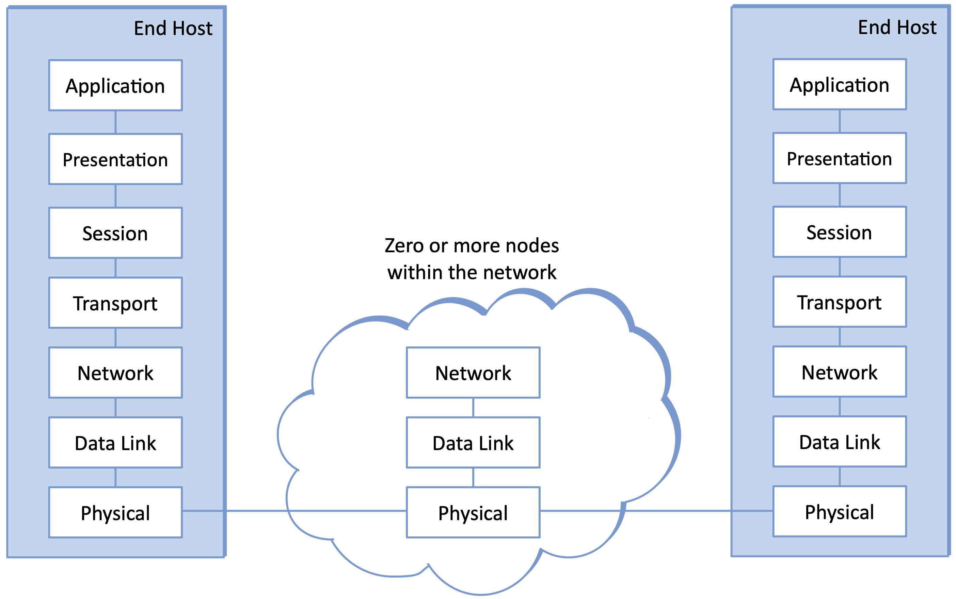
OSI Architecture
Prescribes 7 layers of abstract functionality
Networking through the Telco lens

Slide 6
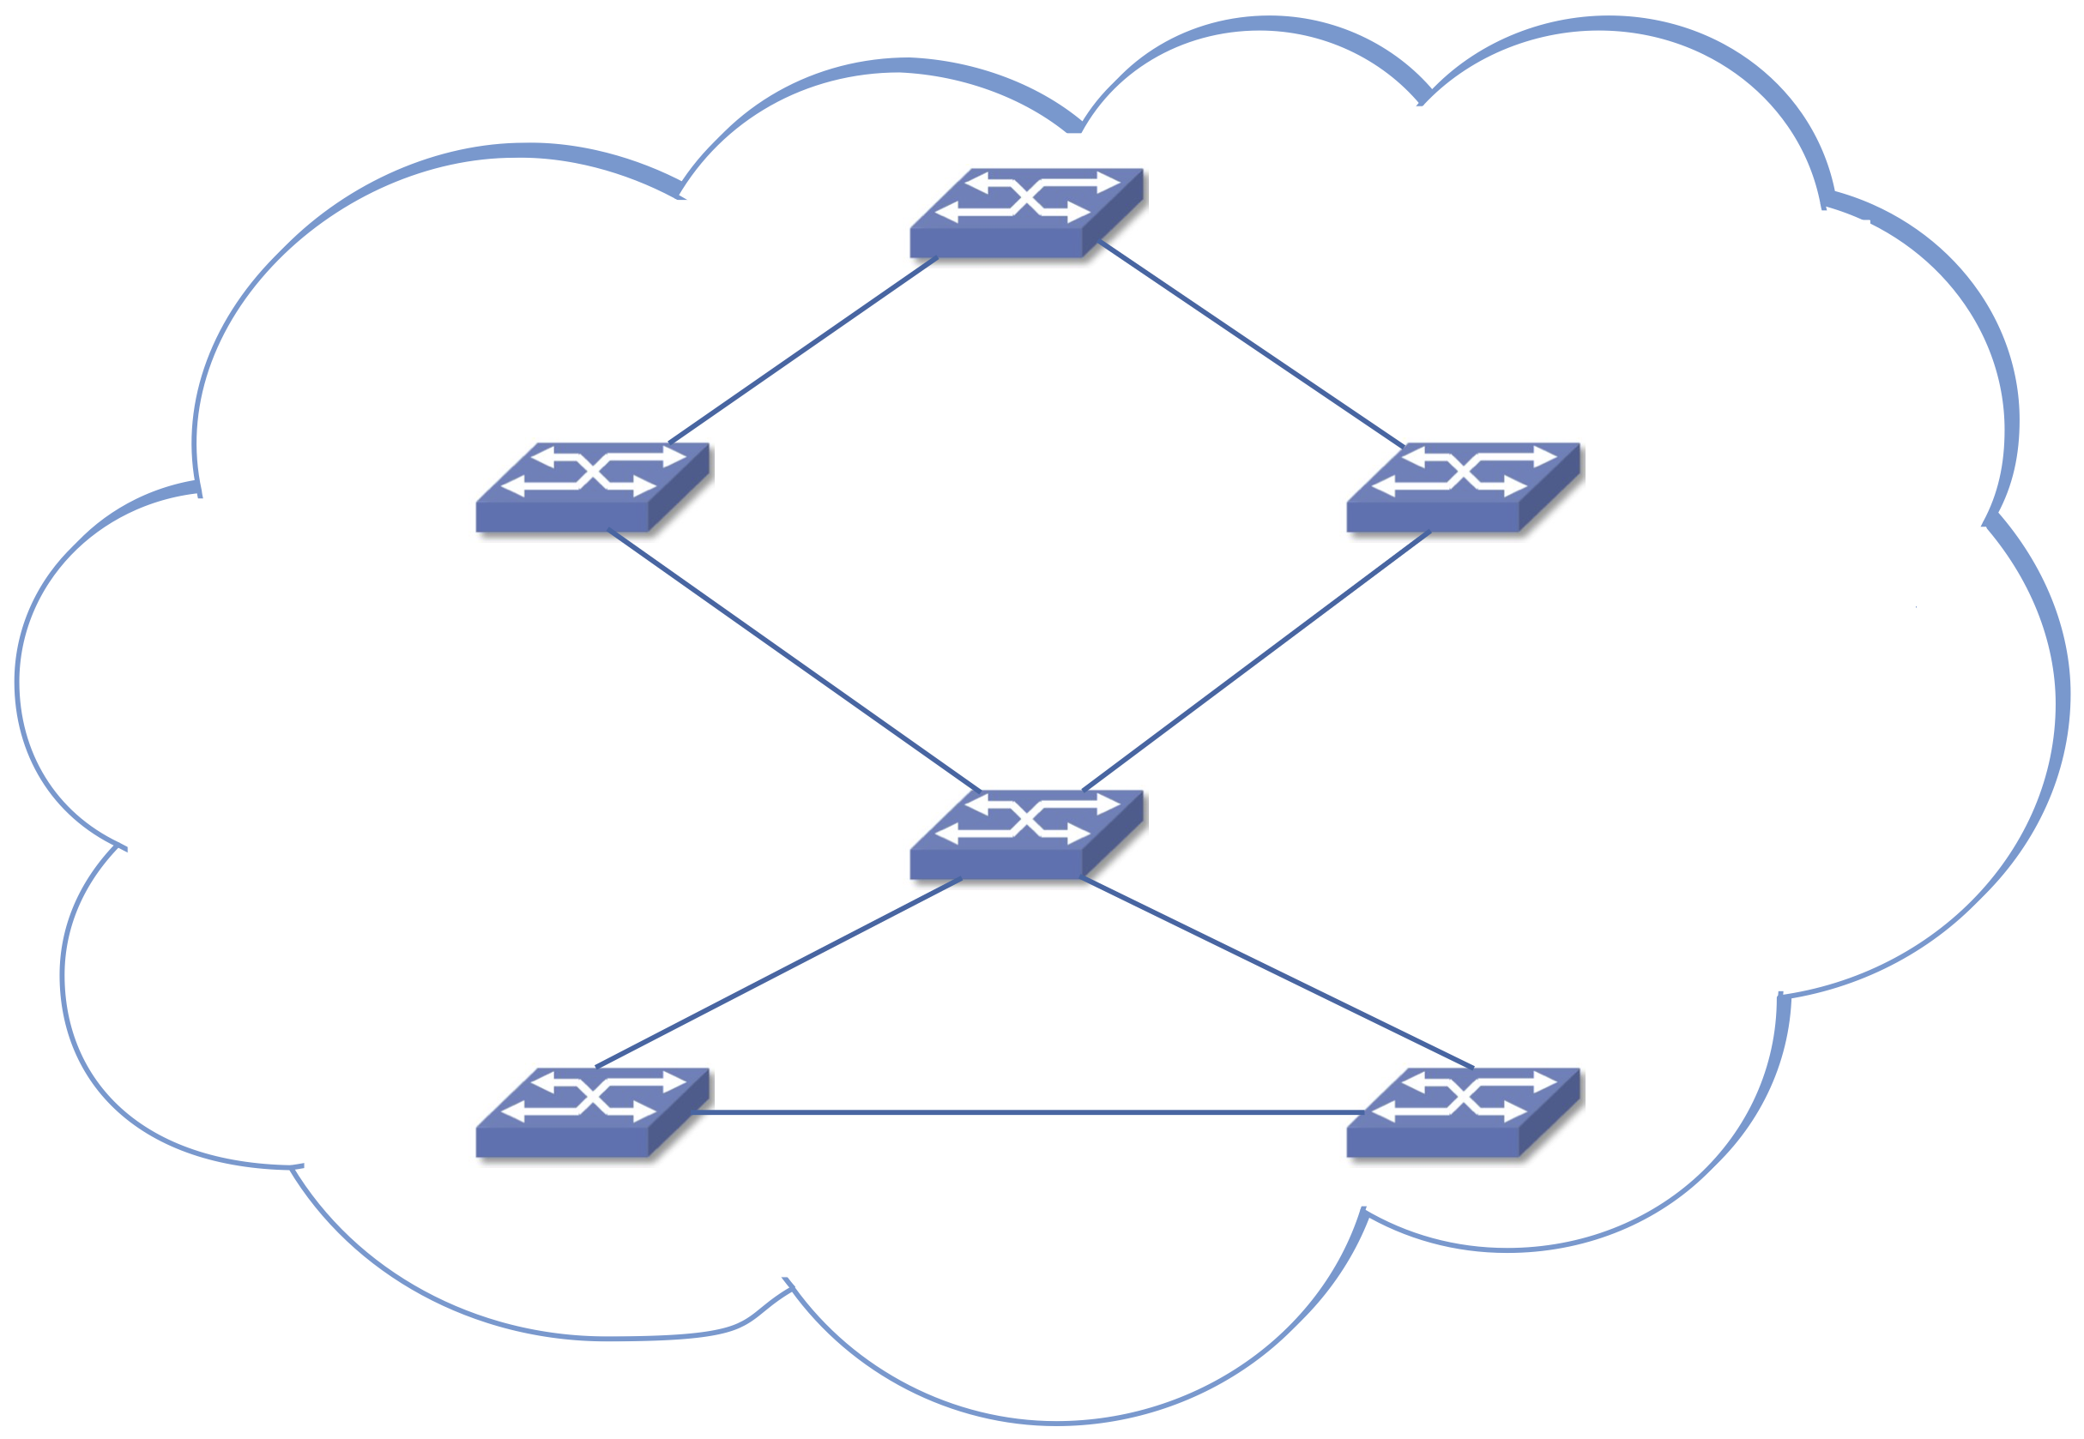
OSI Architecture
Prescribes 7 layers of abstract functionality
Networking through the Telco lens
Outlines role of switching

Slide 7
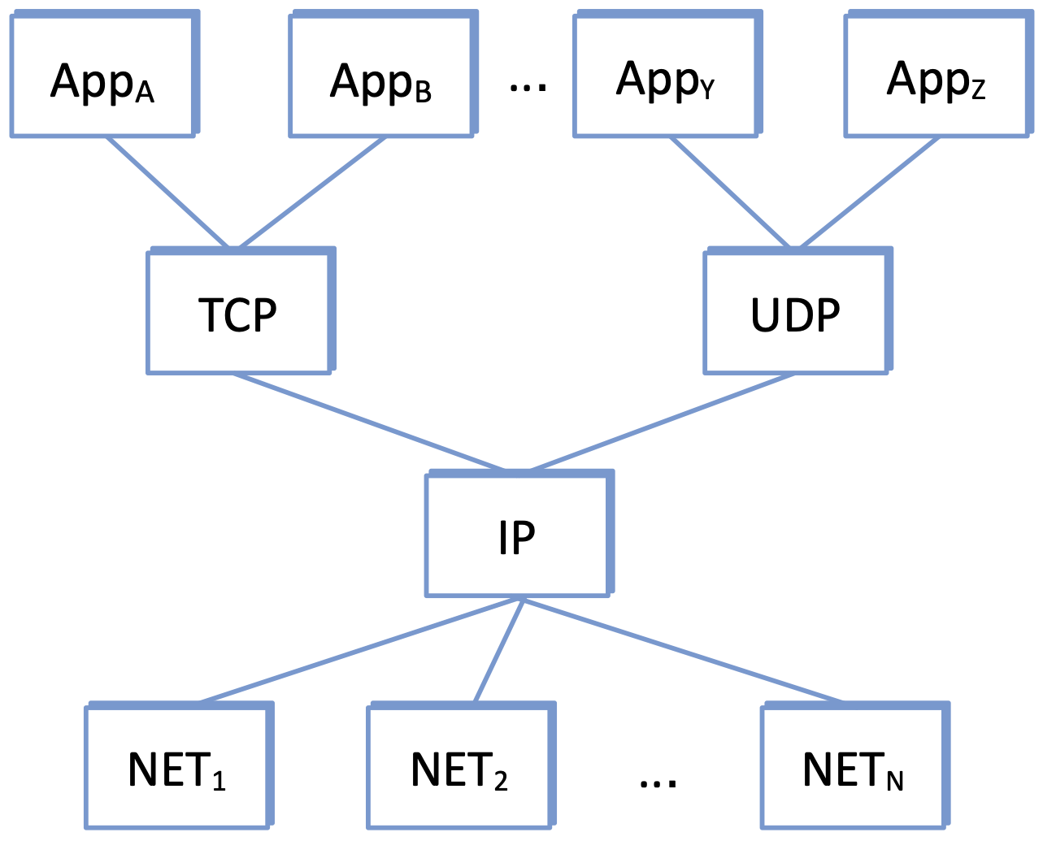
Internet Architecture
Organized around core protocols
Hourglass Shape
Many apps on top
Many link technologies below
IP defines the narrow waist
Universal Connectivity
Best-Effort Packet Delivery

Slide 8
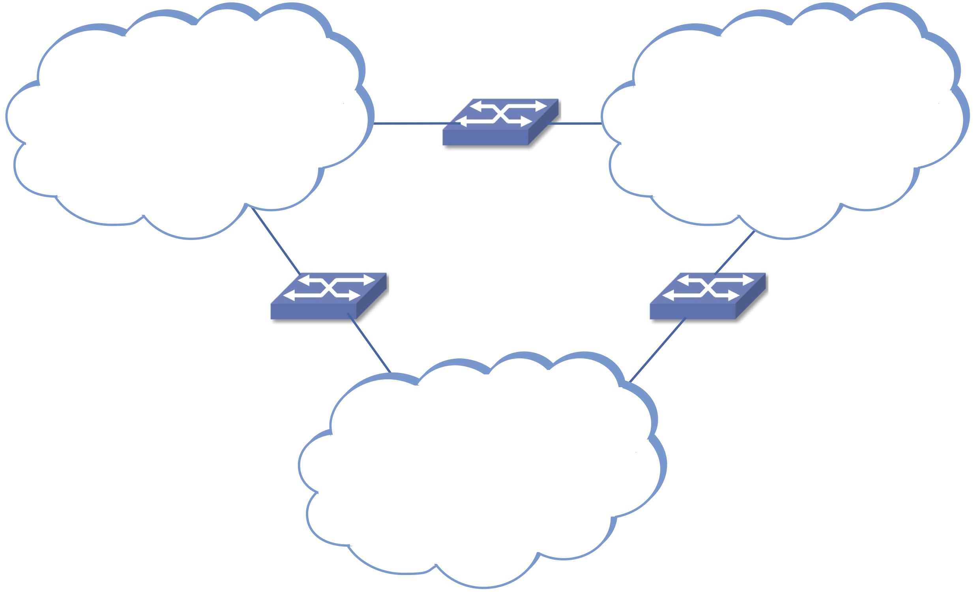
Internet Architecture (cont)
IP is a logical network
Overlayed on physical networks
Powerful idea → Recursive Networks
You can build a network by…
connecting two or more nodes with a link
connecting two more networks with a node

Slide 9
Design Principles
Separation of Concerns
Don’t try to solve all problems (satisfy all requirements) at once
Internet Example
Focus on universal connectivity
Remain agnostic about apps (top) and technologies (bottom)
End-to-End Arguments
Don’t try to solve problems at low levels (inside the network) that can only be fully addressed at high levels (with application knowledge)
Internet Example
Reliable delivery can only be verified end-to-end
Detect (and optionally “fix”) errors inside the network only as an optimization

Slide 10
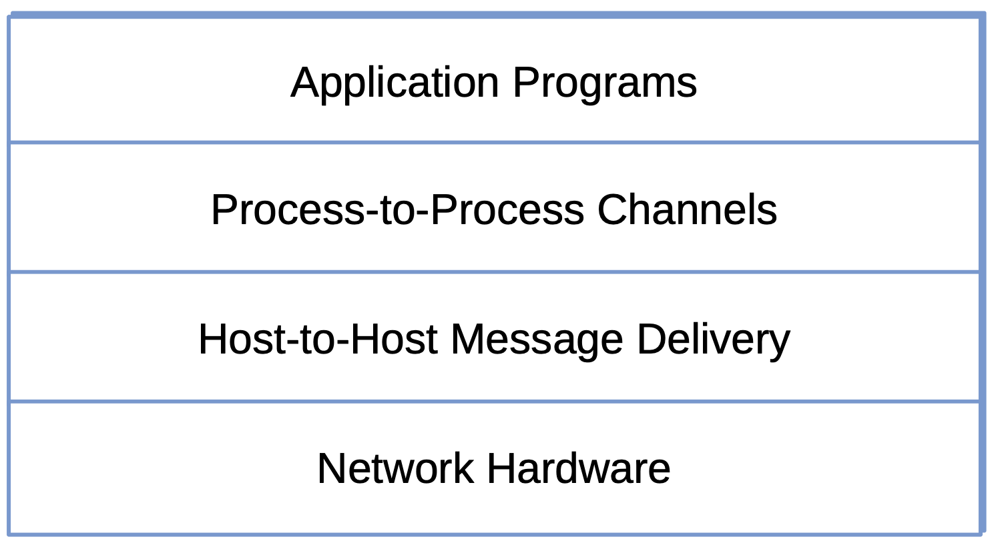
Layering
Approach to modularity
Stack of abstractions
Hardware at the base
Each layer builds on lower-level services
Layers independently replaceable
Internet Example
IP → host-to-host packet delivery
TCP → process-to-process communication channel

Slide 11
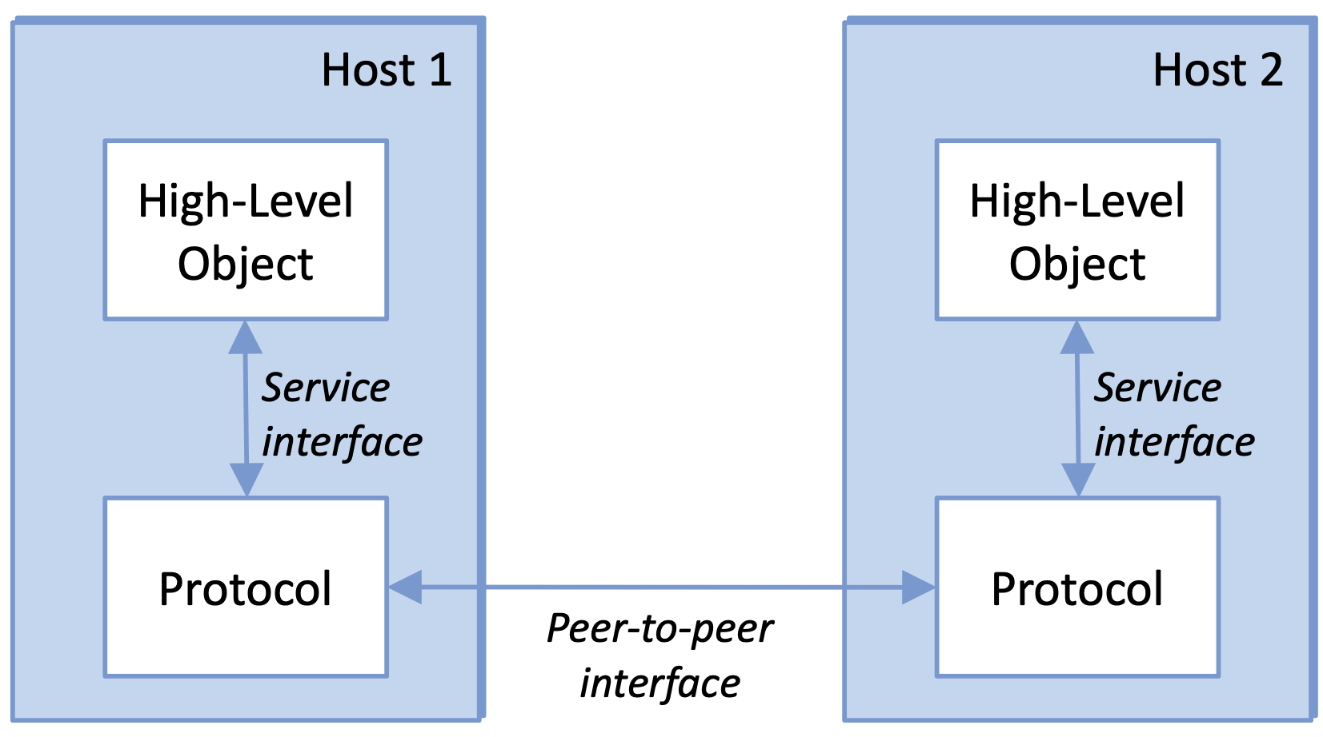
Protocols
Network module
Defines two interfaces
Service interface: operations exposed to layer above
Peer interface: message format exchanged with remote peer

Slide 12
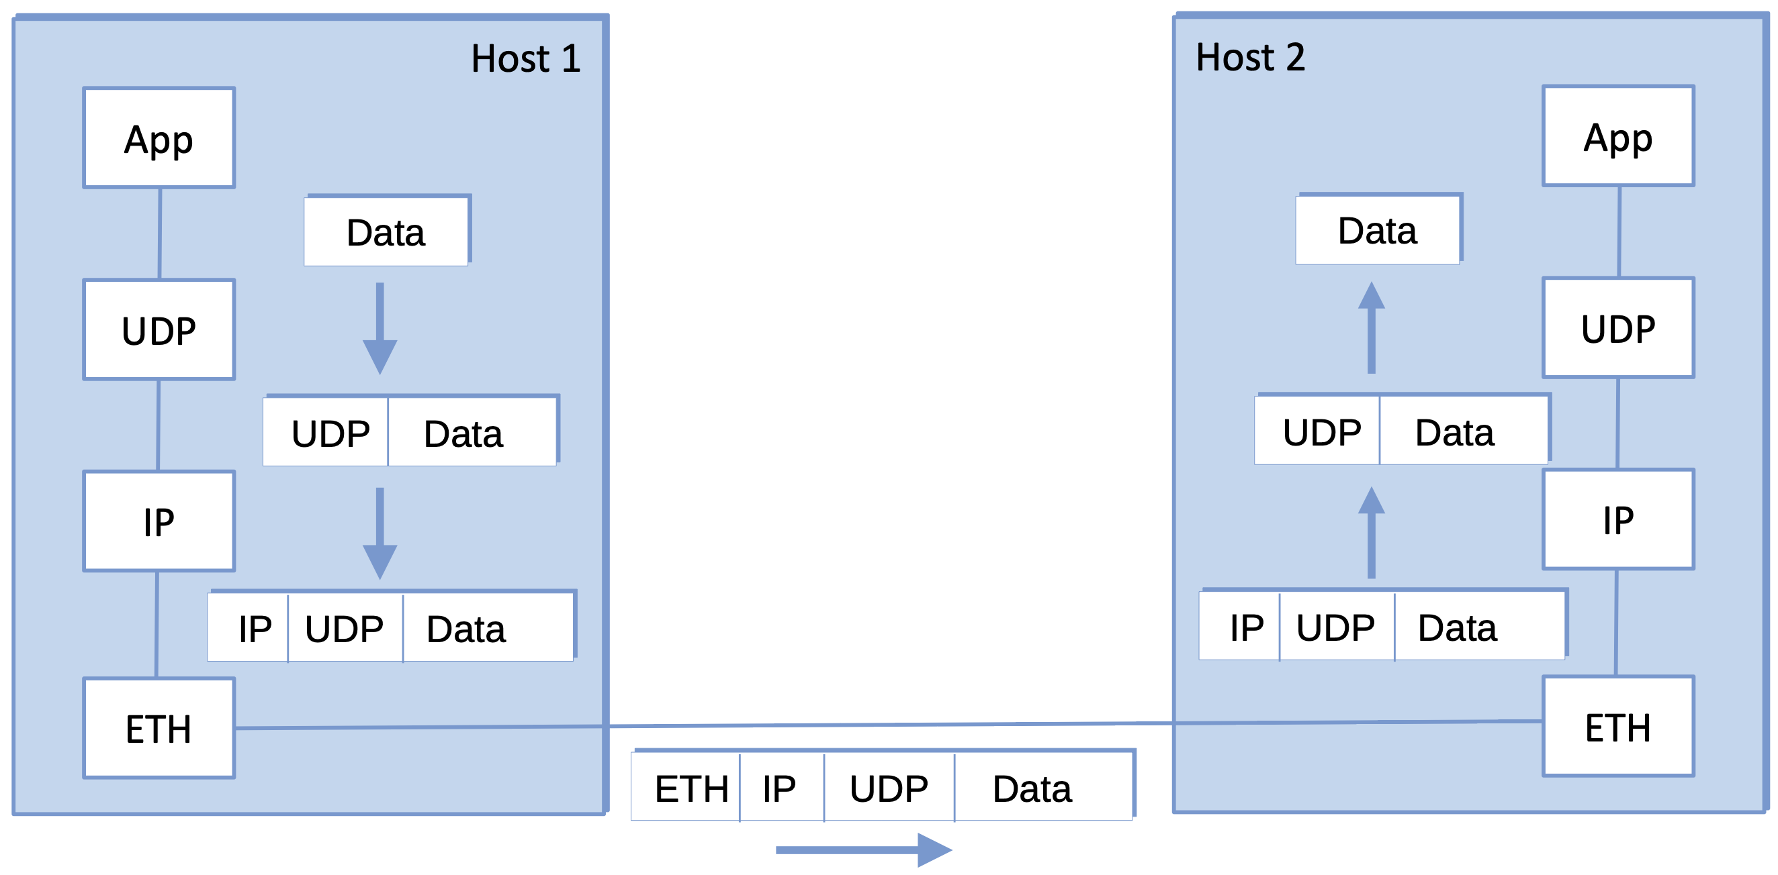
Encapsulation
Each layer prepends a header (control info for its peer)
Payload untouched by intermediate nodes
Destination strips headers in reverse order

Slide 13
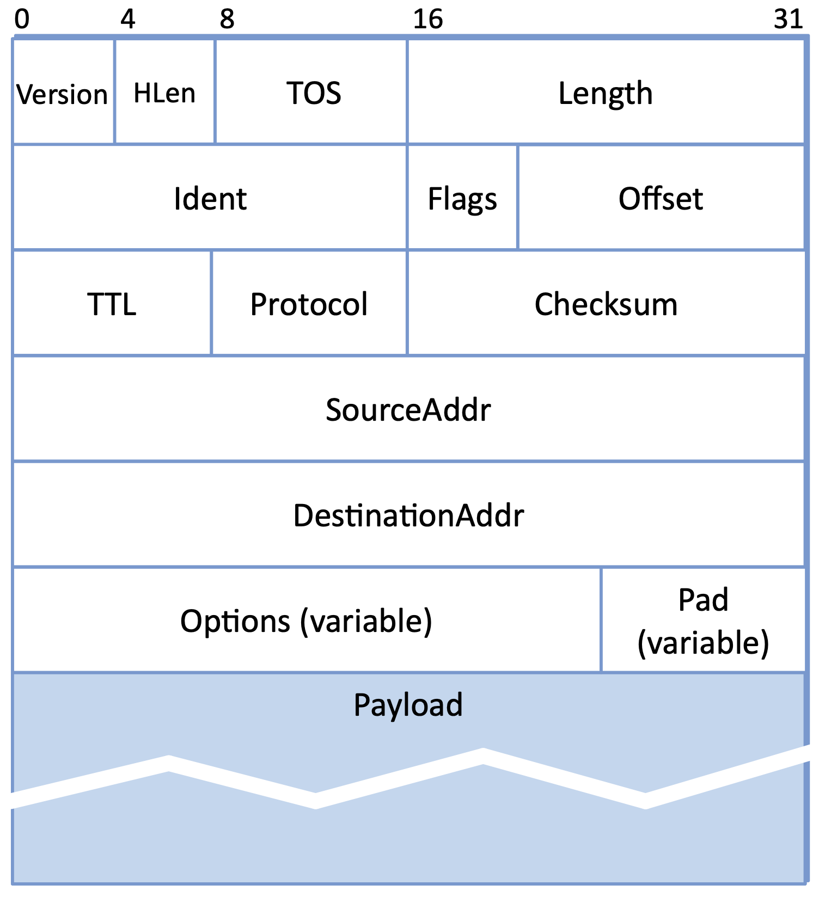
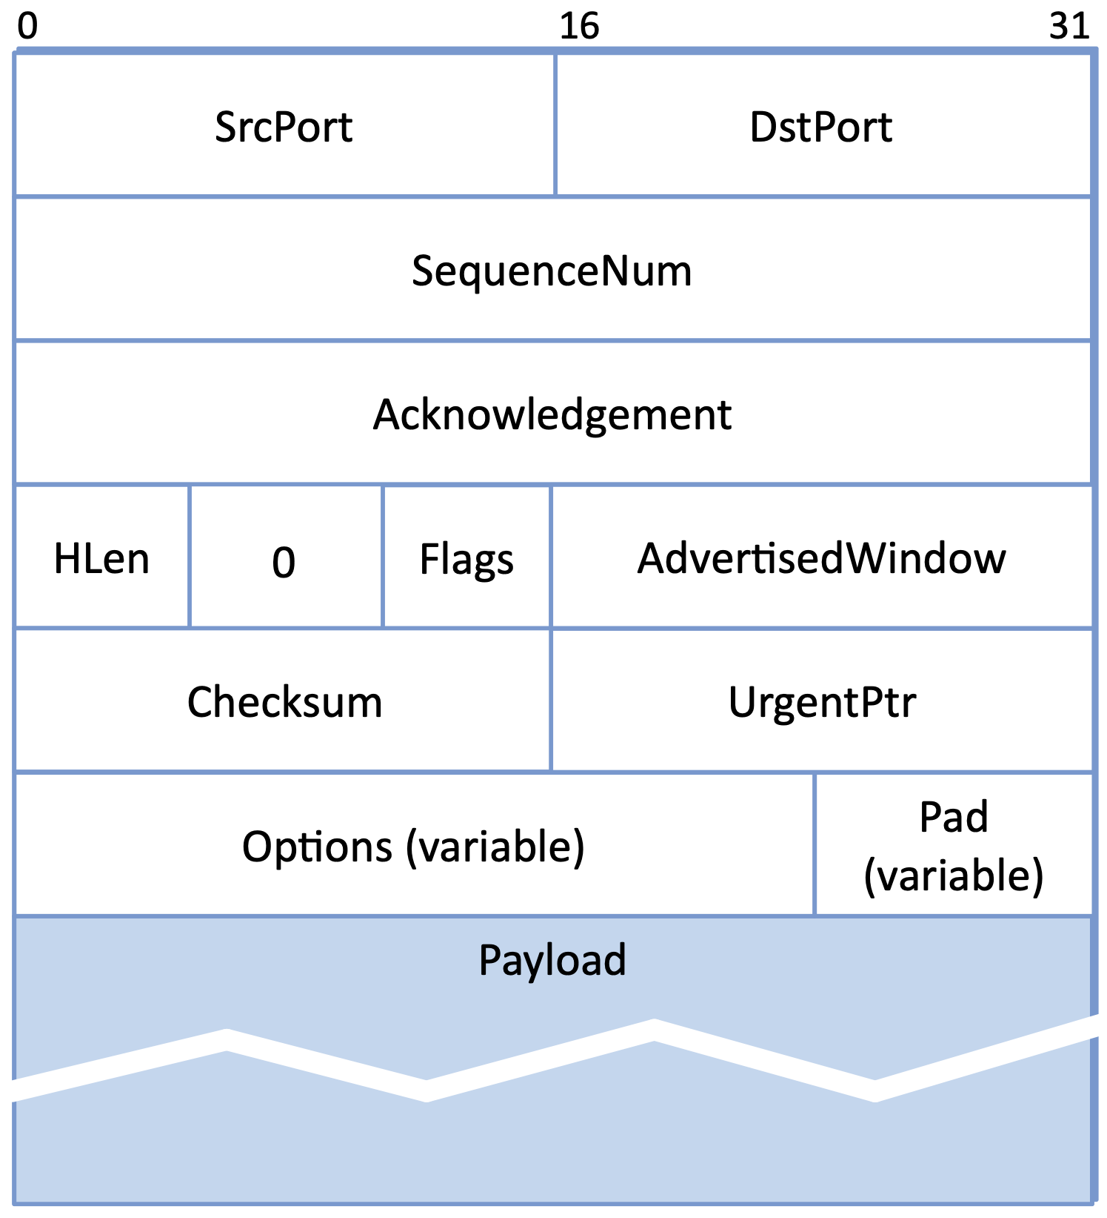
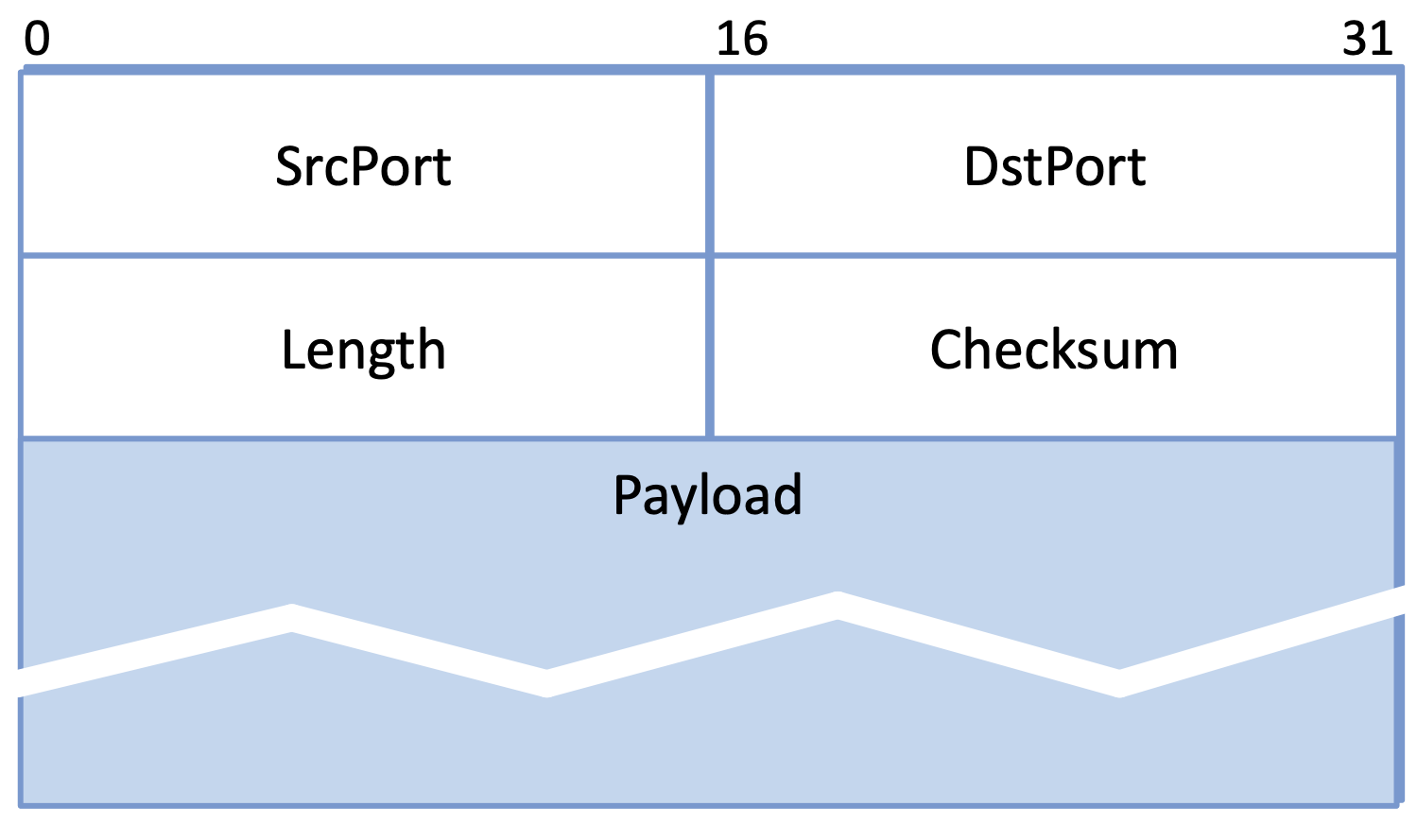
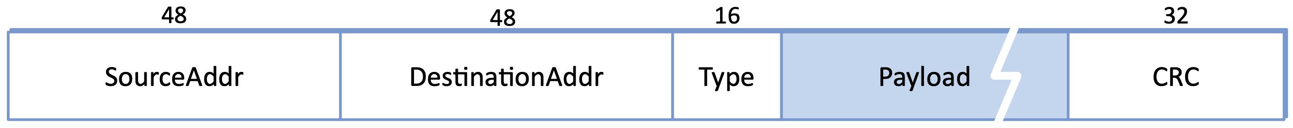
Example Headers
UDP
IP
TCP
ETH

Slide 14
Protocol Specifications
Abstract definition
Prose, pseudocode, state diagrams, packet header diagrams
RFCs give examples for Internet protocols
Key requirement: different implementations must interoperate
Focus typically on the peer-to-peer interface
Common service interface lowers barrier to use, but not required

Slide 15
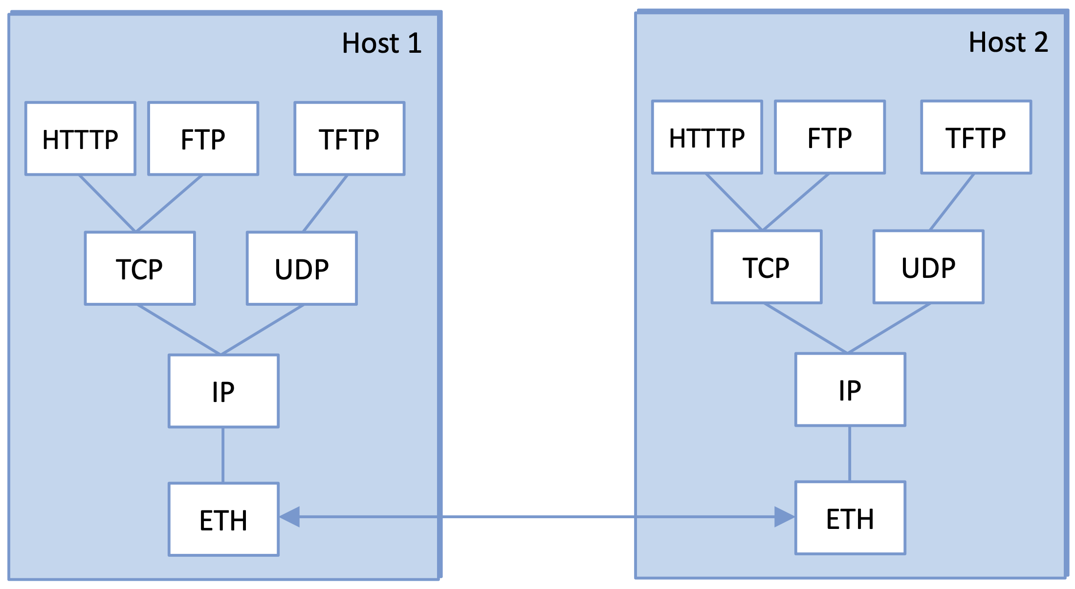
Multiplexing and Demultiplexing
Common for multiple users (apps or protocols) to share a protocol
Demux key in header identifies the intended recipient
No universal format
ETH: 16-bit Type field
IP: 8-bit Protocol field
TCP/UDP: pair of 16-bit Port fields

Slide 16
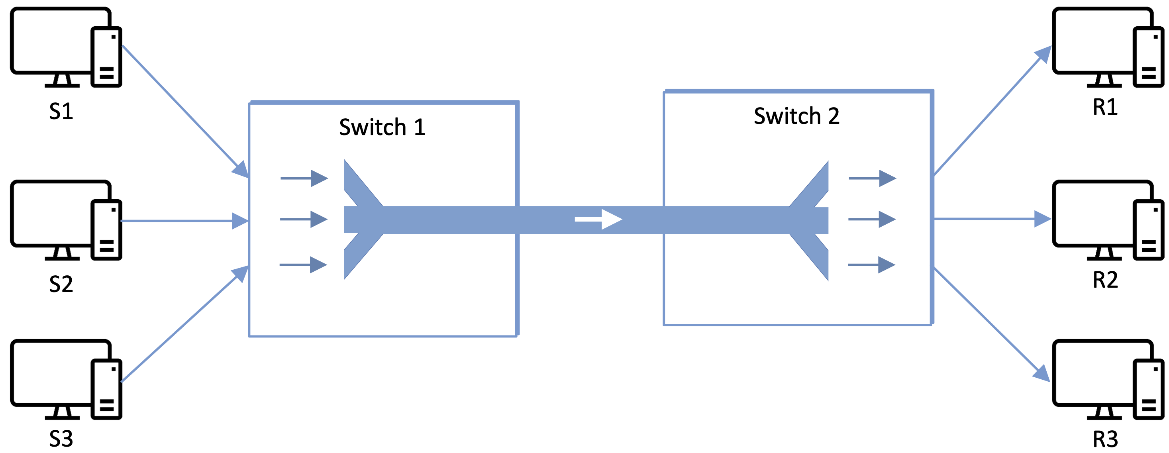
Multiplexing (More Generally)
About how to share resources
Synchronous TDM (STDM)
Fixed time slots per flow
Frequency Division (FDM)
Fixed frequency band per flow
Limitation
Idle slots waste capacity
Fixed number of flows

Slide 17
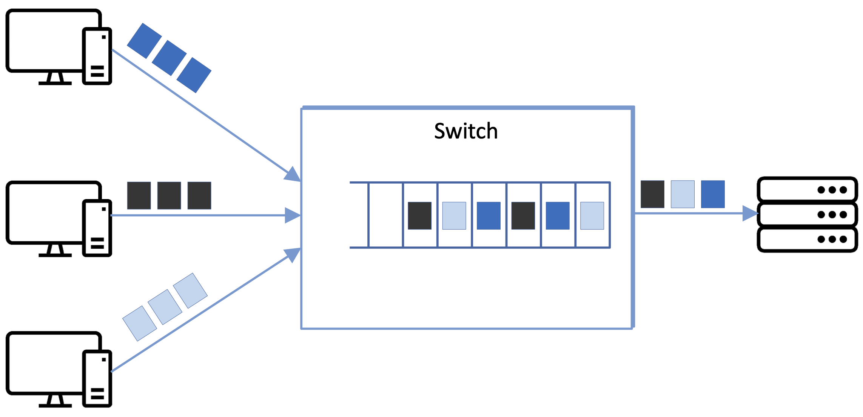
Statistical Multiplexing
Transmit on demand
Packets define “scheduling interval”
Queue packets waiting service
e.g., FIFO
Congestion
Input rate exceeds output rate
Packet buffer overflows
No choice but to drop some packet

Slide 18
Performance Metrics
Bandwidth / Throughput
Measured in bits-per-second (bps)
Limited by spectrum “bandwidth” (e.g., 10 MHz implies 10 Mbps)
Latency / Response Time / Delay
Measured in seconds (ms, µs)
One way: Propagation + Transmission + Queuing
Transmission = TransferSize / Bandwidth
Round-trip (RTT)
Intuition
Small transfers: RTT-dominated
Large transfers: bandwidth-dominated

Slide 19
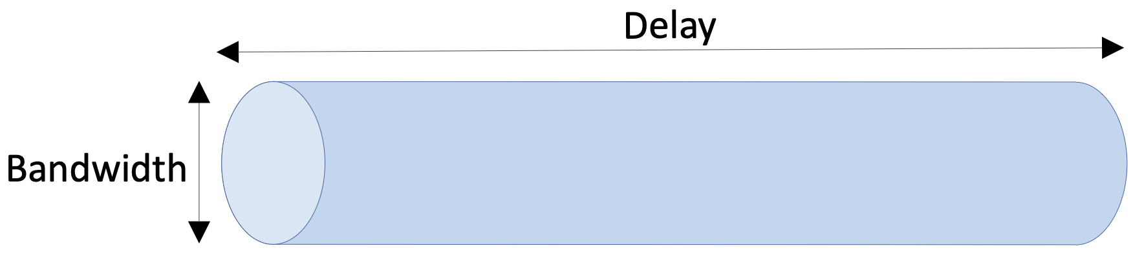
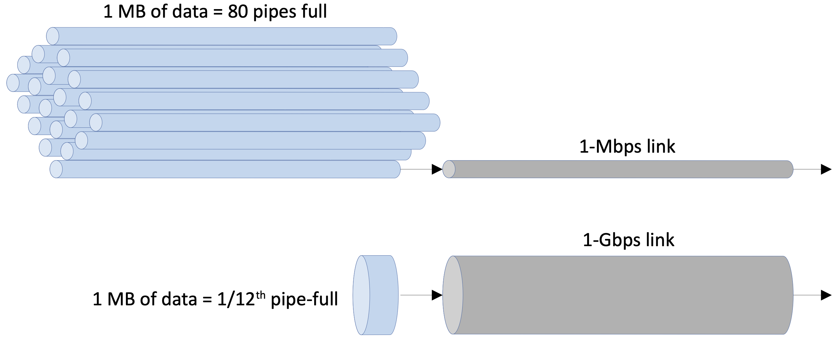
Delay × Bandwidth Product
Bits "in flight"
Typically RTT × Bandwidth
Goal is to ”keep the pipe full"
Otherwise measured xput suffers
As bandwidth → ∞
Latency becomes the bottleneck
Physics (speed of light)

Slide 20
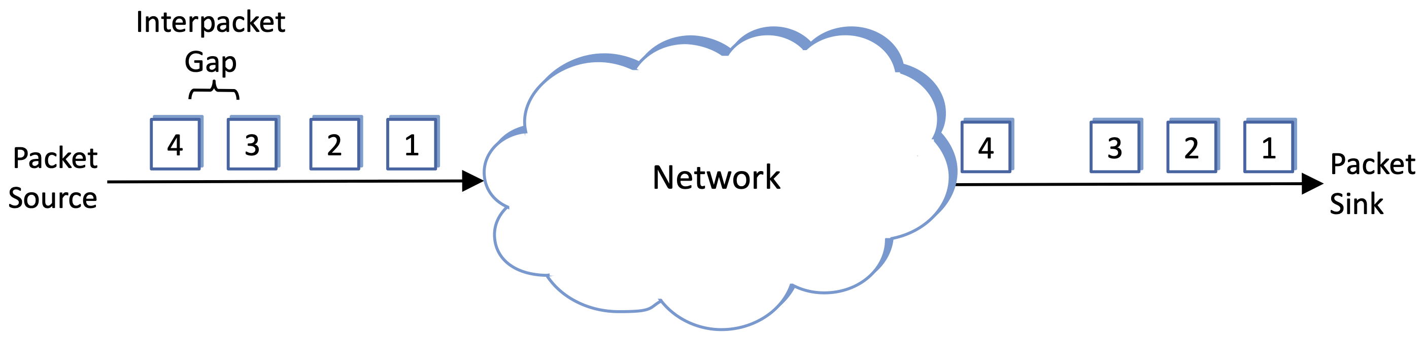
Application Requirements
Some applications can use as much bandwidth as the network can deliver
shorter downloads
Some applications care about delay
faster response times
Some applications care about jitter: minimize variation in delay
predictable arrival rate

