Slide 1
Chapter 2: Network Applications
Computer Networks: A Systems Approach

Slide 2
Overview
The genius of the Internet is that it is designed to support any application. Those applications are implemented in software and run on general-purpose computers. This chapter introduces this application ecosystem, setting the stage for understanding everything it takes to support it.

Slide 3
Client-Server Computing
Dominant application programming paradigm
Client initiates / Server responds
Each application defines its own protocol
e.g., HTTP, SMTP
Typically runs on top of TCP/IP
Provided as part of the OS
Socket API provides the programming interface
Originally defined in BSD Unix
Now universal across all operating systems
Often wrapped in a language-specific library (e.g., java.net)

Slide 4
Socket API
Server performs a passive open; blocks waiting for requests
Client performs an active open
Both sides exchange messages
bind(sock, &addr, len);
listen(sock, backlog);
new_sock = accept(sock, &peer, &len);
connect(sock, &addr, len);
send(sock, msg, len, 0);
recv(sock, buf, len, 0);
/* Server */
bind(sock, &addr, len);
listen(sock, backlog);
new_sock = accept(sock, &peer, &len);
/* Client */
connect(sock, &addr, len);
/* Both */
send(sock, msg, len, 0);
recv(sock, buf, len, 0);

Slide 5
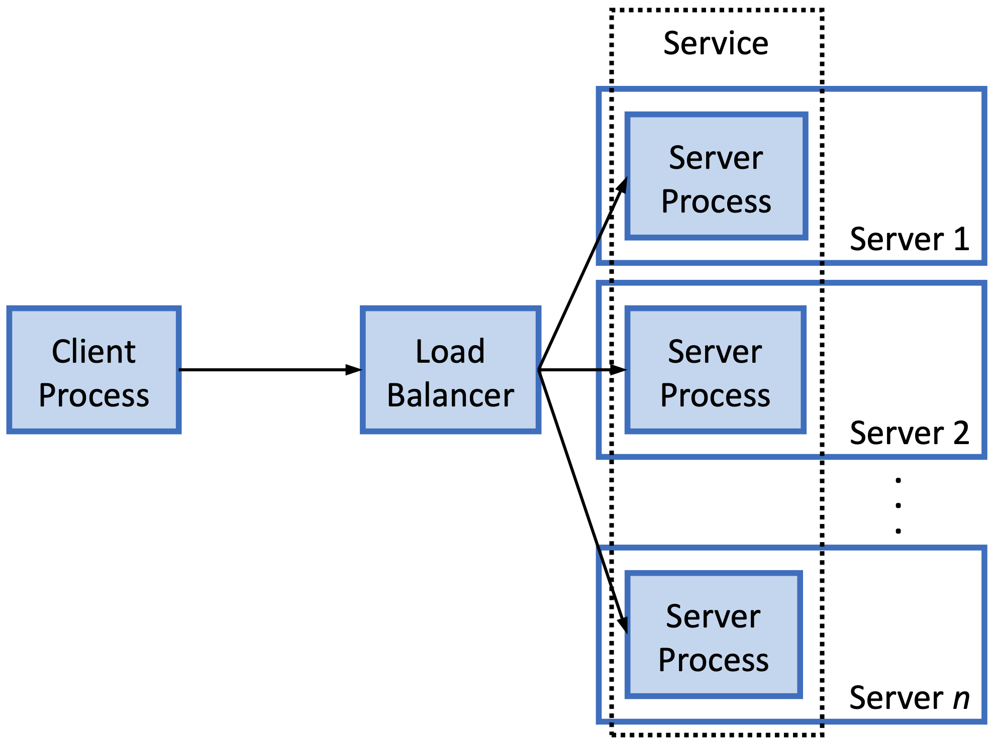
Scalable Services
Cloud scales server side
Load balancer distributes requests across a pool of backend instances
Instances ~ Containers
Client see a single IP address
Makes request to a service

Slide 6
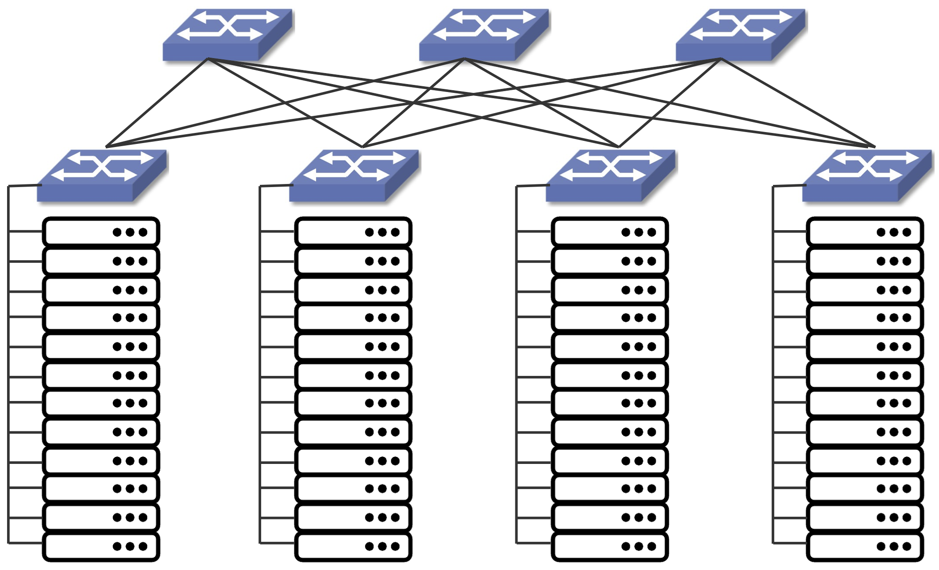
Scalable Services: Datacenter
Leaf-spine Datacenter Fabric
Commodity Switches
Example shows two-level fabric
Leaf (Top-of-Rack) Switches
Connect servers within a rack
Spine Switches
Connect leaf switches across racks
Supports multiple paths

Slide 7
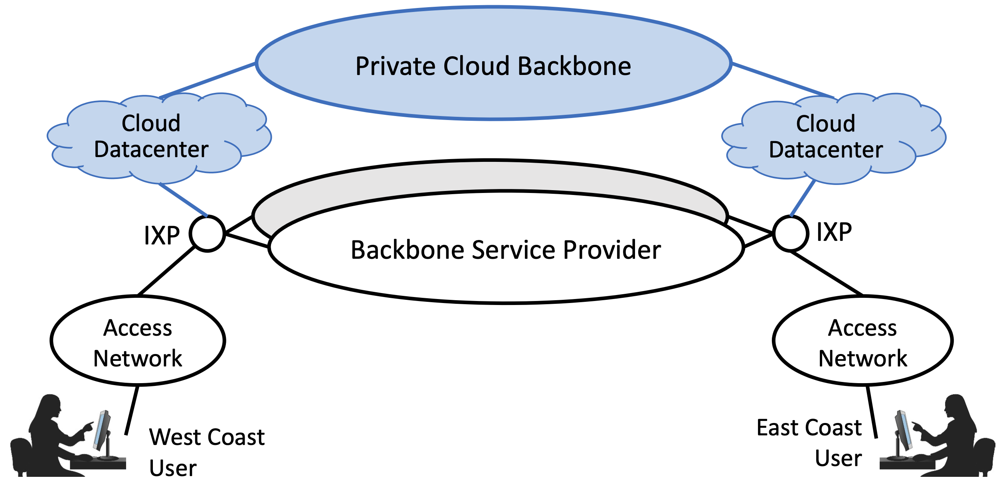
Distributed Services
Replicate service over multiple sites
Lower Latency: serve from nearby site
Higher Capacity: aggregate resources
Higher Availability: survive site failure
5000+ cloud sites worldwide
Hyperscale datacenters
Edge locations (e.g., IXP)
Internet and Cloud are Symbiotic
Cloud runs over Internet protocols
Internet functions run on cloud servers

Slide 8
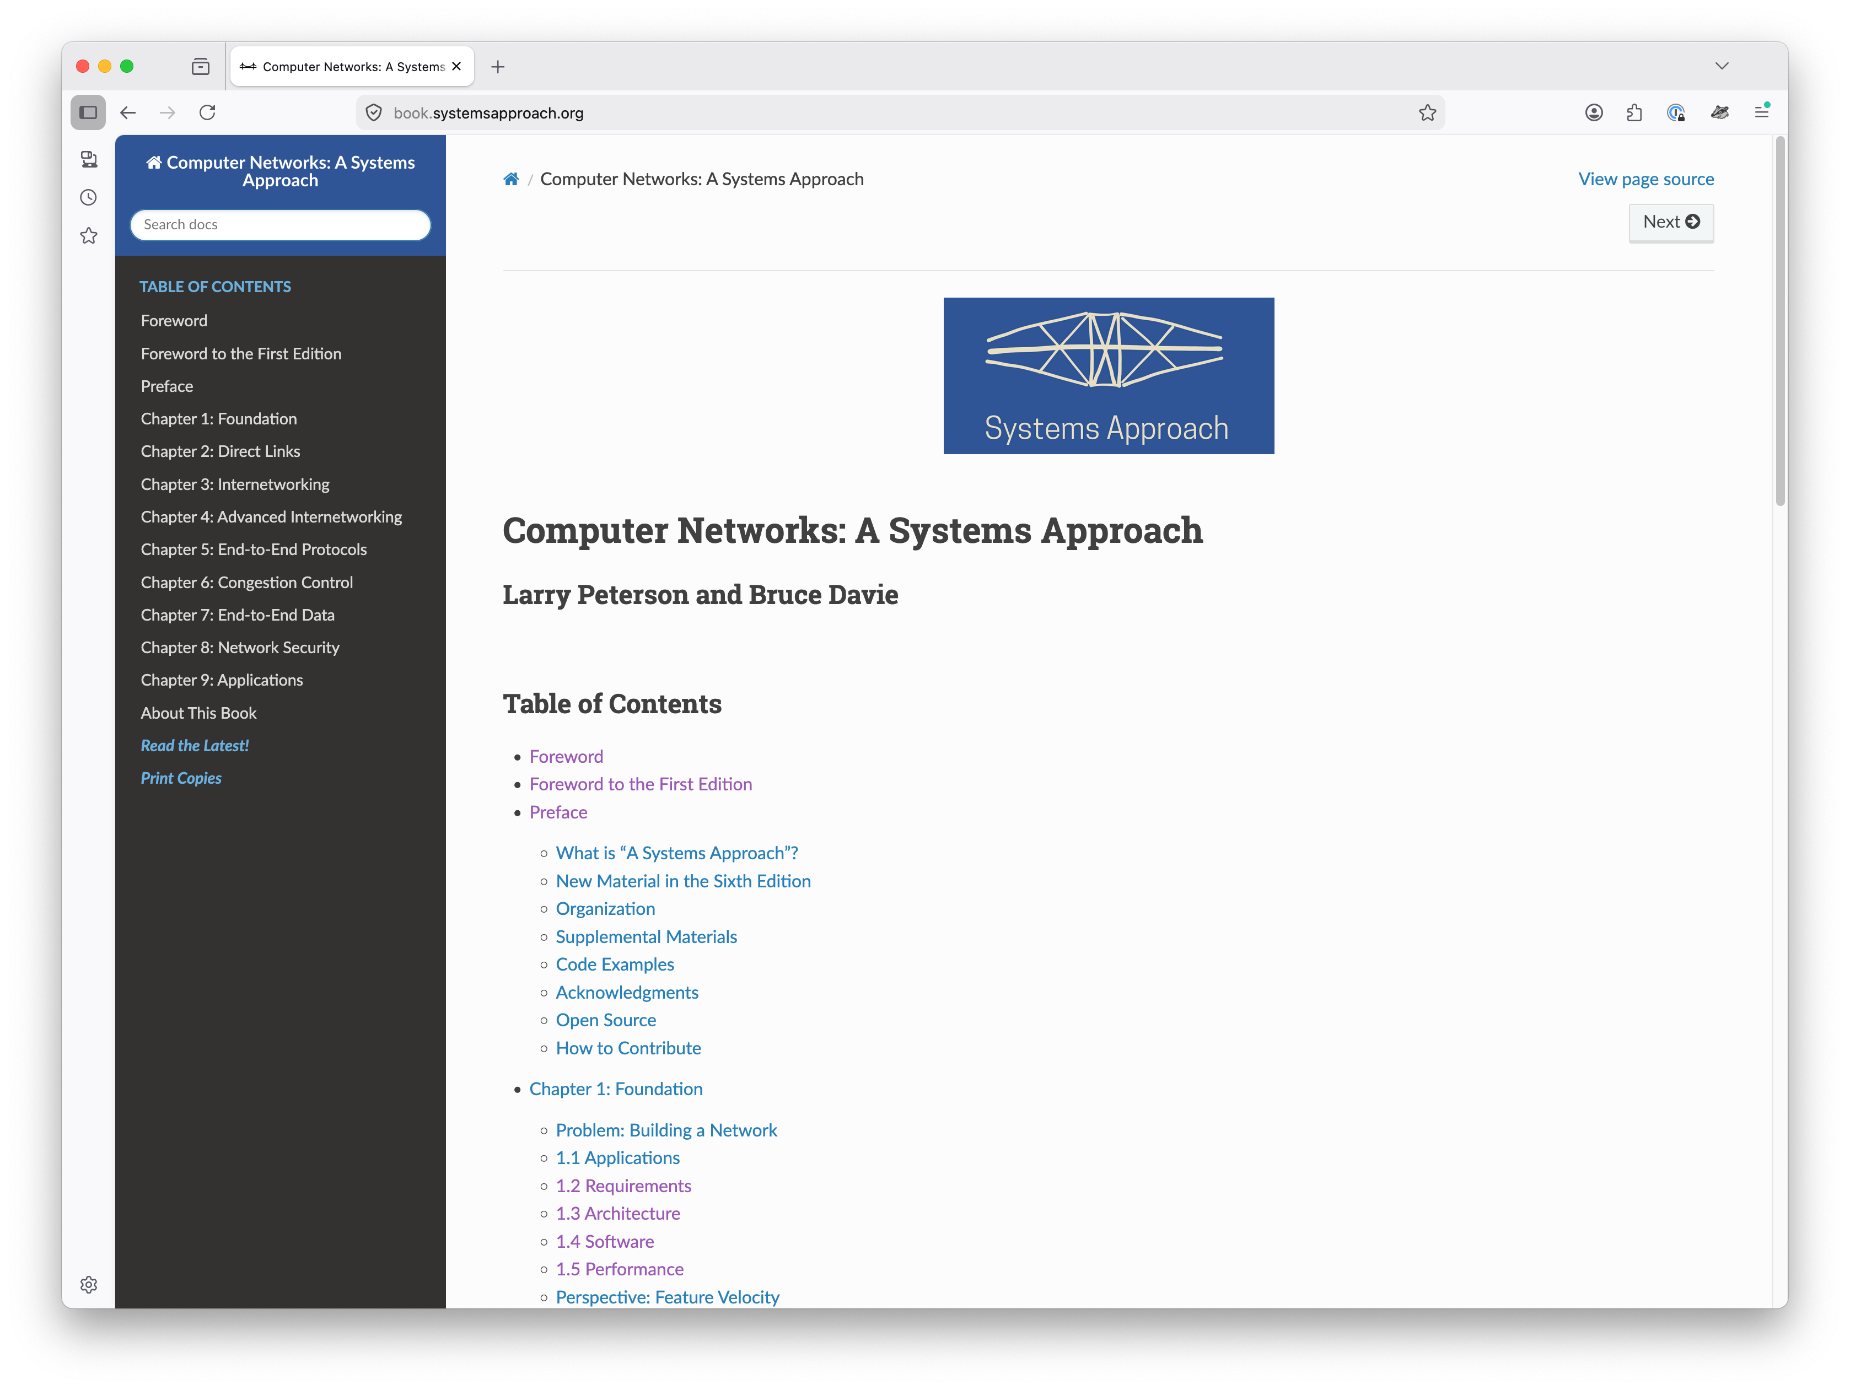
HTTP: From Application to Framework
HTTP began as the protocol of the World Wide Web
Has evolved into a framework for Internet applications
Mobile apps, video streaming…
Request/Response Protocol
and more…

Slide 9
Request/Response Protocol
Request: Method + Resource (named by URL)
GET (retrieve), POST (submit), PUT (update), DELETE (remove)
Response: 3-digit status code + reason phrase
2xx success, 3xx redirect, 4xx client error, 5xx server error
HTML and HTTP are companion standards
Data format separate from transfer protocol
Easy to substitute other formats (e.g., XML)

Slide 10
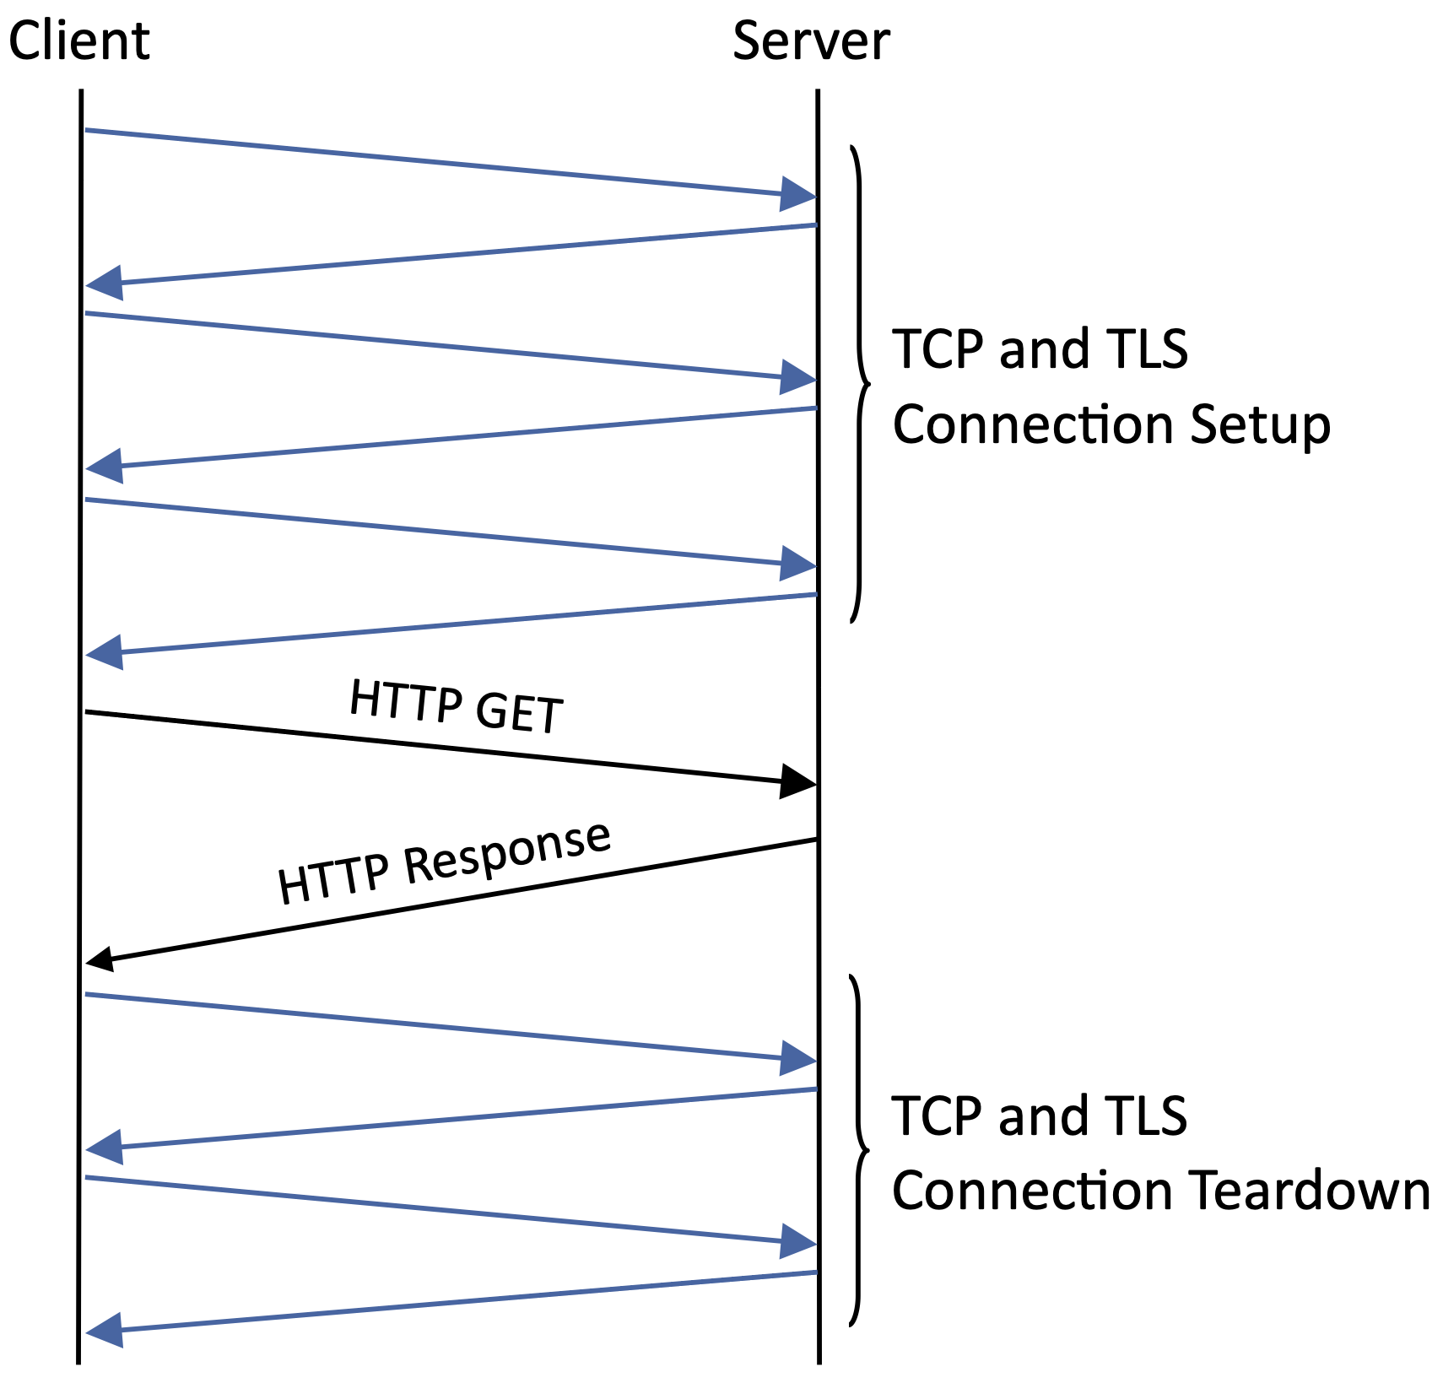
Connection Overhead
HTTP 1.0
One TCP connection per object
Page with 12 images → 13 TCP connections
TLS adds additional round trips
HTTP 1.1
Persistent connections
Reuse one TCP for multiple requests
HTTP/2
Multiplexed streams
Concurrent request/response pairs on one TCP
HTTP/3 & QUIC
Replaces TCP entirely
See Chapter 15

Slide 11
Naming Scheme
URI: Uniform Resource Identifier
Names any resource on the Internet
Format: scheme + scheme-specific part
URL: Uniform Resource Locator
URI that also locates the resource
https://book.systemsapproach.org/index.html (the familiar form)
URN: Uniform Resource Name
URI that gives a persistent name without implying a location
doi:10.17487/RFC0791 (identifies RFC 791 regardless of where it's hosted)

Slide 12
Caching Infrastructure
Two Benefits
Reduces response time
Reduces server load
Where do caches live?
Browser
Site Proxy
CDNs: Overlay network with caches distributed globally
HTTP explicitly supports caching
Expires Header: cache valid until this time
Conditional GET: server returns page only if modified since last fetch
302 Redirect
Routes clients to nearest cache — intrinsic part of a CDN (Chapter 16)

Slide 13
RESTful API
ReST: Architectural style underlying the Web
Representable State Transfer (Fielding, 2000)
Everything is a resource, identified by a URI
HTTP methods parallel Object Oriented Programming
CRUD: Create, Read, Update, Delete
HTTP: POST, GET, PUT, DELETE
Payload carries state representation
e.g., JSON, XML
Reuses web infrastructure
Proxies, CDNs, and Caches work automatically

Slide 14
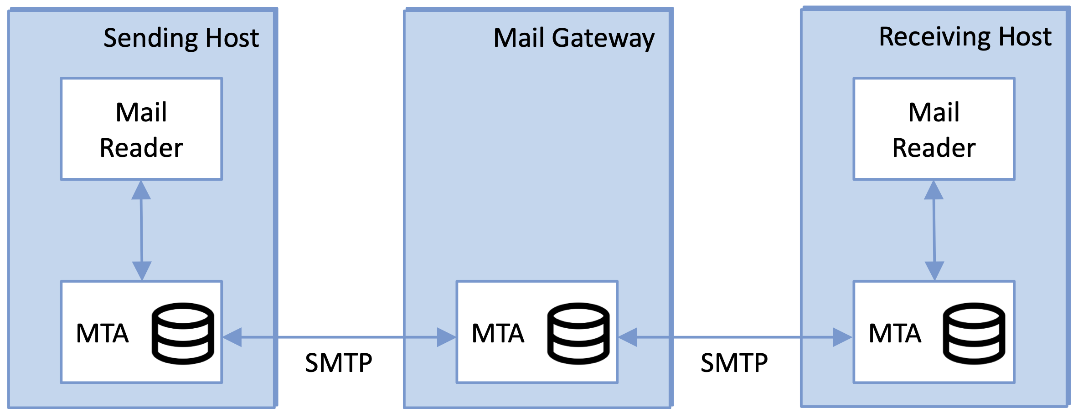
Electronic Mail
Email
Internet's original killer app
Example of pre-web design
Mailbox Abstraction
Rendezvous point for messages
SMTP
Send mail to a mailbox
Store-and-forward via MTAs
IMAP / POP
Retrieve mail from a mailbox
Modern Web Mail (e.g., Gmail)
HTTPS/ReST replaces IMAP

Slide 15
Message Format
RFC 822 / 5322
Header + Body (both as ASCII text)
Headers: To, From, Subject, Date, Received
MIME (1992)
Extends email to carry binary content
Content-Type declares the data type
e.g., image/jpeg, audio/mp3, multipart/mixed
Base64 maps binary to ASCII

Slide 16
Message Transfer
MTA (Message Transfer Agent)
Both client and server sides
Store-and-forward
Each MTA buffers to disk
Retries for days if needed
Hides organization internals
SMTP defines the Protocol
ASCII command/response dialog
Influenced HTTP’s design
HELO cs.princeton.edu
250 Hello daemon@mail.princeton.edu
MAIL FROM:<bob@princeton.edu>
250 OK
RCPT TO:<alice@systemsapproach.org>
250 OK
DATA
354 Start mail input; end with <CRLF>.<CRLF>
...message body...
.
250 OK
QUIT
221 Closing connection

Slide 17
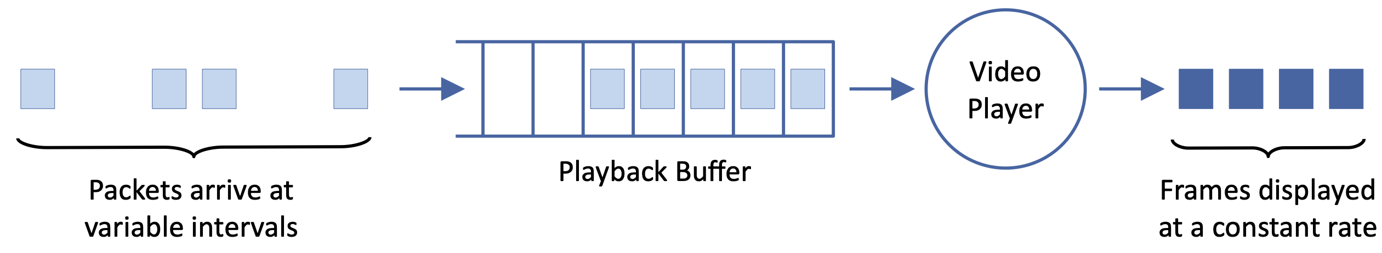
Adaptive Streaming
Video must adapt to variable network capacity
DASH (Dynamic Adaptable Streaming over HTTP)
Store video as N quality levels × M time segments
Client downloads MPD manifest
Issue HTTP GET requests for one segment one at a time
Each segment is an opportunity to request a different quality level
Buffer draining → request lower quality
Buffer filling → try higher quality

Slide 18
Rate Adaptation
Goal: match video bitrate to available bandwidth
Two mechanisms working in tandem
TCP's congestion control adjusts sending rate
DASH adapting volume of traffic being sent
Key Tradeoffs
Stability: frequent quality switches more annoying than a steady lower quality
Responsiveness: slow reaction wastes bandwidth or causes stalls
Real-time video conferencing cannot use buffered streaming
Needs < 300ms end-to-end latency
Requires a different approach (Chapter 17)

