Slide 1
Chapter 3: Packet Switching
Computer Networks: A Systems Approach

Slide 2
Overview
For any system you set out to build, you first have to identify the available building blocks. Throughout its history, many network technologies have come and gone, but Ethernet has survived and adapted to become a ubiquitous building block. This chapter describes Ethernet (both as a link technology and a switching technology), which then serves as the foundation for everything else that makes up the Internet.*
*Of course wireless networks are important (and we cover them in Chapter 5), but as a foundational chapter, we need to start with switches.

Slide 3
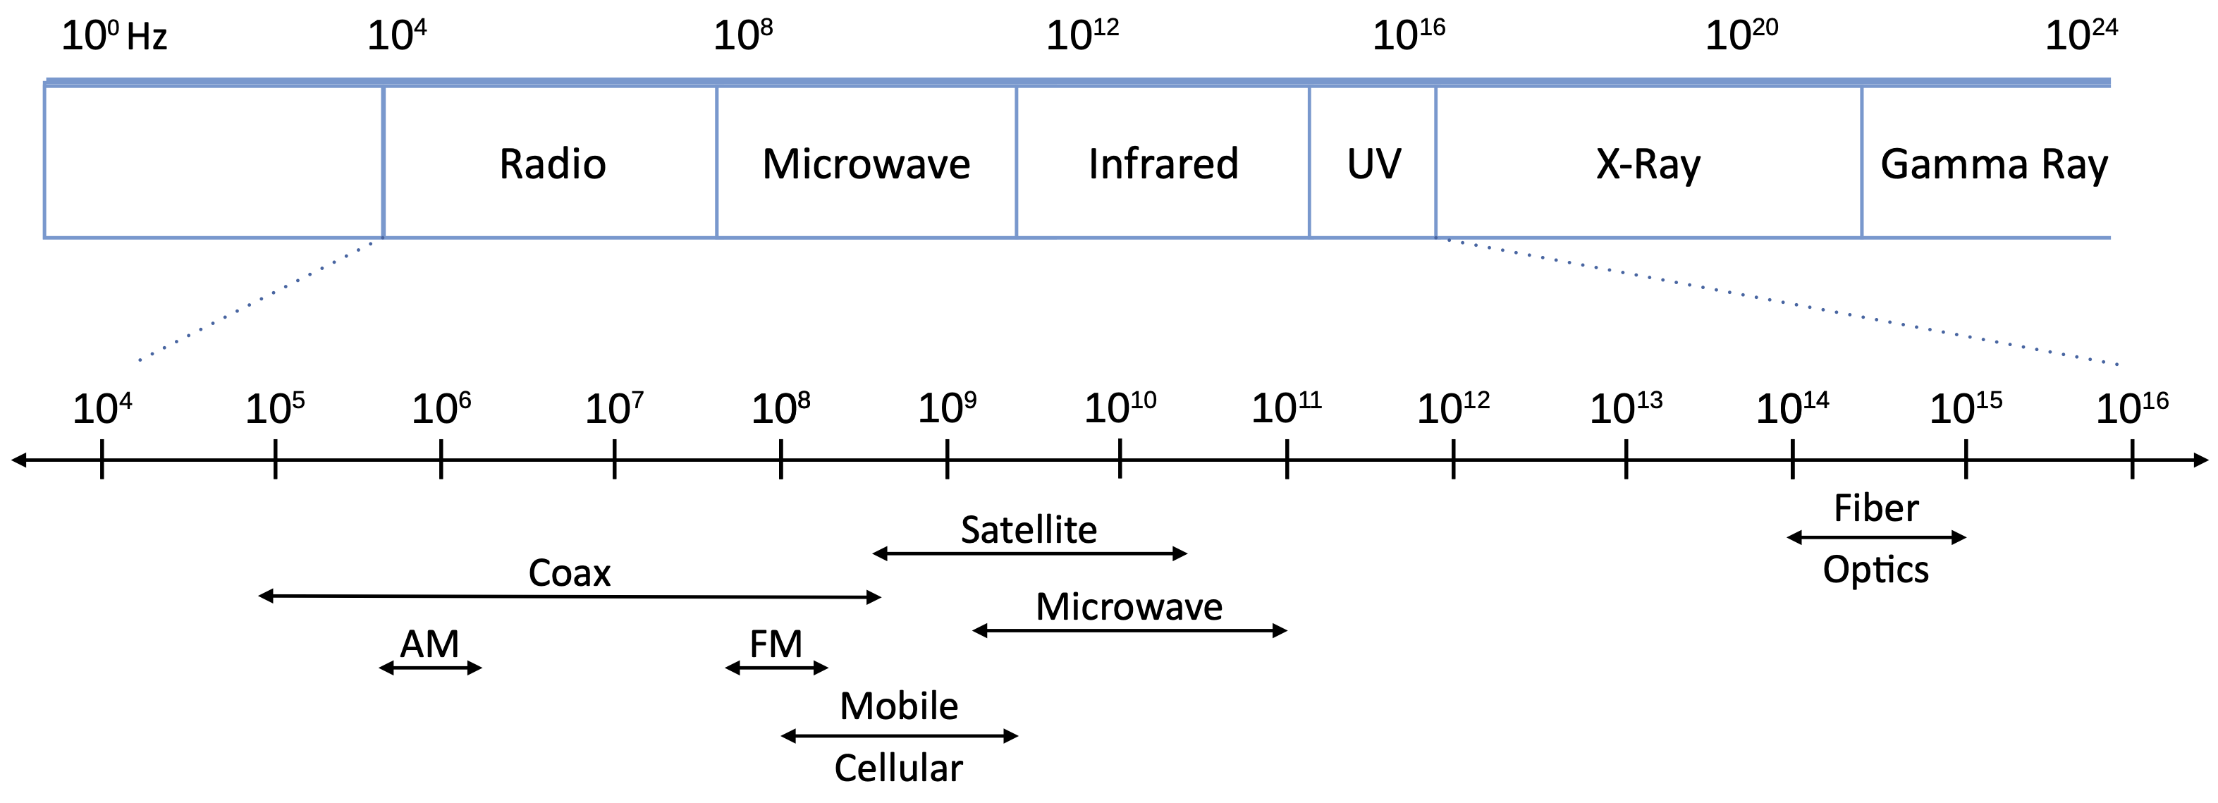
Spectrum
Networks carry information as electromagnetic waves
Networks run over a range of frequency bands

Slide 4
Link Layer
Directly connects nodes sharing a physical medium
Sometimes called “Media Access Control” (MAC)
IP runs on top of whatever link technology is available
Ethernet, WiFi, 4G/5G, SONET…
Three key problems to address
How to encode bits on signals sent over the physical medium
How to group bits into frames
How to detect if there are any bit errors in a delivered frame

Slide 5
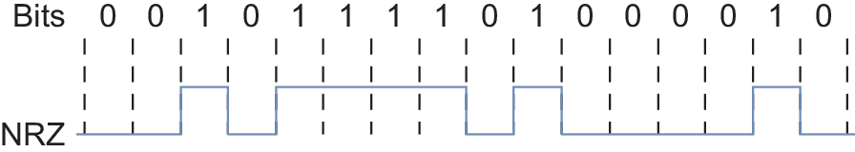
Encoding
NRZ: Non-Return to Zero
Simplest mapping: 1 = high voltage, 0 = low voltage
Problems
Clock drift means that long runs of same value are hard to dissect
Signal is sampled to detect above/below average → average drifts

Slide 6
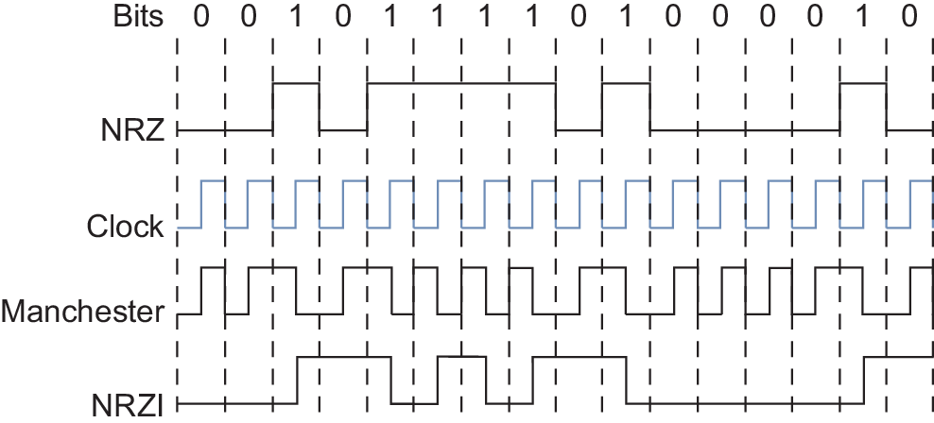
Encoding (cont)
NRZI
Transition to encode a 1
No change to encode a 0
Fixes long runs of 1s
Suitable if long runs of 0 are rare
Manchester
Transmit XOR of NRZ and clock
50% overhead
4B/5B (8B/10B)
Map every 4 data bits to a 5-bit code
Only 16 of 32 code words used for data
No code has more than one leading 0
Encode code words with NRZI
25% overhead

Slide 7
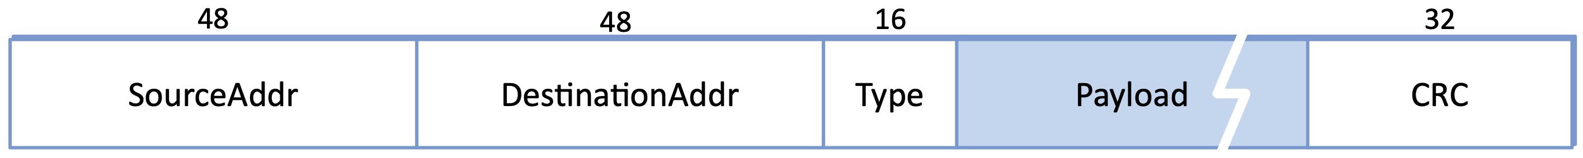
Framing
Raw bit stream must be grouped into frames for processing
Frames are passed between host and network adaptor (NIC)
Techniques
Sentinel-based: special pattern marks frame boundaries
Length-based: header field declares number of bytes in frame
Clock-based: fixed-size frames tied to a master clock
Every link-layer protocol defines its own frame format
e.g., Ethernet has a 64-bit preamble (alternating 0s and 1s), followed by…

Slide 8
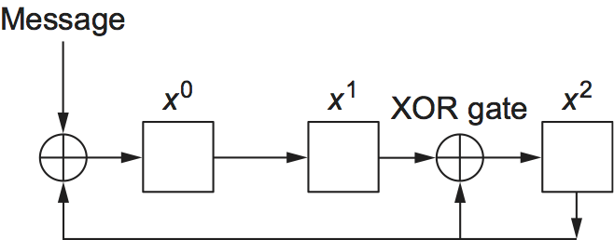
Error Detection
Corruption on the wire is inevitable
Receiver must detect it
Cyclic Redundancy Code (CRC)
Treat frame as a polynomial M(x)
Divide M(x) by generator C(x)
Attach “remainder” as error code
Receiver redivides by same C(x)
Nonzero remainder implies corruption
CRC-32 specifies a specific C(x)
Catches all 1-bit and 2-bit errors
Catches all odd-bit errors
Catches all burst errors ≤ 32 bits
Computed in hardware at line speed

Slide 9
Evolution of Ethernet
Invented at Xerox PARC in 1973
10 Mbps over shared coaxial cable
Inspired by ALOHA wireless network
CSMA/CD – Carrier Sense Multiple Access with Collision Detection
Listen for idle channel before transmitting
Backoff exponentially if a collision is detected
Adapted Over Time
10M → 100M → 1G → 10G → 100G → 400G
Improved encoding
Improved signaling
New media (e.g., fiber)
Multi-Access → Point-to-Point (became a switched network)
Always backwards compatible (frame format, 48-bit addresses)

Slide 10
Packet Switches
Building block of the Internet
Switches are to Networking as Servers are to Computing
Where functionality described in Part II is implemented
Common Platform
Receive frames on input ports
Make a forwarding decision
Transmit frames on output ports
Configured (programmed) for varied deployments
IP packets (L3 Switch, Router)
Ethernet packets (L2 Switch, Bridge)
Both (L2/L3 Switch)

Slide 11
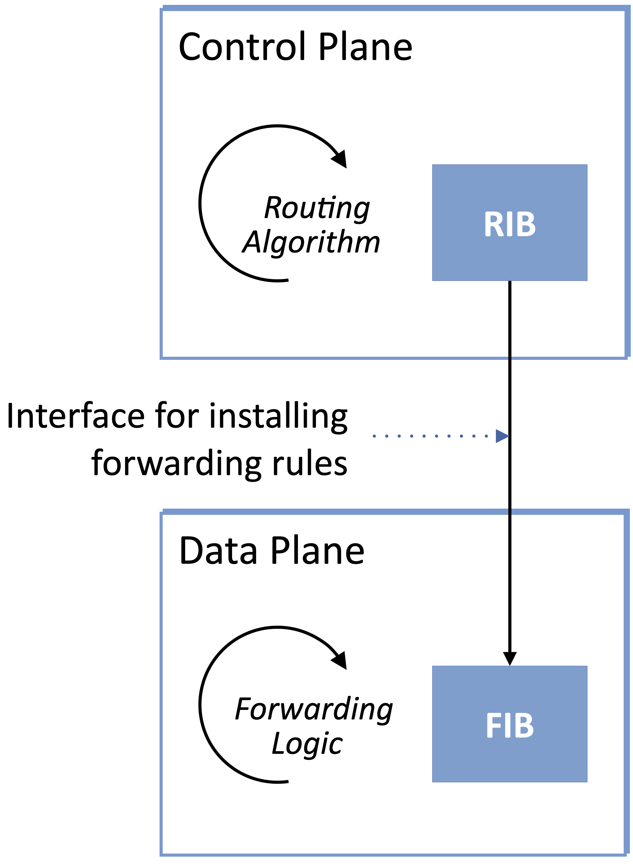
Control and Data Planes
Control Plane
RIB (Routing Information Base)
Routing algorithms learn routes
e.g., BGP, OSPF
Data Plane
FIB (Forwarding Information Base)
Optimized for forwarding decisions
Driving towards an open API
OpenFlow (1st generation)
P4 (2nd generation)

Slide 12
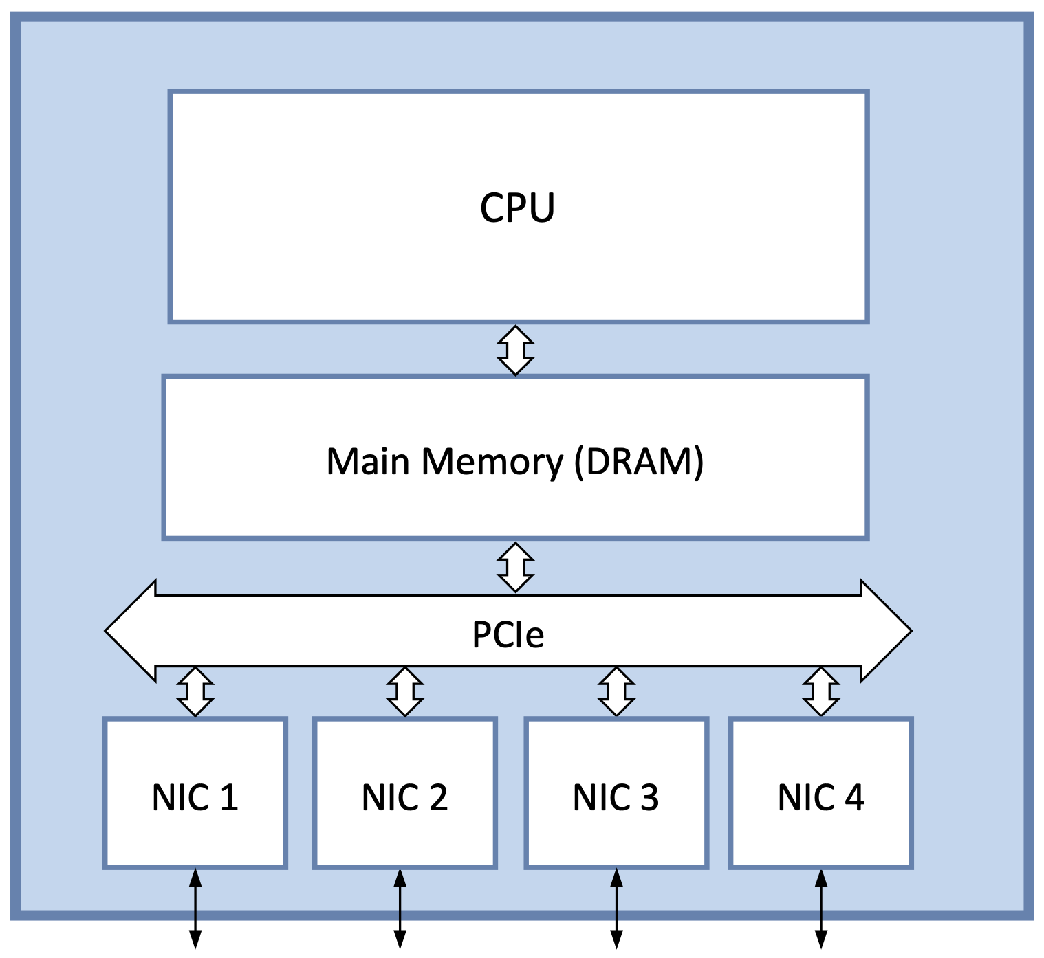
Software Switch
Commodity server + multiple NICs
Packets stored in main memory
Both control & data plane run on CPU
PCI bus serves as “cross-connect”
Bus limitations (large packets)
Cross bus twice per packet
100 Gbps implies ~5 x 10-Gbps NICs
CPU limitations (small packets)
40M pps is a reasonable target
Throughput = pps x BitsPerPacket
= 40 x 10⁶ x 64 x 8
= 2048 × 10⁷
= 20 Gbps

Slide 13
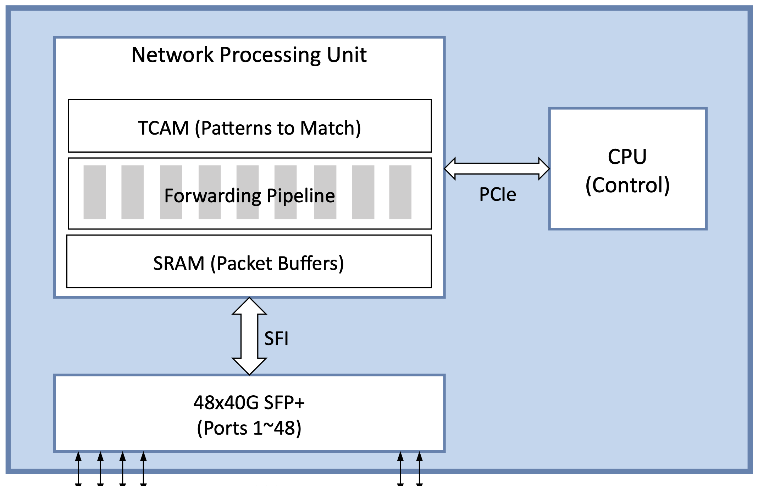
Hardware Switch
Switching Chip
Domain Specific Architecture
Similar to GPU (graphics), TPU (AI)
Forwarding Pipeline
Implements matching logic
TCAM
Stores patterns to match
Ternary supports wildcard matches
SRAM
Buffers packets
Faster than DRAM
Bare-metal switches available
Includes high-speed ports
Just add software

Slide 14
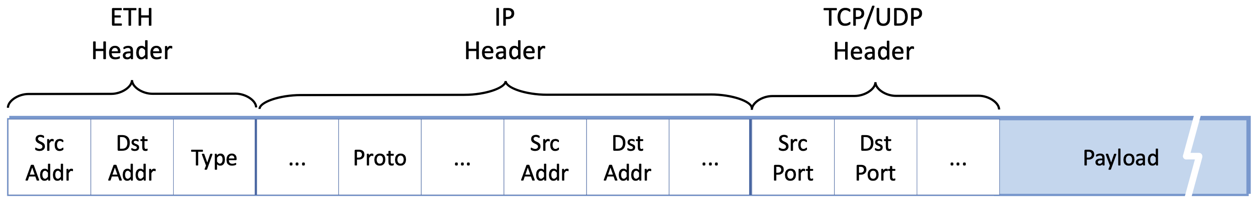
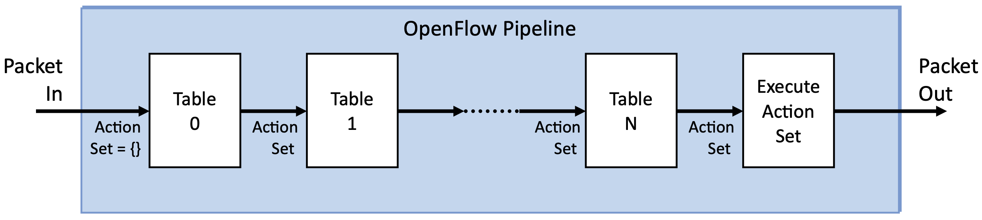
Flow Rules
OpenFlow
Set of <Match, Action> rules
Match
Combination packet header fields
Action
Forward to specified port
Drop
Modify header & forward
Pass up to controller
Forwarding Pipeline
Sequence of “Lookup Tables”
Processes packets in parallel
Accumulate Actions to execute at the end

Slide 15
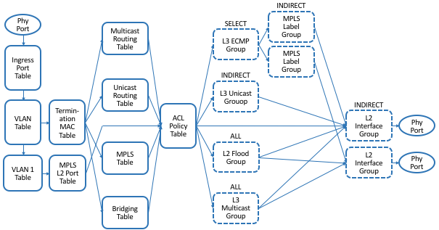
OpenFlow
Full Pipeline (Many of these tables covered in later chapters)

Slide 16
Programmable Pipeline
OpenFlow uses a Fixed Pipeline
Each table is hardwired to specific hearer field(s)
Change requires a change to the standard
Vendors introduced vendor-specific features
A programmable alternative is more flexible
P4: Programming Protocol-independent Packet Processors
Language for defining custom packet processing
Similar to C, but with constructs for matching headers
PISA: Protocol-independent Switch Architecture
Forwarding pipeline with programmable stages/tables
Serves as the target “instruction set” for P4 compiler
Toolchain for generating Control/Data Plane API from P4 programs

Slide 17
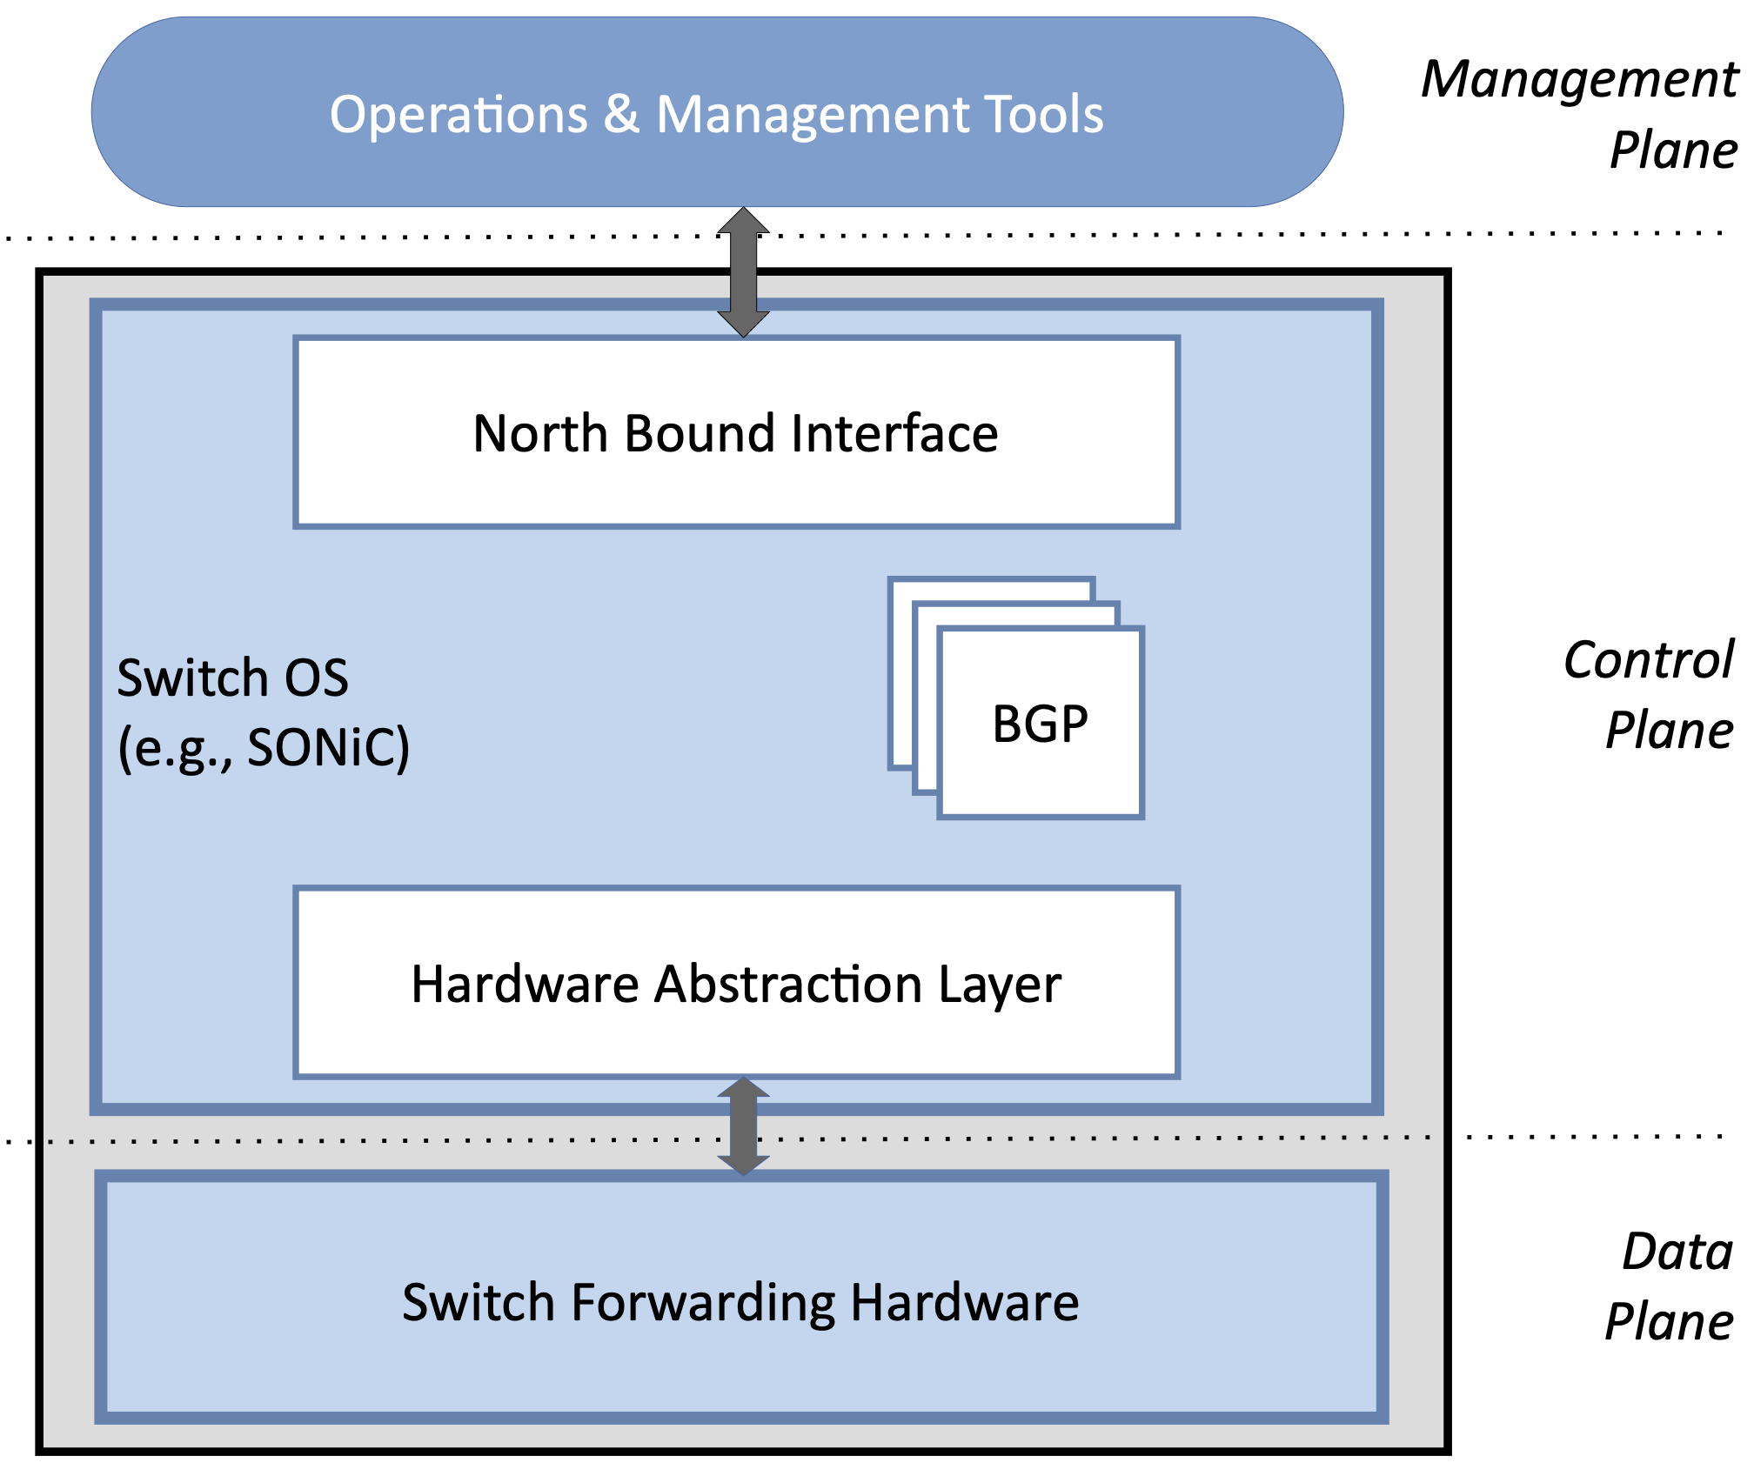
Switch OS
Switch OS runs on switch CPU
SONIC: open Linux-based option
Switch OS hosts the Control Plane
Offers Northbound Interface (NBI)
Off-Switch Management Plane
Uses NBI to manage switch

Slide 18
Circuit Switching
Focused on Packet Switching up to this point
Built around statistical multiplexing
Adopts Store-and-Forward model
Alternative is Circuit Switching
Set up end-to-end path before using
Reserve link bandwidth and switching capacity along circuit
Bits (or signals) flow through switch without buffering
Two Examples
Modern: All-optical networks using Wave Division Multiplexing
Legacy: Electrical switches (optical fiber) using Time Division Multiplexing

Slide 19
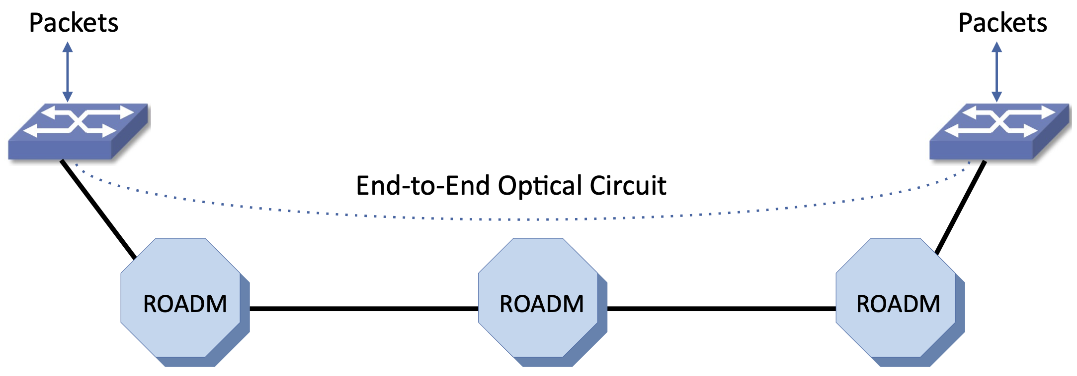
All-Optical Networks
DWDM
Multiple "colors" share one fiber
80+ channels at 100 Gbps each
ROADM
Individual wavelengths routed end-to-end without converting to electrical signals
Packet switches at either end of an all-optical circuit

Slide 20
SONET
Synchronous Optical Networking
Comes out of Telephony Networks
Hierarchy of byte-streams (circuits) switched end-to-end
Multiplex by sending a frame every 125 µs
Base level is STS-1 = 51.84 Mbps (810 bytes per frame)
STS-1 can carry 810 x 64-Kbps voice circuits
One byte for each voice circuit every 125 µs
Aggregating STS-1 yields higher bandwidth circuits
Three STS-1 yields STS-3 = 155.52 Mbps
N STS-1 yields STS-N = Nx51.84 Mbps
Tops out at STS-768 = 39,813.12 Mbps (~40 Gbps)

