Slide 1







Calibri (16pt by default)
Calibri (16pt by default)
Darker Color 0070c0
Default Color 6a99d0
Lighter Color bdd7ee
WiFi
Access Point
Generic
Switch
Generic
Switch
User
UE
Phone
UE
Phone
UE
Phone
Generic Office
or Enterprise
5G
Basestation

Slide 2
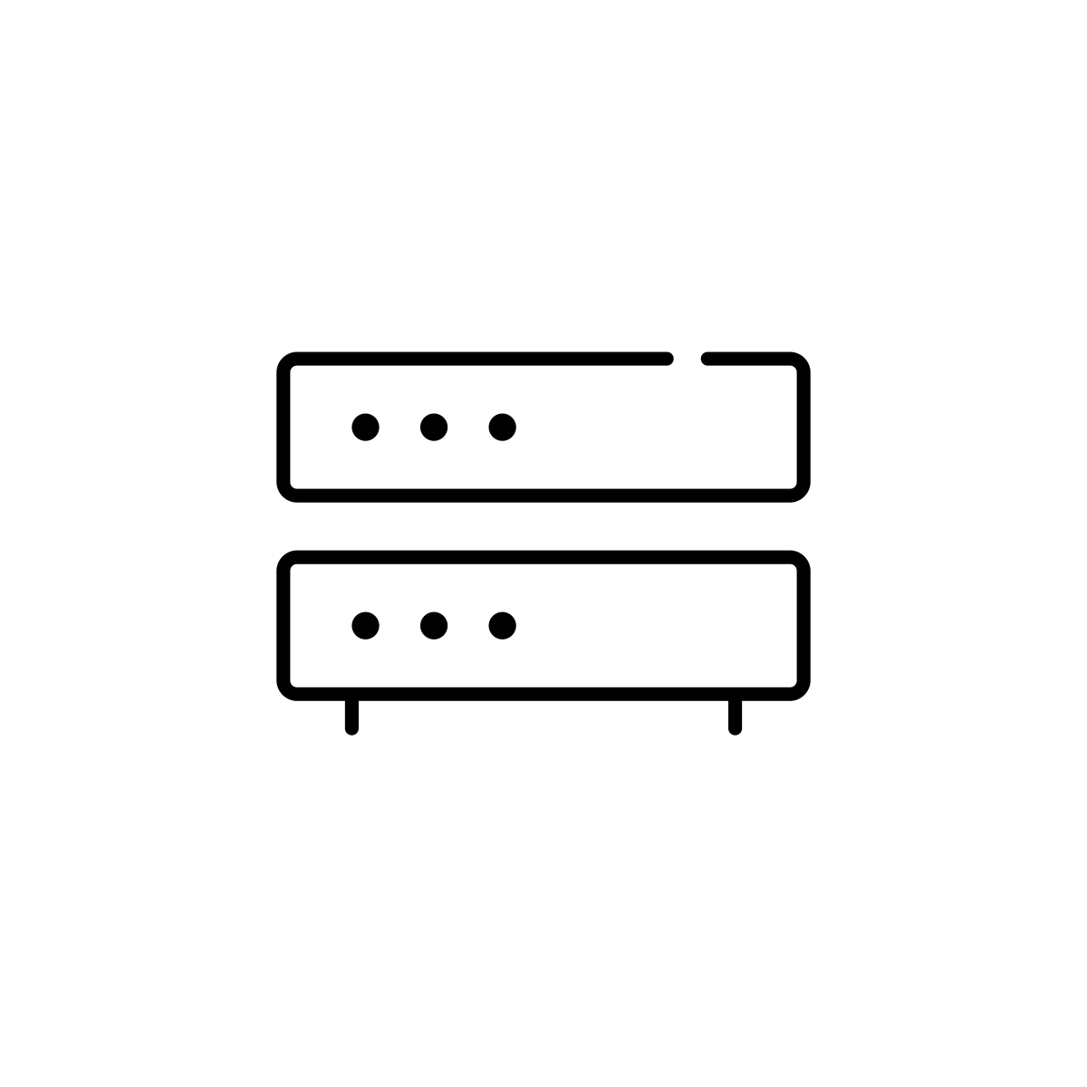




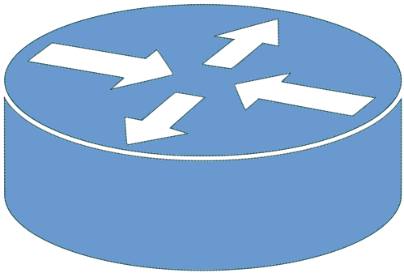
Query
Alt Client
Disk
Stable Store
Client
Server
Alt Server
Response
Router
Cloud
Network

Slide 3
Host A
S3
S2
S5
Host B
S1
S7
Host C
S6
S4

Slide 4
Host A
S3
S2
S5
Host B
S1
S7
Host C
S6
S4

Slide 5
(a)
(b)
S6
S6

Slide 6
Control
App
Control
App
Control
App
Control
App
. . .
Network OS
Global
Network
Map
Control Plane
Data Plane
Flow Rules

Slide 7
Spine 1
Spine 2
ECMP
Groups
Leaf 1
Leaf 3
Leaf 2
Paired
Leaves
(Dual ToRs)
Leaf 4
Server
Server
Link Bonding
Dual-Homed
Servers
External
Routers

Slide 8
Match:
Label = 102
Match:
Label = 102
Spine 1
(103)
Spine 2
(104)
Pop Label
Pop Label
Push
102
IP
IP
Match:
DST_IP = 10.0.2.0/24
Match:
DST_IP = 10.0.2.1/32
Leaf 1
(101)
Match:
DST_IP = 10.0.2.0/24
Match:
DST_IP = 10.0.2.1/32
Leaf 2
(102)
IP
IP
10.0.1.1/24
10.0.2.1/24
Host 1
Host 2

Slide 9
0
8
16
31
Next Hdr
Hdr Ext Len
Routing Type
Segments Left
Last Entry
Flags
Tag
Segment List[0] (128-bit IPv6 Address)
Segment List[n] (128-bit IPv6 Address)

Slide 10
0
20
23
24
31
EXP
S
TTL
Label
TTL
IP Header

Slide 11
INDIRECT
Phy
Port
MPLS Label Group
SELECT
Multicast
Routing Table
L3 ECMP Group
Ingress
Port
Table
MPLS Label Group
INDIRECT
Unicast Routing Table
L3 Unicast Group
VLAN
Table
Termin-ation MAC
Table
INDIRECT
ACL Policy Table
L2 Interface Group
Phy Port
ALL
MPLS Table
L2 Flood Group
L2 Interface Group
VLAN 1
Table
MPLS
L2 Port
Table
Phy Port
ALL
Bridging Table
L3 Multicast Group

