Slide 1
Smart Water Management for
Urban Green Infrastructure
SMART CITIES · WATER DOMAIN
A low-cost, network-resilient edge-IoT irrigation node with deep-learning soil analysis
Project Report & Demonstration · Design of Smart Cities
Notes:
Title slide. Introduce the project as sitting in the water domain of smart city design, not as an agriculture project.

Slide 2
Cities irrigate a great deal of land — on a timer
Parks, urban forests, road medians, green belts, green roofs and community gardens
A timer cannot sense
Both failures at once
Nobody notices
It does not know it rained yesterday, or that one bed drains faster than another.
The same green space is over-watered in places and under-watered in others.
Open-loop systems report success whether or not water actually reached the soil.
Green infrastructure is growing in importance — vegetation moderates the urban heat island, manages stormwater and improves air quality. Cities are asked to maintain more of it, more reliably, without using more water.
Demand-driven irrigation is the direct response to that pressure.
Notes:
Frame the problem in the civic water domain. The key point is that open-loop timer irrigation produces over- and under-watering simultaneously, and reports success either way.

Slide 3
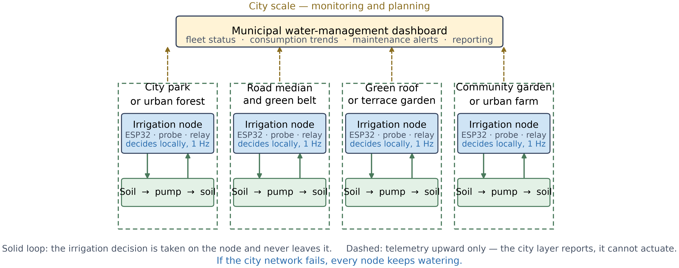
What we built
One node per irrigation zone, replicated across heterogeneous urban green space
₹970
1 Hz
0
cost per node
local decision rate
network dependency
Notes:
The node is deliberately generic across site types. Emphasise: each site closes its own loop; telemetry flows up, commands never flow down.

Slide 4
SRS — Requirements
SECTION ONE
Software Requirements Specification — what the system must do, and what it must survive

Slide 5
SRS — Requirements
Ten functional and six non-functional requirements; the non-functional ones decide whether it scales
Functional
Non-functional
Measure soil moisture, air temperature and humidity
Switch the pump automatically from the measurement
Use two thresholds with a dead band, not one set point
Emit a telemetry record at a fixed interval
Indicate state locally, visible without instruments
Classify soil type and condition from a photograph
Produce weather-aware watering advice
Provide monitoring, reporting and manual override
The irrigation decision is taken on the node, never remotely
Unit cost low enough to deploy in quantity
Failure of a secondary sensor must not stop irrigation
The monitoring layer must be incapable of actuation
Commodity parts, for municipal procurement and repair
Undetectable failure modes must be identified and documented
Notes:
Stress NFR-1 and NFR-4: these are the requirements that distinguish a city deployment from a single demo unit.

Slide 6
SDS — Design
SECTION TWO
Software Design Specification — architecture, hardware, data and the control law

Slide 7
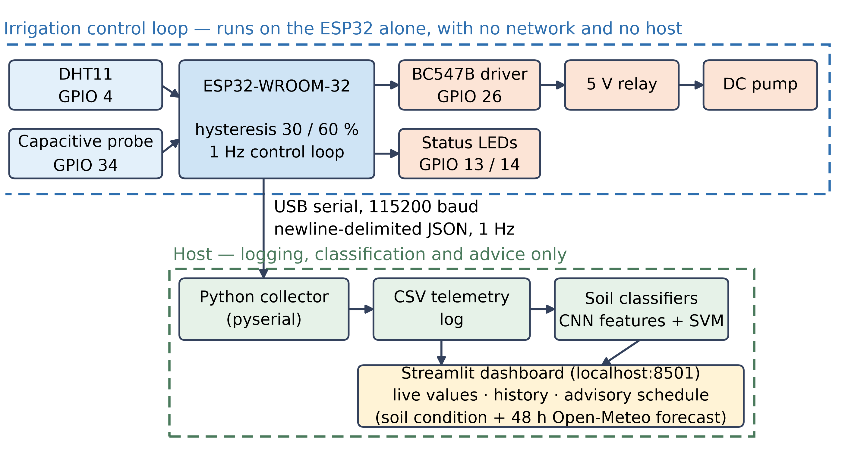
Four layers, one boundary that matters
Everything needed to keep vegetation watered lives on the microcontroller. Every layer above it is additive: logging, classification, advice, reporting.
Notes:
Walk the four layers quickly. The point to land is the boundary: the host can observe everything and command nothing.

Slide 8
The node never asks a server
whether to irrigate
CENTRAL DESIGN DECISION
On a farm that is convenience. Across a fleet of four hundred nodes it is the difference between a network outage degrading visibility and a network outage stopping service.
Network fails
Host fails
Node fails
Every node keeps watering
Every node keeps watering
One zone affected, not the fleet
Notes:
This is the slide to slow down on. It is the smart-city argument: adding visibility must not add a single point of failure.

Slide 9
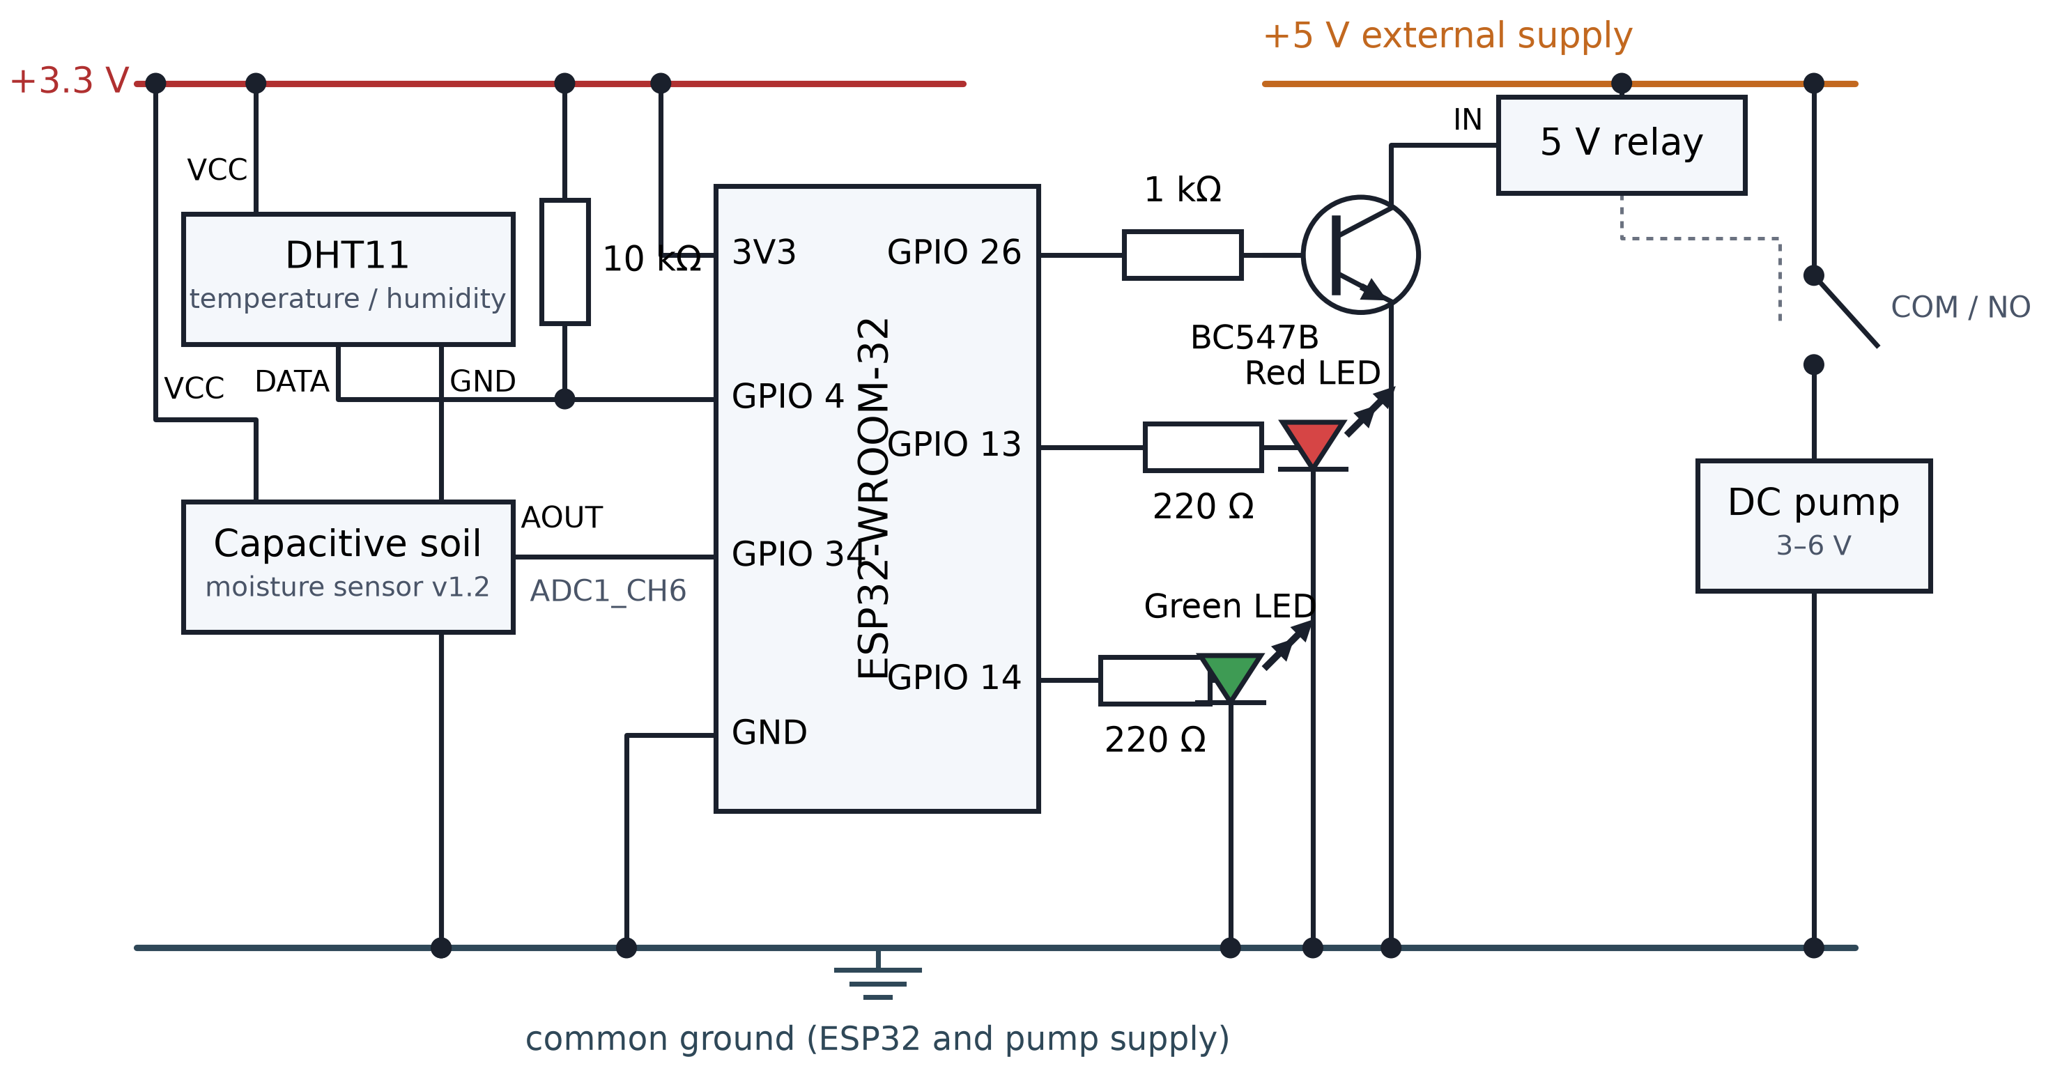
Hardware and cost
Commodity parts only — unit cost is a design parameter, not an outcome
Bill of materials
ESP32-WROOM-32 | ₹284
Capacitive probe v1.2 | ₹83
DHT11 module | ₹61
5 V relay module | ₹42
Pump, BC547B, LEDs, resistors, wiring | ₹500
Total per node | ₹970
100 zones ≈ ₹97,000 400 zones ≈ ₹3.9 lakh
Hardware only — excludes enclosures, plumbing, installation and maintenance. Given to show the order of magnitude at which this becomes a procurement question.
Notes:
Be explicit that the scale figures are arithmetic on unit cost and exclude installation. Do not overclaim.

Slide 10
Implementation
SECTION THREE
Firmware, host software and the assembled node

Slide 11
The control loop, once per second
Self-contained: no host, no network, no cloud service
1
Read sensors
DHT11 on GPIO 4, capacitive probe on GPIO 34 as a raw 12-bit value
Stack
C/C++ on the Arduino core
USB serial, 115200 baud, JSON
Python 3.11 + pyserial
TensorFlow / Keras
scikit-learn
Streamlit + Plotly
ReportLab
Open-Meteo forecast API
2
Convert and clamp
Two-point calibration to 0–100 %; the clamp also guards a disconnected probe
3
Apply hysteresis
Pump on below 30 %, off above 60 %, hold state in between
4
Update indicators
Red steady for alive; green blinks at 250 ms while the pump runs
5
Emit telemetry
One JSON record at 115200 baud, then wait one second
Notes:
If the DHT11 read fails, nulls are sent and irrigation continues on moisture alone. That is NFR-3 in the firmware.

Slide 12
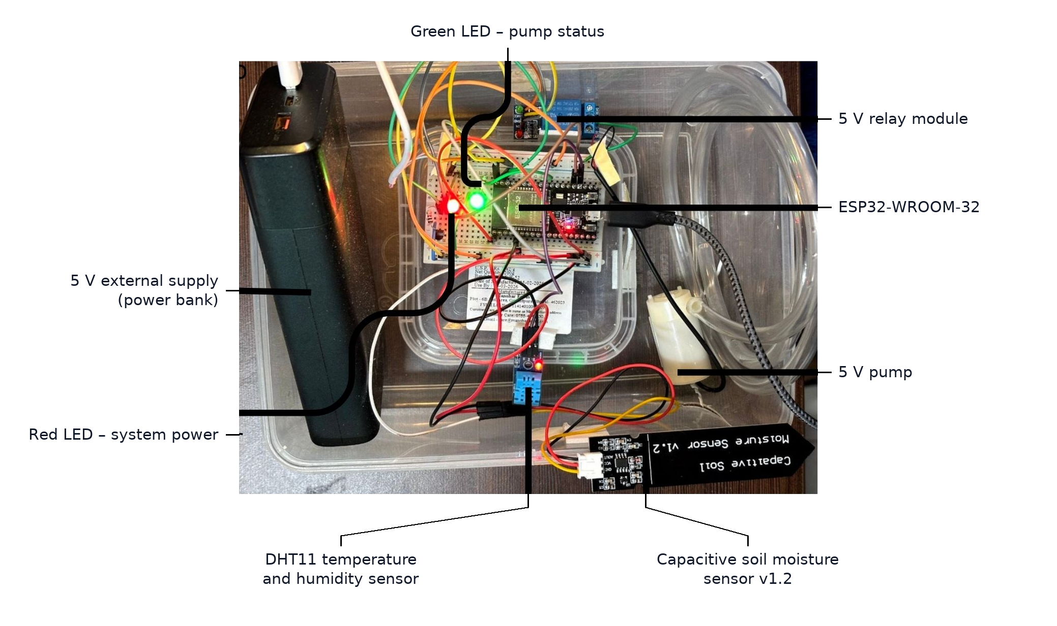
The assembled node
Probe in a sealed soil container that can be wetted and left to dry — repeatable control of the variable under test
Notes:
Point out the separate 5 V supply for the pump and the common ground. Good slide to hand over to the demo video.

Slide 13
Testing
SECTION FOUR
Not only whether it works, but what it cannot see

Slide 14
Seven fault-injection tests
Five behaved as specified; two did not, and both are reported
Test | Condition applied | Result
TC-01 | Moisture 65 %, normal conditions | Pump off, telemetry sent — pass
TC-02 | Moisture 22 % | Pump on, green LED blinking — pass
TC-03 | Moisture 45 % with pump already on | State held, no chatter — pass
TC-04 | Moisture exactly 30 % | Pump off, matches the rule — pass
TC-05 | DHT11 data line removed | Nulls sent, irrigation continued — pass
TC-06 | Moisture probe unplugged | Fail-safe triggered, but fault not detected
TC-07 | Pump supply removed while running | Pump stopped, firmware kept reporting it on
TC-07 is the most consequential result. The relay is commanded but never measured, so a dead pump is reported as running. In a municipal deployment this persists until vegetation visibly declines — and every record in between says the site was watered.
Notes:
Do not skip past TC-06 and TC-07. Examiners respect a team that found its own failure modes.

Slide 15
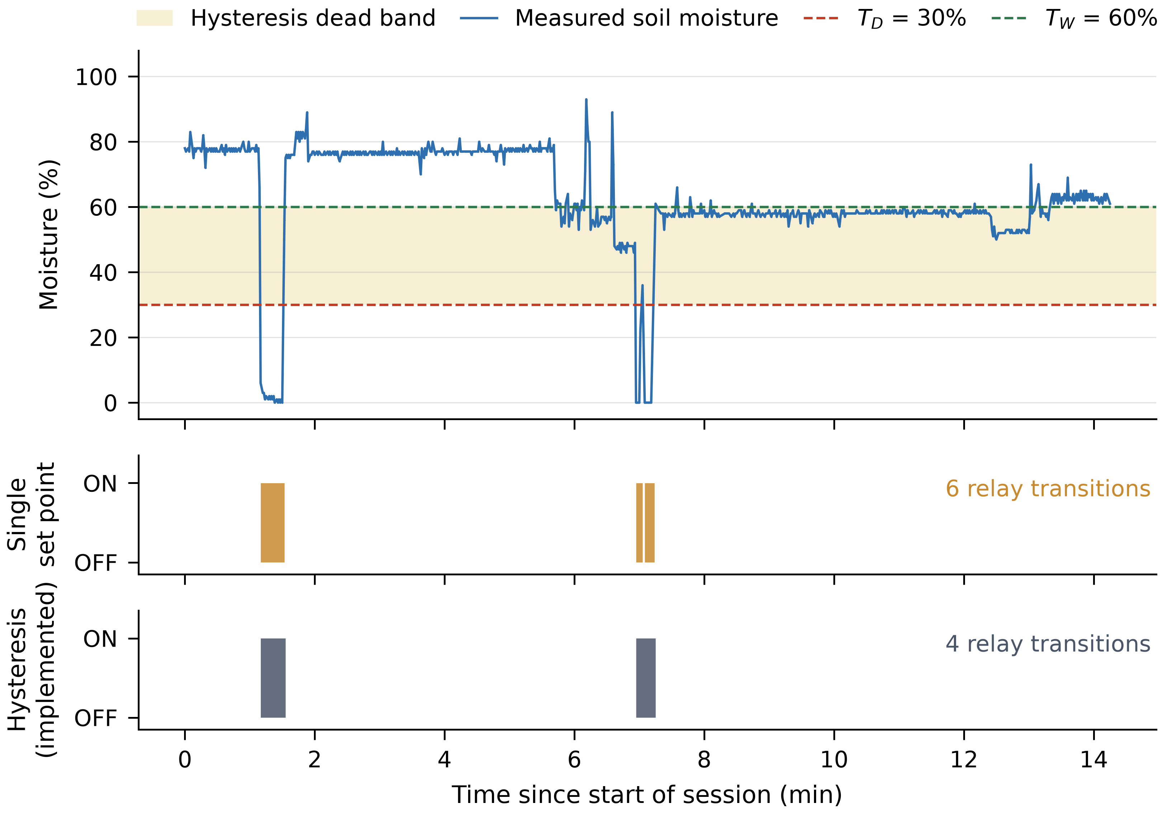
Control-law validation
8,171 telemetry records across 33 logging sessions, median interval 1.00 s
17 %
fewer relay transitions
than a single set point
6.6 %
of readings fall inside
the 30–60 % dead band
Notes:
The benefit is moderate because the probe spends little time in the dead band. Across a continuously running municipal fleet, 17 percent fewer actuations accumulates into relay and pump service life.

Slide 16
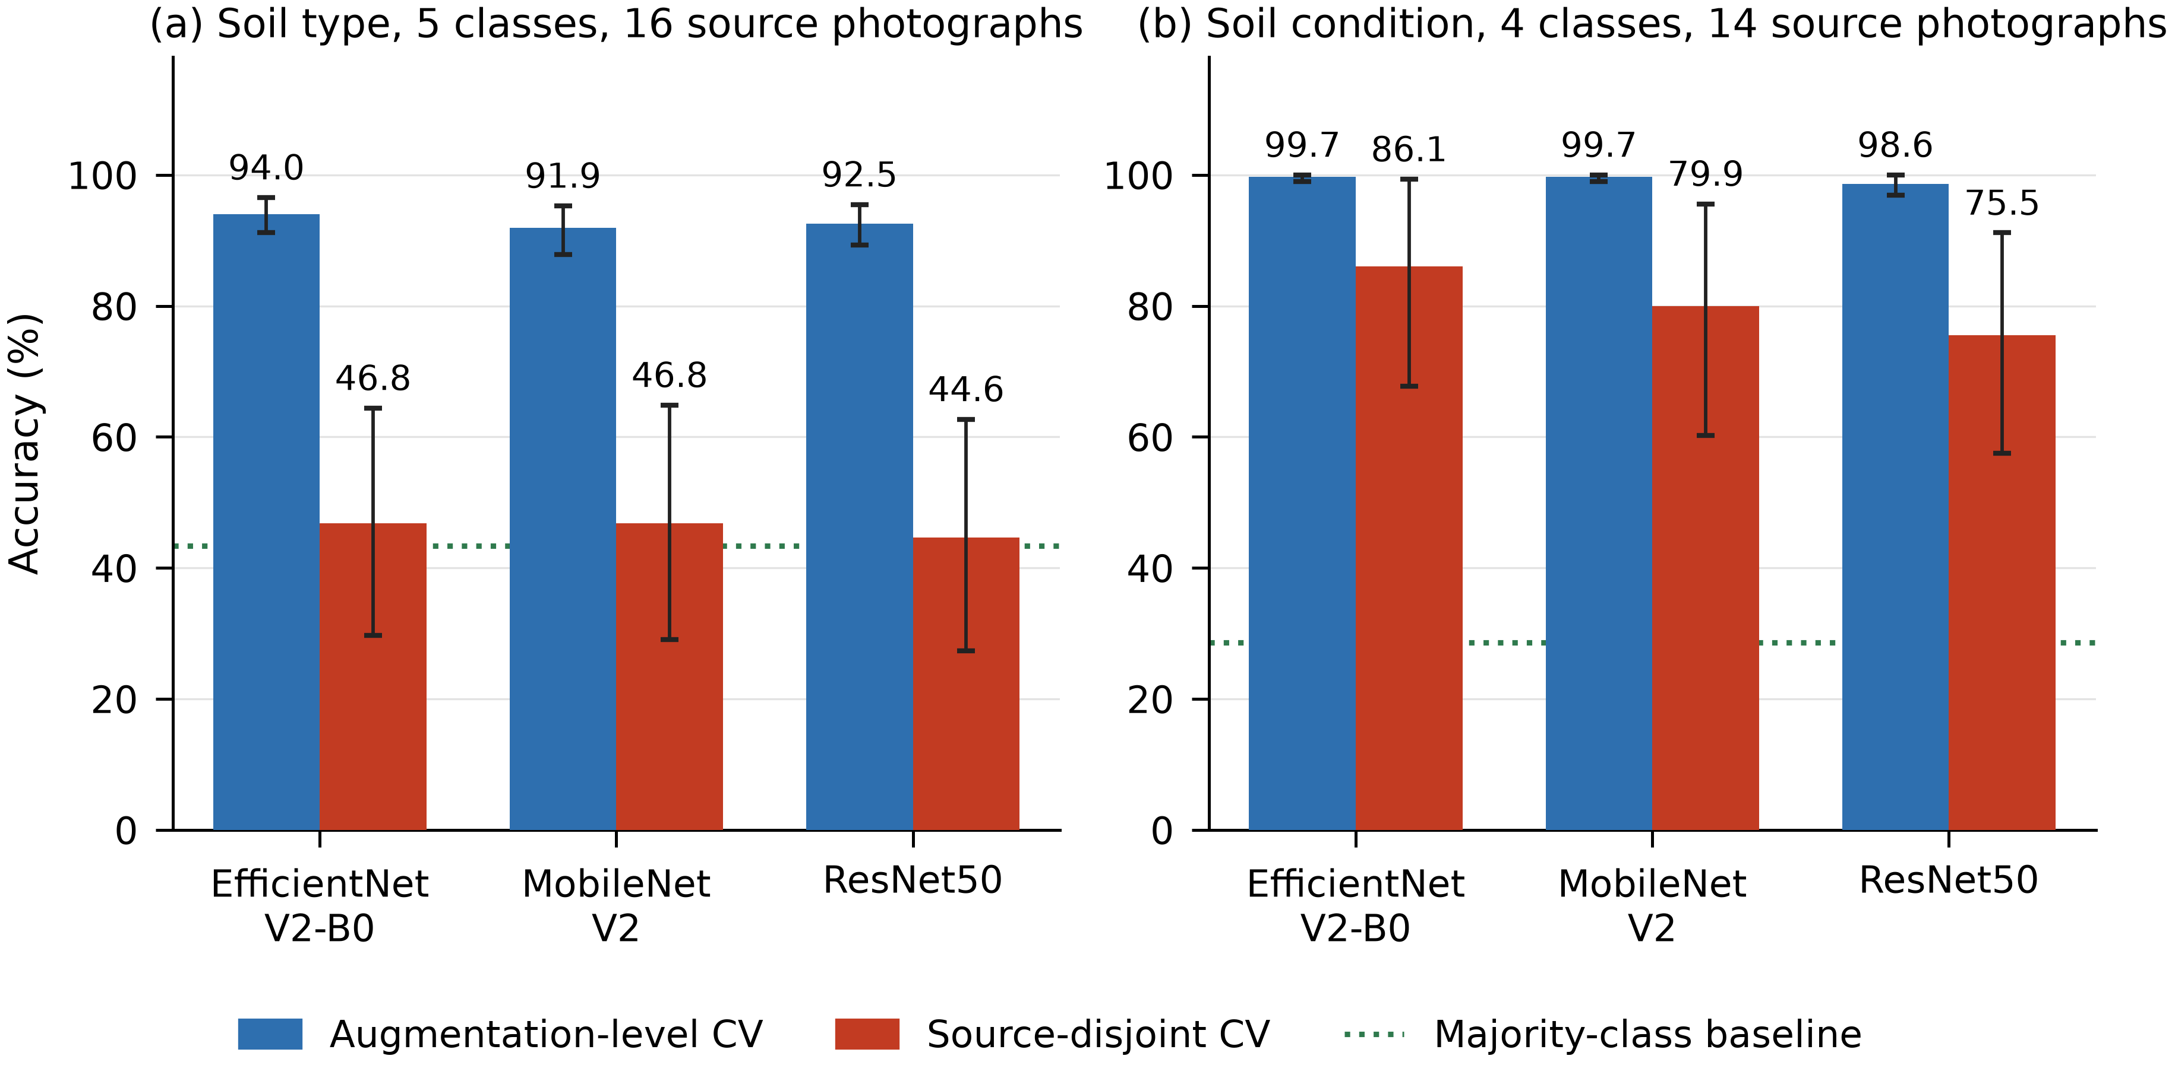
How the soil classifier was evaluated
The same classifier and features, tested two ways
Two protocols
Augmentation-level
Shuffle all expanded samples, then split. Near-identical crops of one photograph land on both sides.
Source-disjoint
Hold out whole photographs. The classifier is tested only on soil it has never seen.
Soil type falls from 91.9–94.0 % to 44.6–46.8 % — close to the 43.3 % obtainable by always guessing the most common class. Most of the apparent accuracy came from recognising photographs, not soils. Soil condition holds up at 75.5–86.1 % and is the usable one.
Notes:
Held across three network architectures and five randomisations, so it is a property of the dataset, not one model. Only 16 source photographs, two classes with a single photograph each.

Slide 17
Outcome
SECTION FIVE
What was achieved, what was not, and what it means at city scale

Slide 18
Measured outcomes
15 of 16 requirements fully met; one partially met
₹970
17 %
5 / 7
per node
fewer actuations
fault tests passed
8,171
86.1 %
46.8 %
records logged
soil condition, unseen
soil type, unseen
The infrastructure objective was met. The analytics objective is qualified: soil condition is usable, soil type is not — and would have looked highly accurate under conventional evaluation.

Slide 19
What this means at city scale
Visibility without fragility
Cost decides coverage
Because the monitoring layer has no actuation path, adding city-wide visibility does not add a city-wide failure mode. An operations centre can lose four hundred nodes from view without any of them stopping work.
At ₹970 a node, the limiting factor on how much green space a city can instrument stops being hardware budget and becomes installation and maintenance.
Silent failure is a governance problem
Accuracy claims need protocols
A dashboard showing green for a dead pump is worse than no dashboard. Undetectable failure modes must be found before deployment, not after.
Smart-city systems increasingly justify decisions by citing model accuracy. A figure quoted without stating how the data were split cannot support a procurement decision.

Slide 20
Limitations and next steps
Limitations
Next steps
A pump that loses power is reported as running
A drifted or fouled probe is trusted
Water saving not measured — no flow meter fitted
Soil type not deployable at its measured accuracy
Validated in a container, not a live municipal site
One probe represents a whole irrigation zone
Telemetry link is wired USB serial
ACS712 current sensor — ₹145, closes the TC-07 gap
Pulse-response probe check to catch a fouled probe
Inline flow meter, so saving is reported in litres
Wi-Fi, LoRaWAN or NB-IoT backhaul for real city scale
Multi-zone valve control from one node
Several hundred field photographs for the classifier
Integration with municipal asset-management workflow
Notes:
The ACS712 is the highest-value single addition: about 15 percent of unit cost, and it removes the one failure the system cannot see.

Slide 21
IN CLOSING
A controller that reports irrigation it is not performing,
and a classifier that reports accuracy it does not have,
fail in the same way
Both look correct from the outside. Neither was discovered by watching the system work — both were found only by testing specifically for them. For infrastructure a city intends to trust without supervision, that testing is not an optional extra.
Thank you

