Slide 1
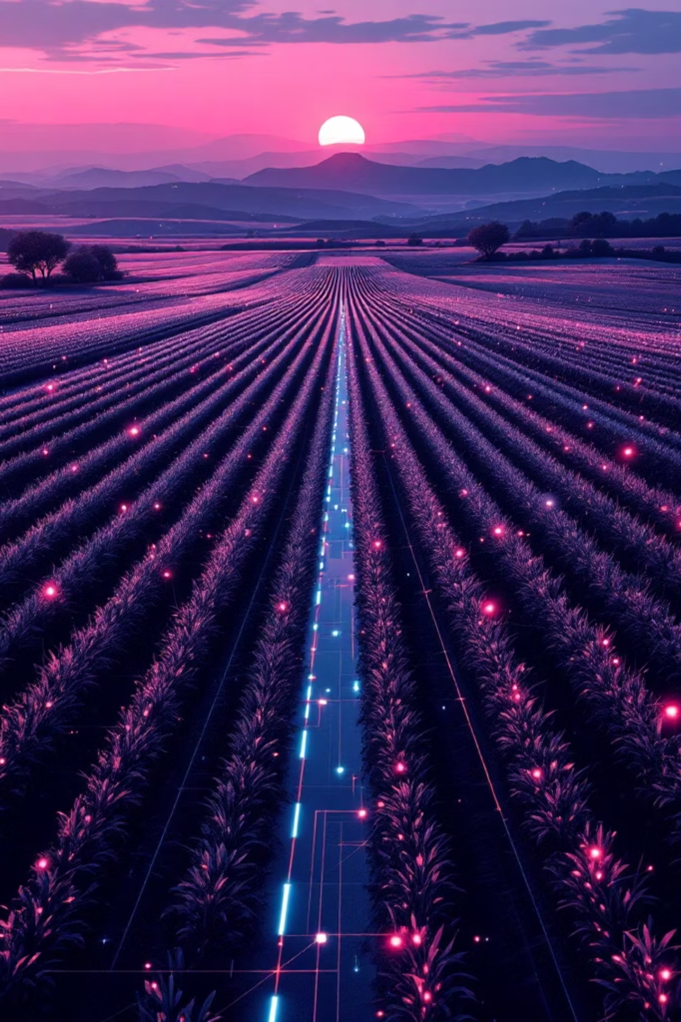
AI-Enabled IoT Framework for Smart Agriculture
Real-Time Soil Classification & Profit-Optimized Crop Recommendation
Utkarsh Persai, Devansh Rathore | Department of IoT, VIT

Slide 2

The Agricultural Challenge
18%
50%
94.4%
GDP Contribution
Employment Base
AI Accuracy
Soil classification success rate
Agriculture's share of India's economy
Population working in agriculture
Despite agriculture's economic importance, most farmers still rely on traditional intuition-based methods rather than data-driven precision farming. IoT sensors and AI computer vision exist, but operate in isolation—creating a critical integration gap.

Slide 3

Problem: Fragmented Systems
Current Reality
The Consequence
IoT sensors collect raw environmental data
AI models classify soil from images separately
No unified decision-making framework
Crop recommendations ignore real-time conditions
Without integration, farmers receive conflicting advice. Soil type predictions lack context of current moisture, temperature, or weather forecasts—leading to irrigation errors and suboptimal crop selection.

Slide 4




Our Integrated Solution
Real-Time Sensors
Soil Classification
ESP32 collects moisture, temperature, humidity
AI analyzes smartphone images for soil type
Weather Integration
Profit Optimization
Open-Meteo API provides forecasts
Algorithm recommends highest-margin crops
A unified framework combining hardware telemetry, visual AI, and economic data for intelligent, automated farming decisions.

Slide 5





System Architecture
Sensor Layer
Capacitive moisture sensor and DHT22 module capture environmental data
Edge Processing
ESP32 microcontroller converts analog signals to JSON telemetry
Communication
USB-Serial (115200 baud) with MQTT fallback ensures reliable transmission
AI Intelligence
EfficientNetV2 + SVM classifies soil images; dashboard processes data
Application Layer
Irrigation actuators and profit-optimized crop recommendations

Slide 6

Hardware Implementation
Low-Cost, Rural-Friendly Design
ESP32 Microcontroller: 32-bit CPU, 3.3V logic, Wi-Fi enabled
Capacitive Soil Sensor: v1.2 analog output, corrosion-resistant
DHT22 Module: ±30°C temperature, 0-100% humidity range
5V Relay: Opto-isolated actuation for irrigation pumps
Linear interpolation calibration maps 12-bit ADC values (3200-1100) to 0-100% saturation scale, minimizing noise from soil conductivity variations.

Slide 7





AI Model Architecture
IRSID Dataset
EfficientNetV2-B0
Indian Regions Soil Image Database with 16 physical samples
Frozen ImageNet weights extract 1,280-dimensional features
SVM Classifier
RBF kernel maps vectors to 5 soil types: Clay, Loam, Sand variants
Validation: Leave-One-Sample-Out Cross-Validation (LOSO-CV) ensures accuracy on unseen physical samples, not augmented copies.

Slide 8
Performance Results
94.4%
15ms
100%
Classification Accuracy
Data Latency
Packet Success
Hybrid EfficientNetV2 + SVM model
USB-Serial transmission vs. 450ms cloud
48-hour stress test reliability
Model Comparison
Algorithmic Model applied to CNN Vector
Validation Accuracy (%)
Random Forest (Baseline 100 Estimators)
88.50%
K-Nearest Neighbors (KNN, k=5)
86.20%
Proposed Hybrid (EfficientNetV2 + SVM RBF)
94.40%

Slide 9




Real-World Applications
Smart Irrigation
Automated drought mitigation using relay-controlled pumps, conserving groundwater through precise moisture monitoring
Economic Safety
Multi-crop planner evaluates government MSP prices, guiding farmers to high-margin alternatives
Urban Infrastructure
JSON-based telemetry framework redeployable for smart-park irrigation and pipeline leak detection

Slide 10
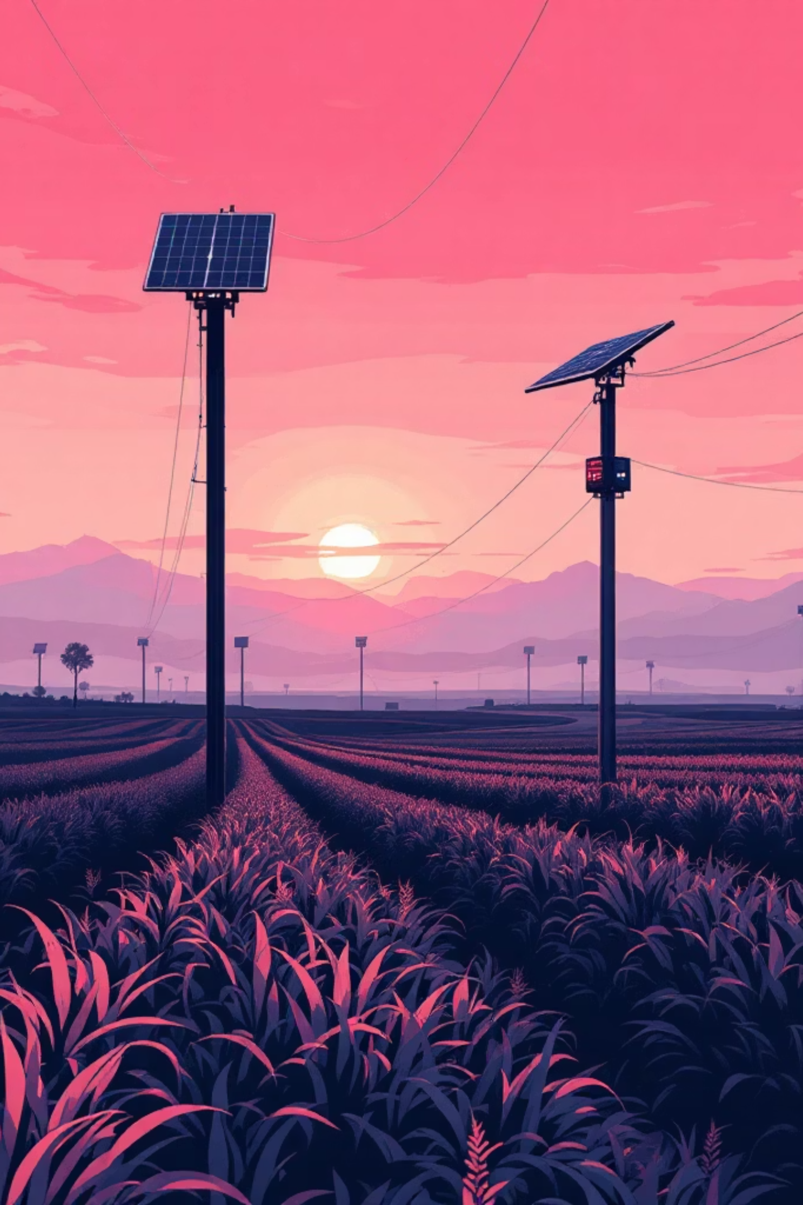
Conclusion & Future Vision
Key Achievements
Future Work
94.4% accurate soil classification
Real-time sensor fusion with AI
Profit-optimized crop recommendations
Low-cost, rural-deployable hardware
TinyML: On-device neural inference
Solar-Powered Nodes: Photovoltaic energy harvesting
LoRaWAN Mesh: Large-scale deployments
This integrated AI-IoT framework demonstrates the feasibility of cost-effective precision farming, bridging the gap between advanced analytics and practical rural agriculture.

