Slide 1
Stock Market Price Prediction

Slide 2
Problem Statement and Introduction
Stock forecasting is a challenging task because it is inherently unpredictable. There are multiple factors that impact the market situation. In this project , we are predicting closing price of NIFTY50 stocks on a given day based on the performance of the stock on previous days. We used multiple machine learning techniques and algorithms to achieve our goal.
Dataset Used : https://www.kaggle.com/datasets/rohanrao/nifty50-stock-market-data
It contains Adaniports stock price from 2007 to 2021.There are 3322 days (or rows in our dataset). There are 15 columns in the dataset (namely Prev Close, Open, High, Close, etc.).

Slide 3
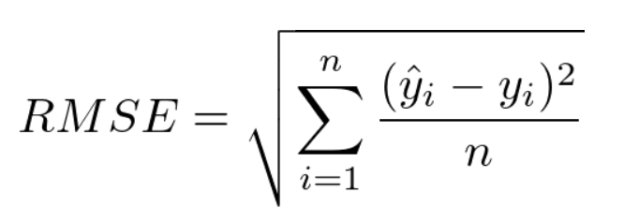
Progress Summary - Intermediate Submission
Evaluation Metric
Elementary Data Analysis and Data Preprocessing:
We used Adaniports Stock from the dataset and filled null values of columns with mean of other non-NAN values.
Extra features like Standard Moving Average, Standard Deviation, etc were introduced for data smoothening.
Data was normalized using MinMaxScaler on numeric columns for better performance.
Baseline Model: Multiple Linear Regression:
MLR model was trained along with L2 regularization (Alpha = 1.5).
PCA was used to reduce the data dimensionality. Best results were obtained for n-components = 55.
Best RMSE was 3.92 in testing and 3.831 in validation data for window size = 5 and 4year-1year-1year split.
Advanced Model 1: LSTM (Long Short Term Memory):
Configuration: loss function = mean squared error, optimizer = adam, learning rate = 0.001, beta 1 = 0.9, beta 2 = 0.99.
Regularization was done by dropping out 20 percent inputs between LSTM layers ’lstm 8’ and ’lstm 9’, and also between ’lstm 9’ and ’lstm 10. RMSE was 15.47(overall), 32.95(on high close prices), 14.54(mid close prices) and 10.16(low close prices), on 12-1-1 split and window 5.
yihat are predicted prices and yi are actual prices. n is number of samples in test data.

Slide 4
Progress After Intermediate Submission
Approaches:
Advanced Model 2: Elastic Net Regression
We used ElasticNet of scikit library. Note that since we found training error more than test error in initial ElasticNet models, we dropped the idea of taking validation set. During GridSearchCV, we took training set and selected the best model that had least rmse on training set. Then we tested it on test set. For elastic net , the splits were 5 year-1 year, 9 year-1 year and 13 year-1 year.
Advanced Model 3: Convolutional Neural Network’
We used a CNN model using tensorflow.keras on univariate time-series data to predict the price on ith day using the prices of previous 5 days (window size = 5).

Slide 5
Elastic Net Regression: Results and Ablation
Initial model
RMSE =
6.35(for 5-1 split), 6.75(for 9-1 split) and 8.87(for 13-1 split)
RMSE =
5.15(for 5-1 split),
6.45(for 9-1 split) and 8.65(for 13-1 split)
window 10
regul. parameter = 0.01
l1ratio = 0.5
window size 5
RMSE = 3.77(for 5-1 split), 6.29(for 9-1 split) and 8.53(for 13-
1 split)
window 15
grid search on regul. parameter
RMSE = 3.42(for 5-1 split), 5.99(for 9-1 split) and 8.43(for 13-
1 split).
grid search on l1ratio
RMSE = 3.42(for 5-1 split),
6.04(for 9-1 split) and 8.43(for 13-1 split).
Taking only closing price column.

Slide 6
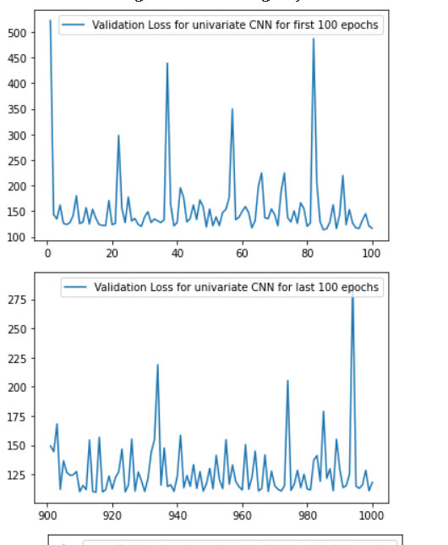
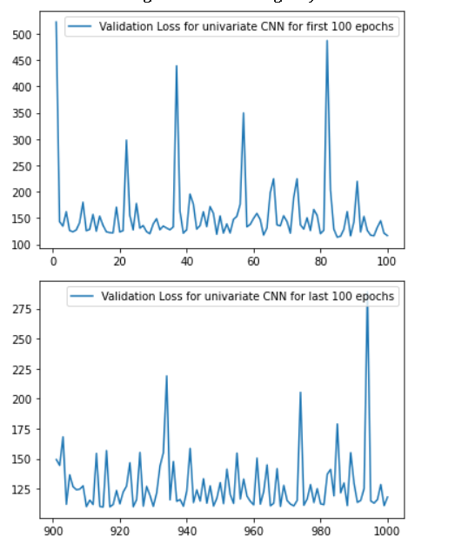
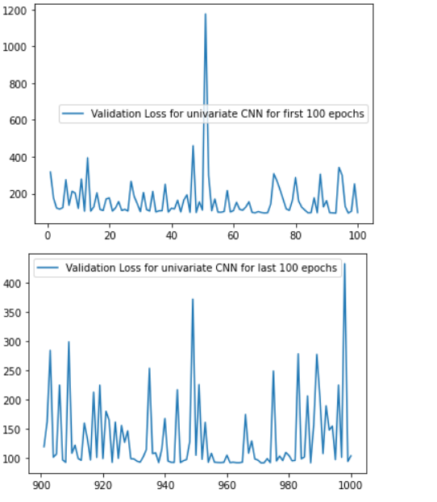
Convolutional Neural Network: Results
Results for window size 5 and 4 years of training data
Results for window size 5 and 8 years of training data
Results for window size 5 and 12 years of training data

Slide 7
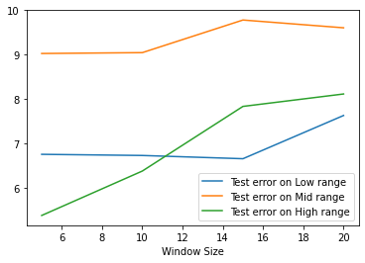
Analysis
Elastic Net
We found training error more than test error in initial and improved Elastic Net models. This is due to inherent difficulty of the dataset which increases with increase in number of samples. Train set had more samples than test set. Also, rot learning on train set was not possible. Solution was closed form solution. Certainly model is not overfitting. It’s rather underfitting.
Yaxis=RMSE

Slide 8
CNN
Error Analysis:
In CNN model while training the data it is resulting in high training loss which is more than validation loss , So the model is clearly not overfitting , But the main problem is that the model is not able to fit the data efficiently because of the highly noisy stock market data , That’s why training loss is quite high which is the major downside of cnn model performance.
The rmse is also not that great because of cnn model not able to fit the data properly , And is giving low rmse due to noisy nature of dataset.
The error is also increasing at last because adani stock is having more fluctuations in the later part of the data resulting in higher rmse for the later days of dataset.

Slide 9
Individual Contributions:
Raj -
Elementary Data Analysis: All graphs, codes and plots.
Convolutional Neural Network: All models, graphs and code.
Utkrisht -
LSTM: All models, graphs and code.
Elastic Net Regression: All models, graphs and code.
Anant -
Multiple Linear Regression: All models, graphs and code.
Sanity Checking: Creation of trivial data-sets for sanity checking of the developed models.

