Slide 1
Offensive Language Identification | Task H1
NLP Project
Group - 12
Kushal Juneja (kushal19057@iiitd.ac.in)
Udit Narang (udit19120@iiitd.ac.in)
Utkrisht Sikka (utkrisht19215@iiitd.ac.in)
Vishal Bansal (vishal19217@iiitd.ac.in)
Notes:
Good evening, we are group 12 and our task was Offensive Language Identification.

Slide 2
Introduction
The tweets often contain offensive language which should not be circulated.
We find offensive posts being exchanged among people of two enemy countries, two political parties, two religions, or even two personalities.
Offensive posts can trigger riots, protests and clashes which can result in loss of life and property
Anonymity has led to a surge in instances of offensive language on Twitter.
We design and evaluate different machine learning models that given a tweet, can detect whether they are offensive or not
Notes:
Utkrisht
Often, the tweets can contain offensive language. According to Oxford University Press, offensive language is rude in a way that causes somebody to feel upset or annoyed because it shows a lack of respect. Offensive posts are potentially dangerous when they target a particular community. Social media platforms have a moderation policy for curbing use of offensive language. This task can be modeled as a binary classification task. We use the OLID dataset to train and test our models. While the original OLID dataset has labels for 3 hierarchical tasks, we only work with labels at the first level, which is a binary classification of whether a tweet is Offensive.(54s)

Slide 3
Related Work
SemEval 2019, had its task 6, called OffenseEval, on offensive language detection, categorization of offensive language and offensive language target identification.
Deep Learning approaches were aggressively used by the teams.
BERT, with a layer of LSTM and softmax attached at its end, when combined with appropriate preprocessing steps is capable to bag first position in SemEval 2020
Bert (Devlin et al., 2019) is a bidirectional Transformer encoder that largely inherits its architecture from the Transformer proposed by Vaswani et al. (2017).
RoBERTa much better as it was trained longer, with large batch sizes.
HateBERT: a BERT model retrained on RAL-E, a large scale dataset of Reddit offensive comments.
fBERT is a BERT model (Sarkar et al., 2021), retrained on SOLID dataset.
Notes:
Utkrisht
SemEval 2019, had its task 6, called OffenseEval, on offensive language detection. One of the teams (Guler et al., 2019) used a combination of bi-directional RNN using LSTM cells, CNN, and a Feed Forward Neural Network. Some claimed to use external datasets to augment training data. Many top ranked teams reported using BERT along with hyperparameter tuning technique.
Bert uses same architecture in pre-training and fine-tuning, except for the output layers. For classification tasks, like offensive language detection, the CLS token is fed into an output layer that can consist of dense, drop out and a final softmax layer.
BERT improves when trained longer, with larger batch sizes, on longer sequences, as proposed in paper RoBERTa. HateBERT is a BERT model retrained on RAL-E, a large scale dataset of offensive Reddit comments. It has shown to outperform original BERT on OffensEval tasks. fBERT is a BERT model (Sarkar et al., 2021), retrained on SOLID dataset, one of the largest corpus of English language for offensive language identification.
Retraining is carried out using masked language modeling, where 15% of input tokens are selected and some of them are masked, others replaced with randomly chosen other tokens. fBERT was reported to give better Macro F1 than HateBERT and BERT. (40s)

Slide 4
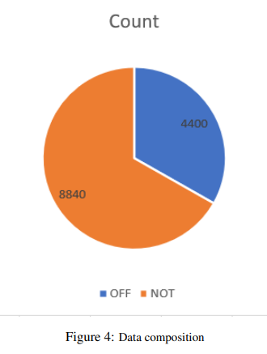
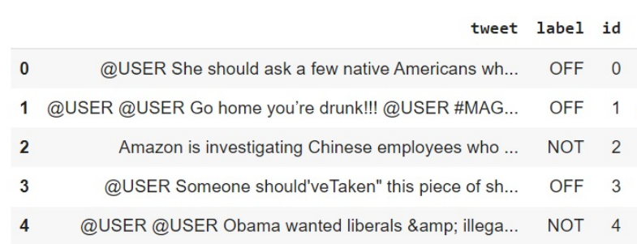
Dataset description: OLID
Trainset consist of 13240 rows and test consist of 860 rows.
3 columns. tweet: tweet text, label: a string which is OFF/NOT, id: a number.
Max length of any tweet in training set is 103 words.
Notes:
Kushal:
https://scholar.harvard.edu/malmasi/olid
The dataset contains a total of 14100 datapoints. Training set contains 13240 datapoints whereas the testing set contains 860 datapoints.
The dataset contains class imbalance. Out of 13240 training datapoints, 8840 non-offensive tweets and 4400 offensive tweets. The maximum number of words in any tweet in the training dataset was 103 words. 46s

Slide 5
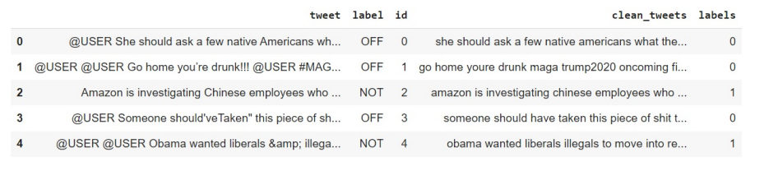
Data PreProcessing
For non DL models
Removed "@USER", <, >, numbers, punctuations, emojis, non ASCII characters, leading and ending trailing spaces and URLs
Replaced & with ‘and’.
Webpage apostrophe with ASCII 39.
Lowercasing.
decontractions i.e. converted don’t to do not, n’t to not .
Notes:
Kushal:
For the non-DL based models, we removed the twitter usernames, punctuations, emojis, non ASCII characters, URLs and trailing spaces. Then we lowercase the entire data. Finally we decontracted the common abbreviations like i’ll to i will.
For DL based model, we only removed the twitter usernames from our dataset. 40s

Slide 6

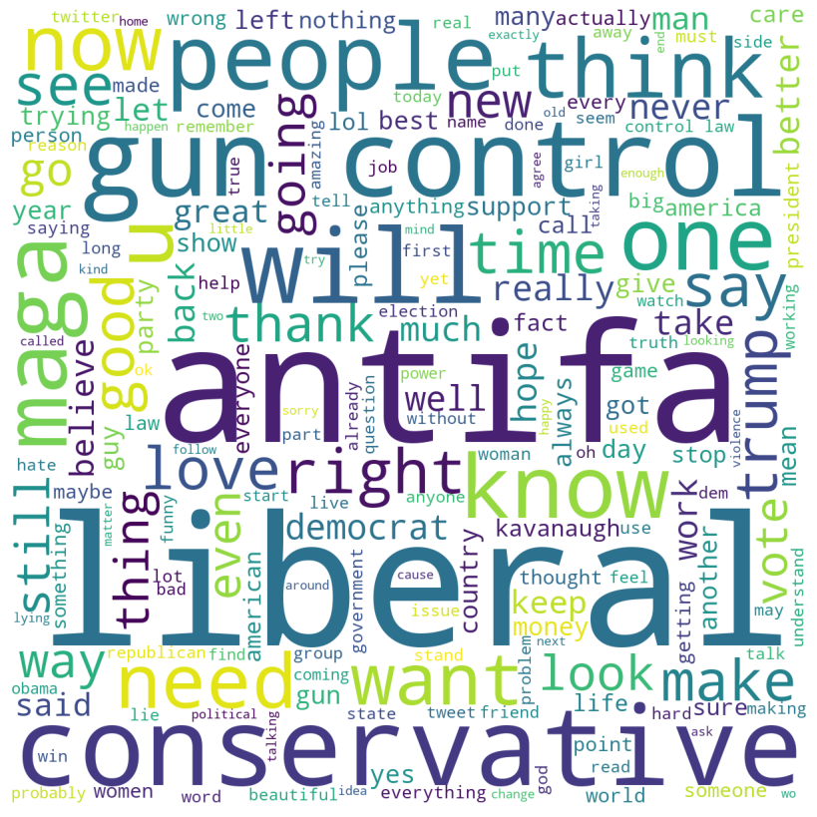
Word Cloud
OFFENSIVE
NOT-OFFENSIVE
Notes:
Kushal:
This is word cloud of offensive and non-offensive tweets.
Major words in offensive wordcloud: shit, fuck, ass, fucking, racist, gun, idiot, lie, hate, disgusting, govt,
Major words in not-offensive wordcloud: love, right, thank, etc, hope

Slide 7
Experiments, Results and Analysis

Slide 8
ML experiments

Slide 9
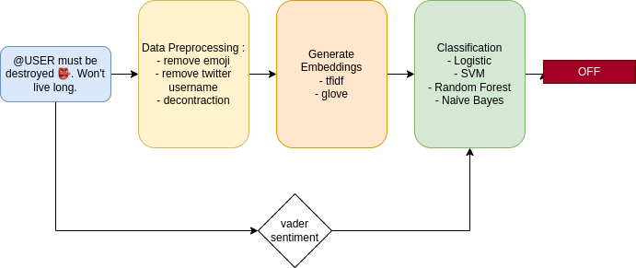
Methodology

Slide 10
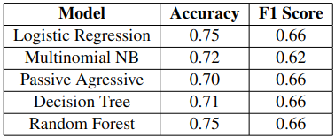
Tf-Idf embeddings

Slide 11
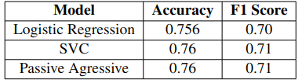
Tf-Idf embeddings + VADER sentiment score

Slide 12
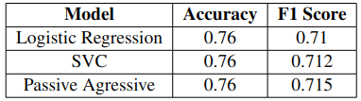
Tf-Idf embeddings + VADER sentiment score + doc2vec embeddings

Slide 13
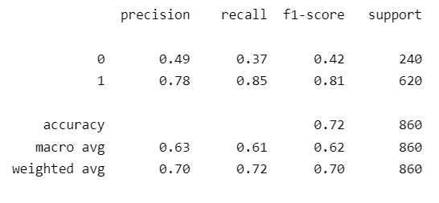
Using Glove Embeddings
Two approaches for finding the sentence embedding:
Mean of embeddings of all the words present in the sentence
Appending the embeddings of each word in sequential order and creating a large embedding for each sentence.

Slide 14
DL experiments

Slide 15
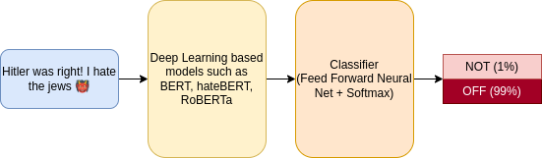
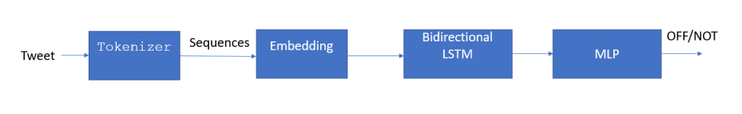
Methodology
Transformer based models pipeline
Preprocessed
LSTM Pipeline
Notes:
Utkrisht
For LSTM, we first, tokenize the tweets using keras’ preprocessing text tokenizer. Our LSTM architecture consists of an embedding layer, then bidirectional LSTM layer, then a dense layer with activation ’relu’, followed by a dropout layer, and finally a sigmoid layer. We also augment dataset with SOLID testset and compute the metrics again.

Slide 16
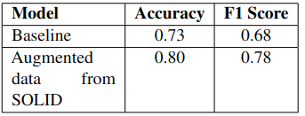
LSTM + SOLID data augmentation
SOLID - https://sites.google.com/site/offensevalsharedtask/solid
Notes:
Utkrisht: Baseline score. We also tried taking a simple ensemble by taking probabilities of lstm and bert and giving equal weightage to each probability. But it increase in F1 was only 0.1

Slide 17
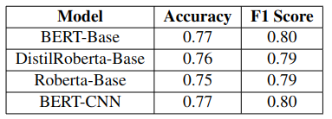
Transformer based models Fine-Tuning
using last 4 layer embeddings
Notes:
These are DL models on which we ran our processed data.
First : tweek on using the cls embeddings from last 4 layers
We use the Bert Base (12 layers)

Slide 18
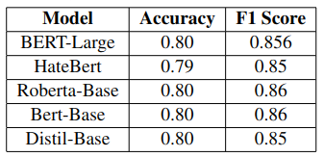
Transformer based models Fine-Tuning
using last layer embeddings
Notes:
Then we tested on using the cls token from last layer.

Slide 19
Demo Time 👏

Slide 20
Contributions
Kushal: Literature Review, ML models TFIDF, DL transformer models such as BERT, RoBERTa.
Udit: ML models with TFIDF, TFIDF + sentiment, TFIDF + sentiment + doc2vec, Glove embedding and DL based models such as BERT, RoBERTa and experimenting models like Hatebert, distilBert, etc using huggingface auto training library.
Utkrisht: LSTM, data augmentation on SOLID testset, ensemble approach by giving equal weights to BERT and LSTM probabilities, common preprocessing for ML models, bert-large-based model, Literature Review mentioned in related section,
Vishal: DL-based models such as CNN+BERT, DistilRoberta-Bert,Roberta-Base, and BERT-Base testing on multiple last layers.Literature Review on CNN+BERT

Slide 21
Thank You

