Slide 1




Smart FMCG Distribution: Predictive Analytics and Optimization
for Enhanced Inventory and Order Management
01
Utkarsh Shukla (21F2001497)

Slide 2



R L Associates:
A Key Player in the FMCG Supply Chain
Founded: October 13, 2018
Location: Kanpur, Uttar Pradesh
Business: FMCG Super Stockiest
Key Activities:
Connects 4-5 manufacturers (e.g., Snapin, Insight, Flamingo) with over 200 distributors
Facilitates product movement from manufacturers to retailers
Manages bulk buying, warehousing, distribution, and inventory control
Role: Essential intermediary in the FMCG supply chain within Kanpur
02

Slide 3





Problems faced by Organisation
Optimization for Enhanced Inventory
Predictive Analytics for Sales Data
Distributors Segmentation
03
The absence of an early warning system meant they couldn't take proactive measures to sell or redistribute products before expiry, directly impacting their bottom line.
The company relied solely on distributors orders for inventory management, without any data-driven forecasting tools. This reactive approach to ordering could lead to frequent mismatches between stock levels and actual demand, causing either overstocking or stockouts.
R.L. Associates struggled to effectively categorize and manage the relationships with distributors due to lack of proper segmentation. Without clear understanding of distributor performance patterns and value contribution, they couldn't implement targeted strategies or optimize their distribution network effectively..

Slide 4
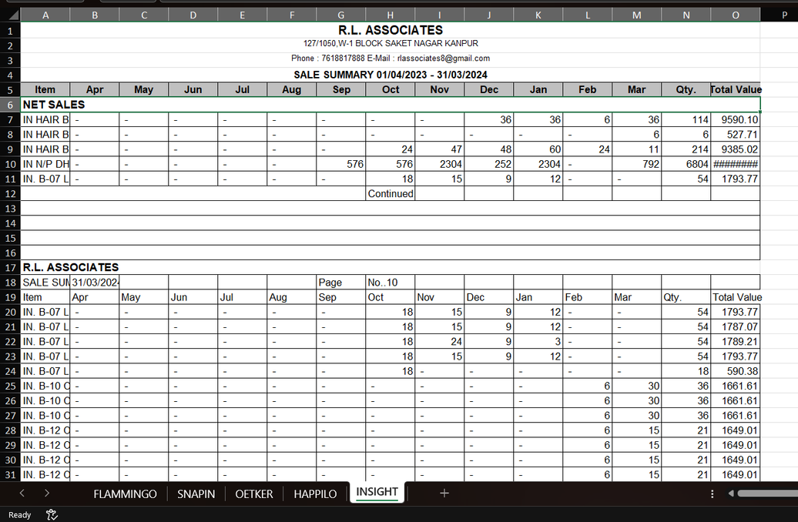
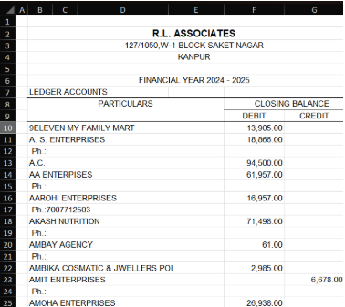
Dataset Collected
04
Monthly Sales Data for Complete fiscal year 2023-24
Transaction Ledger Data of 6 months
The workbook has five sheets, each named after a manufacturer (FLAMMINGO, SNAPIN, OETKER, HAPPILO, INSIGHT) that RL Associates deals with. It is organized in a tabular form, listing product details under "Item" and monthly sales data from April 2023 to March 2024, with summary metrics like total quantity sold and total sales value (INR).
The dataset for distributor segmentation contains transactional data from R.L. Associates. The key columns utilized are the distributor names (PURTICULARS) and their corresponding payment amounts (DEBIT), which reflect the financial activity between the distributors and the Super Stockist.

Slide 5
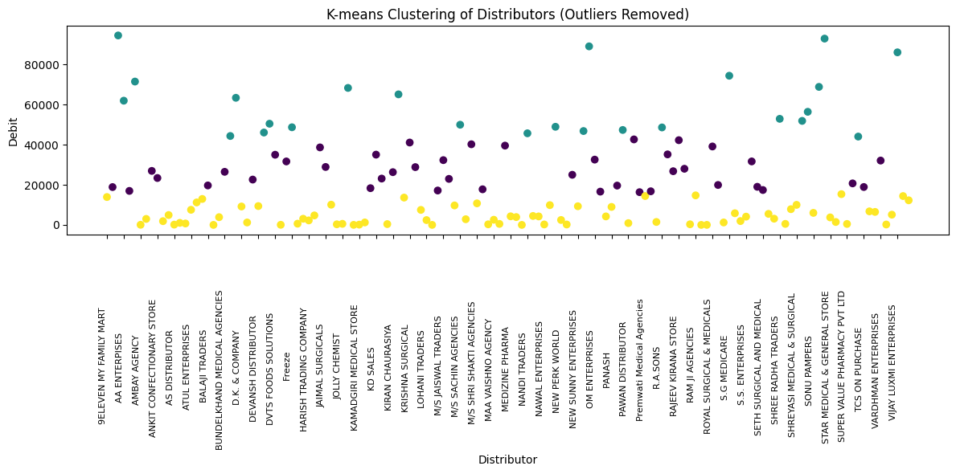
Distributors Segmentation
The Distributor Segmentation Analysis utilized K-means clustering to segment distributors based on debit patterns, uncovering actionable insights for business strategies. The analysis began with data loading and cleaning, converting debit values to numeric format, and removing nulls. Outliers, including major banks and large trading firms, were identified using the Interquartile Range (IQR) method and excluded to ensure data integrity. Normalization was applied to debit values using StandardScaler for clustering readiness. The Elbow Method determined k=3 as the optimal number of clusters. Three segments emerged: High-Value (₹44,061–₹94,500), Medium-Value (₹16,331–₹42,648), and Low-Value (₹1–₹15,347), each with distinct transaction characteristics. Key representatives in these clusters highlighted premium distributors, regular contributors, and small-scale businesses. A total of 15 outliers spanning large institutions and high-value accounts were documented, ranging from ₹121,668 to ₹11,190,130. These findings provide a comprehensive foundation for targeted distributor strategies.
05

Slide 6

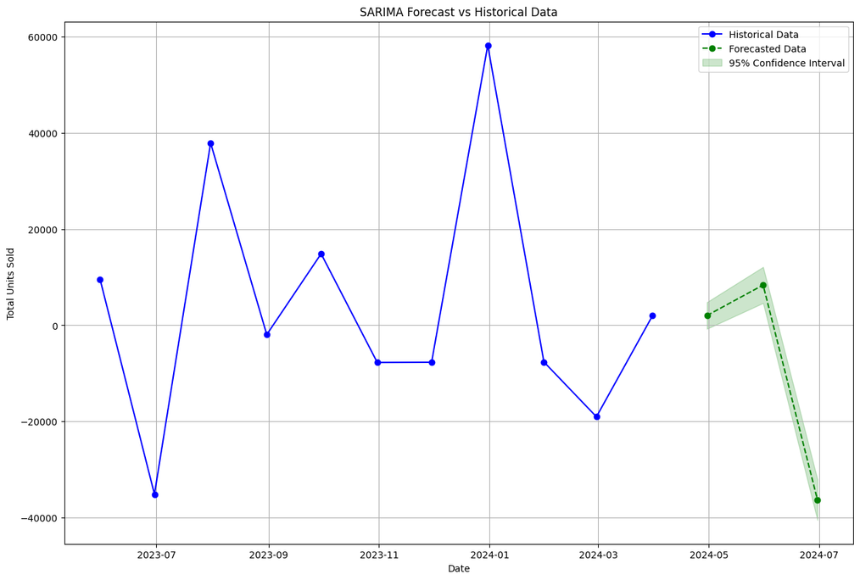

Predictive Analysis
This project applied predictive analytics to forecast sales for five manufacturers collaborating with R.L. Associates: FLAMMINGO, SNAPIN, OETKER, HAPPILO, and INSIGHT. Using the Seasonal AutoRegressive Integrated Moving Average (SARIMA) model, the objective was to enhance inventory management and streamline order placement. The process involved exploratory data analysis to identify sales trends and seasonal patterns, stationarity checks with ADF tests, optimal parameter selection using grid search, and model training on aggregated monthly sales data.
Why SARIMA ?
06
SARIMA was chosen for its ability to handle seasonality, capture non-linear trends, and offer diagnostic tools for model validation. Forecasts generated for the next three months demonstrated improved accuracy compared to simpler models. This approach equips R.L. Associates with actionable insights to optimize inventory, refine order planning, and improve operational efficiency, significantly advancing their predictive analytics capabilities.
Example forecasting 3 months sales using Snapin data By Sarima

Slide 7
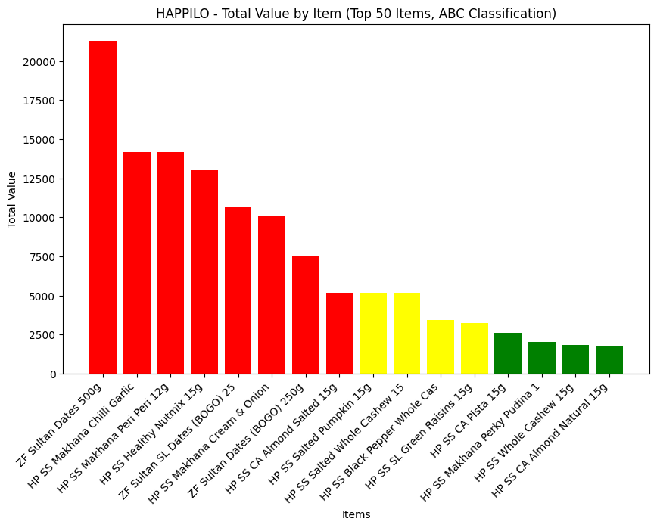

Enhanced Inventory
Early Warning System
The Early Warning System (EWS) classifies products by expiry risk using sales metrics like annual sales, recent sales, and variability. Critical products have zero sales, high-risk items show low sales or high variability, and low-risk items are stable. Interventions include markdowns for critical items, promotions for high-risk ones, and maintaining stability for low-risk products, optimizing inventory and reducing losses.
07
ABC Analysis
ABC analysis classifies inventory into Class A (top 20%, high-value items contributing 80% of value, needing strict control), Class B (next 30%, moderate-value items contributing 15%, needing moderate control), and Class C (remaining 50%, low-value items contributing 5%, requiring basic control). Items are sorted by value, with cumulative calculations identifying their impact. Visualization tools like bar and cumulative percentage plots simplify insights, focusing on top items and aggregated data. This enables efficient inventory management and strategic planning.
ABC Analysis on Happilo Dataset

Slide 8
Key Analytic Insights
Based on the SARIMA forecast plots
Based on K means distributors clustering
Based on ABC Analysis of Sales Data
Cluster Characteristics:
High-Value Segment: ₹44,061–₹94,500; premium distributors with significant transactions.
Medium-Value Segment: ₹16,331–₹42,648; regular distributors with moderate volumes.
Low-Value Segment: ₹1–₹15,347; small-scale distributors with minimal transactions.
Outlier Analysis:
Identified 15 outliers, including banks, large traders, and high-value accounts, with transaction ranges from ₹121,668 to ₹11,190,130.
FLAMMINGO: Sharp value drop after top items, indicating heavy reliance on primary products
SNAPIN: Gradual value decline, showing most balanced product performance
HAPPILO: High initial value with steep decline, typical of new market entrant
OETKER: Extreme single-product dependency with dramatic value drop
INSIGHT: Steep decline from top products across large 800-item portfolio
FLAMMINGO: Extreme volatility with high-amplitude swings
SNAPIN: Moderate cyclical patterns with stable forecast
HAPPILO: New entrant with strong initial spike
OETKER: Stagnant performance near zero
INSIGHT: Low-amplitude, consistent fluctuations
08

Slide 9

Strategic Recommendations for Enhanced FMCG Operations
Advanced Inventory Management
Optimized Distributor Engagement
Operations Enhancements
Focus Marketing Investments: Direct resources to high-growth products.
Adapt to Market Trends: Monitor competitors and adjust dynamically.
Team Training: Build advanced analytics skills within teams.
Feedback Loops: Use distributor and customer insights for dynamic strategy updates.
Cluster-Specific Programs:
High-Value: Offer loyalty incentives.
Medium-Value: Provide volume-based discounts.
Low-Value: Focus on growth support.
Refine Tiers: Use analytics to identify and invest in emerging performers.
Reassess Partnerships: Consolidate or phase out underperformers.
Predictive Inventory Systems: Leverage SARIMA forecasts to avoid stockouts/overstocking.
Dynamic ABC Analysis: Update categories regularly based on sales trends.
Early Warning Mechanisms: Start tracking expiry , till then rely on Early Warning System and ABC Analysis given under project.
09

Slide 10

Thanks
10

