Slide 1
Health Prediction Models
Parkinson's, Diabetes, and Heart Disease Prediction using Machine Learning
Your Name
Date

Slide 2
Introduction
This project involves the development of machine learning models to predict health conditions including Parkinson's Disease, Diabetes, and Heart Disease. The models are deployed using Streamlit, a powerful framework for building web applications in Python.

Slide 3
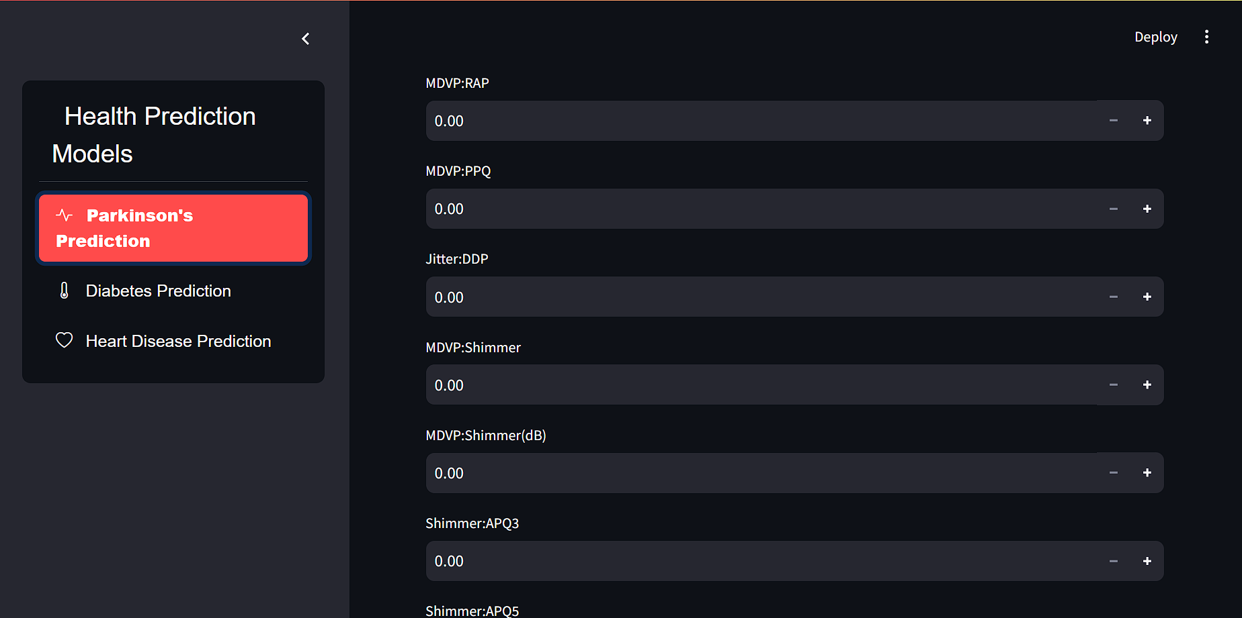
Parkinson's Disease Prediction Model
• Parkinson's Disease is a neurodegenerative disorder.
• Features used include MDVP metrics, shimmer, jitter, etc.
• The model is implemented using Logistic Regression.
• The prediction interface is integrated with Streamlit.

Slide 4
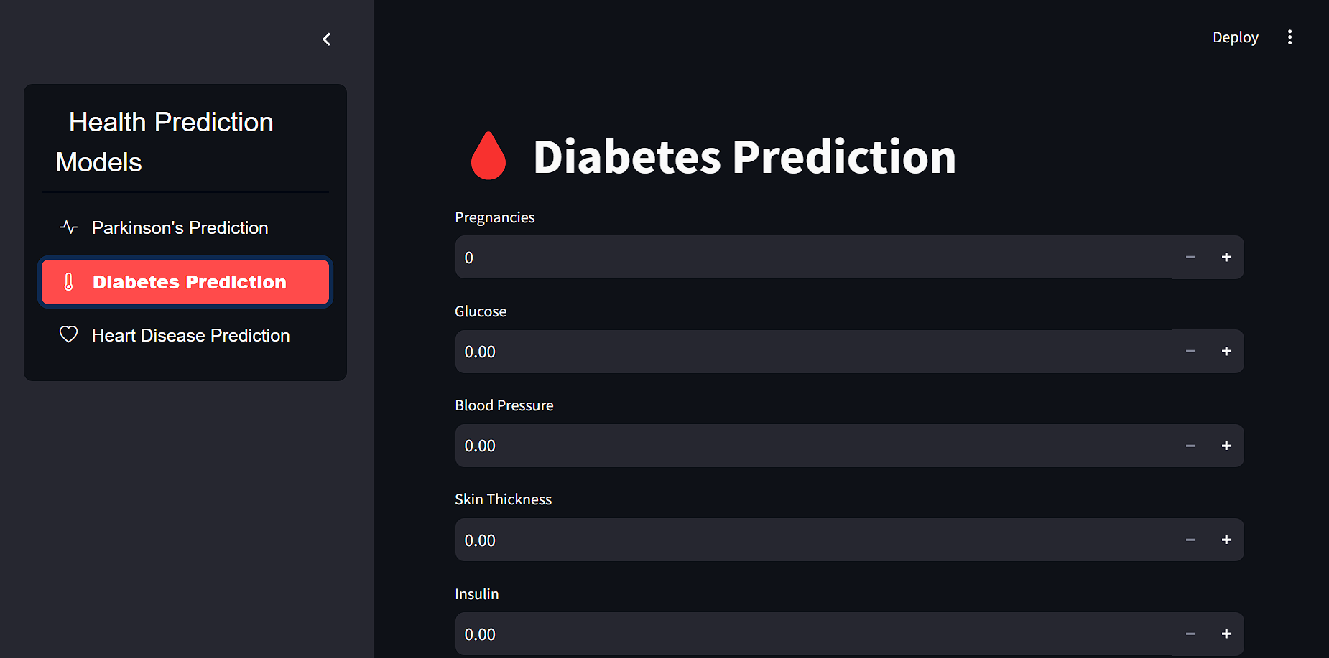
Diabetes Prediction Model
• Diabetes is a chronic condition that affects the body's ability to process blood glucose.
• Features include Pregnancies, Glucose, BMI, Age, etc.
• The model is implemented using Logistic Regression.
• The prediction interface is integrated with Streamlit.

Slide 5
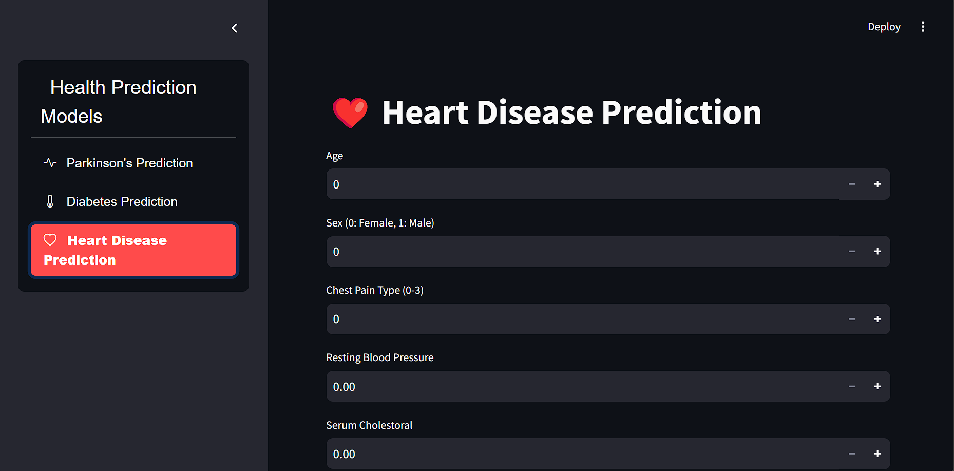
Heart Disease Prediction Model
• Heart Disease is a range of conditions that affect the heart.
• Features include Age, Sex, Cholesterol, etc.
• The model is implemented using Logistic Regression.
• The prediction interface is integrated with Streamlit.

Slide 6
Implementation in Streamlit
• The web application is built using Streamlit.
• The models are integrated into a single interface.
• Custom styling is applied for better user experience.
• The app includes navigation and prediction buttons.

Slide 7
Results & Accuracy
• Each model's accuracy is evaluated.
• The predictions are presented to the user in a clear manner.
• The models show promising results for health prediction.

Slide 8
Conclusion
• This project successfully developed and deployed models for predicting Parkinson's Disease, Diabetes, and Heart Disease.
• The web application is user-friendly and provides accurate predictions.
• Future work could include adding more models and enhancing the UI.

Slide 9
Q&A
Any questions?

