Slide 1
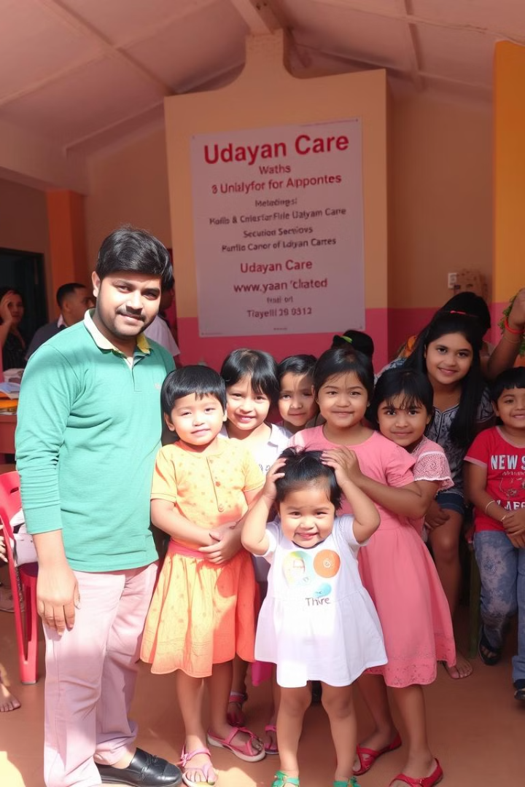
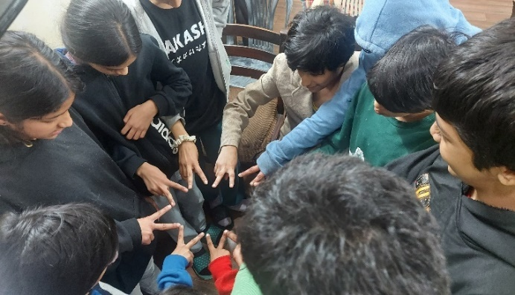
Social Internship Program (SIP) at Udayan Care
Welcome! This presentation will provide insights into our Social Internship Program at Udayan Care, highlighting our experience and key learnings.
Presented by:
Yash – 24PGDM234
Anurag - 24PGDM185
Vidhi Dubey - 24PGDM117
Utkarsh Anand – 24PGDM146
Sweta Alok - 24PGDM172

Slide 2
About the Organization
Udayan Care
Key Programs
Udayan Care is a charitable trust, established in 1994, dedicated to supporting children, youth, and women through education and empowerment.
The organization operates programs like Udayan Ghars (homes for children), Udayan Shalini Fellowship (education support), and Vocational Training Centers.
Mission: To empower vulnerable children, youth, and women to live a life of dignity and self-reliance.
Vision: To create a nurturing and enabling environment that fosters holistic development and positive change.

Slide 3
About the Scenario
Udayan Ghars Internship
Responsibilities
Our internship was conducted at Udayan Care's Udayan Ghars, with a strong focus on:
Our responsibilities included detailed documentation of activities, engaging teaching methods, and active engagement with students, all aimed at contributing to their educational and emotional well-being. These efforts support Udayan Care's mission to provide a life of dignity and self-reliance for vulnerable children.
Quality Education: Enhancing learning environments and educational resources.
Digital Literacy: Equipping students with essential computer skills and online knowledge.
Child Welfare: Promoting a safe, nurturing, and supportive atmosphere for holistic development.

Slide 4
Integration into the Environment
Actively Engaged
We were actively engaged in both teaching and administrative tasks, contributing to the daily operations of the Udayan Ghars.
Established Meaningful Connections
We established meaningful connections with the children and staff, fostering a supportive and collaborative environment.
We adapted to the organization's structured workflow, understanding their processes and protocols.
Adapted to Workflow

Slide 5
Problem Context
Identified Gaps
Challenges Faced
We observed a lack of advanced educational resources, digital literacy skills, and structured aftercare programs to support the children's well-being.
We encountered emotional and social barriers, resource constraints, and skill development gaps that hinder the children's progress.

Slide 6
Analytical Framework
Political
Economic
Government policies on child welfare, NGO funding, and education reforms.
Financial support from CSR initiatives, donor dependency, and economic downturns affecting funding.
Social
Technological
Changing societal attitudes towards child care, importance of education, and gender equality initiatives.
Integration of digital education tools, need for better IT infrastructure, and online learning opportunities.
Environmental
Legal
Sustainable practices in NGO operations, impact of climate conditions on shelter homes.
Compliance with child protection laws, NGO regulations, and licensing requirements.

Slide 7





Findings and Insights
Students require personalized learning plans tailored to their individual needs and learning styles for better growth and development.
Digital literacy is crucial for modern education and future career opportunities. Lack of tech skills limits their potential.
Long-term mentorship and support are valuable for helping students transition into independent life.
Resource limitations, including limited funding, affect the expansion of programs and facilities, impacting access to resources.
Emotional well-being is critical for students. Structured aftercare and counseling programs provide essential support.

Slide 8
Proposed Solutions
1
Enhanced teacher training programs for better classroom management, student engagement, and understanding individual learning needs.
2
Development of a Child Health & Activity Management Portal for efficient data tracking, monitoring progress, and tailoring individual care.
3
Expansion of digital infrastructure, including computers, internet access, and online learning platforms, to bridge the digital divide.

Slide 9
Implementation Plan
1
Phase 1
Launch digital training initiatives for both children and teachers, incorporating interactive modules and online learning platforms.
2
Phase 2
Develop and integrate the Child Health & Activity Management Portal into the existing system, ensuring seamless data flow.
3
Phase 3
Conduct ongoing evaluation and improvement based on feedback from students, teachers, and stakeholders, ensuring continuous development.

Slide 10



Intellectual Outcomes: Impact and Alignment
Skill Development & Education(UNSDG 4 – Quality Education)
Enhanced learning opportunities through mentorship and digital literacy programs.
1
Improved educational access for underprivileged children.
Economic Empowerment(UNSDG 8 – Decent Work & Economic Growth)
2
Vocational training and job readiness programs increase employability.
Strengthening financial independence for young adults.
Reduced Inequalities(UNSDG 10 – Reduced Inequalities)
3
Bridging the digital and educational divide for marginalized communities.
Providing equal opportunities through structured support programs.

Slide 11
Conclusion
1
Hands-on experience in social work and nonprofit management
2
Deep understanding of child development and NGO operations
Gained practical exposure to working in an NGO setting.
Observed the importance of structured care and mentorship for children.
Understood the real-world challenges of social impact organizations.
3
Acquired skills in mentorship, administration, and digital education
Developed leadership and teamwork skills while working with children.
Strengthened communication and problem-solving abilities.
Gained experience in using digital tools for education and administration.

