Slide 1
An Automated Classification Approach of Software Engineering Papers
Practical Course “Werkzeuge für Agile Modellierung”
21.03.2022
Utku Erol
Vladimir Solovyev
Supervisor: Angelika Kaplan

Slide 2
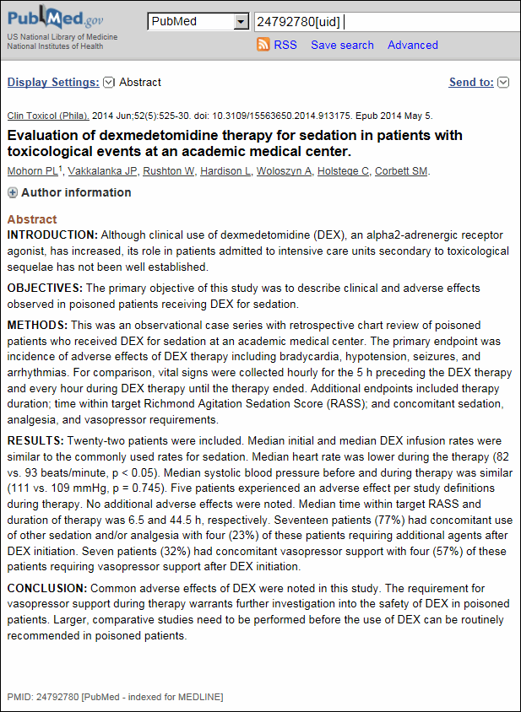
Structured Abstracts
Medicine
IMRAD standard
(Introduction, Methods, Results, Discussion)
Advantages
Higher quality
Completeness
Easier to understand
Source: https://www.nlm.nih.gov/bsd/policy/structured_abstracts.html

Slide 3
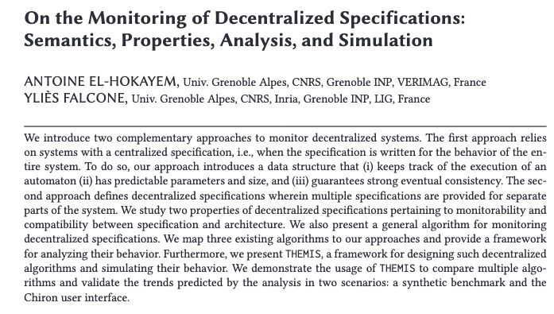
Unstructured Abstracts
Most software engineering papers
Many different formats
More complicated for analysis
E.g. search engines
Abstract structure from the medicine domain not directly applicable
E.g. contributions such as replication data (code, dataset)
Source: https://dl.acm.org/doi/10.1145/3355181

Slide 4
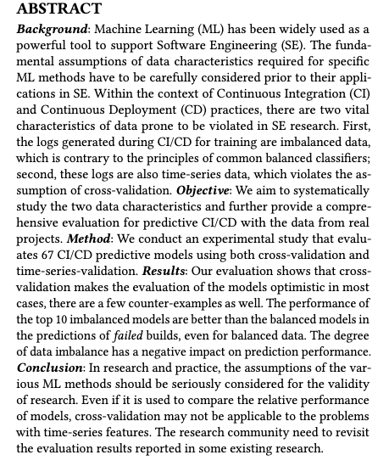
Towards Structured Abstracts in SE
[Budgen08] survey
23% had no preference
70% preferred structured abstracts
7% preferred conventional abstracts
EASE suggests an adopted IMRAD format
Hierarchical classification with 6 high level classes:
Background and motivation
Aim and contribution
Research object
Applied research method
Results and findings
Summary
Source: https://dl.acm.org/doi/pdf/10.1145/3383219.3383222

Slide 5
Goal
Define and analyze a set of classes for software engineering paper abstracts
Prepare dataset
Train classifier model
Sentence-based multi-label classification
Compare classical methods to deep learning
Manually labeled dataset
Unstructured abstract
ML classification
Structured abstract

Slide 6
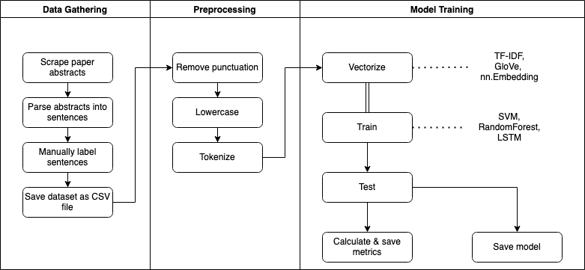
Overview

Slide 7
Data Gathering
Selected venues:
EASE
ESEC-FSE
ICSE
TSE
TOSEM
Scrape from the website: www.dl.acm.org
Parsing abstracts with the nltk tokenizer into sentences
Venue/Year | #papers | #sentences
EASE 2020 | 27 | 249
EASE 2019 | 20 | 193
ESEC-FSE 2020 | 101 | 861
ICSE 2020 | 129 | 1151
TSE 2020 | 63 | 555
TOSEM 2020 | 31 | 268
All | 371 | 3447

Slide 8
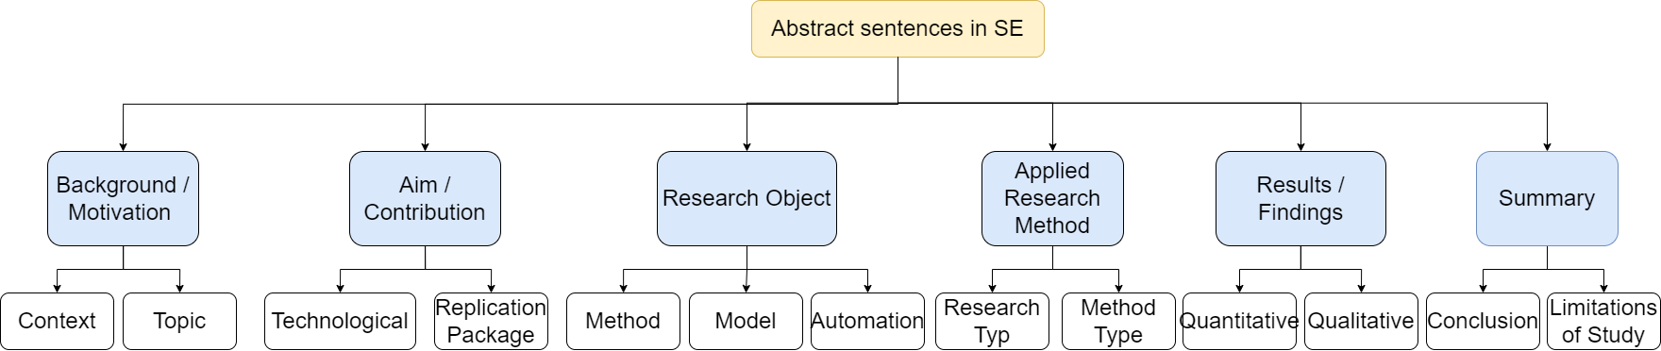
Data Gathering: Labels
Background and motivation
What has been done already in this area?
What problems exist?
Aim and contribution
What is this paper aiming to achieve?
What is the scientific contribution?
Research object
What is investigated in the paper?
Method, algorithm, process, automation, etc.
Class hierarchy (incomplete)

Slide 9
Data Gathering: Labels
Applied research method
Method for evaluating and proving research results
Experiments, interviews, surveys
Results and findings
Quantitative or qualitative results of the paper
Positive, negative, or numbers
Summary
Conclusion, what could be solved
Future works, limitations
Class hierarchy (incomplete)

Slide 10
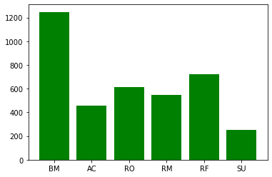
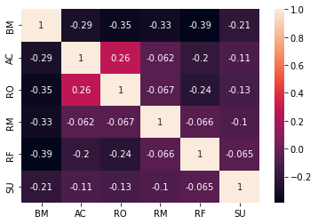
Data Analysis
Imbalanced dataset
Summary is underrepresented → can be merged with results & findings
Applied undersampling
Correlating target classes
Aim and contribution & research object → research object is a contribution
Label Distribution
Correlation of Labels

Slide 11
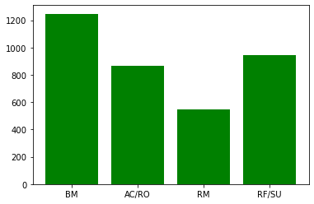
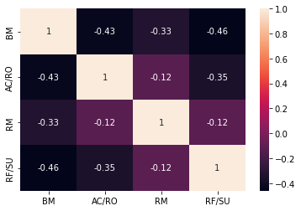
Data Analysis
Dataset after merging 2 pairs of labels
Aim and contribution & research object
Results and findings & summary
More balanced, less review conflicts
New Label Distribution
New Correlation of Labels

Slide 12
Preprocessing
Applied preprocessing options:
Remove punctuation
Lowercase
Tokenize
Other preprocessing options such as stemming and stop word removal led to worse performance
"Based on these perceptions, we conclude that automatic code inspection is considerably relevant in an end-user development context such as VBA."
['based', 'on', 'these', 'perceptions', 'we', 'conclude', 'that', 'automatic', 'code', 'inspection', 'is', 'considerably', 'relevant', 'in', 'an', 'enduser', 'development', 'context', 'such', 'as', 'vba']

Slide 13
Model Training
2 different datasets
...with all 6 categories
...with merged 4 categories
Evaluation of classifiers
Accuracy: share of correct predictions
Precision: how many of the positively classified were relevant
Recall: how good is the model at detecting the positives
F1: emphasizing recall and precision equally
Classical Algorithms | Deep Learning
Support Vector Machines (SVM) Random Forest Decision Tree Logistic Regression Naive Bayes | LSTM with Pytorch LSTM with Tensorflow Fully Connected (FC) Layers with Tensorflow Bert with Tensorflow

Slide 14
Model Training: SVM
Implemented with sklearn library
TF-IDF vectors as input
Weights based on number of occurence
Better recall than precision in general
F1 score distribution correlates with the label distribution
Very poor results for summary

Slide 15
Model Training: RandomForest
Implemented with sklearn library
TF-IDF vectors as input
Very similar results to SVM

Slide 16
Model Training: LSTM (TF-IDF)
Pytorch with Lightning
TF-IDF vectors as input
2 bidirectional LSTM layers
Better precision than recall in general
More balanced precision/recall ratio
No improvement
Longer train durations
Sentence vectors
LSTM <> LSTM
Sigmoid
Probability predictions
input
model
output

Slide 17
Model Training: Decision Tree
NLTK library
Input: Binary encoding of most frequent words
One classifier per category
if software != False:
if we == False:
if our == False:
if study == False: return 1
if study != False: return 0
if our != False: return 0
if we != False:
if no == False: return 0
if no != False: return 1

Slide 18
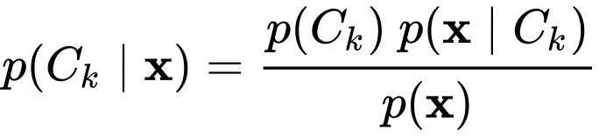
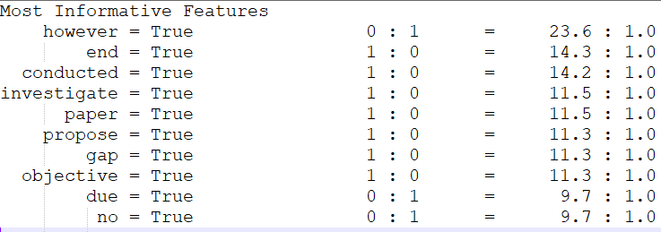
Model Training: Multilabel Naïve Bayes
NLTK library
Input: Binary encoding of most frequent words
Formula

Slide 19
Model Training: Logistic regression
Sklearn library
Input: TF-IDF
One classifier per category
Extreme precision-recall divergence

Slide 20
Model Training: FC Layers with TF-IDF
Tensorflow library
Input: TF-IDF
Deep learning model with fully connected layers
Output: probabilities of categories

Slide 21
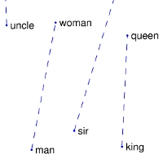
Model Training: LSTM with GloVe
Tensorflow library
Input: pre-trained GloVe word embeddings
king – man + woman = queen
Deep learning model with the bidirectional LSTM layer

Slide 22
Model Training: Tensorflow with BERT
Tensorflow library and transformer-based pre-trained language model BERT
Input: sentences
Uses context of words
I went to the bank to get money
I spent two hours on the river bank
bank != bank, depends on context

Slide 23
Summary
Problem
No common standard for structured abstracts in SE
Standards from other domains can‘t be directly applied
Idea
Common hierarchical classification scheme specific for SE aspects
Multilabel sentence classification
Contribution
Labeled dataset
ML models (classical methods vs. deep learning)
Benefits
Automated labeling of SE paper abstracts
Evaluation
Classification performance metrics accuracy, precision, recall, F-beta etc.

