Slide 1



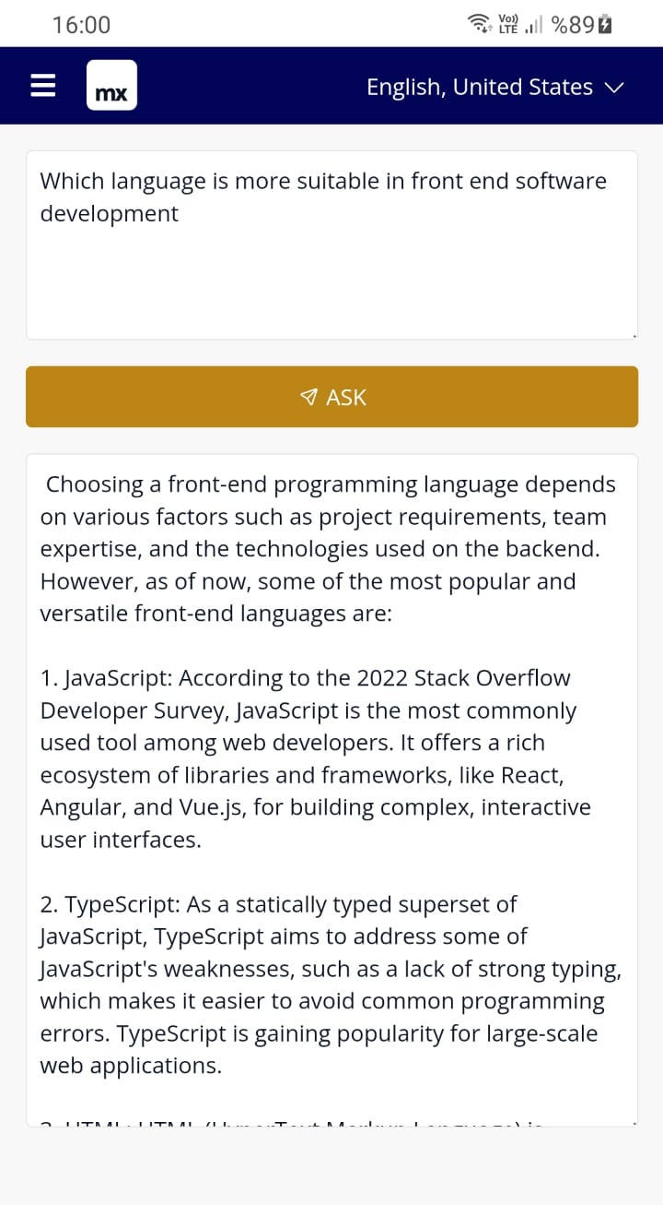
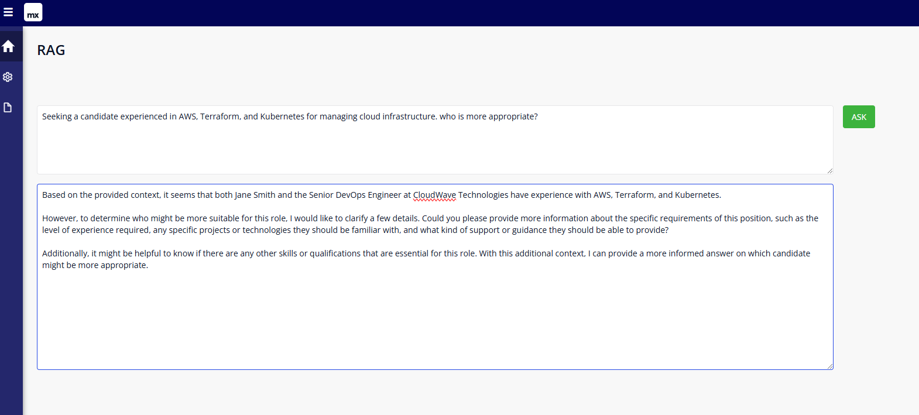
OpenwebUI Rag (retrieval-augmented generation)
FT Mx Community Contribution
Siemens LLM PWA PoC

