Slide 1


Mx 10.14 ,10.15
PWA push notification
Google maps autocomplete module
Mx Expert 17th Sept -> 28th October
DOM manipulation
Chatbot
Wiki is replaced by SharePoint
ADV Mx Community 29th Aug
Calendar Widget
ADV Mx Community 26th Sep
Cancelled Chatbot
07-08 Aug ADV Intermediate training inhouse
Ward Manager -> Prototype ChatBot
Wit.ai , aws lex
IFM workshop
What do we have in Desigo
What are the KPIs
IFM IBM ESB middleware Cloud->OnPrem
İnsights Hub prod tenant active
A

Slide 2

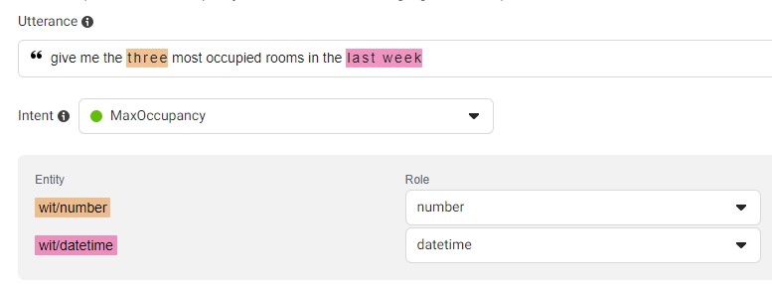
Natural language processing (NLP) uses to enable computers to understand natural language as humans do.
Management App
Bx App
User Asks
Train
Result
Training
Backups
ChatBot
Integration w Bx env

Slide 3
