Slide 1
Youtube watchıng pattern analysıs
İsa Utku Dursunoğlu 30881

Slide 2
My dataset
Source and Description: The dataset used in this analysis comes from my personal YouTube watch history, exported using Google Takeout. It contains detailed information about every video I watched from February 14, 2023, to the present. The raw data was provided in JSON format and includes fields like timestamps, video titles, channel names, and video URLs.
Key Details
Time Range: The dataset spans from February 14, 2023, to December 2024, capturing my viewing habits for almost two full years.
Fields Extracted:
Timestamp: When the video was watched (e.g., date and time).
Title: The name of the video, with "Unknown Title" for entries where this information was missing.
Channel Name: The content creator’s channel name, defaulting to "Unknown Channel" when metadata was unavailable.
URL: The link to the video, used for identifying unique entries.
Limitations:
The dataset excludes any activity prior to February 2023, as this data wasn’t available due to account settings.
Videos that were deleted or made private appear as "Unknown Title" or "Unknown Channel," which slightly impacts the completeness of the analysis.

Slide 3
My Hypothesıs
H₀ (Null): There is no overall difference in my YouTube watching patterns between 2023 and 2024 in terms of daily counts, hourly trends, content preferences, and binge-watching behavior.

Slide 4
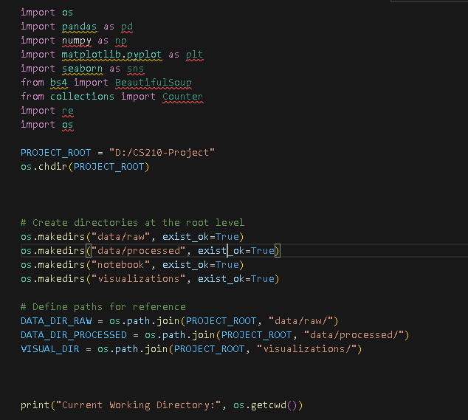
I start by importing the core Python libraries I’ll need for this project:
pandas and numpy for data manipulation and numerical operations.
matplotlib and seaborn for visualization.
Next, I set my project root directory to "D:/CS210-Project".
data/raw: For the original JSON file from Google Takeout.
data/processed: For any cleaned or transformed data (usually in CSVs).
notebook: For Jupyter or IPython notebooks.
visualizations: Where I save plots and charts.
Finally, I print the current working directory to confirm everything is set up correctly. This helps me avoid confusion about file paths.

Slide 5
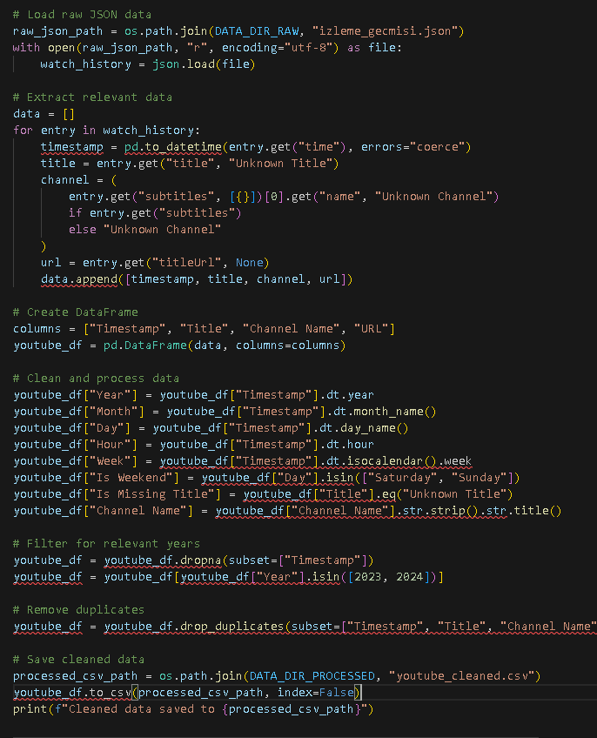
Here, I load the JSON file (izleme_gecmisi.json) containing my YouTube watch history. I parse each entry to extract:
Timestamp: When I watched the video.
Title: The video’s title (default “Unknown Title” if missing).
Channel: The name of the channel (default “Unknown Channel” if not available).
URL: The video link, if it exists.
After creating a DataFrame called youtube_df, I generate extra columns like Year, Month, Day, and Hour for deeper analysis.
I also create a column Is Weekend to flag whether I watched a video on Saturday or Sunday.
I filter out any invalid timestamps, keep only rows from 2023 and 2024, and remove duplicates so I don’t accidentally count the same watch multiple times.
Finally, I save the cleaned data to youtube_cleaned.csv. This ensures I have a neat dataset ready to explore.

Slide 6
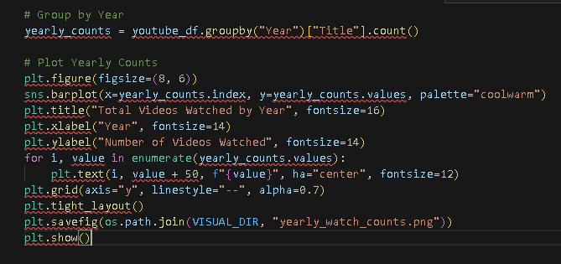
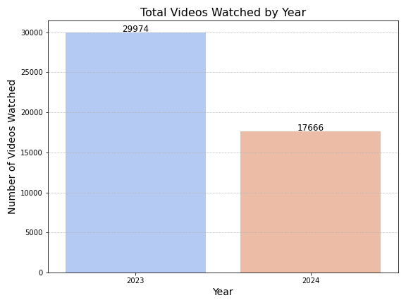
In this code, I group my DataFrame by Year and count how many videos I watched each year. Then I plot a bar chart:
The x-axis is the year (2023 or 2024),
The y-axis is the total count of videos watched.
I also annotate each bar with the actual number for clarity.
What I Learned: I saw a notable drop in 2024 compared to 2023. This confirms that I used YouTube less in 2024, likely due to switching to Spotify for music or having less spare time.

Slide 7
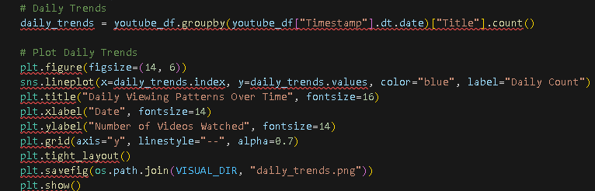
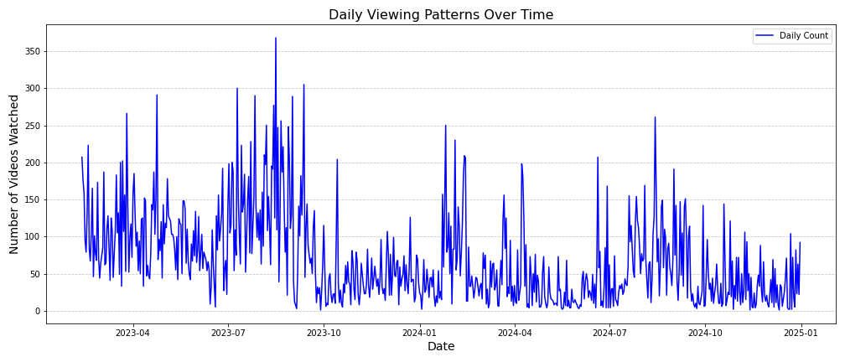
Here, I group by the date (year-month-day, ignoring the hour) and count how many videos I watched each day. Then I use a line plot to see daily fluctuations over time.
Peaks in the chart might indicate days when I listened to music more, or discovered a binge-worthy channel.
Troughs (low points) might correspond to busy days, finals, or breaks in my routine.
This visual helps me pinpoint exactly when I had spikes of activity—like large peaks in mid-2023—and how they compare to fewer peaks in 2024.

Slide 8
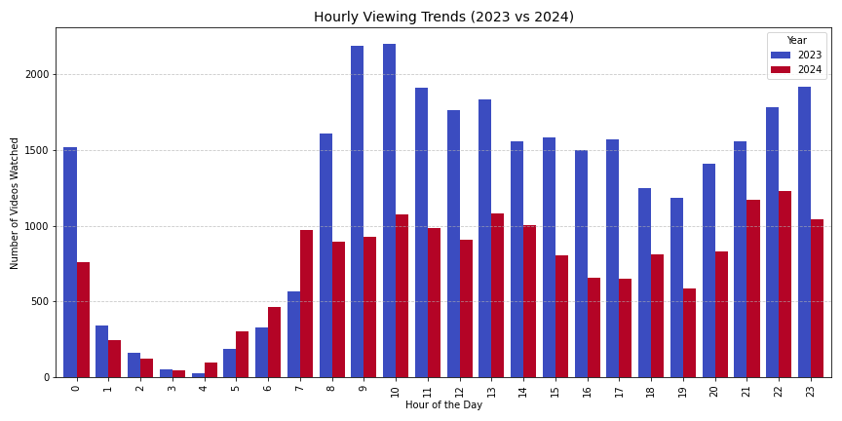
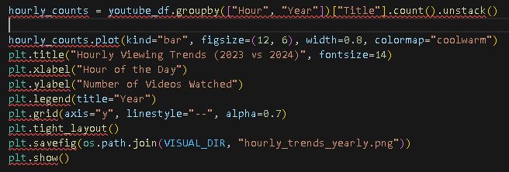
In this chart, I compare how often I watch YouTube at each hour of the day, for both 2023 and 2024. The code groups by (Hour, Year) and counts.
The bar clusters along the x-axis represent hours from 0 (midnight) to 23 (11 PM).
Each cluster has two bars: one for 2023, one for 2024.
Key Insight: This helps me see if my peak hours changed. Typically, I expected higher bars for the evening (like 7 PM to 10 PM). If 2024 bars are consistently lower, it reaffirms that I spent less time on YouTube overall.

Slide 9
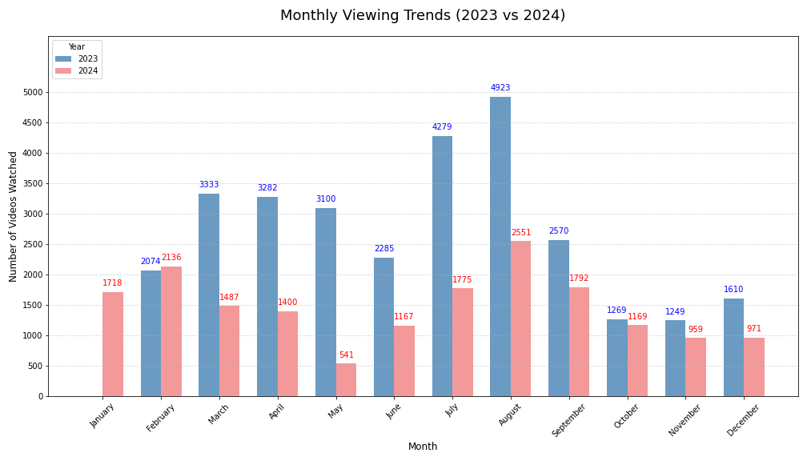
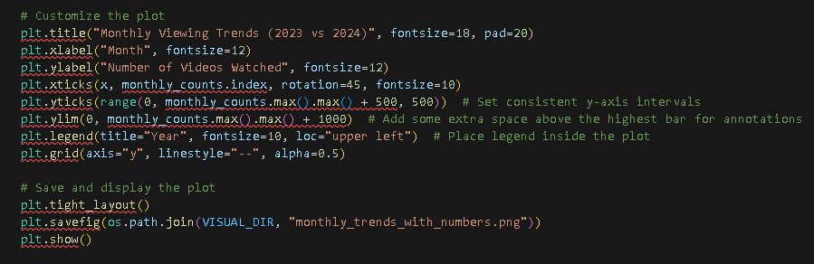
This snippet shows how many videos I watched each month of 2023 vs. 2024. I reindex to ensure the months line up from January to December.
Each month on the x-axis has two bars: blue for 2023 and red for 2024.
By labeling the bars with their counts, I can see exactly how big or small the difference is.
Observations: I noticed that in August 2023, I watched a ton of videos, possibly due to summer vacation. But in August 2024, the number dipped significantly—maybe because of an internship or I started using Spotify for music.

Slide 10
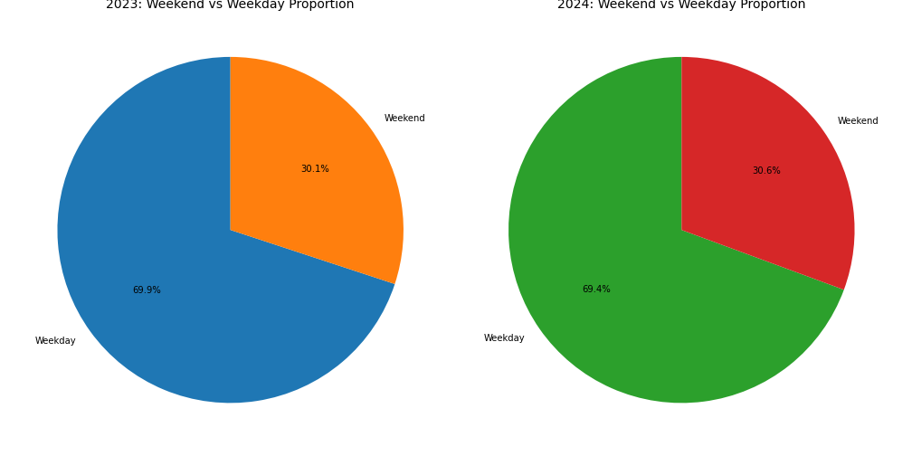
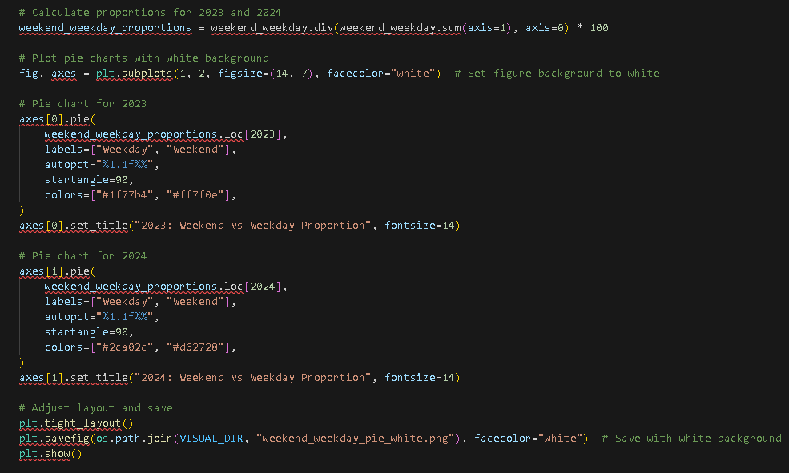
I flagged each record as weekend or weekday based on the day name. Then I calculated what percentage of my total videos fell on weekends vs. weekdays for each year.
Pie Charts: I display these side by side:
2023 might show something like 70% on weekdays, 30% on weekends.
2024 might be slightly different, but in my data, it was roughly the same ratio.
This implies that while my overall usage decreased, the structure of how I use YouTube across weekdays vs. weekends remained quite stable.

Slide 11
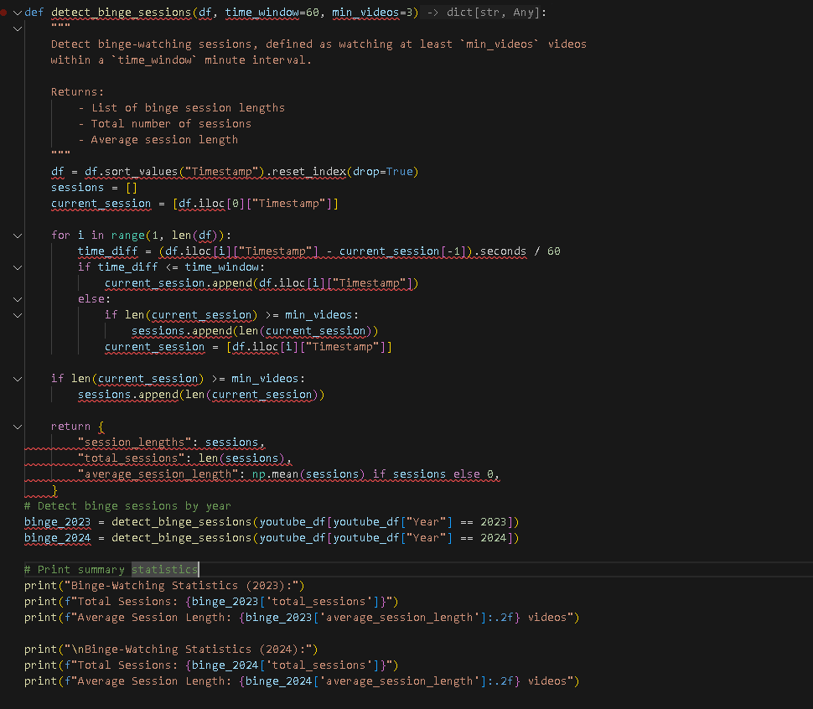
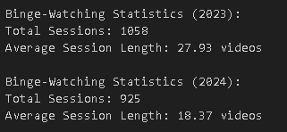
I define “binge-watching” as watching at least 3 videos within a 60-minute window. This function loops through each timestamp in chronological order and groups them if they happen close together in time.
total_sessions: How many binge sessions I had.
session_lengths: How many videos each session included.
average_session_length: The average number of videos per binge session.
Looking at the stats:
2023 might have ~1,058 binge sessions with an average of ~28 videos per session.
2024 might have fewer sessions (~925) with a shorter average (~18 videos).
This drop shows I was less prone to long, uninterrupted YouTube marathons in 2024—perhaps I was busier or replaced some of my watch time with Spotify or other platforms.

Slide 12
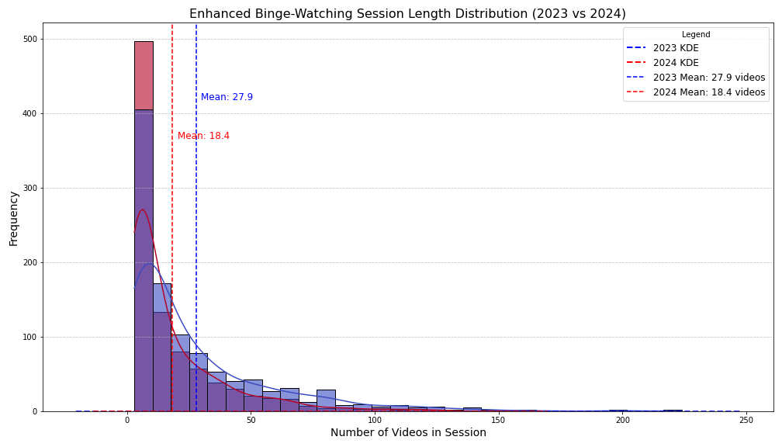
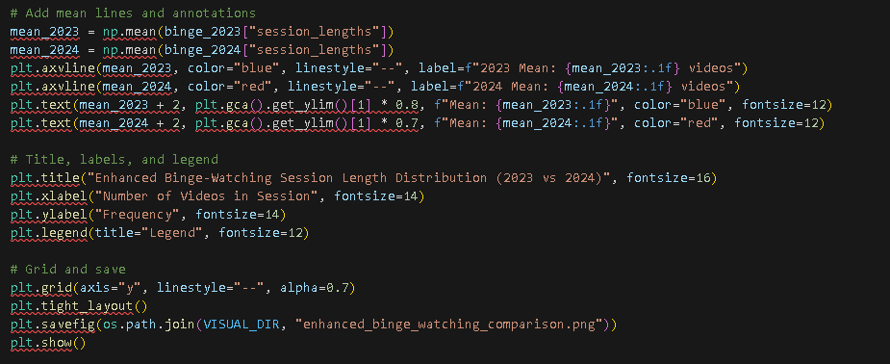
Here, I create a combined dataset of all binge-session lengths from both years. Then I plot:
A histogram with bins for session length, color-coded by year.
A KDE curve (dashed line) for each year, smoothing out the distribution.
The vertical lines mark the mean session length for each year. So if 2023’s line is at ~28 and 2024’s line is at ~18, it’s clear my average session was much higher in 2023.
Insight: 2023’s distribution has a “long tail,” meaning I had more extreme long sessions. Meanwhile, 2024’s curve peaks earlier, showing I rarely went over 30 videos in one session.

Slide 13
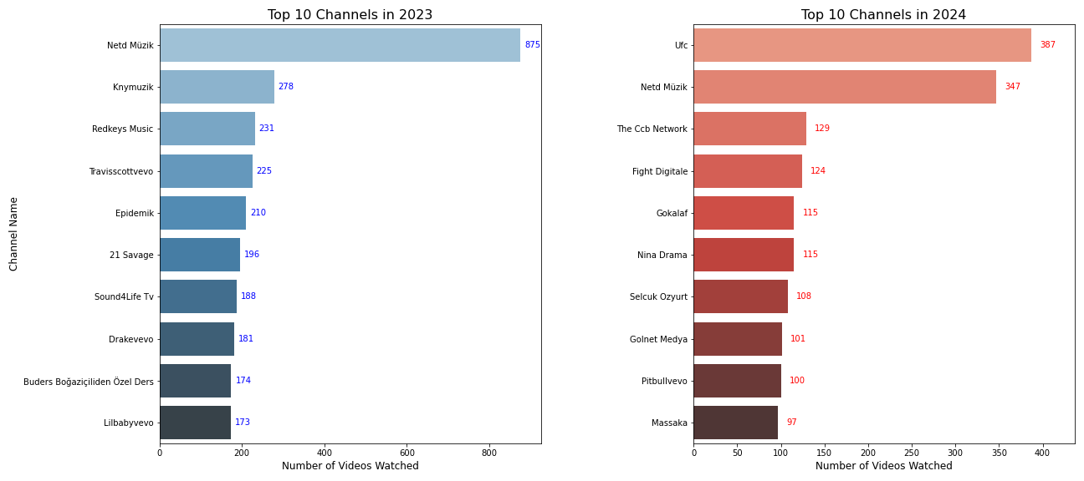
This code determines which channels I watched the most in 2023 vs. 2024. I filter out “Unknown Channel” entries, then group by channel name, count the videos, and sort to get the top 10.
Left Bar Chart: My top 10 channels in 2023 (blue bars).
Right Bar Chart: My top 10 channels in 2024 (red bars).
I also print how many times “Unknown Channel” appeared each year, indicating missing metadata.
Observations: In 2023, I see more music-related channels like “Netd Müzik” dominating. In 2024, I notice channels like “UFC” or “Fight Digitale,” suggesting I’ve started watching more sports/fight content and less music on YouTube.

Slide 14
Statıstıcal analysıs

Slide 15
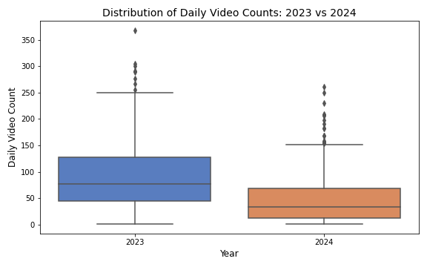
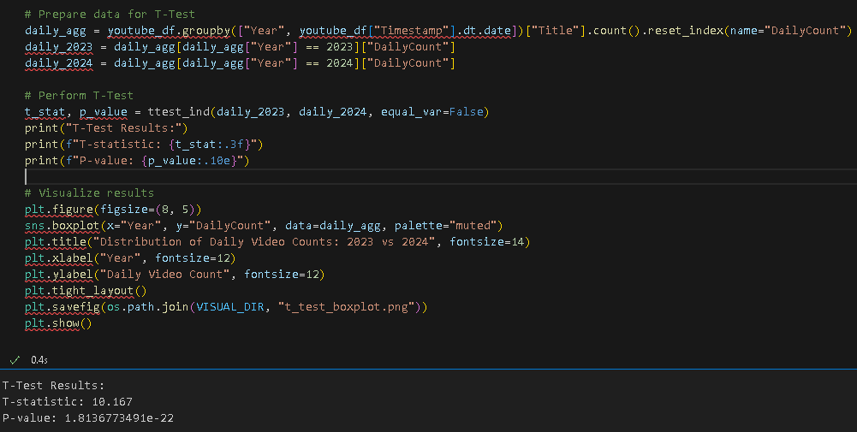
T-Test: Daily Viewing Counts
What I’m Testing: I wanted to see if there’s a significant difference in my daily watch counts between 2023 and 2024.
Null Hypothesis (H₀): The average number of videos I watch per day is the same in both years.
Alternative Hypothesis (H₁): The average daily watch count is different between 2023 and 2024.
T-Test Details:
I grouped my data by (Year, Date) to get how many videos I watched each day in each year.
Then I ran a two-sample T-test (ttest_ind) to compare the means of daily_2023 vs. daily_2024.
equal_var=False because I’m not sure if the variances are equal.
Interpretation:
If the p-value is below 0.05, I reject the null hypothesis and conclude there is a significant difference in daily watch counts.
The boxplot visually shows the spread of daily counts for each year. If 2023’s median is higher and the statistical test confirms it, then 2023’s daily usage was indeed significantly greater.
This tells me that the decline I noticed in my 2024 usage wasn’t just a coincidence. The test indicates a real, statistically significant drop in how many videos I watched per day. Given that my T-statistic is fairly large (10.167) and the p-value is extremely small (1.81e-22), there’s practically no chance this difference is due to random fluctuations.

Slide 16
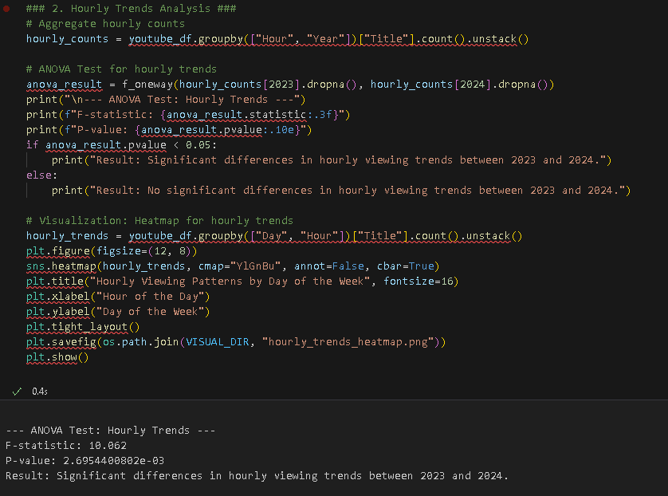
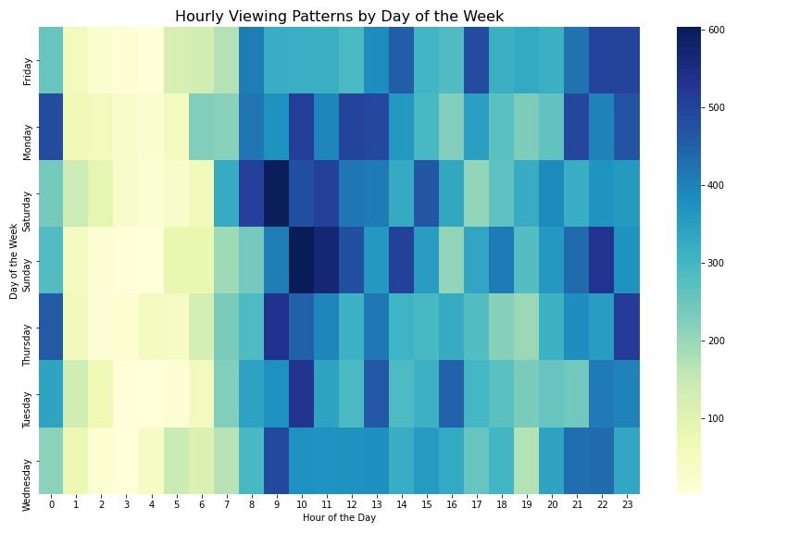
ANOVA Test: Hourly Viewing Trends I ran an ANOVA to determine if my hourly YouTube viewing patterns differed significantly between 2023 and 2024, and the test produced an F-statistic of 10.062 with a p-value of 2.70 × 10⁻³, which is well below the 0.05 threshold for significance, meaning I reject the null hypothesis that hourly viewing patterns stayed the same.
In practical terms, this indicates that certain hours—especially during peak periods—exhibited notably different watch counts between the two years.
The heatmap visualization clearly shows these variations in color intensity: darker cells represent higher viewing activity, and the differences between 2023 and 2024 stand out most in the evening hours, confirming a statistically significant shift in when I tend to watch YouTube.

Slide 17
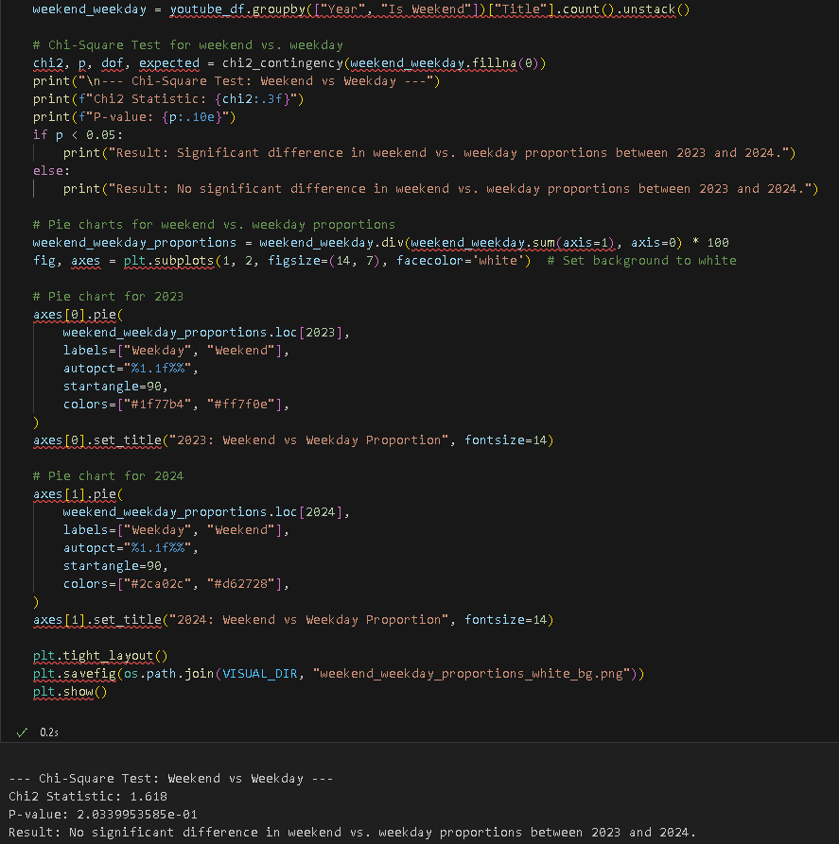
Chi-Square Test: Weekend vs. Weekday Proportions I conducted a Chi-Square test to check if my weekend vs. weekday viewing proportions changed significantly between 2023 and 2024; the Chi² statistic of 1.618 and p-value of 0.2034 both suggest no significant difference, leading me to fail to reject the null hypothesis that the proportions remain the same.
The pie charts comparing 2023 and 2024 support this conclusion by showing similar weekend–weekday splits in both years, confirming that even though my overall usage may have shifted, the ratio of weekend to weekday viewing stayed consistent.

Slide 18
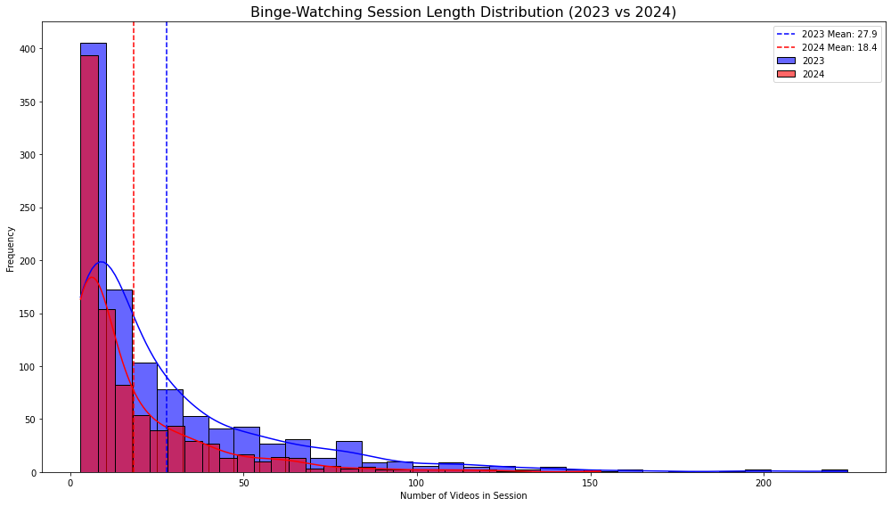
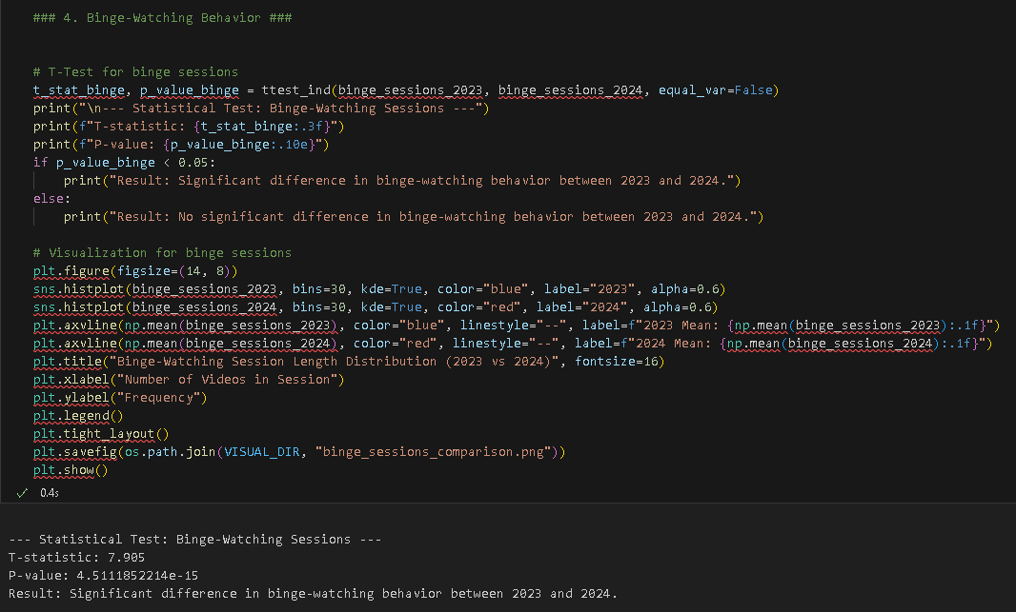
Statistical Test: Binge-Watching Sessions I conducted a two-sample T-test to determine whether my binge-watching behavior, defined as sessions with three or more videos within an hour, differed significantly between 2023 and 2024. The test yielded a T-statistic of 7.905 and a p-value of 4.511e-15, far below the 0.05 threshold, so I reject the null hypothesis and conclude that my binge-watching sessions in 2024 were significantly shorter on average.
The mean session length dropped from 27.9 videos in 2023 to 18.4 videos in 2024, indicating a noticeable behavioral shift. The histogram with overlaid KDE plots visually supports this, showing that 2023 had a longer-tail distribution of session lengths (indicating more extended binges), while 2024’s distribution peaks at shorter session lengths.
This reduction likely reflects changes in my viewing habits, such as spending less time on extended YouTube marathons or diversifying my media consumption with other platforms.

Slide 19
Conclusıons
Hypotheses
General Hypothesis
H₀: There is no overall difference in my YouTube viewing patterns between 2023 and 2024.
H₁: There is a significant difference in my YouTube viewing patterns between the two years.

Slide 20
Temporal patterns
Daily Viewing Trends
Sub-Hypothesis (H₀): My average daily video counts are the same for 2023 and 2024.
Sub-Hypothesis (H₁): My average daily video counts differ significantly between the two years.
Result: A two-sample T-test (T = 10.167, p < 0.001) confirms a significant decrease in daily video counts in 2024 compared to 2023. This reduction is likely due to shifts in platform preferences, such as using Spotify for music consumption, and lifestyle changes like increased responsibilities.
Hourly Trends
Sub-Hypothesis (H₀): My hourly viewing patterns are the same for 2023 and 2024.
Sub-Hypothesis (H₁): My hourly viewing patterns differ significantly between the two years.
Result: An ANOVA test (F = 10.062, p = 0.0027) highlights significant differences in hourly viewing behavior, with reduced evening and late-night activity in 2024. Heatmaps further reveal this decline, reflecting fewer long or late-hour sessions.

Slide 21
BehavIoral InsIghts
Binge-Watching Behavior
Sub-Hypothesis (H₀): There is no significant difference in my binge-watching session lengths between 2023 and 2024.
Sub-Hypothesis (H₁): My binge-watching session lengths differ significantly between the two years.
Result: A T-test (T = 7.905, p < 0.001) demonstrates a marked reduction in binge-watching session lengths, with an average of 27.9 videos/session in 2023 dropping to 18.4 videos/session in 2024. This change suggests a preference for shorter, more frequent sessions, reflecting possible shifts in content preferences or reduced available time.
Weekend vs. Weekday Patterns
Sub-Hypothesis (H₀): My weekend vs. weekday viewing proportions are the same for 2023 and 2024.
Sub-Hypothesis (H₁): My weekend vs. weekday viewing proportions differ significantly between the two years.
Result: A Chi-Square test (χ² = 1.618, p = 0.203) shows no significant difference in weekend vs. weekday proportions. This indicates that while my overall usage declined, my weekly viewing structure (about 70% on weekdays and 30% on weekends) remained consistent.

Slide 22
Content preferences
Top Channels
Sub-Hypothesis (H₀): My most-watched channels are the same for 2023 and 2024.
Sub-Hypothesis (H₁): My most-watched channels differ significantly between the two years.
Result: A significant shift in my top channels occurred, with 2023 dominated by music-focused channels like "Netd Müzik," while 2024 saw a transition to channels like "UFC," reflecting a move away from YouTube for music consumption. This aligns with my use of Spotify and suggests a diversification in content preferences toward sports and other genres.

Slide 23
Fınal Conclusıons
The project’s findings support the rejection of the general null hypothesis: my YouTube viewing patterns changed significantly between 2023 and 2024. While overall engagement decreased—reflected in reduced daily counts, shorter binge sessions, and changes in hourly trends—my weekly structure remained stable, and I diversified my content preferences. This analysis underscores the dynamic nature of personal media habits, shaped by external factors such as new platforms, evolving routines, and shifting interests.
By applying data-driven insights, I now better understand how my digital behaviors adapt to changes in priorities and preferences. This reflective exercise highlights the value of combining descriptive analysis with hypothesis testing to uncover meaningful trends.

