Slide 1
Python Basics
Meryl Brodsky, Communication & Information Librarian
Karina Sánchez, Digital Scholarship Librarian
August 12, 2026
https://bit.ly/4fUdDNd for these slides
Notes:
Hi Everyone. Welcome. I am Meryl Brodsky. I am a liaison librarian here at UT Libraries. Please go ahead and open up these slides. The bitly is below the date.
Today I’ll be presenting with Karina Sanchez, the Digital Scholarship Librarian.

Slide 2
Welcome
Itinerary for the day
Attendance link: https://bit.ly/3TUFHbZ
1:00 - Welcome + introductory slides
Instruction
1:10 - 1:30 Google Colab introduction + basic terms for Python https://bit.ly/4wcxrBB
1:30 - 1:40 Break
1:40 - 2:30 Google Colab Python expressions & operators
Software installation* optional today
2:30-3:00 Python + VS code installation (not needed for tomorrow, but helpful)
Notes:
Here’s our itinerary for today. Please fill out the attendance sheet.
This session is geared towards newbie programmers. It’s at a basic level.
You will find that tomorrow’s workshop covers some of the same topics. This is by design. It is to reinforce today’s learnings.
Don’t worry though. By the first 20-30 minutes of tomorrow’s workshop, we will pass where we get to today.
Two things of note:
1. The Software installation is optional today. We will be on hand to help you install Python and VS code. If you’ve had enough at the end of the instruction, and you want to leave, feel free. However, you will need the software installed by Thursday’s session, so please make sure you have it ready to go by Thursday.
2. There will be a break between 1:30-1:40.

Slide 3
Land Acknowledgement
We would like to acknowledge that UT Austin is on the Indigenous lands of Turtle Island, the ancestral name for what now is called North America.
Moreover, we would like to acknowledge the Alabama-Coushatta, Caddo, Carrizo/Comecrudo, Coahuiltecan, Comanche, Kickapoo, Lipan Apache, Tonkawa and Ysleta Del Sur Pueblo, and all the Indigenous Peoples and communities who have been or have become a part of these lands and territories in Texas.
Link to the full UTL land acknowledgement- https://www.lib.utexas.edu/land-acknowledgement-statement
Notes:
I’d like to read our land acknowledgement. We would like to acknowledge that UT Austin is on the Indigenous lands of Turtle Island, the ancestral name for what now is called North America.
We would like to acknowledge the Alabama-Coushatta, Caddo, Carrizo/Comecrudo, Coahuiltecan, Comanche, Kickapoo, Lipan Apache, Tonkawa and Ysleta Del Sur Pueblo, and all the American Indian and Indigenous Peoples and communities who have been or have become a part of these lands and territories in Texas.
Link to the full UTL land acknowledgement- https://www.lib.utexas.edu/land-acknowledgement-statement

Slide 4
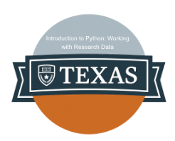
Logistics
Breaks are built-in
Ask questions!
Workshop materials and slides will be posted on GitHub
https://github.com/utlibraries/workshop-materials
We will not record this workshop
Badge: “Introduction to Python: Working with Research Data”
Notes:
We have a break planned for ten minutes at 1:30 today.
Please ask questions. We have helpers for every session to help out if you have a problem or a question.
There are a lot of materials for this workshop. We will be placing them in a GitHub repository so that you can access them after the workshop
Badging - We are offering a badge for completing this workshop. If you stay through the workshop, you’ll earn this badge, which you can then use however you like. If you would like more information about this badge, please click on the link titled Badge on this page.

Slide 5
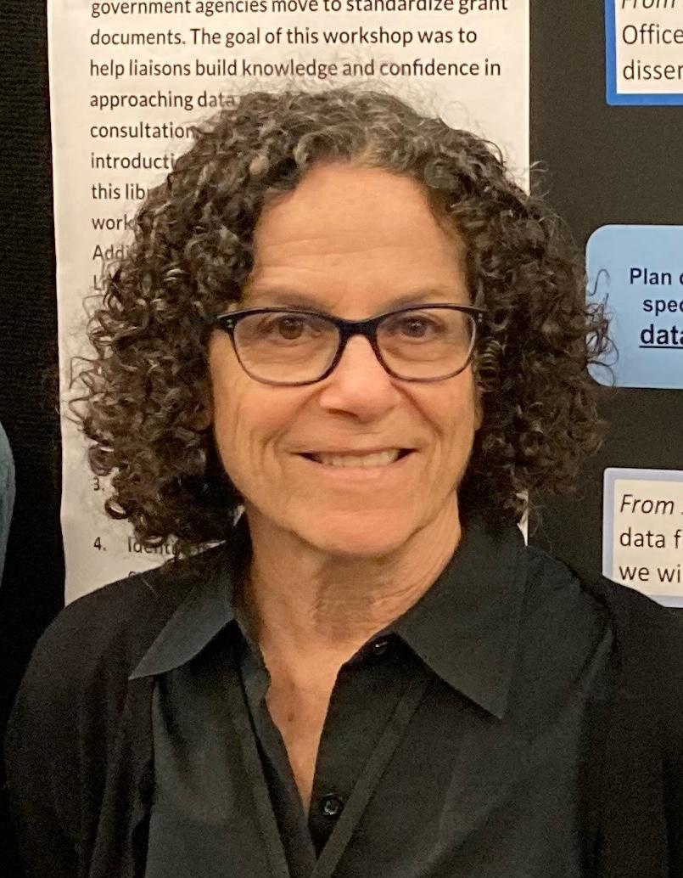
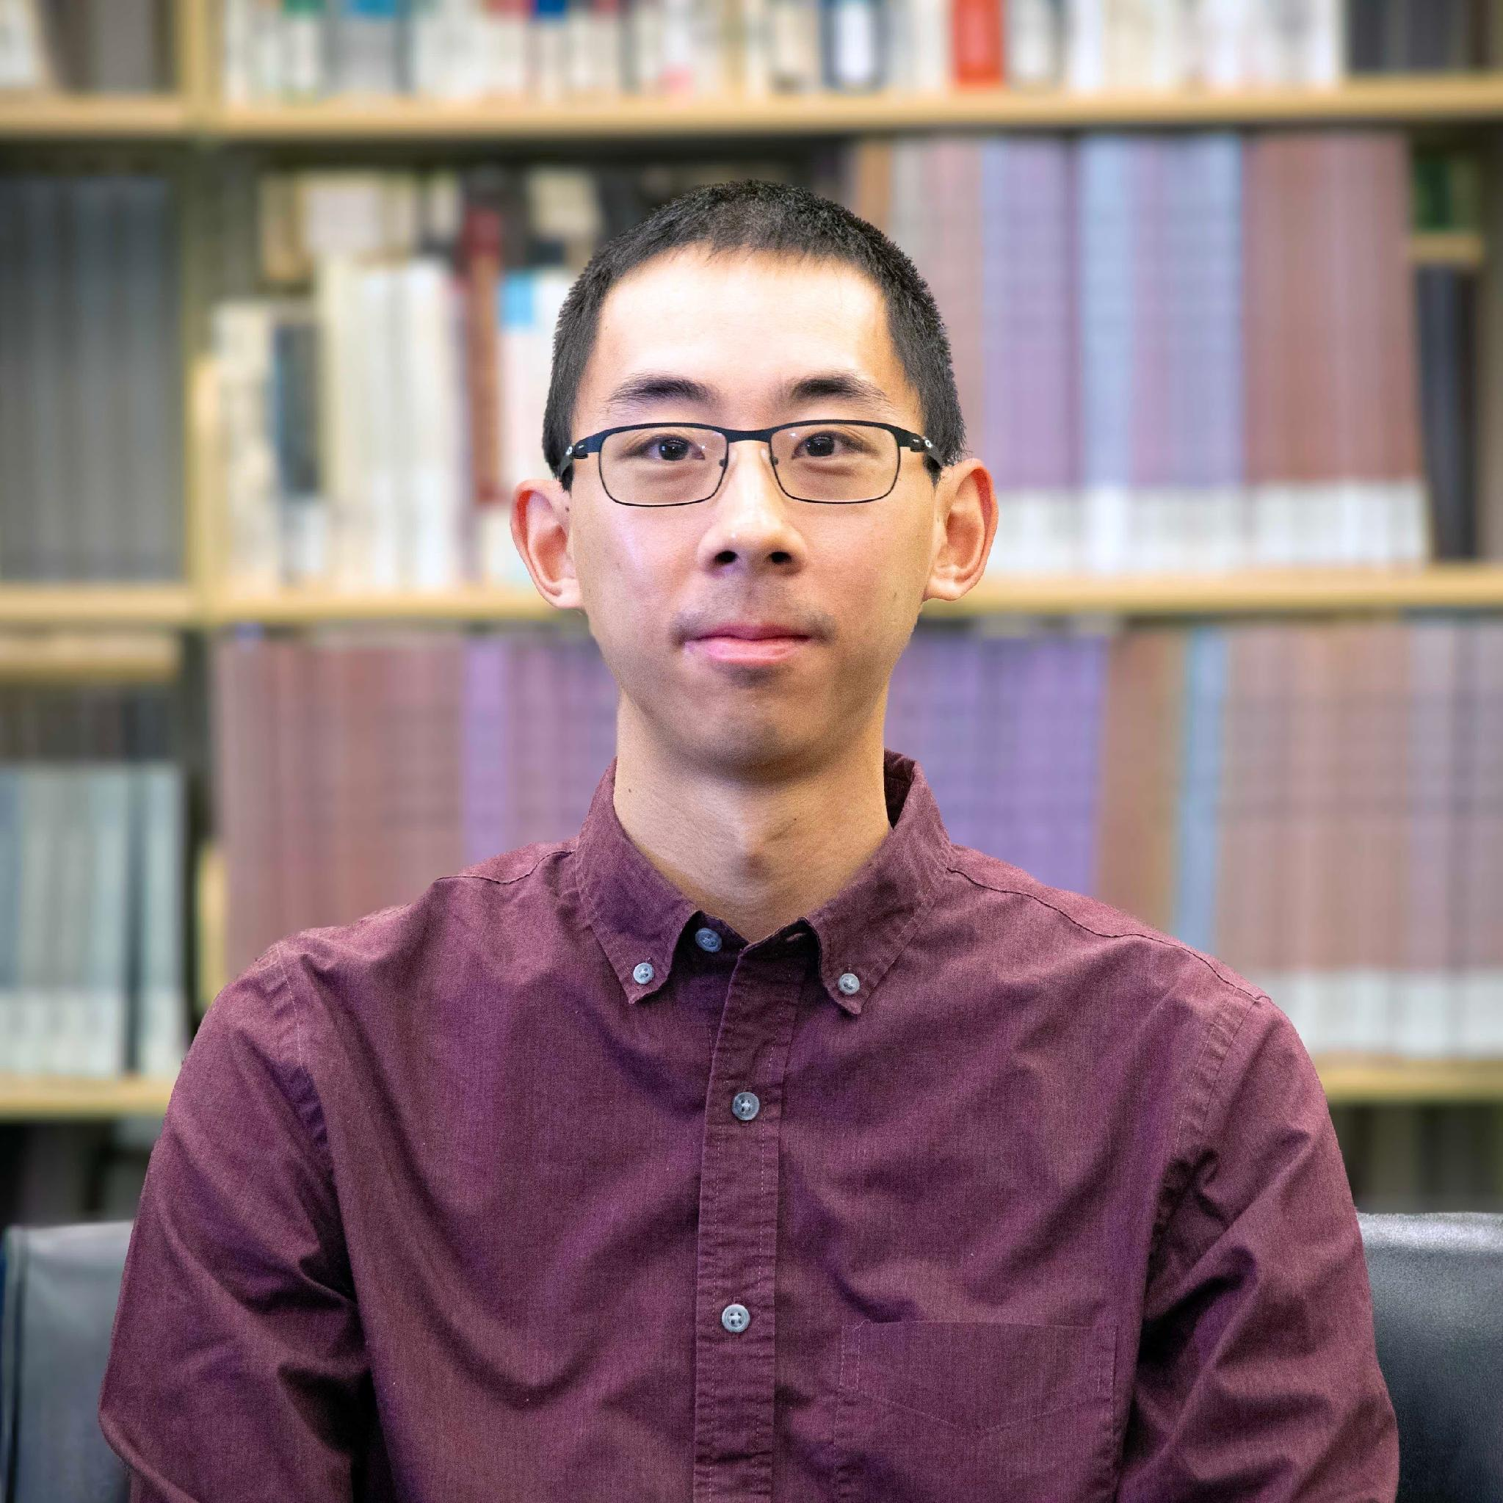
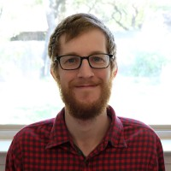
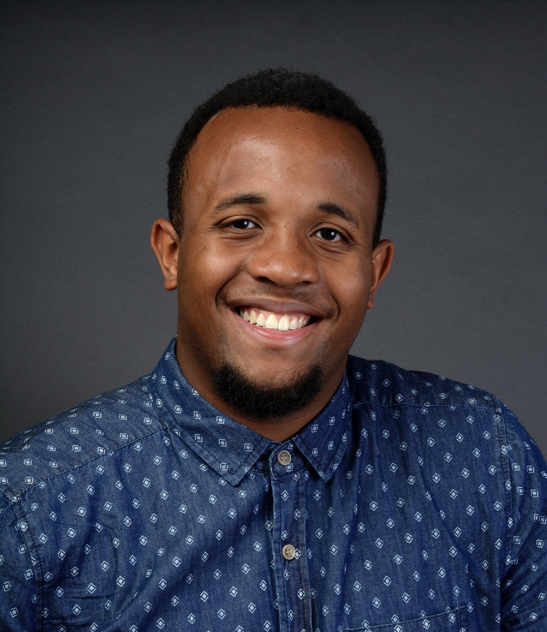
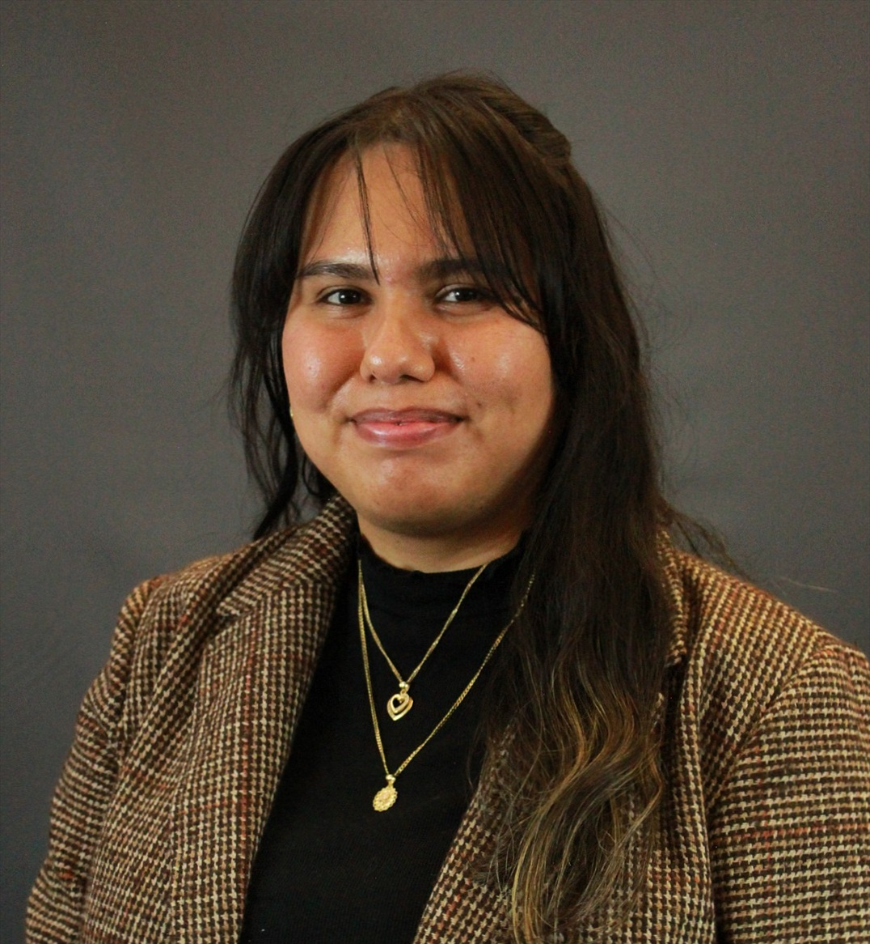
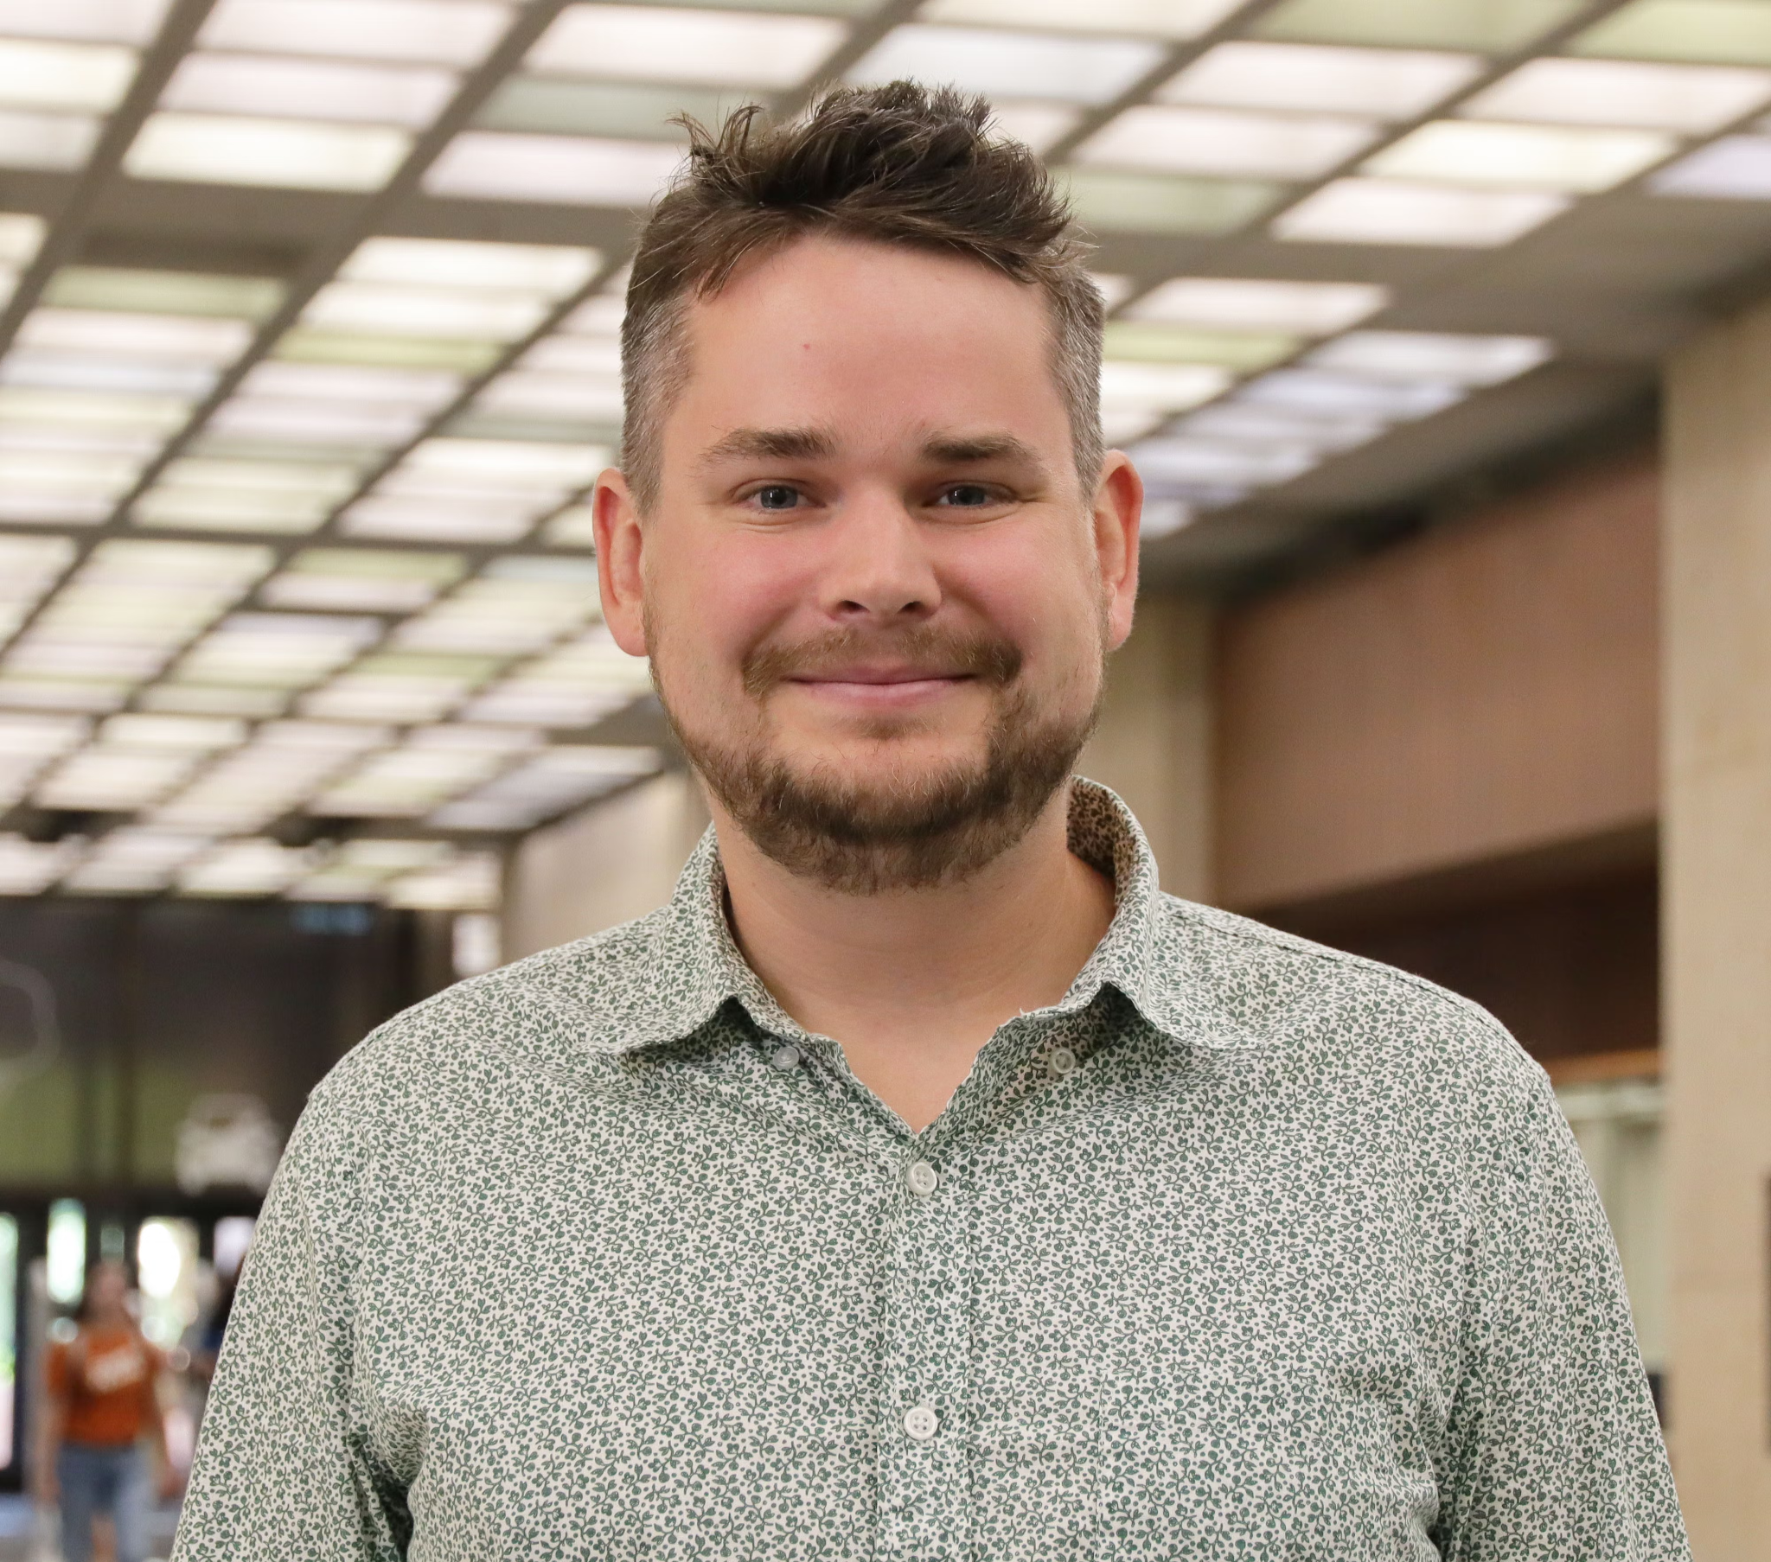
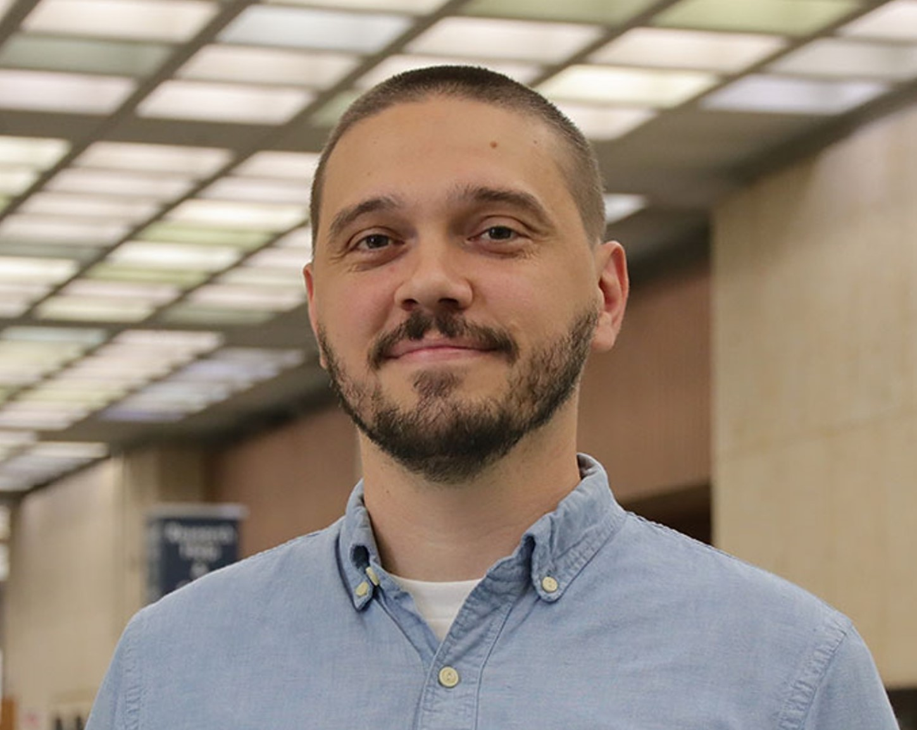
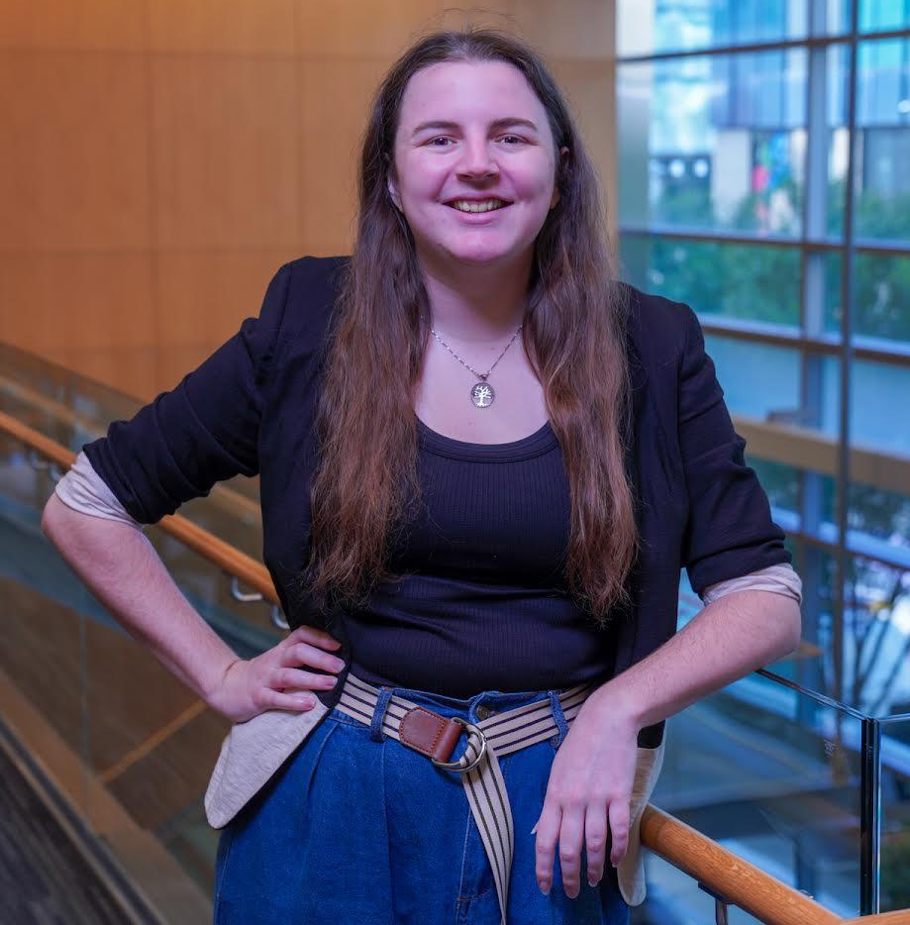
Instructors/Helpers
Meryl Brodsky
Bryan Gee
Ian Goodale
Jeremy Thompson
Communication & Information Librarian
Research Data Coordinator
European Studies and Linguistics Librarian
Digital Processing Archivist
Karina Sanchez
Alex Marden
Michael Shensky
Anna McGilvray
Digital Scholarship Librarian
GIS & Geospatial Data Coordinator
Head of Research Data Services
Physical and Computational Sciences Librarian
Notes:
Here are the instructors and some of the helpers in this workshop.
They are:
Alex Marden, GIS and Geospatial Coordinator
Anna McGilvray, Liaison Librarian for Physical & Computational Sciences
Bryan Gee, Open Research Coordinator
Ian Goodale, European Studies& Linguistics Librarian
Jeremy Thompson, Digital Processing Archivist
Karina Sanchez, Scholars Lab Librarian
Michael Shensky, Head of the Research Data Services Group
We also have helpers with us today, and they are:
Ebru Turk, Scholarly Publishing Librarian
Molly Roy, Liaison Librarian for Performing Arts
Luke Fancher, Scholars Lab GRA
And possibly Caitlin Young, Scholars Lab GRA

Slide 6
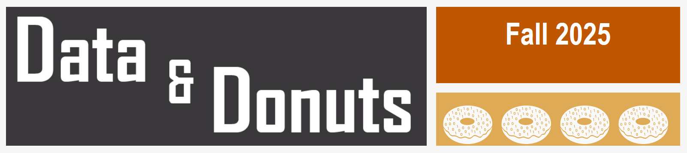
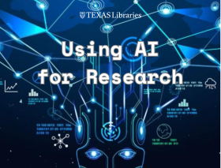
Upcoming Fall Workshop Series
Data & Donuts Workshop Series
What Workshops covering research data practices and software
When On the following dates: Sept. 11, Sept. 25, Oct. 9, and Oct. 23
Time 12pm - 1:15pm
Where Zoom (all dates) / PCL Scholars Lab (select dates)
More info https://guides.lib.utexas.edu/data-and-donuts
Fall 2026
What Workshops covering AI uses in research
When December 2, 2026 (Thursday): noon to 1 PM
Where Virtual
More info https://guides.lib.utexas.edu/AI/workshops
Using AI for Research
Library Events: https://lib.utexas.edu/events
Notes:
We’ve got other workshops and workshop series coming up in the Spring that may interest you.
Here are two.
Data & Donuts is a workshop series specifically related to data and software. These are a little over an hour and most are virtual or hybrid.
Using AI for Research series is on AI tools and how to use them for research purposes. The one highlighted here is on AI Assisted Literature Searching
To find library workshops, you can go to our home page, and search the Events section of the page. Most workshops require pre-registration.

Slide 7
Workshop Code of Conduct
Use welcoming and inclusive language
Be respectful of different viewpoints and experiences
Gracefully accept constructive criticism
Focus on what is best for the community
Show courtesy and respect towards other community members
Contact any Helper or Instructor for assistance
Notes:
We also would like to introduce a code of conduct. Please:
Use welcoming and inclusive language
Be respectful of different viewpoints and experiences
Gracefully accept constructive criticism
Focus on what is best for all of us
Show courtesy and respect towards each other
Contact any of us who are instructors or helpers with any code of conduct concerns.

Slide 8
Goals - Introduce you to Python
Introduce the fundamental knowledge required to help you start using Python
Learn some of the vocabulary of Python, such as Data Types, Variables, Functions
Use Python without installing any software - this workshop will use Google Colab
Learn about resources to help you when you have a question or a problem
Notes:
Today our goal is introduce you to working with Python. We’ll go over basic vocabulary terms, and you’ll get a chance to actually do some programming using Google Colab, an Integrated Development Environment, and I’ll talk more about what that is in a moment.
Last, we’ll talk about how to get help outside of this workshop.

Slide 9
What is Python & why you should learn it
Open source programming language
Cross platform compatible (Windows, MacOS, & Linux)
Used in a variety of fields and disciplines
Large ecosystem of open source packages
Shared code can foster reproducibility
Notes:
Python is:
An open source programming language. This means that it’s free. It’s regularly updated, and there is a large user community. That user community comes in handy when you have questions or problems.
Python is the fastest-growing language in computer programming.
You should learn it because it is:
Compatible with Windows, Mac & Linux
It’s used in a variety of fields and disciplines
Flexible, in that it supports working with both numeric and text data
There are many open source packages, which can help to automate certain functions. We’ll talk more about these later.
Since lots of people use Python, it’s more useful to share Python code, which can foster reproducibility, which contributes to “open science.”

Slide 10
What you can do with Python
Text Mining
Web Scraping
Data Analysis
Data Visualization
Simulations & Modeling
Notes:
Python can be used for Text mining, that is looking for words or sentiments expressed in text once it is in a machine readable format. There is a good deal of humanities and social sciences research that uses this kind of analysis.
It’s used for Web Scraping, that is to pull data from websites.
It an be used for file management or analyzing data, as well as editing data, and visualizing data – that is creating graphs or charts.
Python is used in scientific fields like physics, chemistry, and bioinformatics for simulations and modeling.

Slide 11
Google Colab = Integrated Development Environment (IDE)
Examples
Benefits
Jupyter Notebooks
Visual Studio
PyCharm
Many others
Easier to write code
Improves code quality
Facilitates code sharing
Notes:
Google Colab is an integrated development environment, or IDE. An IDE is a software application that provides a user interface for software development.
It’s kind of like a shell that makes working with a programming language easier.
IDEs can enhance productivity and efficiency by offering features like code completion, syntax highlighting, and identifying where there are errors.
It can also help with project management by being able to download replicable code or upload files.
IDEs makes it easier to write code. They improves code quality because it catches typos and other errors, and sometimes make suggestions for fixes. Also, you can share work in an IDE and work with other people.

Slide 12

Google Colab
Colab is a free Google service that allows you to create and run Jupyter Notebooks in the cloud
You can use it to write Python code and text notes in compartmentalized cells within a notebook
Code cells can be run individually to allow for previewing outputs and troubleshooting issues
Notebooks are stored in Google Drive and can access other files in Google Drive
Notes:
Google Colab, which is what we’ll be using, is a free, cloud-based environment for writing and executing Python code. It's essentially a browser-based Jupyter Notebook environment, allowing users to combine code, text, images, and other media.
It works particularly well for education because it is browser-based, so no software installation is required.
Just so you know, you’ll have access to the Colab Notebooks and our slides, after the workshop.

Slide 13
Google Colab Notebook for today
https://bit.ly/4wcxrBB
Notes:
Here’s a link to the Colab Notebook we’ll use for today’s workshop. Please open it up now.

Slide 14

Post Programming
Helpful Resources
Workshop Assessment Form
Software installation
Image: Wong, Tommy. (July 5, 2006). https://www.flickr.com/photos/gracewong/183286968
Notes:
Date 5 July 2006
Source https://www.flickr.com/photos/gracewong/183286968
Author Tommy Wong
Permission: (Reusing this file) Free content licence.

Slide 15
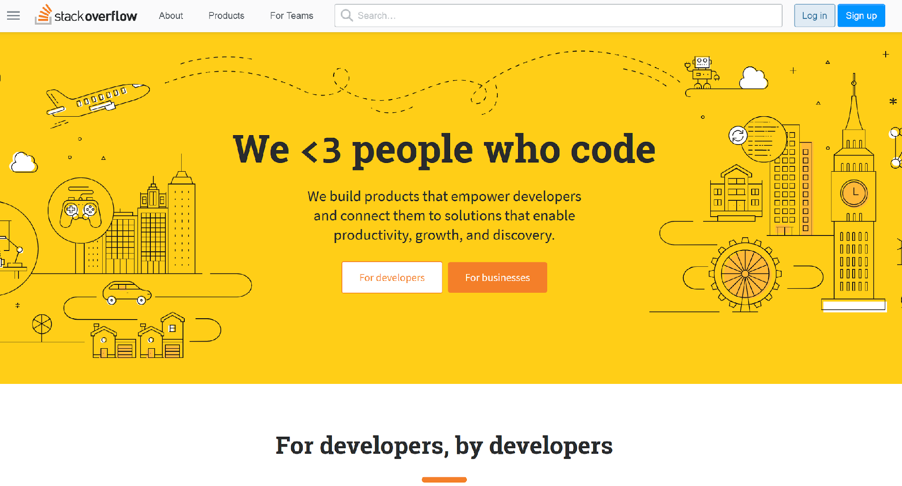
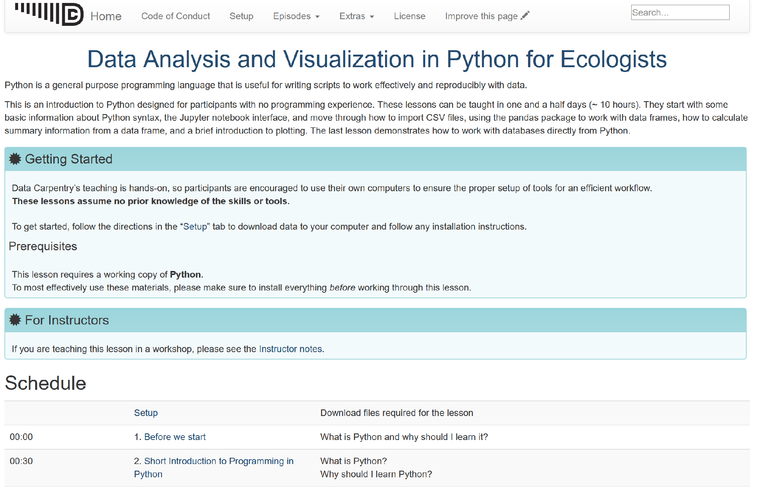
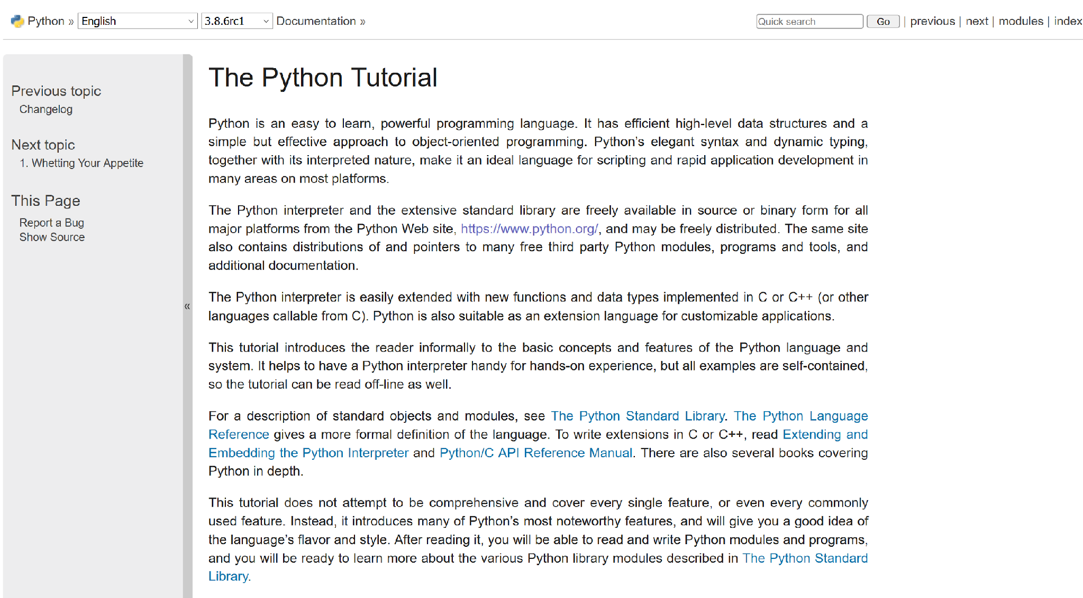
Helpful Resources
Stack Overflow (https://stackoverflow.com/)
Data Carpentry (https://datacarpentry.org/python-ecology-lesson/)
Python Documentation (https://docs.python.org/3/library/index.html)
Python Glossary
(https://www.w3schools.com/python/python_ref_glossary.asp)
Python Tutorial (https://docs.python.org/3/tutorial/index.html)
LinkedIn Learning (https://www.linkedin.com/learning/topics/python)
UT Statistics Short Courses (https://stat.utexas.edu/training/software-short-courses)
Google Colab: Intro to Python (https://colab.research.google.com/notebooks/intro.ipynb)
Notes:
Here are some extra resources that we have found to be helpful.
If you search for help when you’re having a question or problem, you can also use Google and thai will likely turn up responses from Reddit or Stack Overflow.

Slide 16
Thank you for coming!
Please fill out this brief survey for today’s workshop
https://bit.ly/ipw-aug26-day1-survey
Please keep this slide for attribution
Notes:
Please fill out our assessment form linked here.

Slide 17
Software Installation*
*This is optional today
Install
Python
VS Code
Git
GitHub Desktop
Detailed installation instructions available at:
https://bit.ly/python-install-test-aug26
Notes:
There are four different pieces of software that we will use during Thursday’s workshop, including Git and Github. Today we’re focusing on Python and Visual Studio Code (an IDE for Python)
If you like, you can install them now, or begin to install them. We will be on hand to help you.
If you’ve had enough for today, feel free to leave, and we’ll see you tomorrow.
You’ll have another opportunity to install this software at the end of tomorrow’s workshop.
Also, tomorrow, you may see or hear some of the same concepts that we discussed today. It’s not all the same, and tomorrow’s workshop will move on from the introductory material pretty quickly.

Slide 18
Installing Python - Windows
Python (https://www.python.org/downloads/)
Test
Make sure you can install new Python packages using the Command Prompt on Windows
Type the following command on your Windows: python -m pip install pandas
VSCode (https://code.visualstudio.com/download)
Test
Create a new file with the extension .py (to designate the file as a Python script)
Click the play/run button in the upper right corner of VSCode to run the script
Git (https://git-scm.com/downloads)
Github Desktop (https://desktop.github.com/download/)

Slide 19
Installing Python - Mac
Python (https://www.python.org/downloads/)
Test
Make sure you can install new Python packages using the Terminal (MacOS)
Type the following command on your Mac: python3 -m pip install pandas
VSCode (https://code.visualstudio.com/download)
Test
Create a new file with the extension .py (to designate the file as a Python script)
Click the play/run button in the upper right corner of VSCode to run the script
Git (https://git-scm.com/downloads)
Github Desktop (https://desktop.github.com/download/)

Slide 20
Troubleshooting Windows & Mac
Link to document:
Notes:
This is a troubleshooting document. You can use it if the standard downloading instructions don’t work. There are Windows and Mac sections.
You may have other issues, depending on whether your computer is owned by the university and you’re a staff person, or the age of your computer, or whether you’ve downloaded python and VS code before.

