Slide 1

Immersive Python Workshop
August 12–14, 2026
Day 2
August 13, 2026
Access shared links
https://bit.ly/ipw-aug26-github

Slide 2
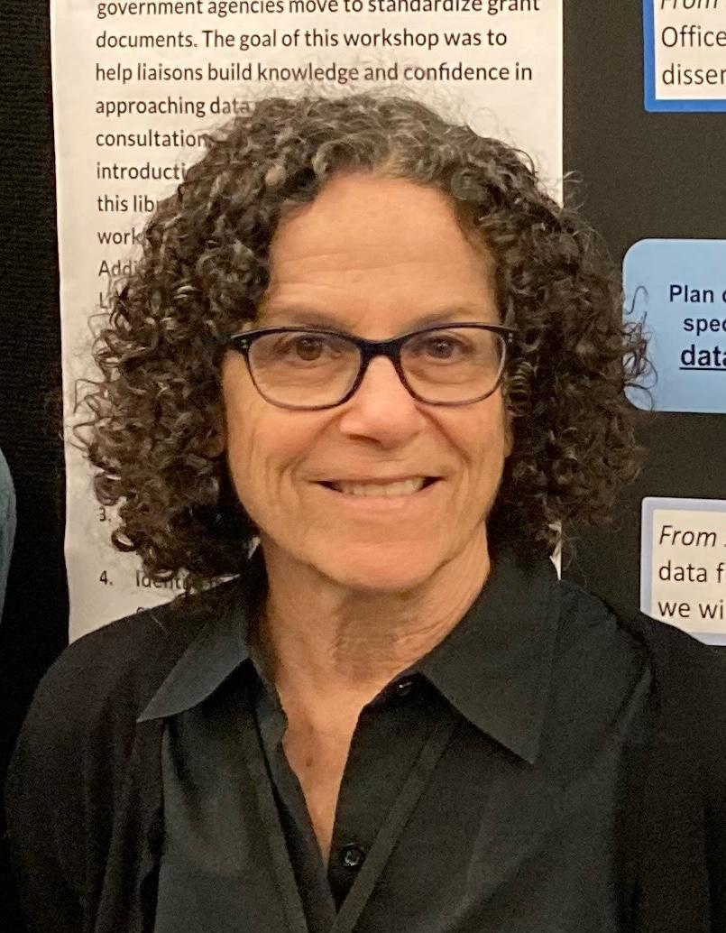
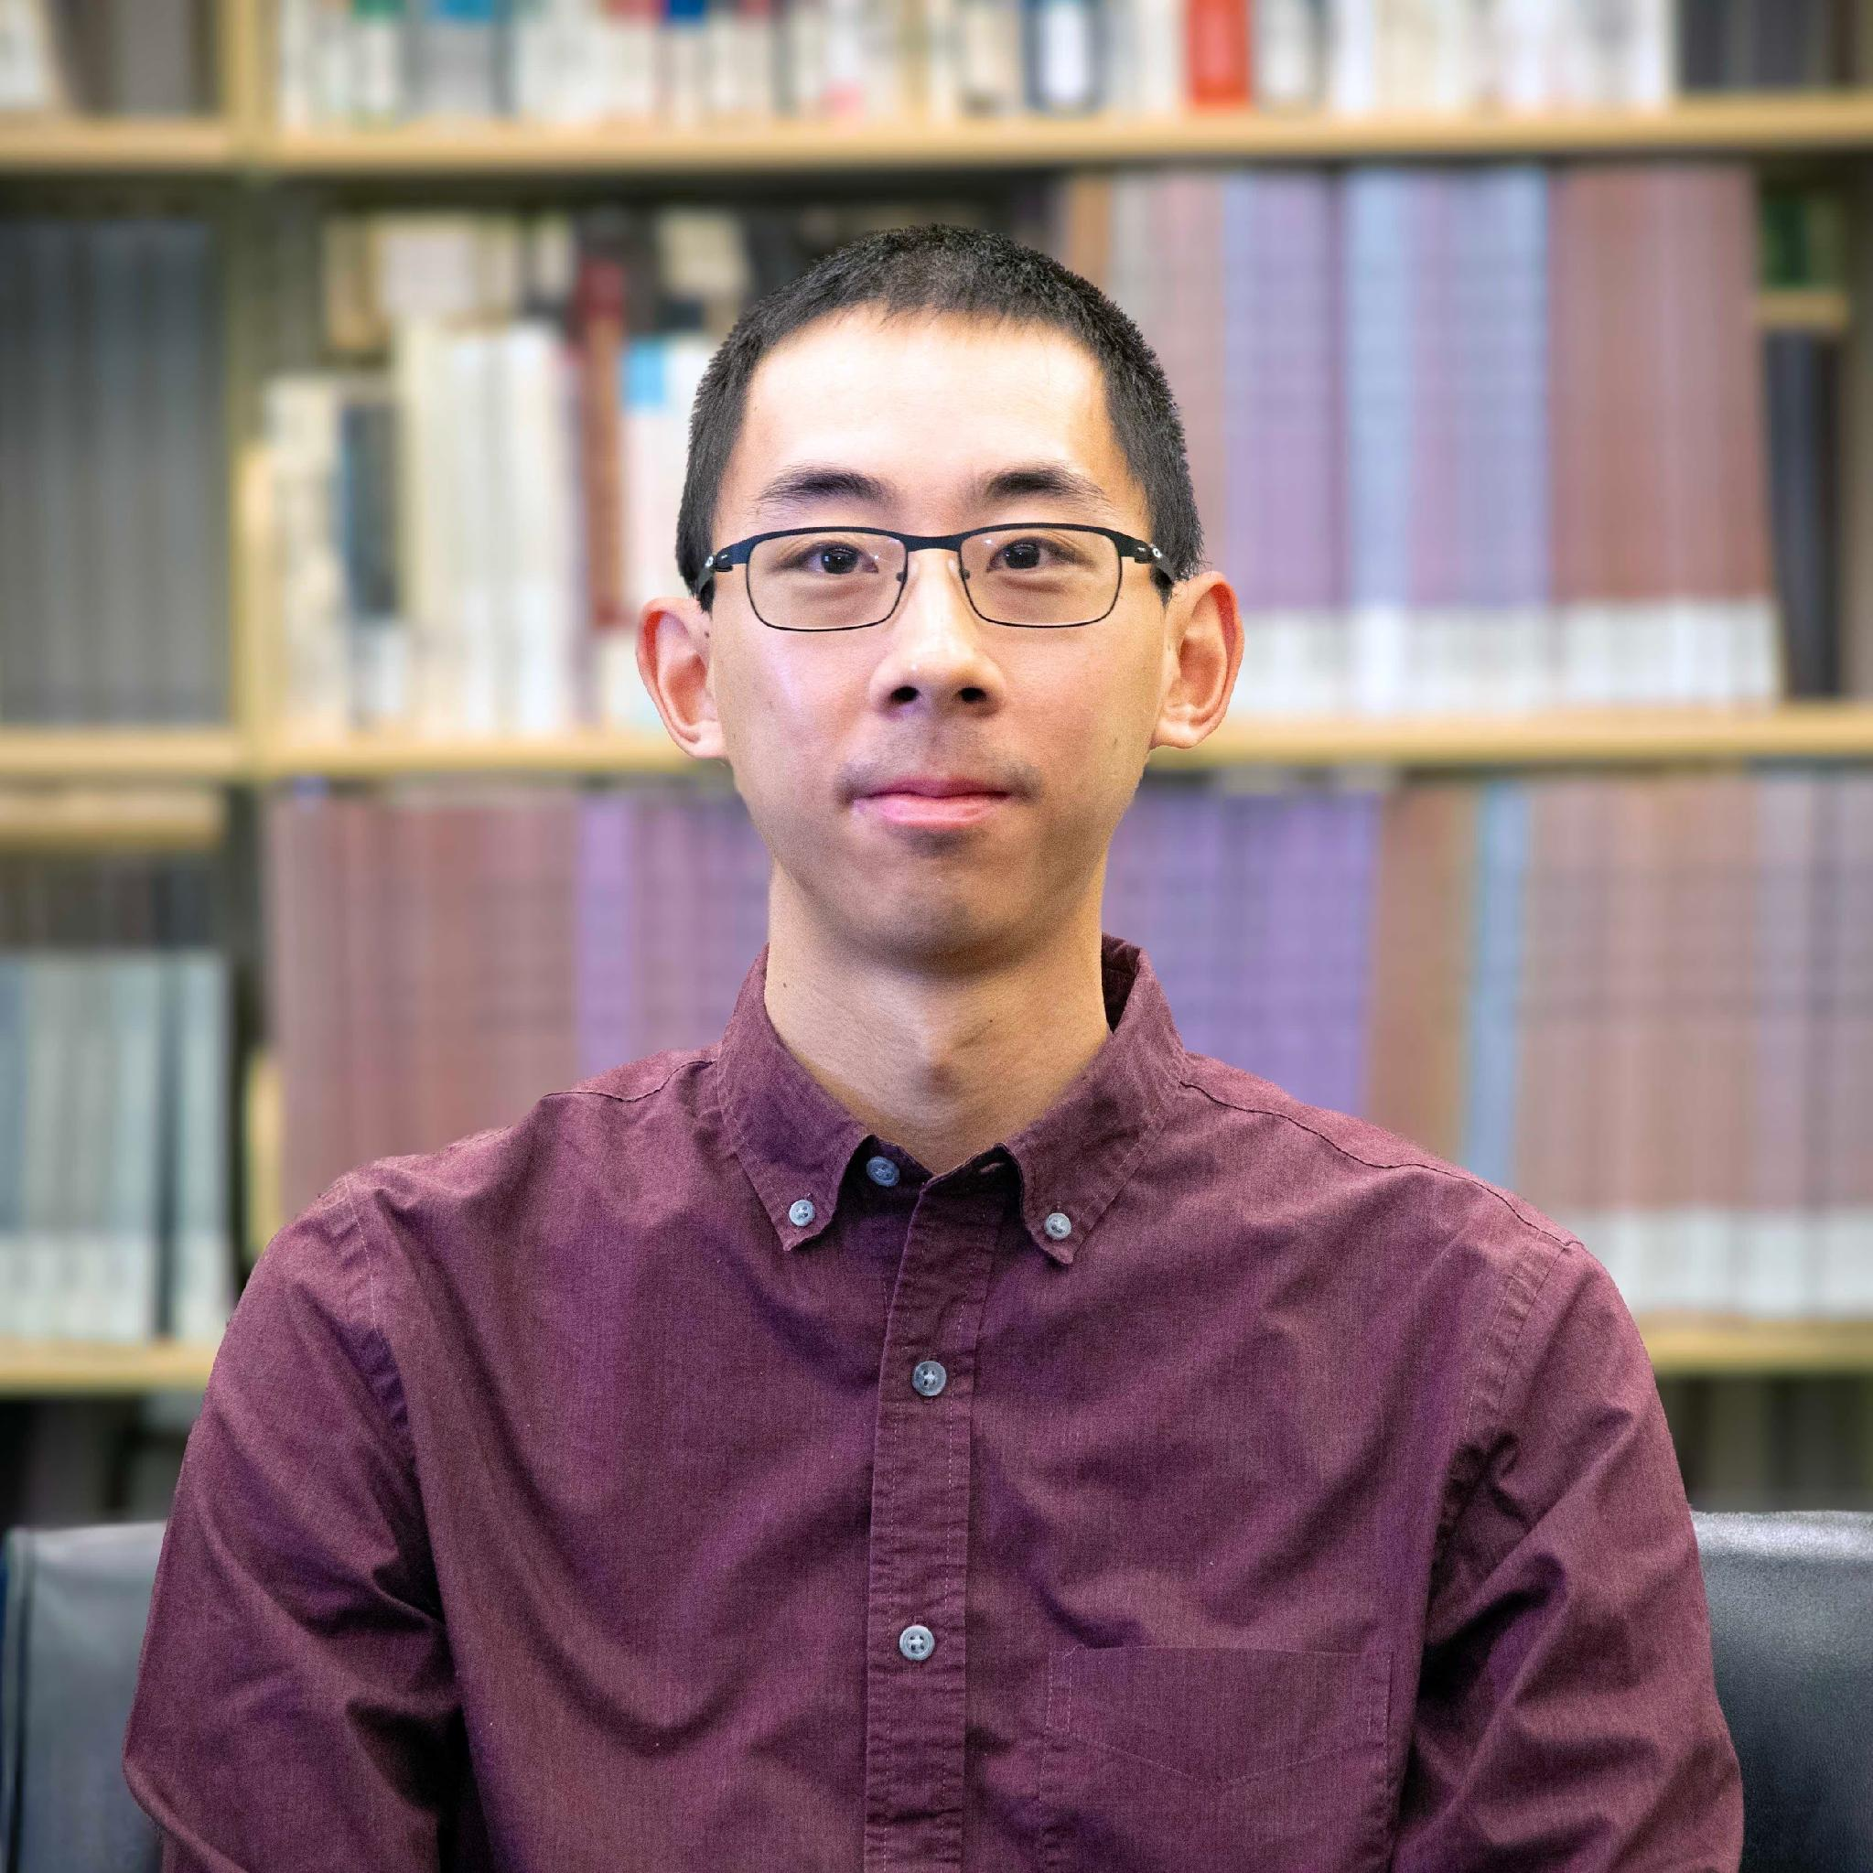
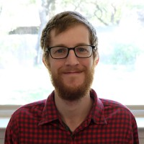
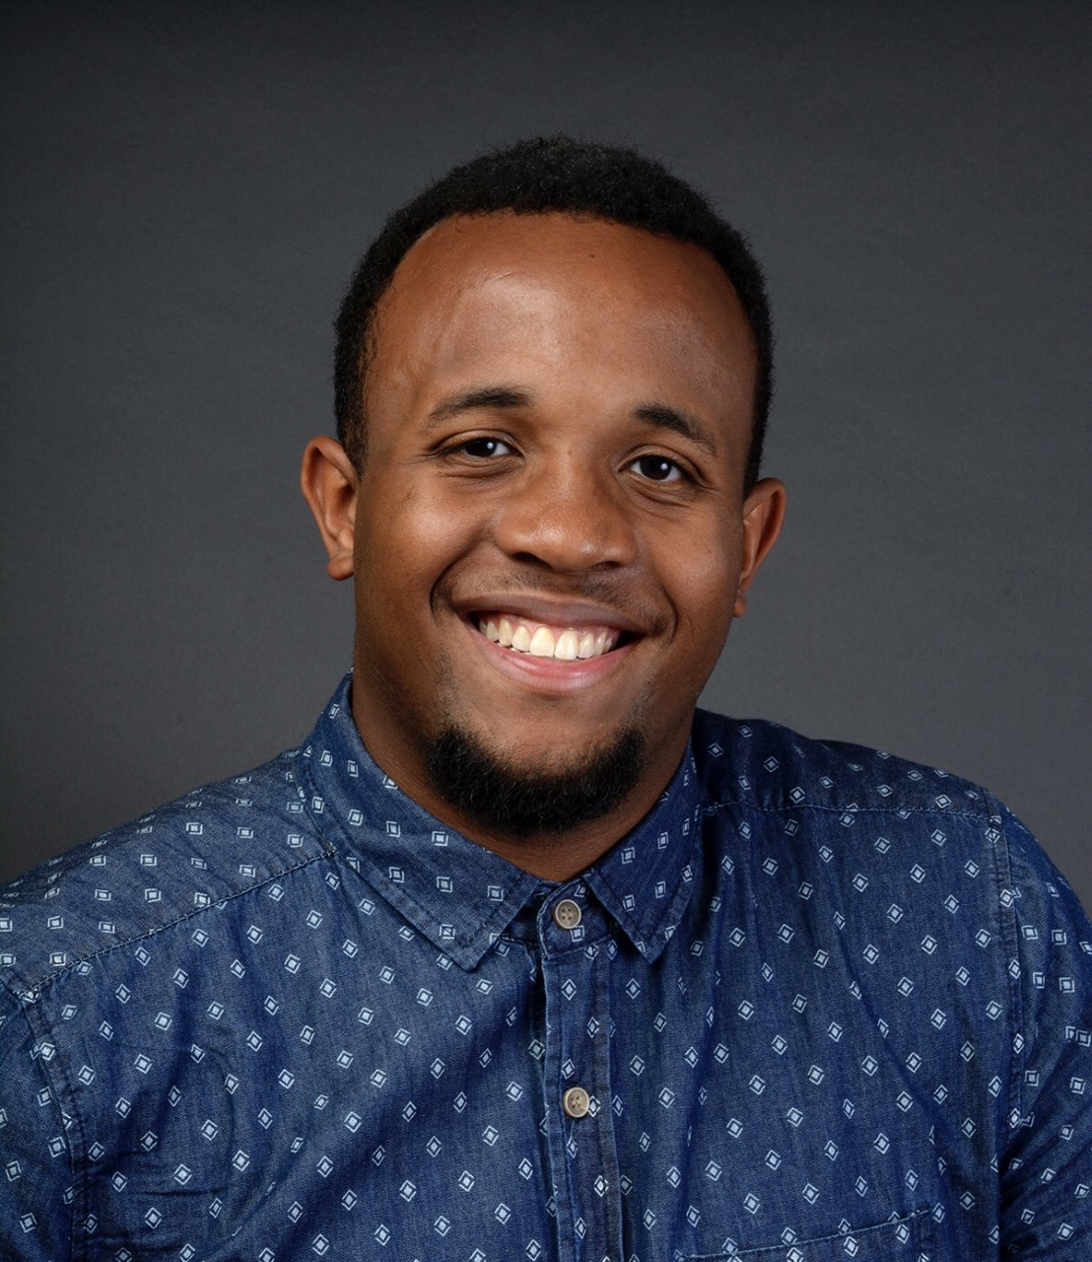
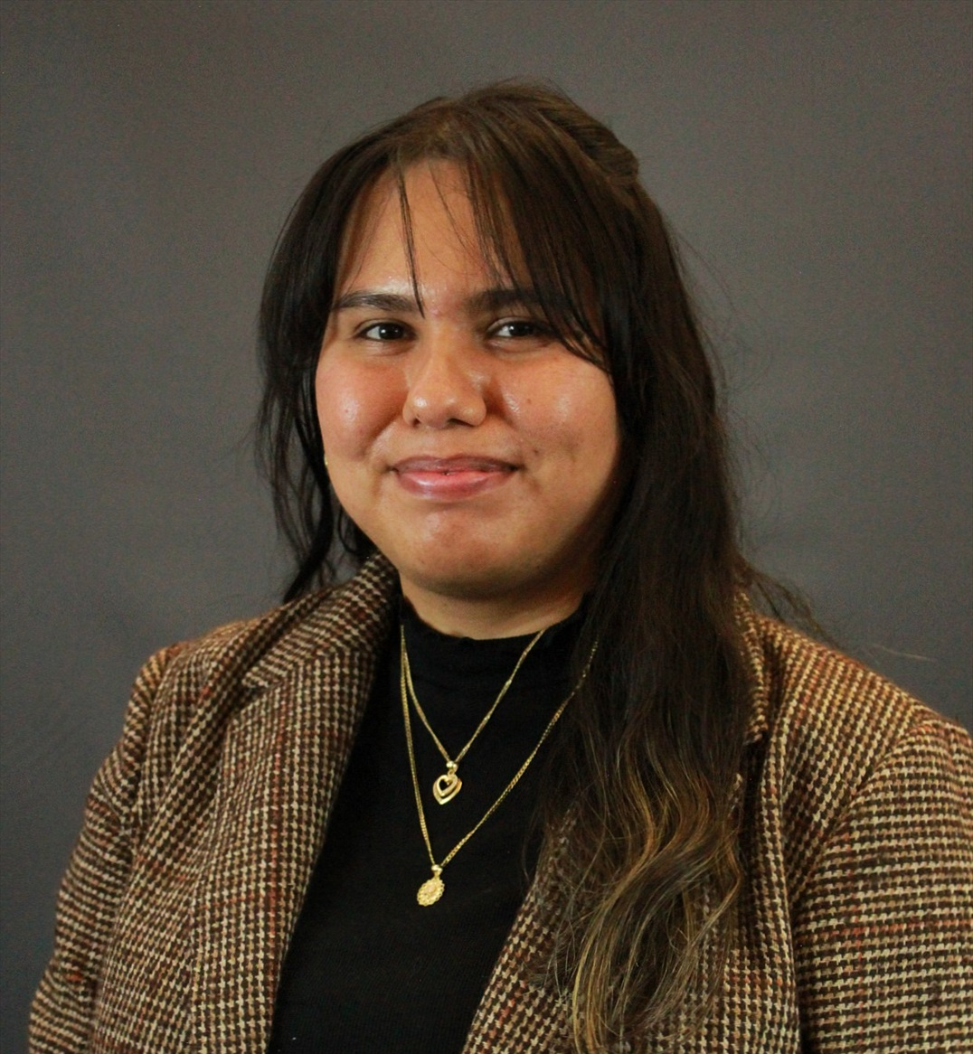
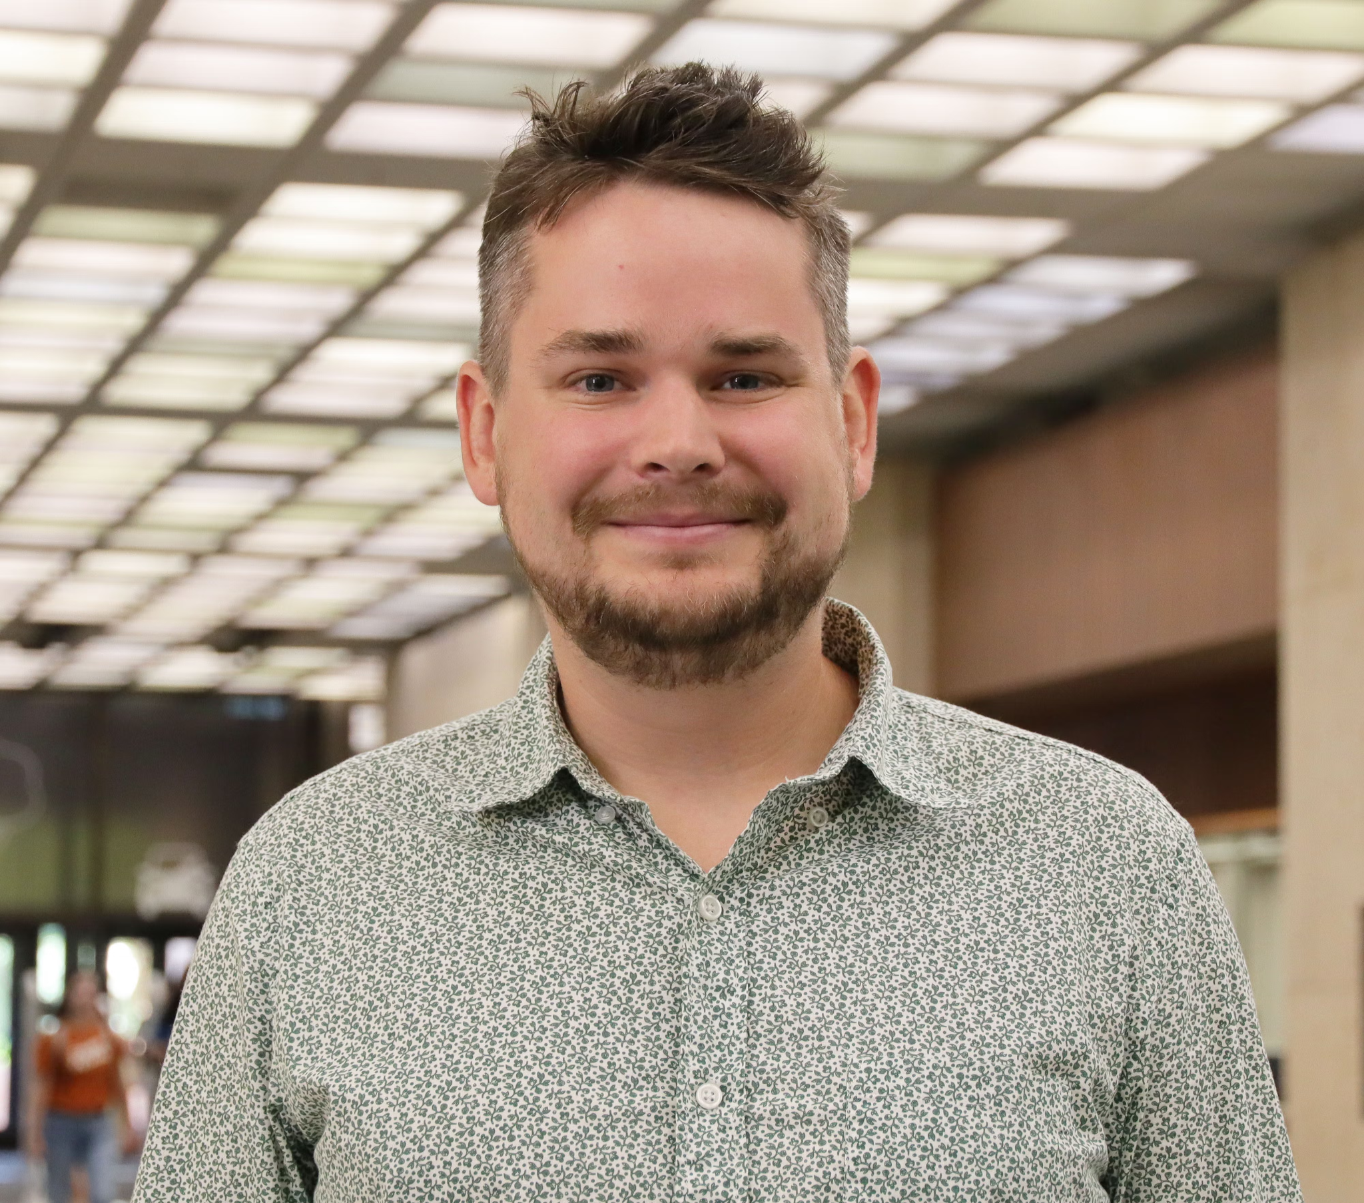
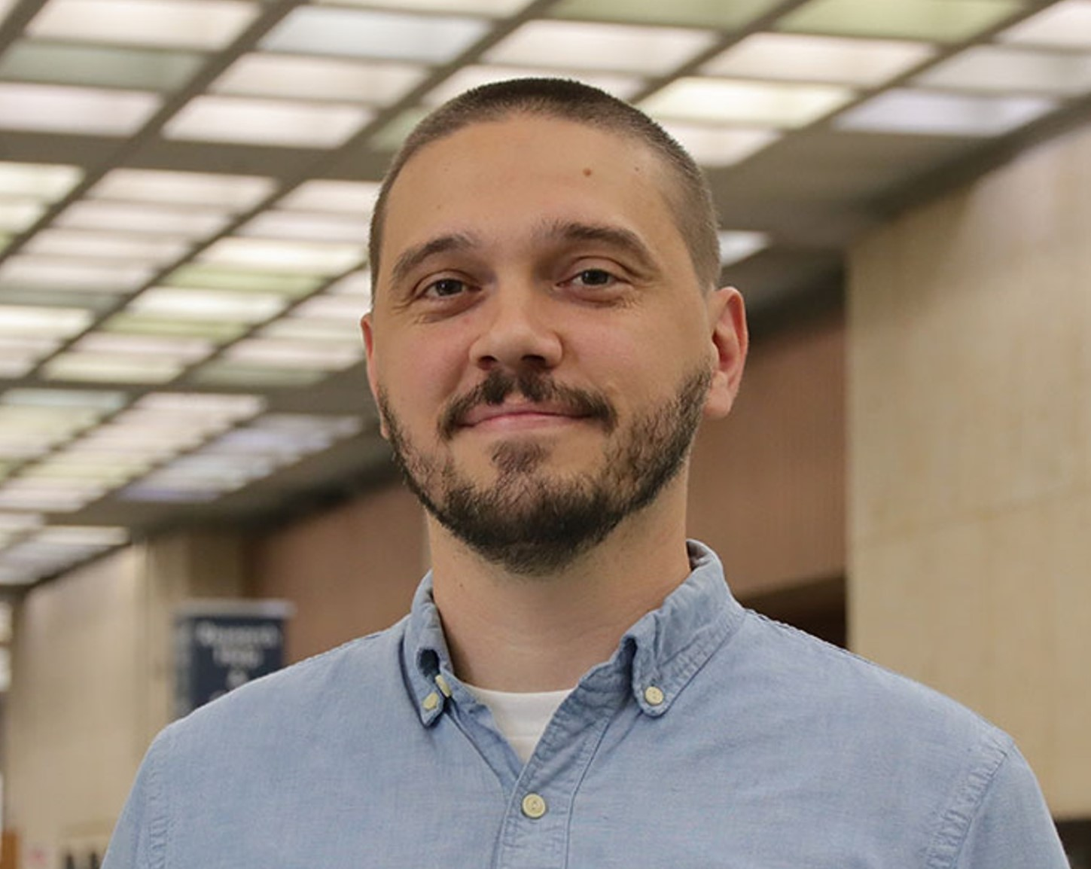
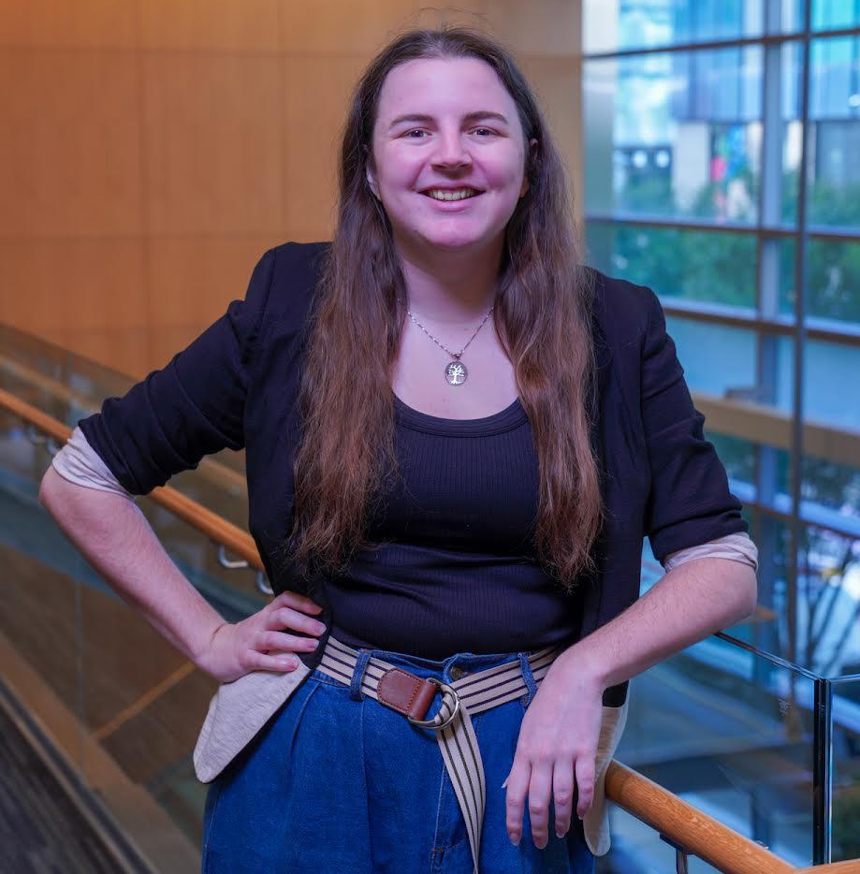
Instruction Team
Meryl Brodsky
Bryan Gee
Ian Goodale
Jeremy Thompson
Communication & Information Librarian
Research Data Coordinator
European Studies and Linguistics Librarian
Digital Processing Archivist
Karina Sanchez
Alex Marden
Michael Shensky
Anna McGilvray
Scholars Lab Librarian
GIS & Geospatial Data Coordinator
Head of Research Data Services
Physical and Computational Sciences Librarian
Notes:
Please ask the instructors to introduce themselves.
Perhaps the helpers will indicate they are a helper by putting the word helper next to their name in the participants?
[[Following introduction, STOP SHARE, Allow Anna to take over PRESENTATION.REMINDER TO START RECORD….

Slide 3



Helpers
Caitlin Young
Luz Gonzalez
Luke Fancher
Janelle Hedstrom
Scholars Lab Graduate Research Assistant
Scholars Lab Graduate Research Assistant
Scholars Lab Graduate Research Assistant
Head, STEM & Social Sciences Liaison Team; Liaison Librarian for Earth Sciences
Molly Roy
Ebru Turk
Liaison Librarian for Performing Arts
Scholarly Publishing Librarian
Notes:
Please ask the instructors to introduce themselves.
Perhaps the helpers will indicate they are a helper by putting the word helper next to their name in the participants?
[[Following introduction, STOP SHARE, Allow Anna to take over PRESENTATION.REMINDER TO START RECORD….

Slide 4
Itinerary for the Day
12:30 PM | Welcome
12:40 PM | Instruction: Intro to Python Basics
1:30 PM | Break
1:40 PM | Instruction: Python Essentials
2:30 PM | Break
2:40 PM | Instruction: Managing and processing files
3:30 PM | Python and VSCode installation help (if required)
4:00 PM | Close

Slide 5
Land Acknowledgement
We would like to acknowledge that we are meeting on the Indigenous lands of Turtle Island, the ancestral name for what now is called North America.
Moreover, (I) We would like to acknowledge the Alabama-Coushatta, Caddo, Carrizo/Comecrudo, Coahuiltecan, Comanche, Kickapoo, Lipan Apache, Tonkawa and Ysleta Del Sur Pueblo, and all the American Indian and Indigenous Peoples and communities who have been or have become a part of these lands and territories in Texas.

Slide 6
Logistics
Shared links document (https://bit.ly/ipw-aug26-github)
Important URLs will be provided here
Asking questions
Timing of breaks
Workshop materials and slides will be posted on GitHub
https://github.com/utlibraries/workshop-materials

Slide 7
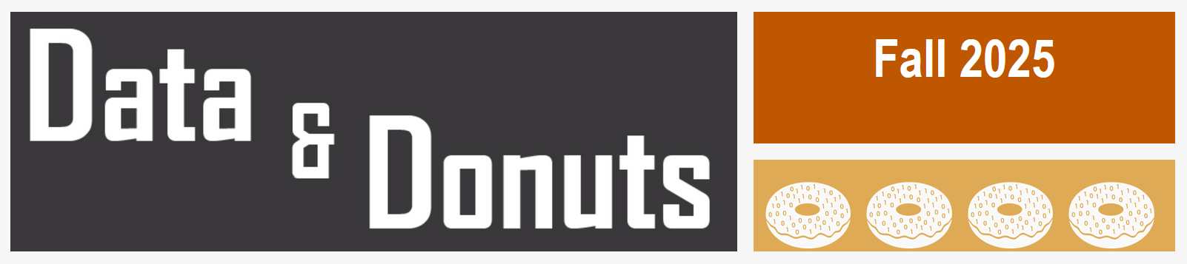
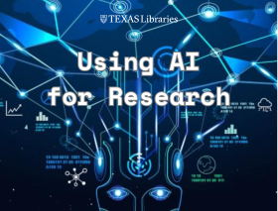
Upcoming Fall Workshops
Data & Donuts Workshop Series
What Workshops covering research data practices and software
When On the following dates: Sept. 11, Sept. 25, Oct. 9, Oct. 23
Time 12pm - 1:15pm
Where Zoom (all dates) / PCL Scholars Lab (select dates)
More info https://guides.lib.utexas.edu/data-and-donuts
Fall 2026
Using AI for Research
What Learn about AI tools for working with research code and data
When December 2, 2026 (Wednesday): 1pm - 2pm
Where Virtual
Notes:
Here are two workshop series that may interest you.
One is the Data & Donuts series. It’s held on Fridays and focuses on a variety of data-related topics.
Using AI is another series the library will host in the Spring. One of the sessions is about AI tools for coding and data.

Slide 8
Code of Conduct
Use welcoming and inclusive language
Be respectful of different viewpoints and experiences
Gracefully accept constructive criticism
Focus on what is best for the community
Show courtesy and respect towards other community members
Contact any Instructor/Helper for assistance
Notes:
We also would like to introduce a code of conduct.
Use welcoming and inclusive language
Be respectful of different viewpoints and experiences
Gracefully accept constructive criticism
Focus on what is best for all of us
Show courtesy and respect towards each other
Please contact any of us who are instructors or helpers with any code of conduct concerns.

Slide 9
Day 2
Intro to Python

Slide 10
Goals for the Intro to Python Section of the Workshop
Introduce the fundamental knowledge required to help you get started using Python
Provide information about related resources you can use to learn more about Python moving forward
Showcase the benefits of using Python for reproducible research
Learn how to use Python without installing any software - this workshop will use Google Colab
We will focus on using a local Python installation during tomorrow’s session

Slide 11
Benefits of Using Scripted Approaches
Scaling data retrieval
Example: APIs vs. web-interface retrieval
Scaling data management tasks
Example: batch renaming thousands of files; indexing a compressed archive
Handling large data files
Example: 200 MB CSV file
Ensuring reproducibility
All steps in a process are preserved in code
Automating recurring processes
Example: scheduling weekly back-up; producing graphical summaries

Slide 12
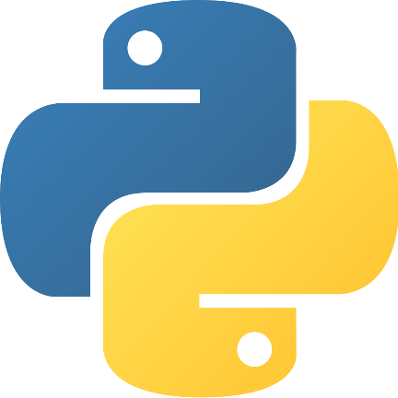
What is Python?
Open source, interpreted programming language
Cross platform compatible (Windows, MacOS, & Linux)
Large ecosystem of open source packages
Can be used for file management, analyzing data, editing data, visualizing data, and more!
Extensive use in a variety of fields and non-academic settings

Slide 13
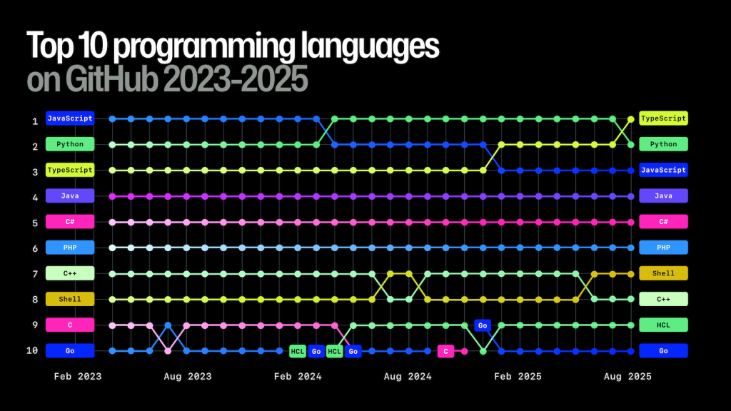


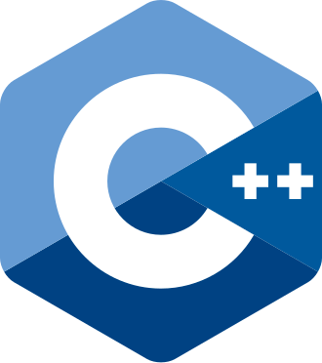
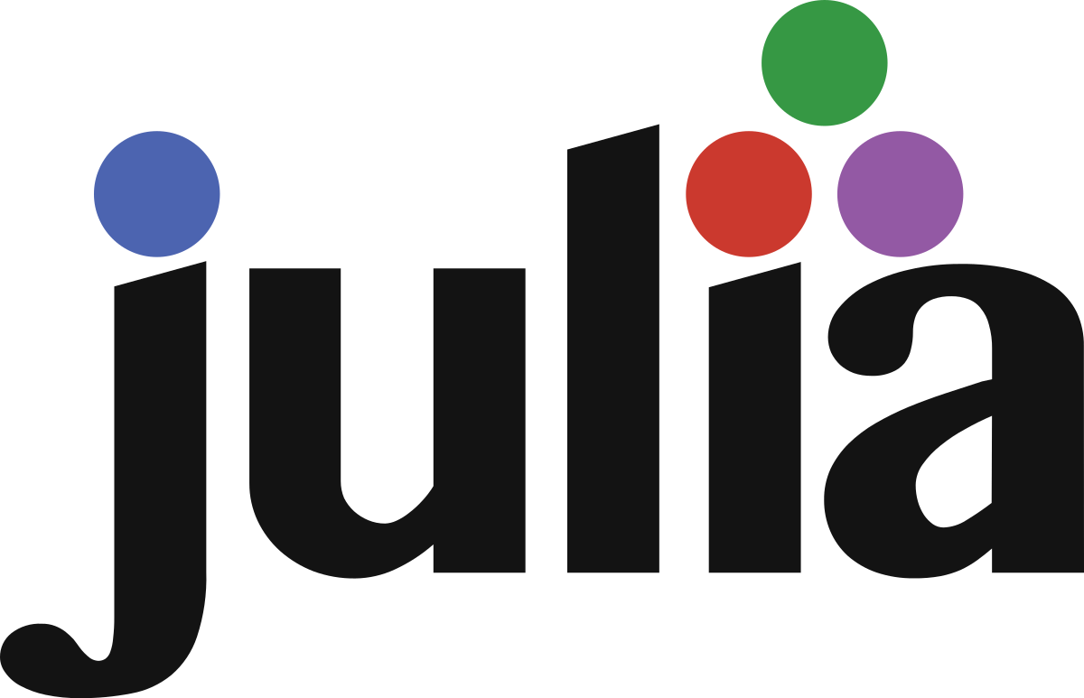

Python and Other Programming Languages
Nature Technology Feature (April 2025): Which programming language should I use? A guide for early-career researchers
GitHub (2025)

Slide 14

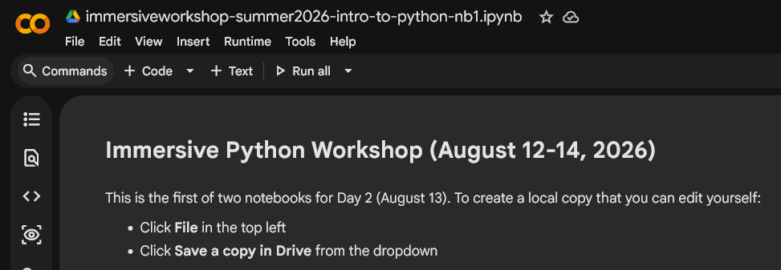
Google Colab
Colab is a free Google service that allows you to create and run Jupyter Notebooks in the cloud
Allows you to write Python code and text notes in compartmentalized cells within a notebook
Code cells can be run individually to allow for previewing outputs and troubleshooting issues
Notebooks are stored in Google Drive and can access other files in Google Drive
https://research.google.com/colaboratory/faq.html
Colab FAQs at https://research.google.com/colaboratory/faq.html

Slide 15
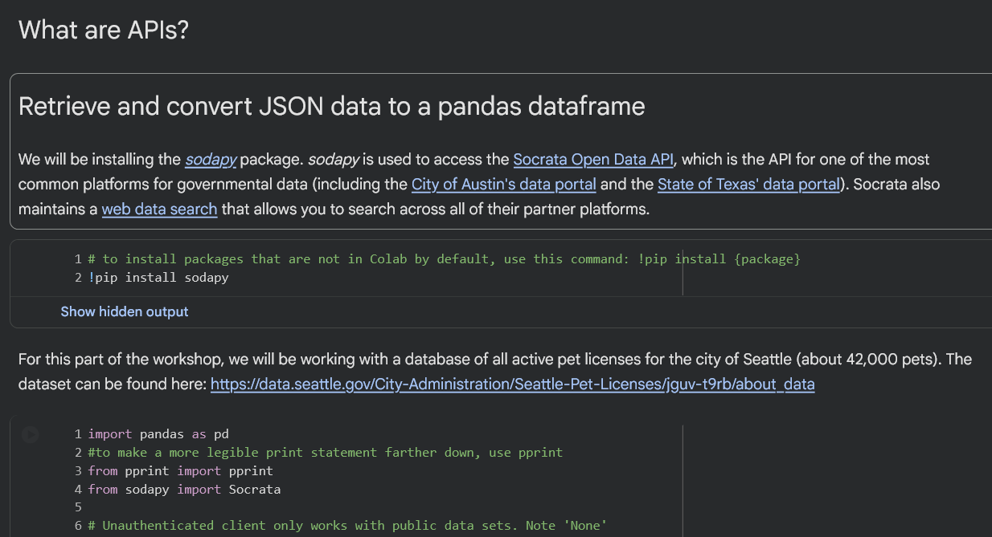
DEMO: Basics of Python for Reproducible Research
Python Basics
Packages and modules
Variables and object types
Syntax
Comments
Retrieve data with the requests module
Link to publicly shared Google Colab Notebook:
https://bit.ly/4g78KR7

Slide 16
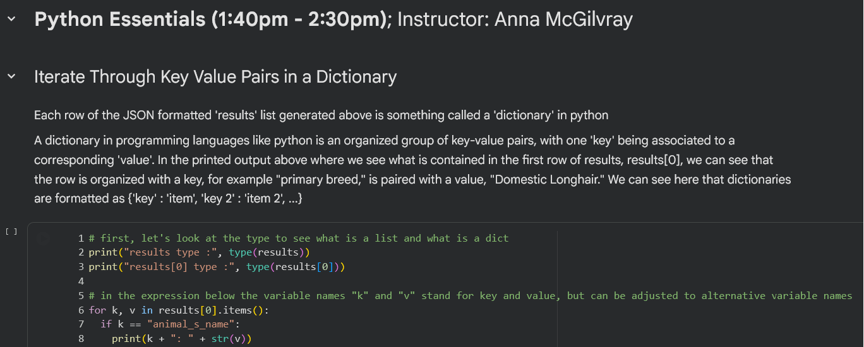
DEMO: Python Essentials
Python Essentials:
Work with dataframes
Utilize “for” loops
Write conditional statements
Use try and except to catch errors
Define new functions
Link to publicly shared Google Colab Notebook:
https://bit.ly/4g78KR7

Slide 17
Running Python 101

Slide 18
Installing Python Locally
Might already be on your computer due to it being included with your OS or other software
Be careful if you have multiple Python versions installed and on Mac do not use OS Python version
Virtual environments can help manage multiple Python and package versions on your local machine. For more information and installation instructions, please consult this link: http://tiny.cc/k1zv001
You can install Python using the default installer or you can use a package manager like Anaconda
Once Python is installed, you will likely want to install extra packages
You can do this with pip or with Anaconda, but for this workshop we will focus on using pip
Notes:
Mac comes preinstalled with Python

Slide 19
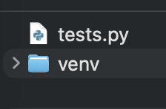
Virtual Environments
A virtual environment is an isolated, self-contained environment on your local computer that uses specific versions of a programming language (such as Python) and any installed libraries or packages.
This environment lives in a directory on your computer, and can be activated and deactivated whenever you need to enter or leave it.
Virtual environments are independent of your code–you can run the same Python script in different virtual environments.
Using virtual environments helps to avoid issues with software versioning, as you can have different versions of a Python package installed in different virtual environments.
Notes:
Mac comes preinstalled with Python

Slide 20
Why Use Virtual Environments?
Using virtual environments helps to avoid issues with software versioning, as you can have different versions of a Python package installed in different virtual environments.
A virtual environment is a sandboxed directory where you can install packages and run different Python versions separate from your main machine. This can also help avoid clashes between your system’s version of Python and a version you are using for coding.
Virtual environments help facilitate reproducibility because you can export exact package versions into a requirements.txt using the pip freeze > requirements.txt command. This allows other users of your scripts to quickly recreate the same setup on their machine.
Notes:
Mac comes preinstalled with Python

Slide 21
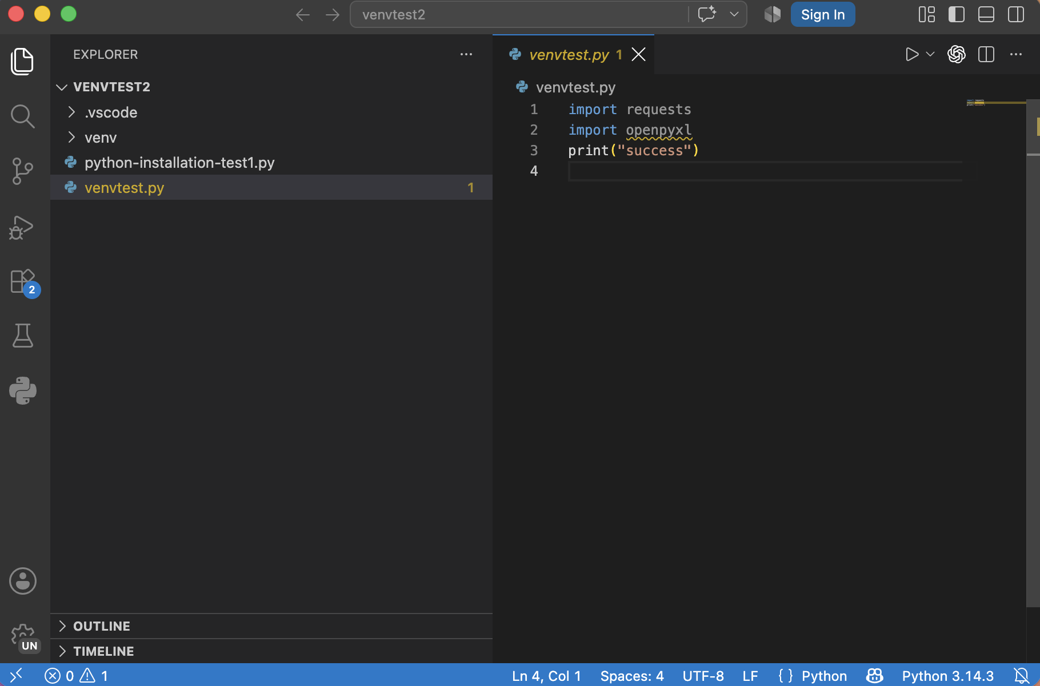
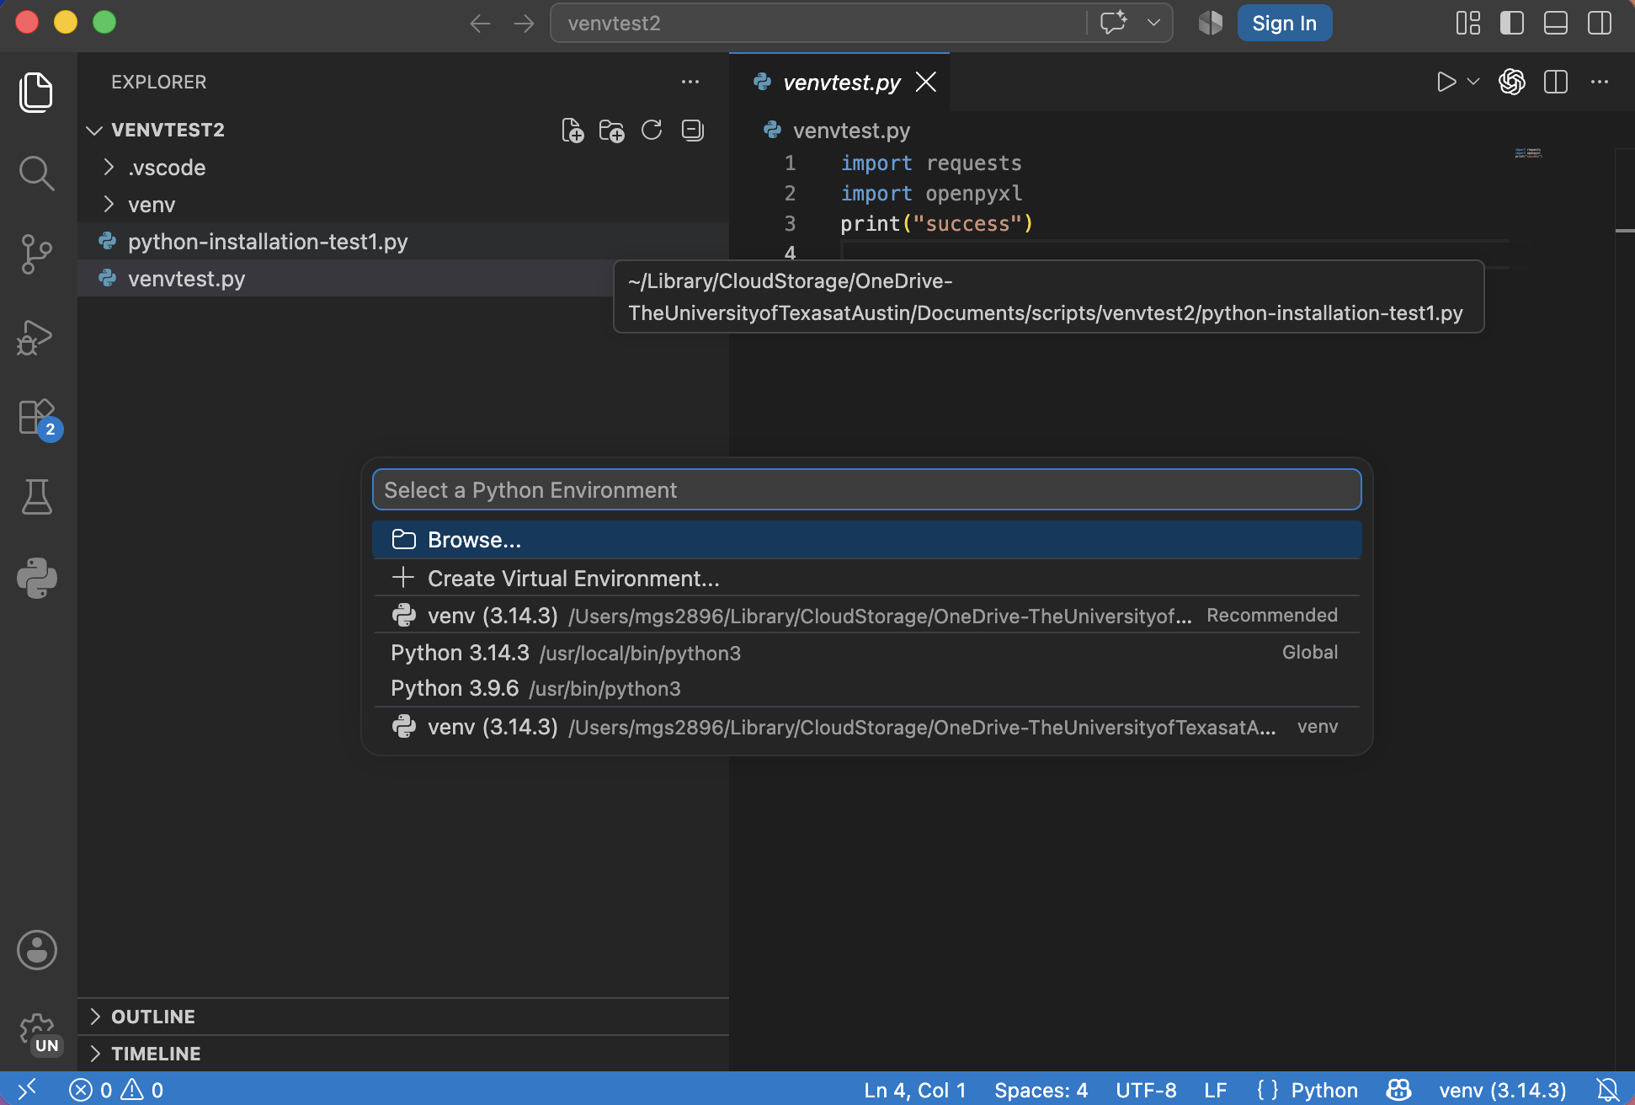
Manage Use of Existing Virtual Environment with VSCode
Open project repo folder in VSCode
Click on Python version in bottom right to view the Python interpreter selection menu
Select the interpreter entry that begins with venv
Check the Python version in the bottom right of the screen and make sure it lists venv
Notes:
Mac comes preinstalled with Python

Slide 22
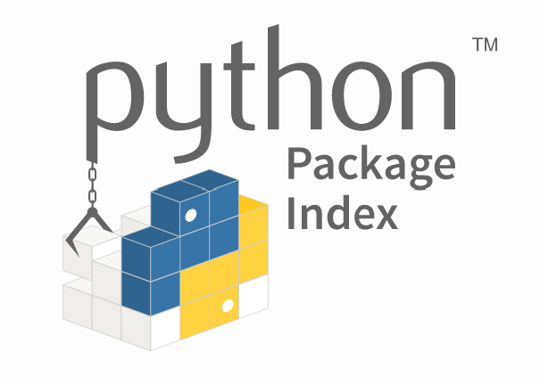
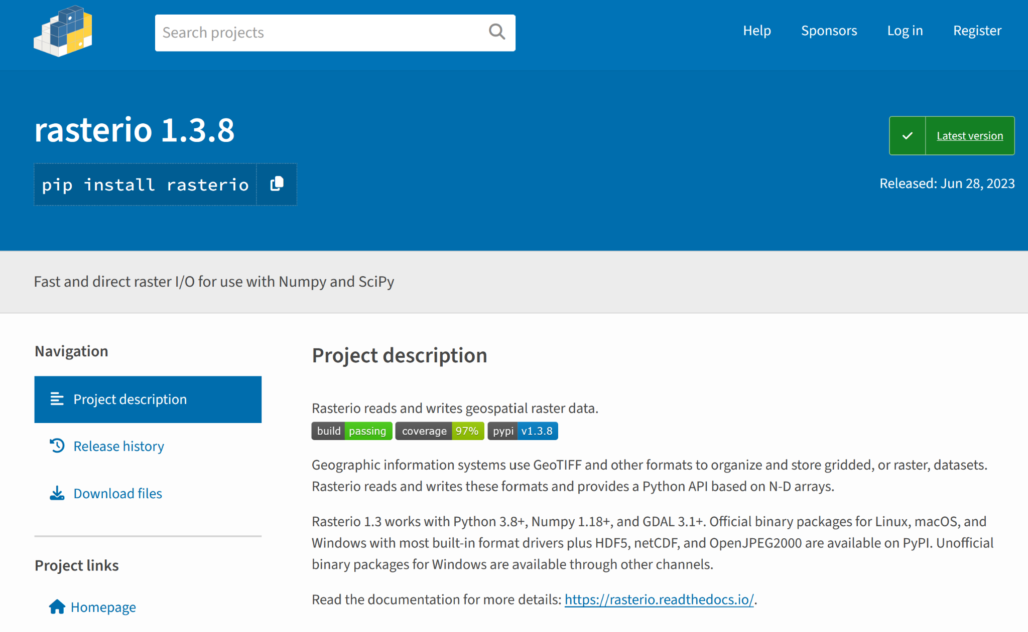
Installing New Python Packages
pip is the default package installer for Python
You can use pip to install packages from the Python Package Index and other indexes
pip can be used to install packages if you are running Python locally or in Google Colab
Packages should always be vetted before installation and use

Slide 23
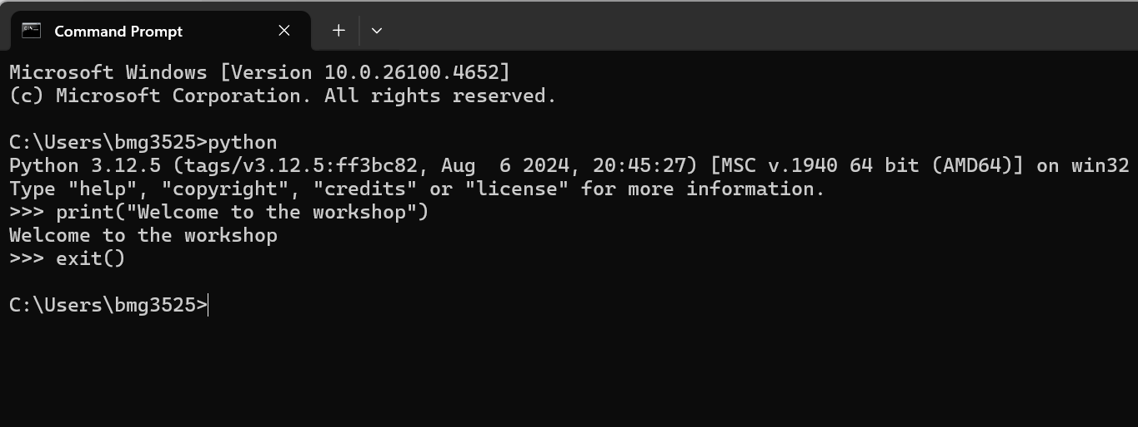
Code Editors and Integrated Development Environments (IDEs)
You can write Python code and run it from your Command Prompt or Terminal…

Slide 24
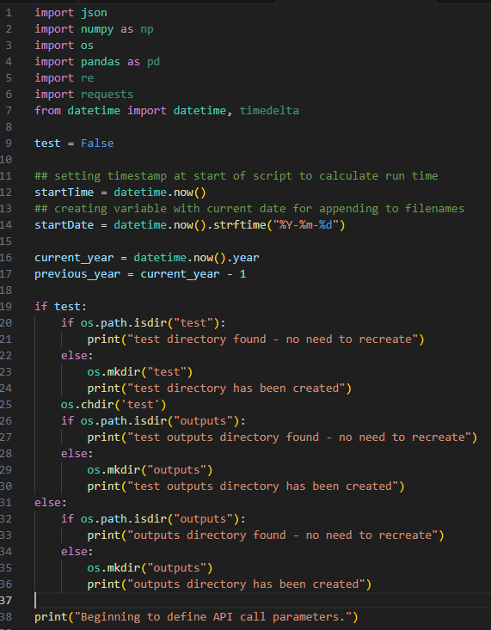





Integrated Development Environments (IDEs)
You can write Python code and run it from your Command Prompt or Terminal…but using an IDE makes writing code much easier
An IDE (integrated development environment) is a software solution designed to facilitate writing code
Jupyter (https://jupyter.org/)
VS Code (https://code.visualstudio.com/)
Pulsar (https://pulsar-edit.dev/)
PyCharm (https://www.jetbrains.com/pycharm/download/)
Spyder (https://www.spyder-ide.org/)

Slide 25

Using VS Code as your Python IDE
VS Code is a great IDE for Python because it is:
Free
Open source
Cross platform compatible
Widely utilized
Extensible and customizable
Download VS Code at https://code.visualstudio.com/

Slide 26
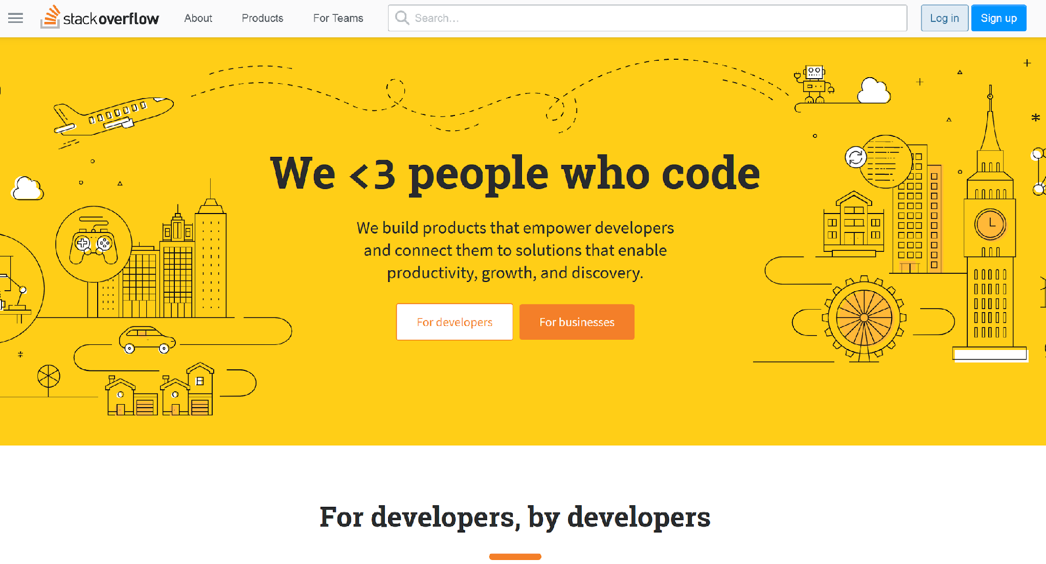
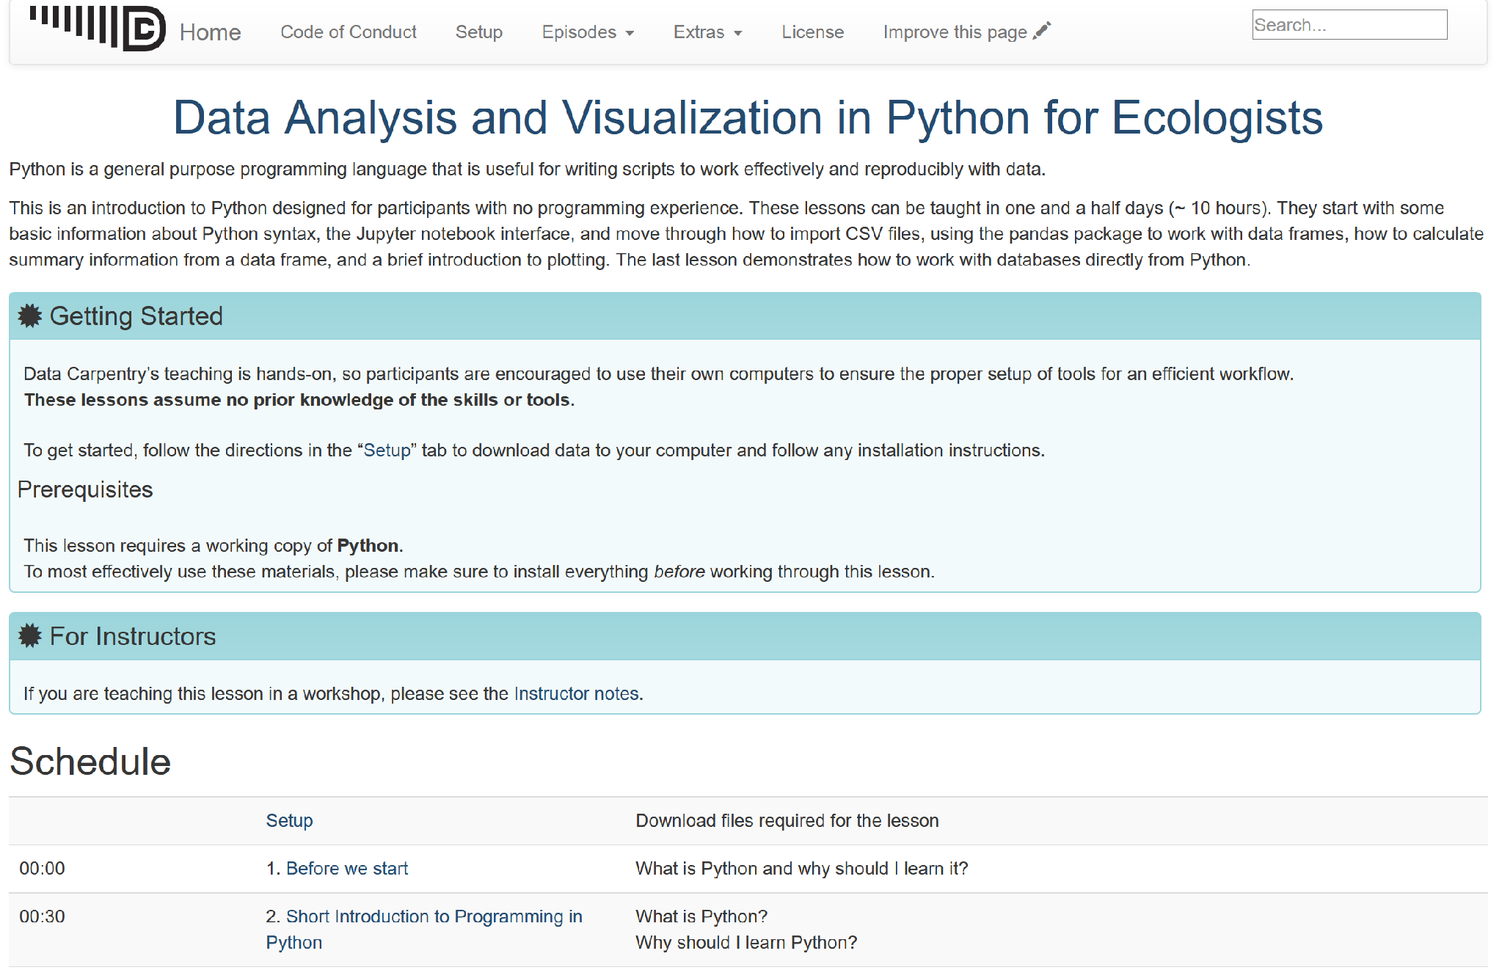
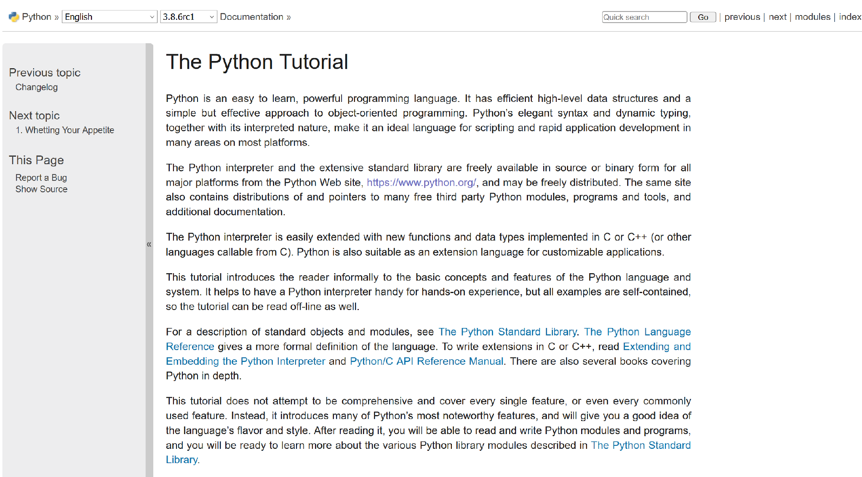
Python Resources, Documentation, and Help
Stack Overflow (https://stackoverflow.com/)
Data Carpentry (https://datacarpentry.org/python-ecology-lesson/)
Python Documentation (https://docs.python.org/3/library/index.html)
Python Tutorial (https://docs.python.org/3/tutorial/index.html)
LinkedIn Learning (https://www.linkedin.com/learning/topics/python)
UT Statistics Short Courses (https://stat.utexas.edu/training/software-short-courses)
Google Colab: Intro to Python (https://colab.research.google.com/notebooks/intro.ipynb)

Slide 27
Software Installation Support

Slide 28
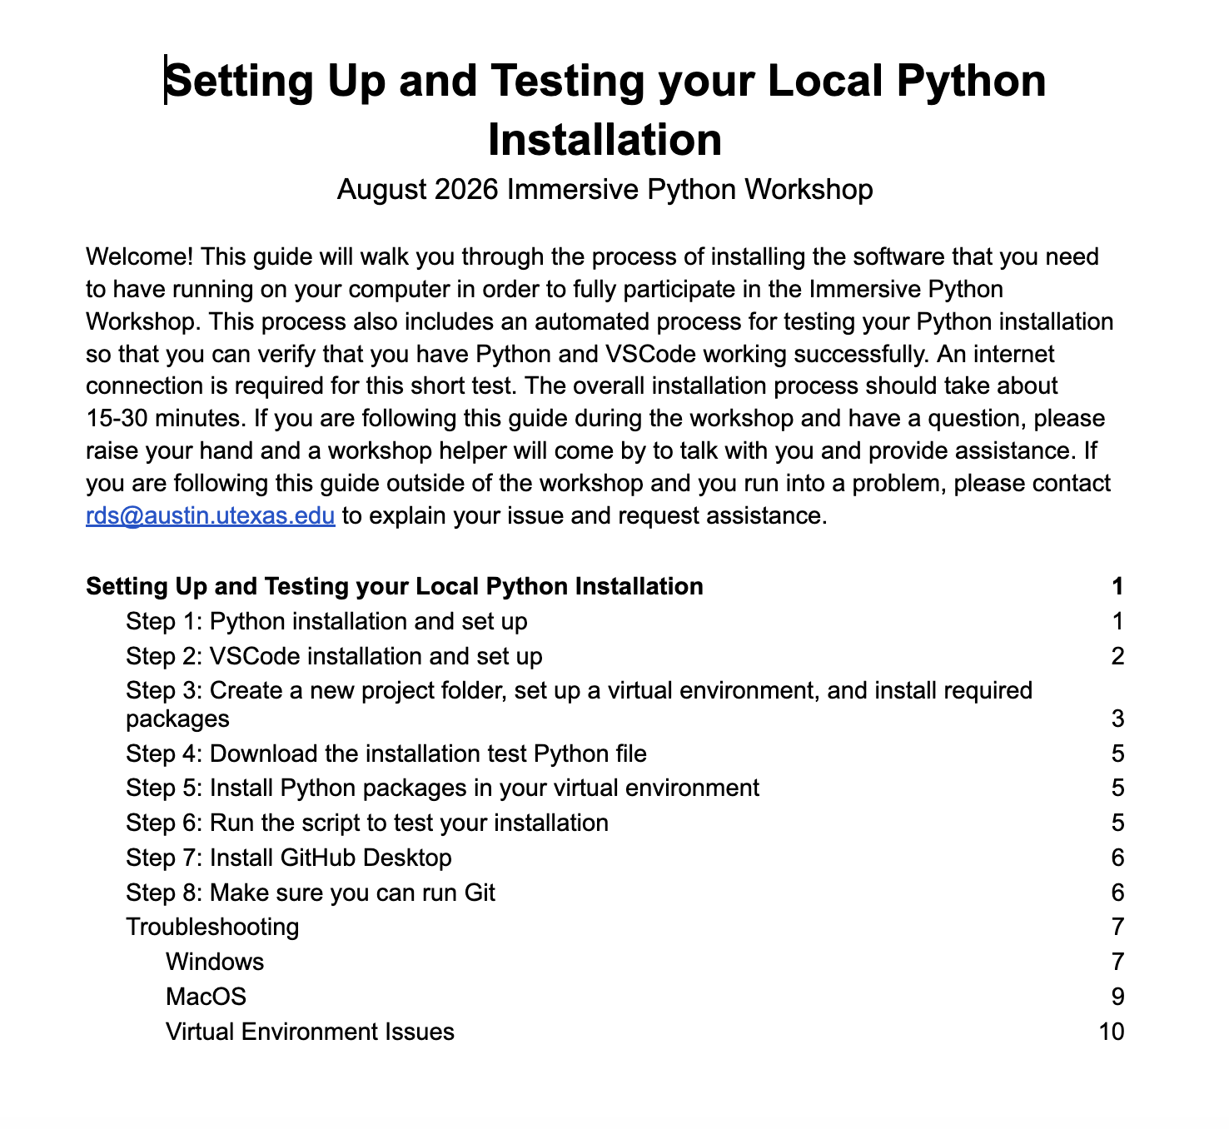
Python Resources, Documentation, and Help
Visit link below for detailed instructions for installing all required software
https://bit.ly/python-install-test-aug26

Slide 29
Create a Virtual Environment
Use your command prompt/terminal to navigate to your project folder:
cd your/path
Example: cd documents
Create your virtual environment:
On Mac:
python3 -m venv venv
On Windows:
python -m venv venv
The above commands create a virtual environment in the folder named “venv” (short for “virtual environment”). You can change the name of your folder to whatever you want, but for simplicity’s sake attendees should just use “venv” here (the second “venv” is the folder name, so to have a different name you could type something like python3 -m venv different_name.
If you running your scripts in the Terminal or Command Prompt you should use the commands below to activate the virtual environment
Mac:
source venv/bin/activate
Windows:
If using Command Prompt: venv\Scripts\activate.bat
If using PowerShell: venv\Scripts\Activate.ps1
Notes:
Mac comes preinstalled with Python

Slide 30
Software Installation Support
Python (https://www.python.org/downloads/)
Make sure you can install new Python packages using the Terminal (MacOS) or Command Prompt (Windows)
Try the following command on your PC: python -m pip install pandas
Try the following command on your Mac: python3 -m pip install pandas
VSCode (https://code.visualstudio.com/download)
Create a new file with the extension .py (to designate the file as a Python script)
Try clicking the play/run button in the upper right corner of VSCode to run the script
Git (https://git-scm.com/downloads)
Github Desktop (https://desktop.github.com/download/)
See next slide for troubleshooting common issues

Slide 31
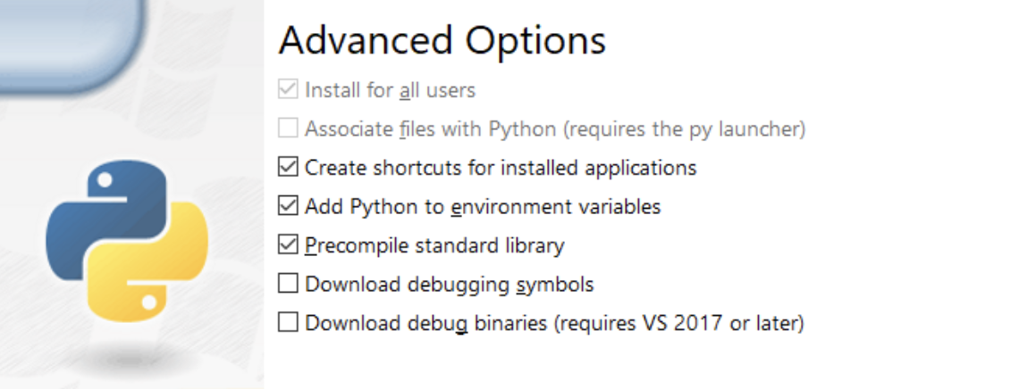
Software Installation Common Issues
Mac
ISSUE: you cannot run a Python script in VS Code
CAUSE: the Python default interpreter path is not set correctly
SOLUTION: In VSCode go to File > Preferences > Settings and search for the Python default interpreter path setting - when you find it, update the the value to the correct Python interpreter path. If you don’t know the path to the interpreter, open your Terminal, type python3, import sys, and the run sys.executable
PC
ISSUE: trying to run python in the command prompt opens the Windows Store
CAUSE: the directory containing your Python interpreter is not correctly listed in your system Environment Variables’ path listing
SOLUTION: Re-run the Python installer to modify your installation and make sure that you have checked the box for “Add Python to environment variables”. Once you have done this go back to the Command Prompt and try to run the python command again
We can help you resolve installation issues - having everything working by start of Day 3 is important

