Slide 1
Software Design

Slide 2
Software Design
Identify your user & requirement
List down the actor
Design UML Diagram
Sequence Diagram
Class Diagram

Slide 3
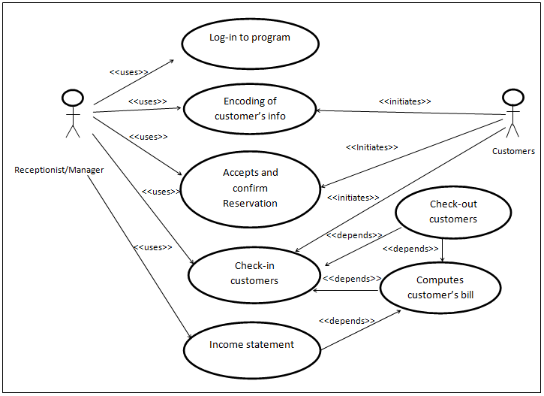

Slide 4
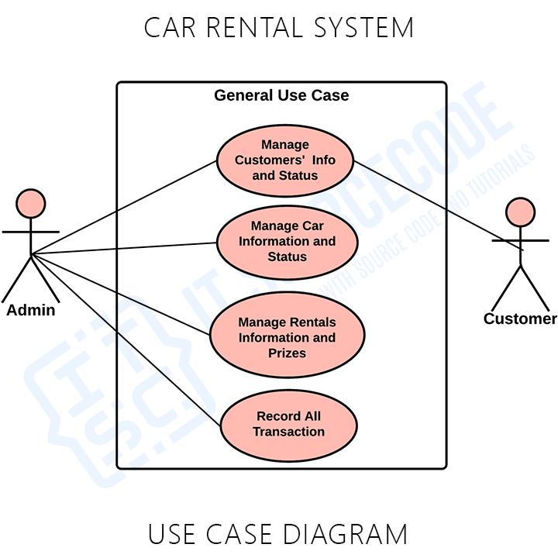

Slide 5
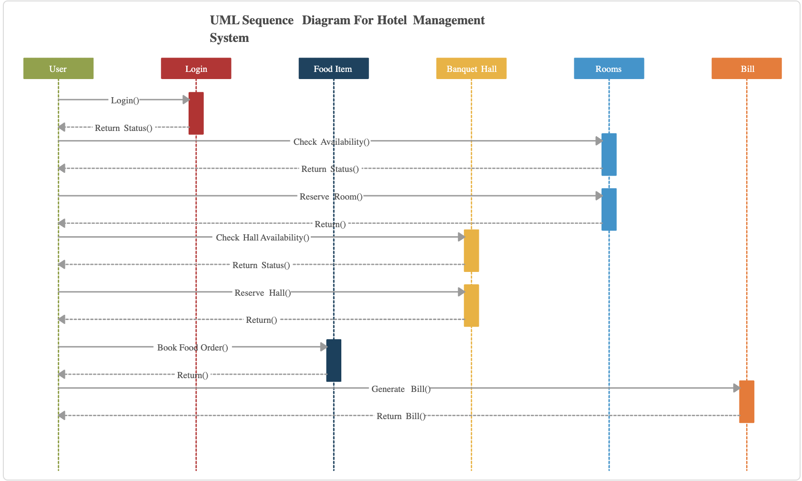

Slide 6
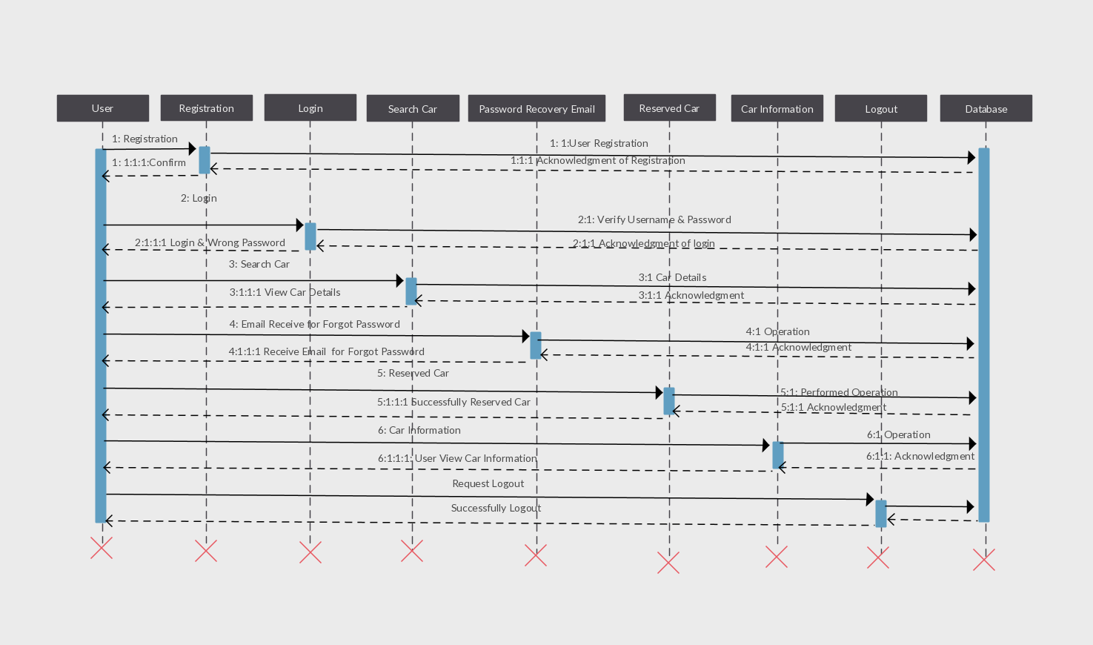

Slide 7
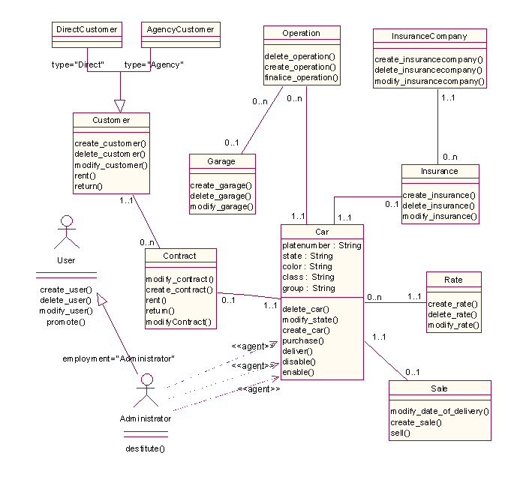

Slide 8
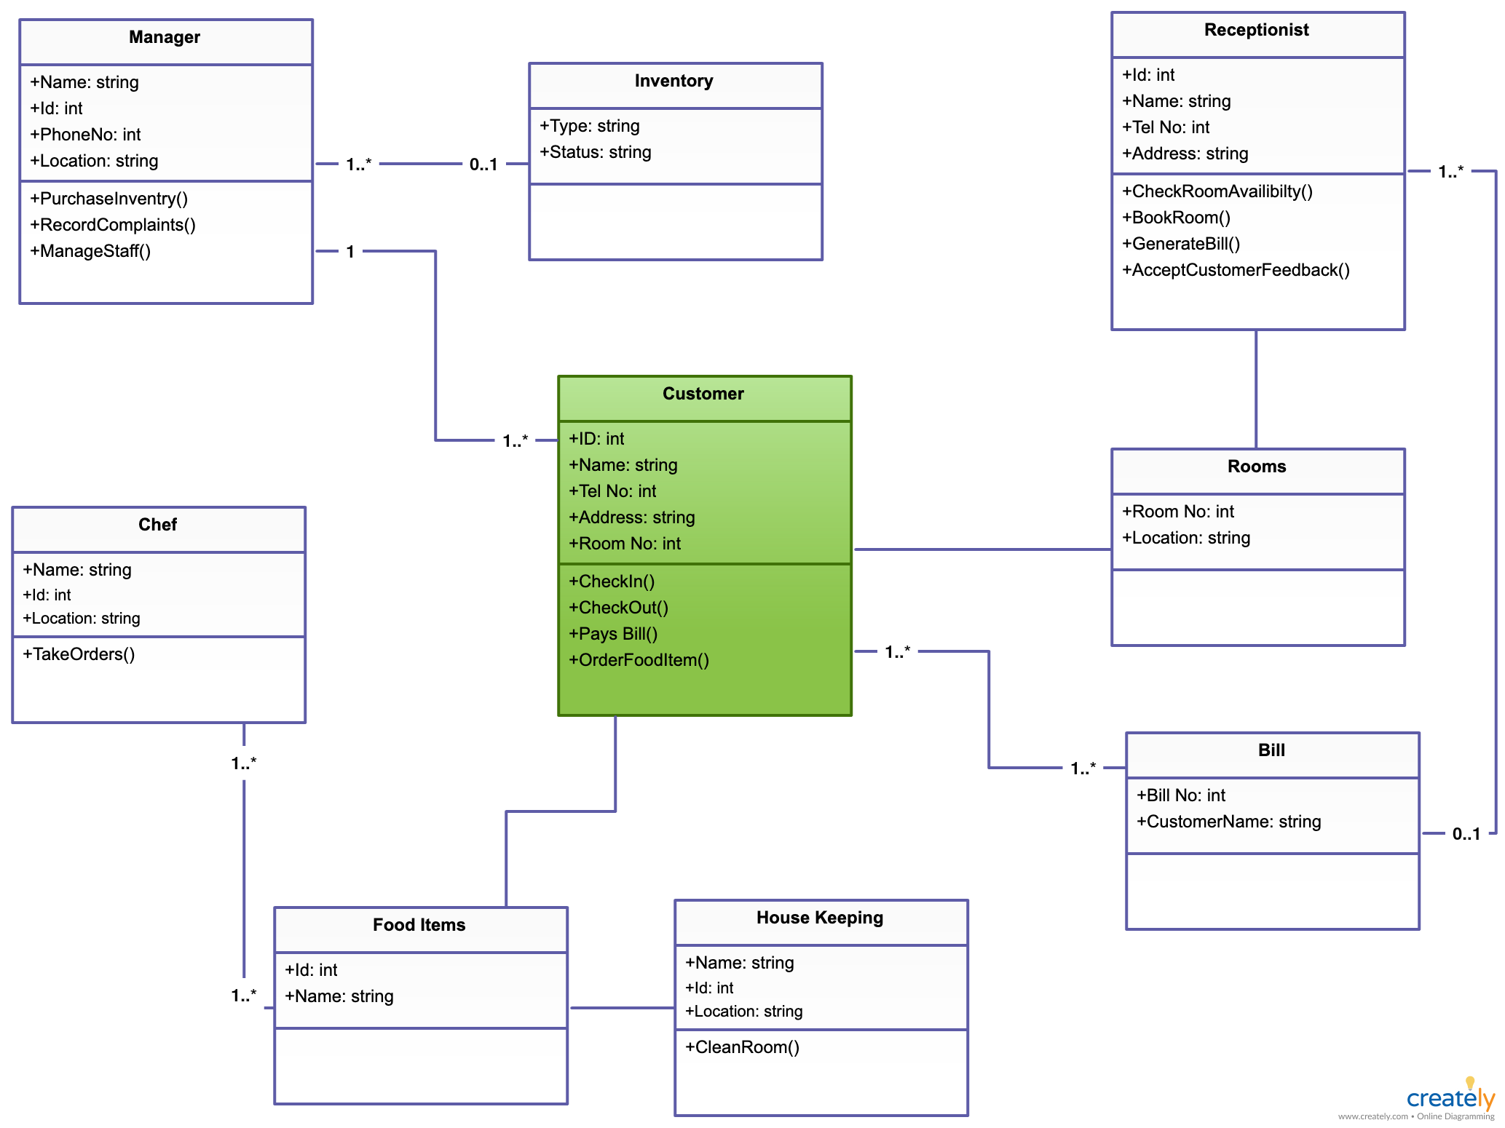

Slide 9
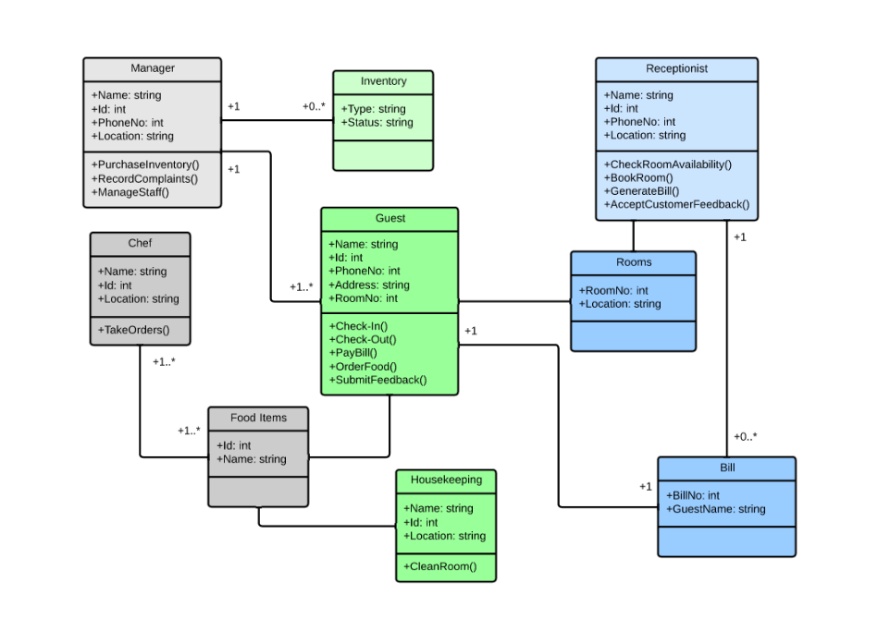

Slide 10
ENTITY RELATIONSHIP DIAGRAM
(ERD)

Slide 11
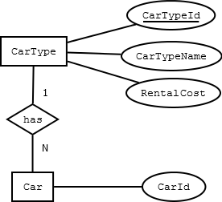
Terminology ERD
Entity
Relationship
Attribute
Primary Key
Secondary key

Slide 12
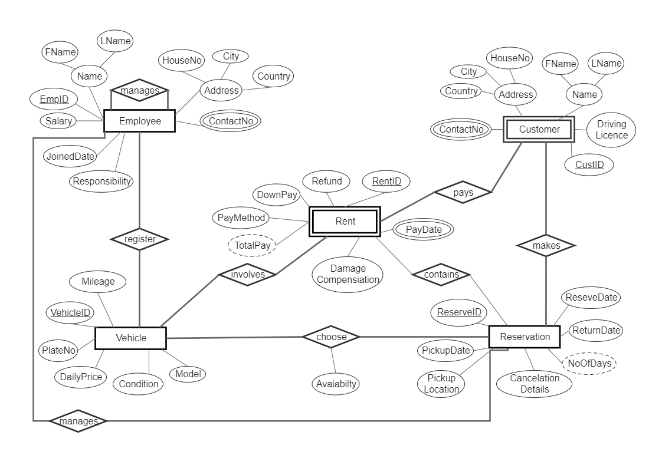

Slide 13
