Slide 1
Next Progress Presentation

Slide 2

WRITE YOUR DESIGN CHALLENGE

Slide 3
WRITE YOUR DESIGN CHALLENGE
EXAMPLE :

Slide 4
STATE YOUR HEADLINES

Slide 5
STATE YOUR HEADLINES
PAYMENTS
HYGENE

Slide 6
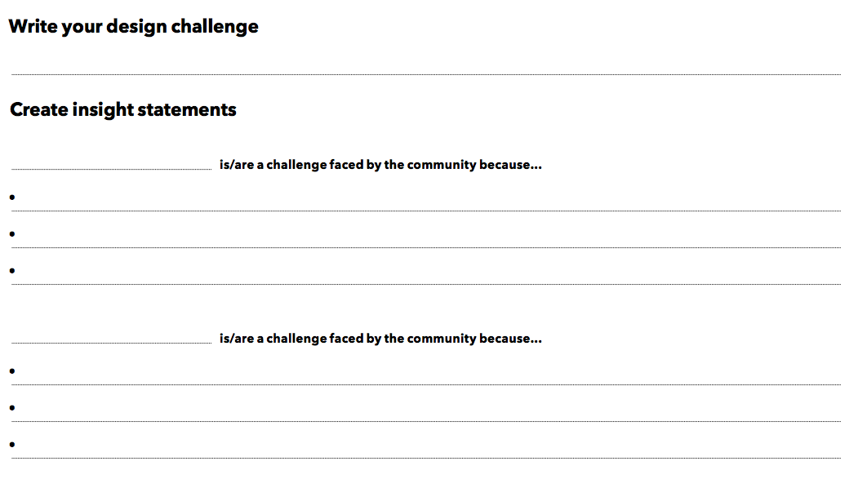
CREATE INSIGHT

Slide 7
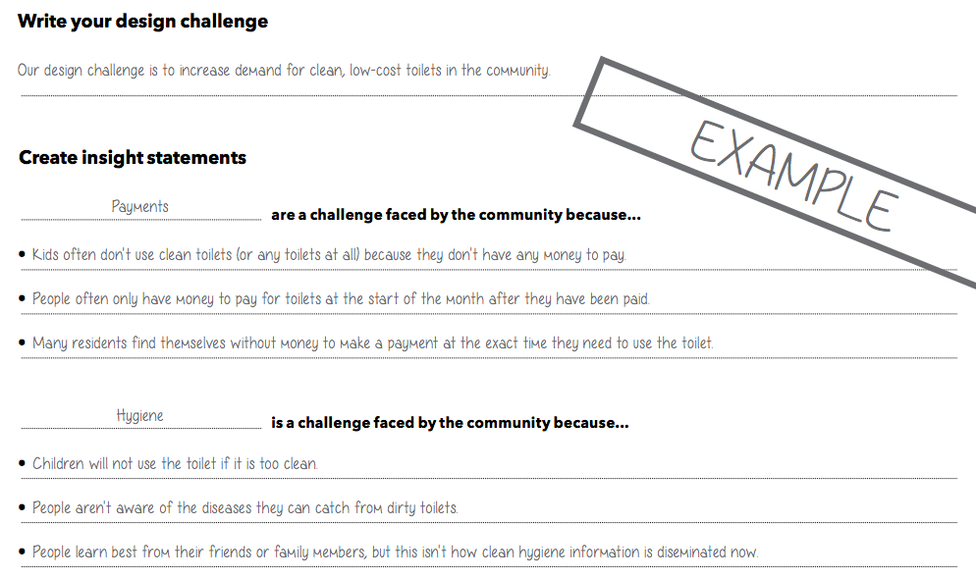
CREATE INSIGHT

Slide 8
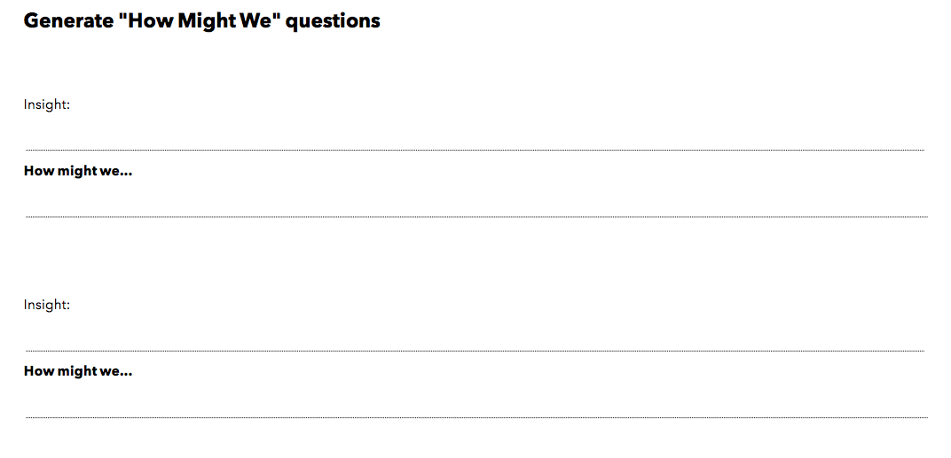
GENERATE HOW MIGHT WE

Slide 9
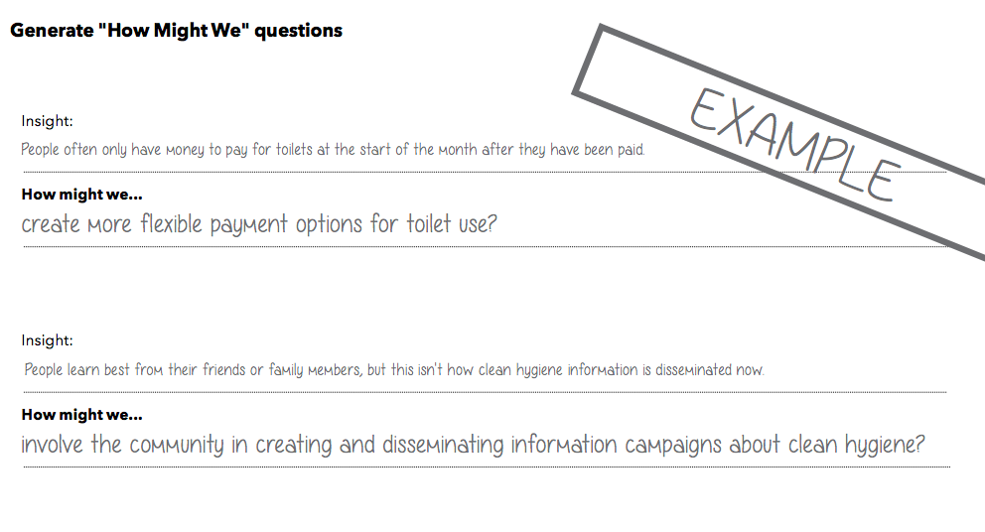

Slide 10
STATE YOUR IDEA

Slide 11
WRITE YOUR PROPOSAL
Introduction
Problem Background
Problem Statement
Goal
Objectives
Scopes
Motivation
Group Members

Slide 12
Introduction

Slide 13
Goal & Objectives

