Slide 1
Mobile Application Programming SCSJ3623

Slide 2
Outline
About the course:
        Course Outline
  Assessment
  Group project
Mobile App. Dev Technologies
Installation: the framework and tools
Test drive on emulator and phone
A tour on VS Code, and Android Studio
A tour on Git and Git Bash

Slide 3
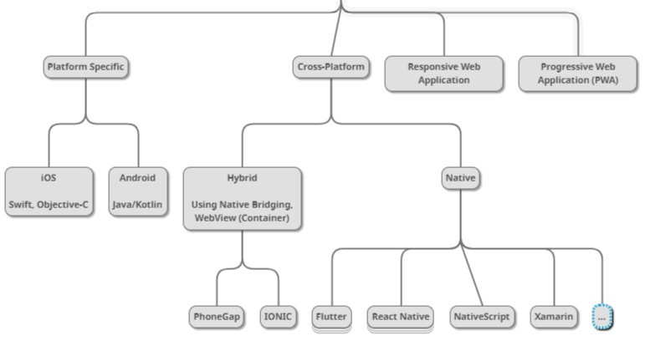


Mobile App Dev. Technologies
This course?
Which technology?

Slide 4

What is Flutter?
A UI Framework for building native application
Cross-platform: Android, iOS, Desktop (Windows, MacOS, Linux), Web
Made by Google
Open-source
Use Dart as the programming language
More on flutter.dev

Slide 5
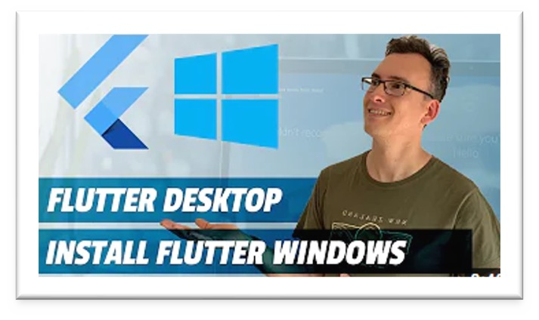
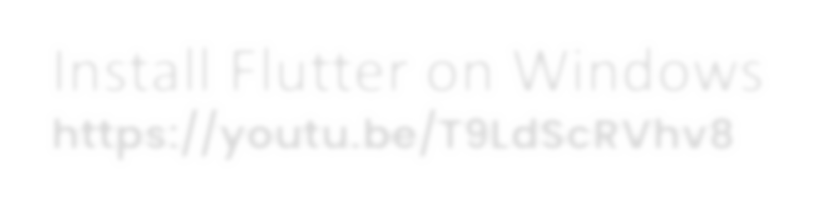


Install Flutter
Install Flutter on Windows
https://youtu.be/T9LdScRVhv8
Notes:
besides installing flutter, the video also shows you how to setup Flutter for Windows Desktop Development. You can skip this step as we are going to use Mobile Development.
Install Flutter on macOS
https://youtu.be/9GuzMsZQUYs
Notes:
besides installing flutter, the video also shows you how to setup Flutter for macOS Desktop Development. You can skip this step as we are going to use Mobile Development.

Slide 6
Install Flutter - Alternative
Install prerequisites:
  Git
  Flutter SDK
  VS Code
  VS Code Extensions (required and useful exts).
  Android Studio

Slide 7
Installing Prerequisites - Git
Installing Git:
  1. Go to https://git-scm.com/downloads/win.
  2. Click on “Git for Windows/x64 Setup”.
  3. Complete the setup.
Why you need Git?
  Git is a version control system used to manage code.
  Flutter SDK and many dependencies are distributed via Git.
  Without Git, flutter doctor and SDK updates won’t work.
  Git also integrates with GitHub and VS Code.

Slide 8
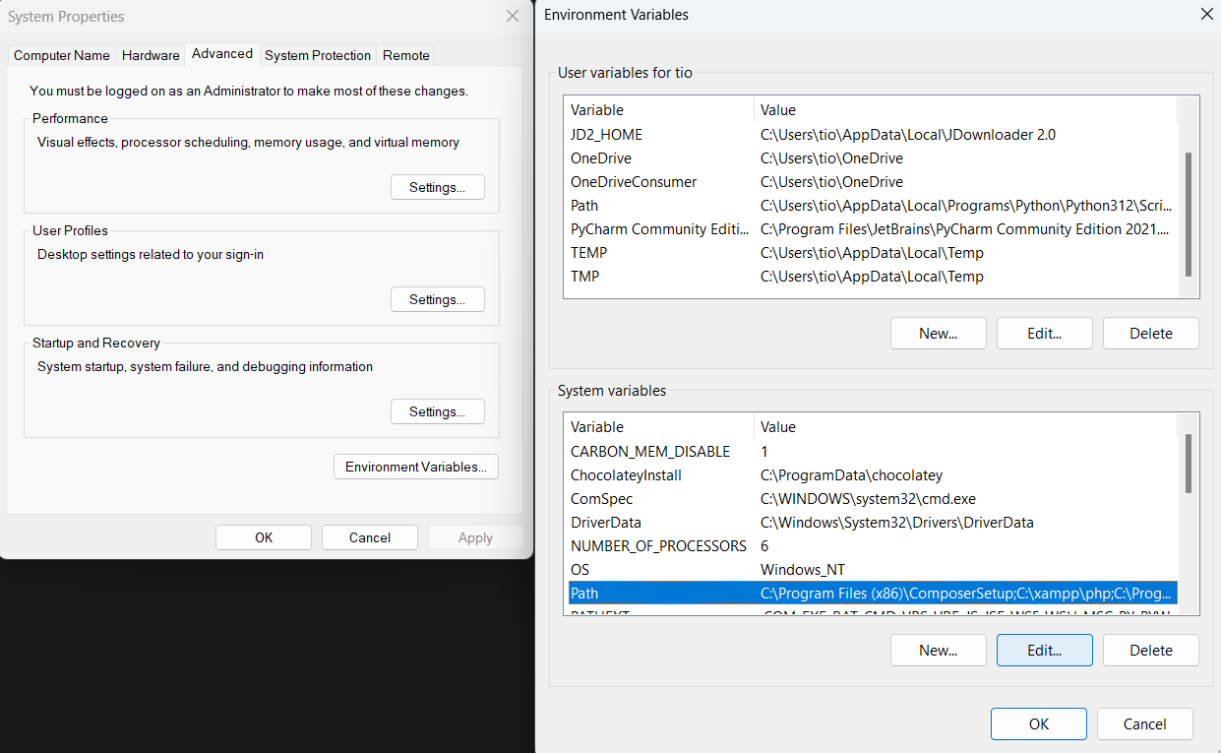
Installing Prerequisites - Flutter
Installing Flutter SDK
  Go to https://docs.flutter.dev/install/manual.
  Download the Flutter SDK bundle.
  Extract the zip file.
  Inside the unzipped folder, move the flutter folder to the C:/ Drive.
  Search “Edit the system environment variables” using the Windows Search and open Environment Variables. Next, edit the PATH under “System variables”.

Slide 9
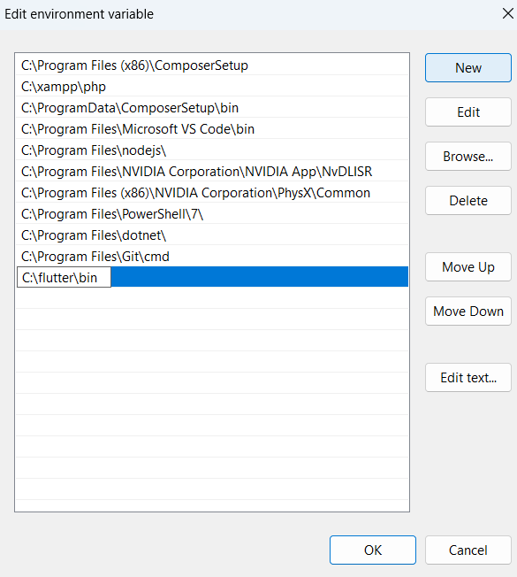
Installing Prerequisites - Flutter
Installing Flutter SDK
  Afterwards, click on New and paste the bin folder which should be “C:\flutter\bin”.
  Apply the changes
  Verify that the flutter is correctly set up by running “flutter --version” using command prompt

Slide 10
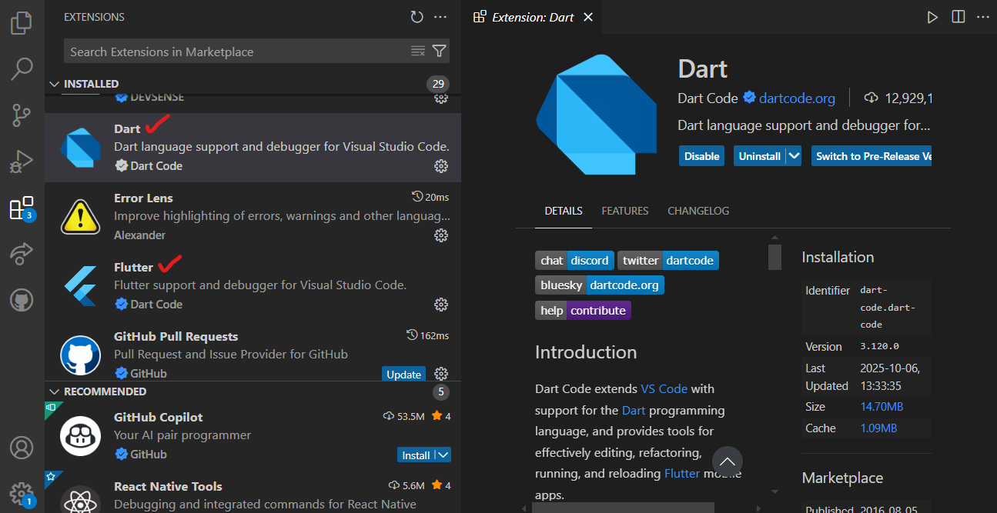
Installing Prerequisites - VS Code
Installing VS Code and Extensions
  Go to https://code.visualstudio.com/ and run the setup.
  After completion, open VS Code and click on the Extensions tab on the left sidebar.
  Search for “Dart” and “Flutter” extensions and install both.

Slide 11
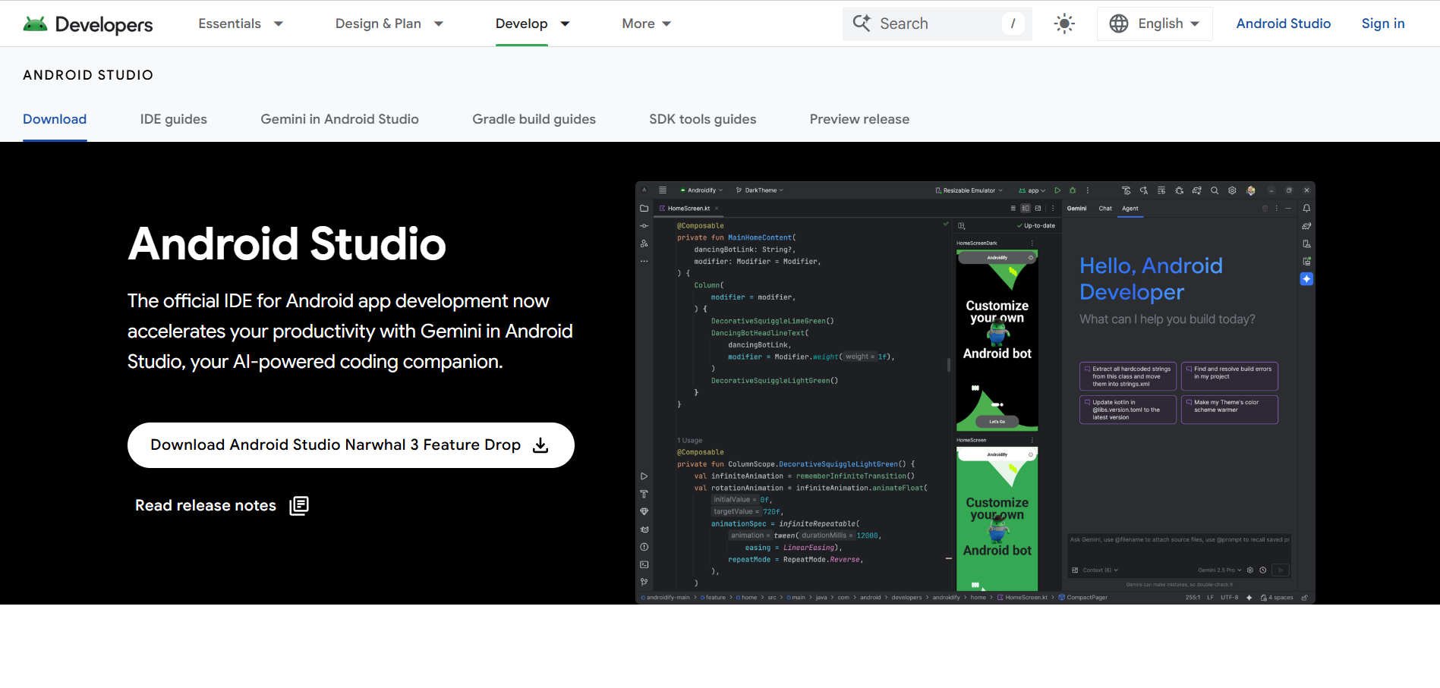
Install Prerequisites – Android Studio
Installing Android Studio
  Go to https://developer.android.com/studio
  Install the latest version
  Run the installer

Slide 12
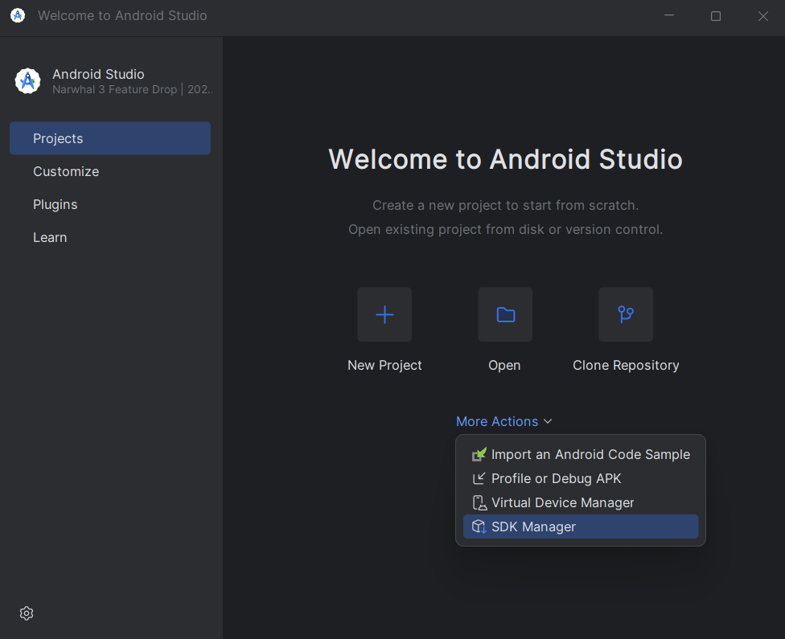
Configure Android SDK
1. Run Android Studio
2. On the start up menu, click “More Actions” then “SDK Manager” to open up the SDK Manager

Slide 13
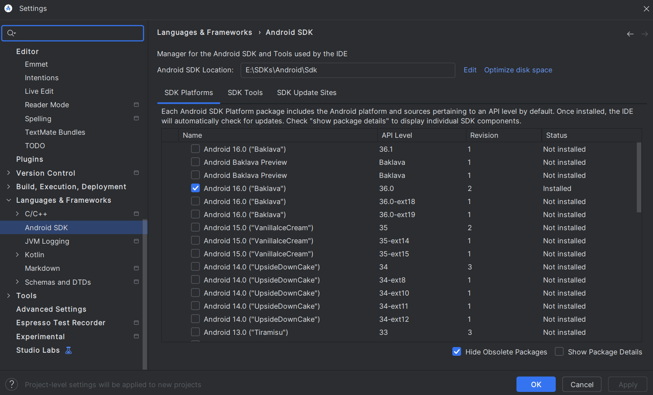
Configure Android SDK
SDK Platform

Slide 14
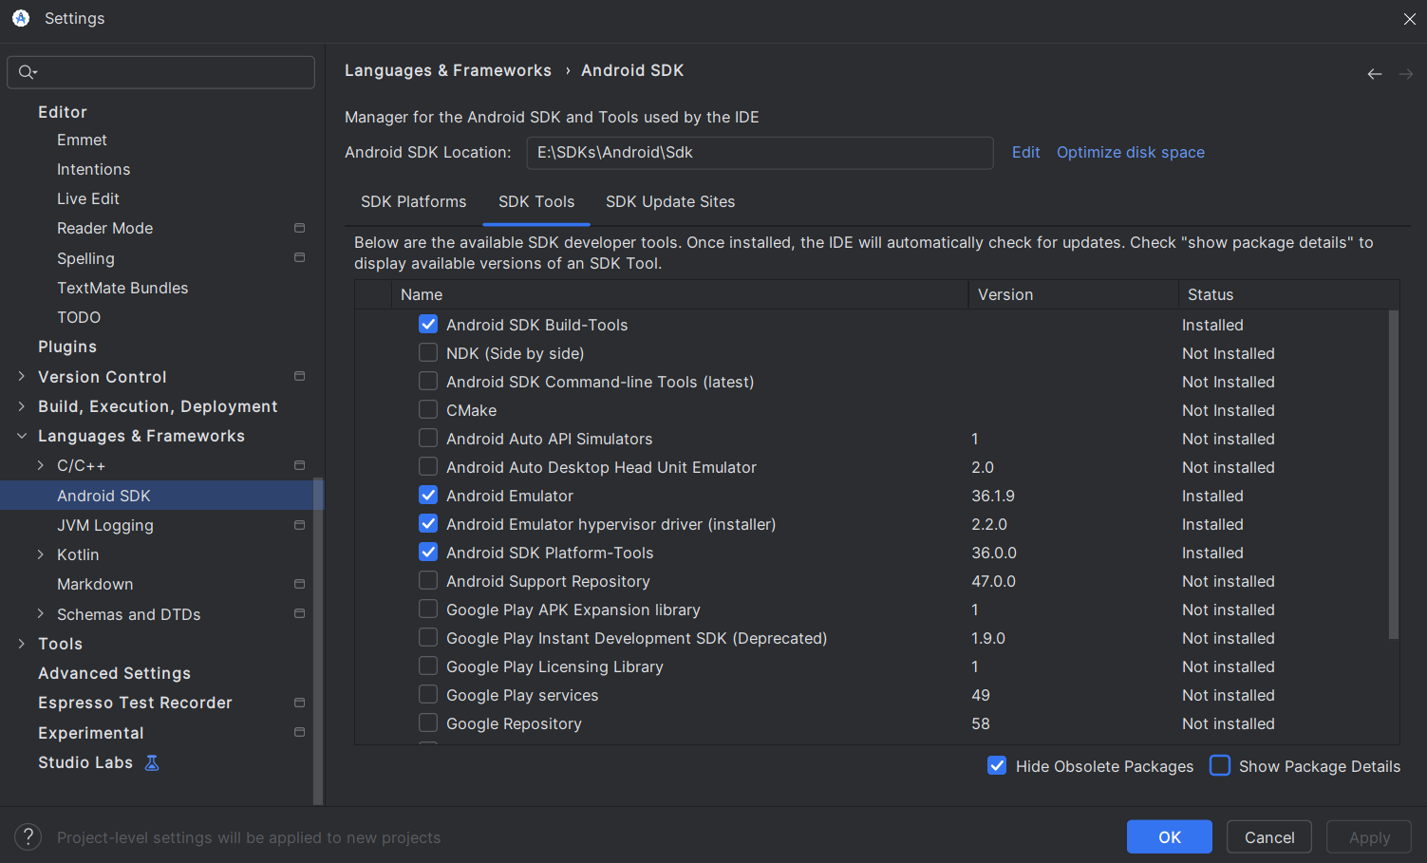
Configure Android SDK
SDK Tools
Install “Android SDK Command-line Tools (latest)”

Slide 15
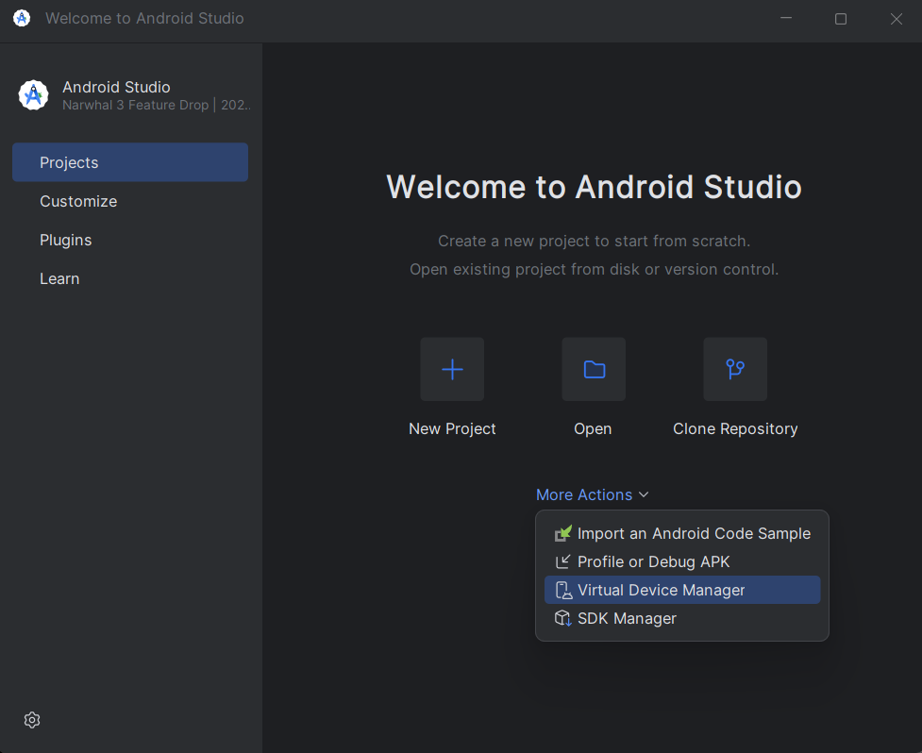
Create Android Emulator
1. On the Android Studio start up menu, click “More Actions” then click “Virtual Device Manager”

Slide 16
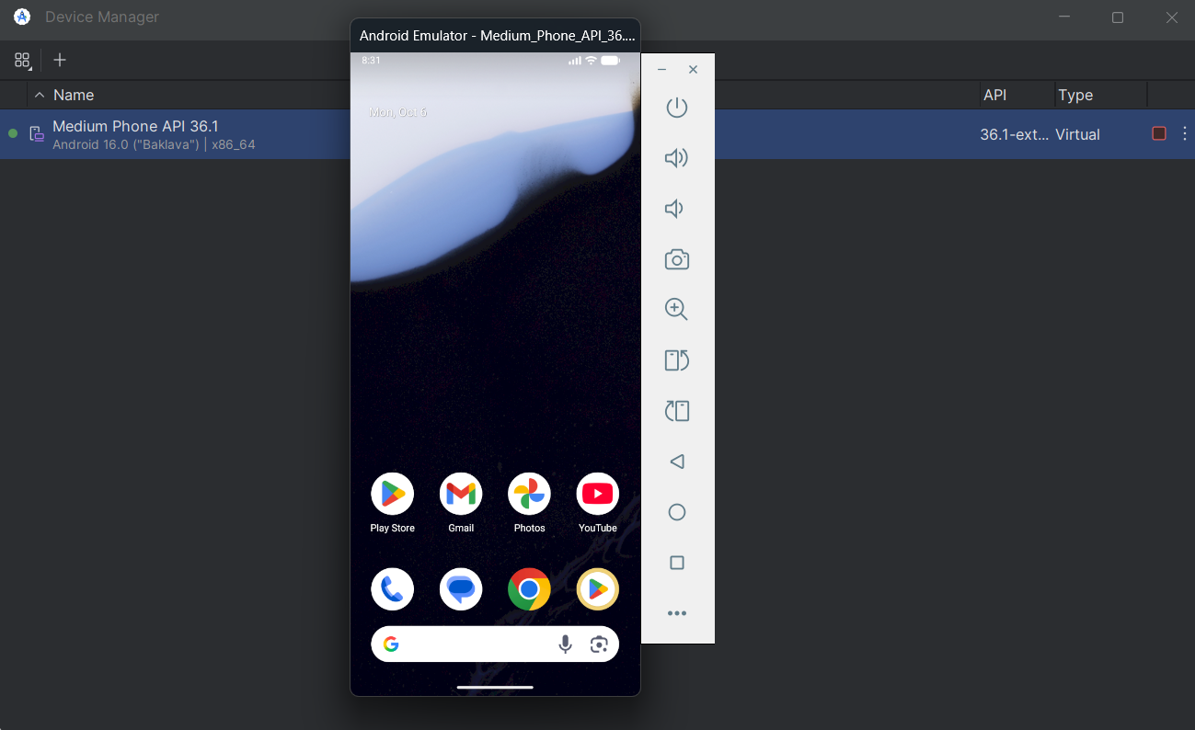
Testing the Emulator via Android Studio
Run the emulator from Device Manager

Slide 17
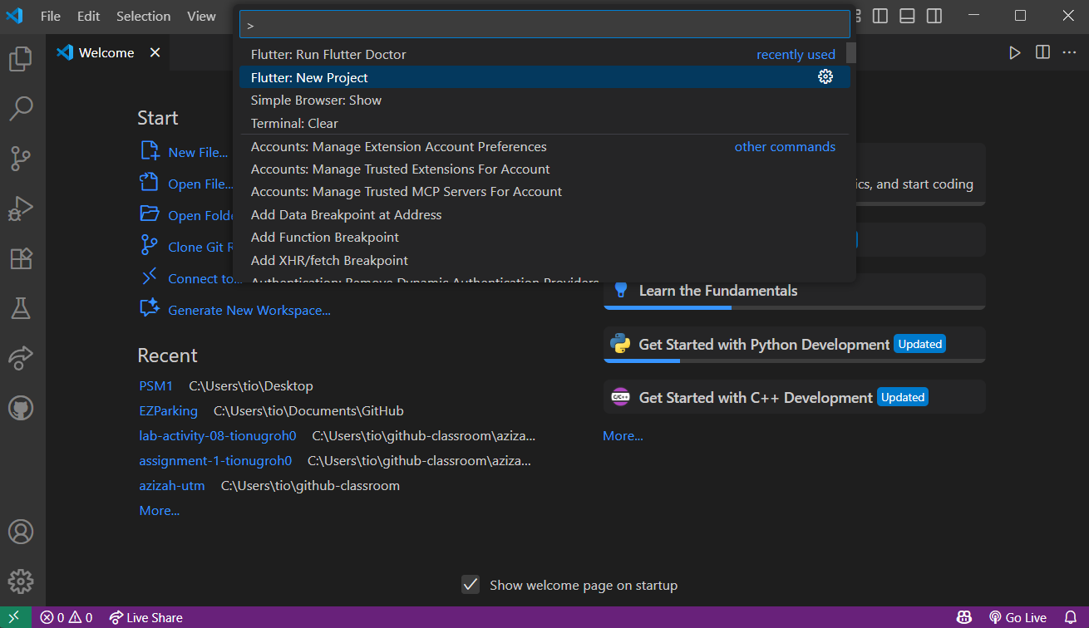
Testing the Emulator via VS Code
x

Slide 18
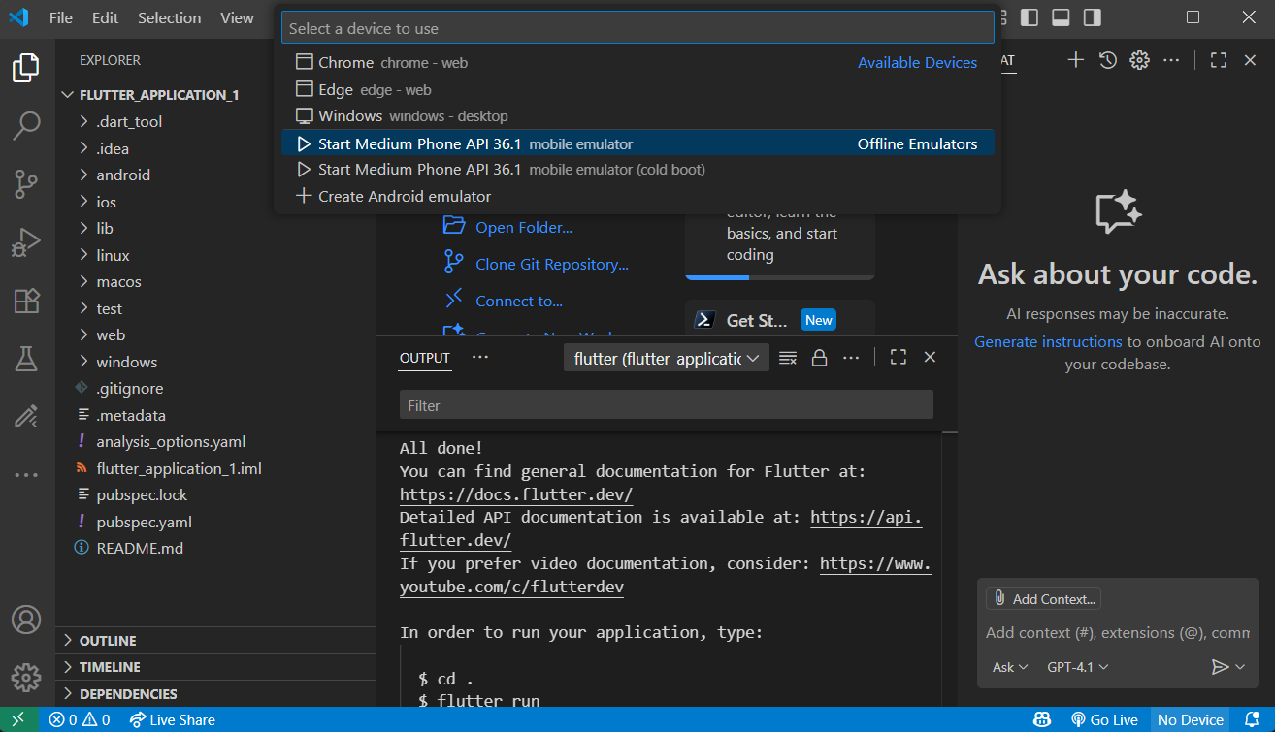
Testing the Emulator via VS Code
x

Slide 19
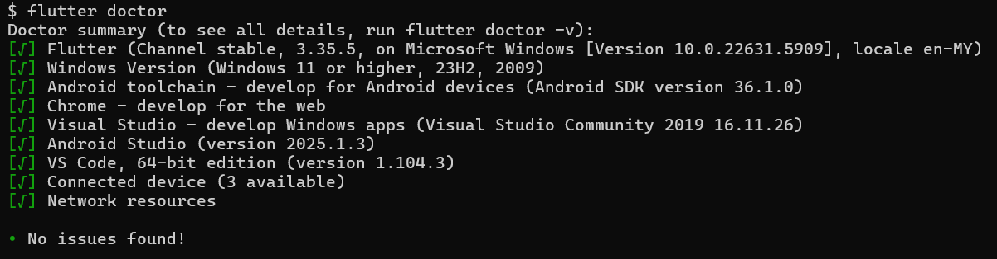
Troubleshooting - Flutter
To verify environment setup, run the following in the command prompt:
“flutter doctor”
2. If issues appear, follow the suggestions in the output and run them.
3. If your environment is ready, your output should look like the following:

Slide 20
A Tour on VS Code
Command Pallet: Ctrl Shift P
Copy code: Shift Alt Arrow (up or down)
Move code: Alt Arrow (up or down)
Comment: Ctrl /
Split Code Editor: Ctrl Alt Left / Right

Slide 21
Test the Installation
Open VS Code
Go to Command Pallete.. Ctrl Shift P
Type: flutter New Project
Run / Start an emulator (from VS Code) or (from Android Studio (AS) Avd Manager)
Run your first flutter program. Press F5

Slide 22
Test the Installation
Next, to test running on a real device
Configure your phone to “Developer Mode”
https://developer.android.com/studio/debug/dev-options
Connect your phone to the PC
Choose your phone on VS Code
Run your flutter project. Press F5
To cast your phone to PC, this is an example app you can use: Letsview
https://youtu.be/HPFhFbw4J-c

Slide 23
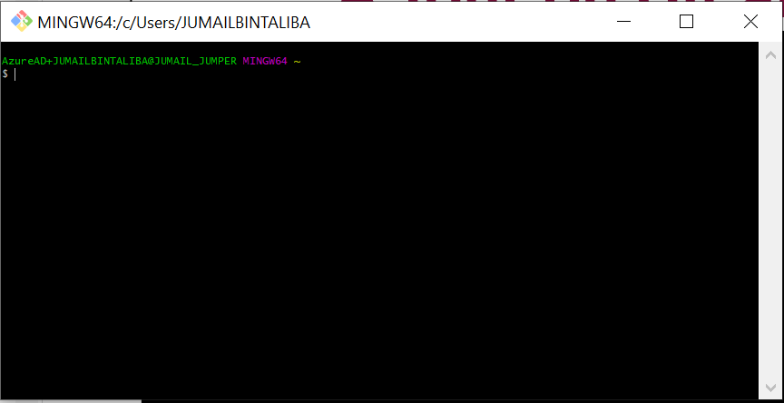
A Tour on Git and Git Bash

Slide 24
Common Unix Commands
Git basics »
Move to a directory and check out the content
$
cd c:/
$
ls
Create a new directory
$ mkdir c:/code
$ mkdir c:/code/flutter
$
cd c:/code/flutter
Create a new file
$
touch readme.txt

Slide 25
What is GIT ?
A distributed Versioning Control System (VCS)
Local Repository #1
Local Repository #3
Remote Repository
e.g. github, bitbucket, gitlab
Local Repository #4
Local Repository #2
Git provides a collection of tools to manage versioning of your project

Slide 26
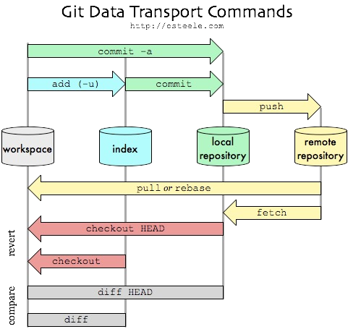
What is GIT ?
From a local repo’s perspective

Slide 27
Example Use Case
Git by examples»
Clone the starter project .
$ git clone http://github.com/jumail- utm/flutter_logo.git flutter_logo
This command will download my repo on github to your local machine

Slide 28
See what’s inside the repo
Git by examples»
$
cd flutter_logo
$
git log
$
git log --oneline
git log will show a list of commits have been done on the repo
Open and run the program in vs code
$
code .

Slide 29
Git by examples»
Checking out snapshot
$ git log --oneline
$ git checkout <commit_hash>
$ git checkout master
Modifying for your own work in a new branch
$
git checkout <commit_hash> -b my_branch

Slide 30
Git by examples»
Create a readme.txt file.
$
touch readme.txt
$
code readme.txt
Check your repo’s status
$
git status
Set the newly created readme.txt file so that it is traceable
$
git add readme.txt

Slide 31
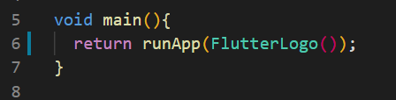
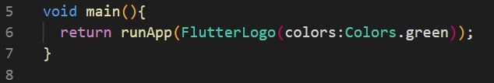
Git by examples»
Commit your update to your local repo
$
git commit –a –m “Update 1: Add a readme.txt”
Continue other tasks and perform a commit for each task, e.g.
$
git commit –a –m “Task 1: Add a flutter logo”
$ git commit –a –m “Task 2: Change color”

Slide 32
Git by examples»
List all branches
$
git branch –a
Go back to master branch
$
git checkout master

Slide 33
Git by examples »
Creating Your own Repository
Create a starter project using the flutter template project
$
cd c:/code/flutter
$
flutter create flutter_counter
$
cd flutter_counter
Create a repo for this project
$
git init
$
git status
$
git add .
$
git commit –a -m “My first commit”
To make changes to the last commit
$
git add .
$
git commit --amend

Slide 34
Pushing to Remote Repo
Git by examples »
Login to github.com with your own account
Create a new public repository on github.com, named flutter_counter
Back to your git bash (command line)
$
git remote add origin https://github/your-
username/flutter_counter.git
$
git push –u origin master

Slide 35
Sharing Offline
Git by examples »
To share a git repo without going through a remote repo, use git bundle.
To create a bundle (e.g., in user1’s PC):
user1$
git bundle build/flutter_counter.git HEAD master
Then share the bundle file by any mean, e.g. copying it to a pen-drive. The file should be inside the build directory
In another pc (e.g. user2’s ) copy the the bundle file and create a clone from it
user2$ git clone flutter_counter.git flutter_counter

Slide 36
Git Resources
https://app.pluralsight.com/course- player?clipId=139ae6dd-af56-45a5-aa4f- 9924129ef340
https://www.tutorialspoint.com/git

