Slide 1
Mobile Application Programming
Project Requirements & Information

Slide 2
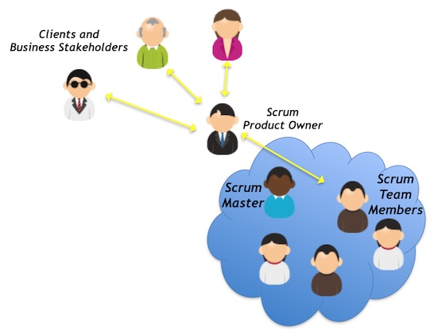
Build Your SCRUM Team
Product Backlogs & User Stories
Mockup
Functional & Non-Functional Testing
Scrum Master
Product Owner
Developers
Cross section is NOT allowed
PMC – plan, monitor, control
Back-end developer
System administrator
Front-end developer
Unit Testing

Slide 3
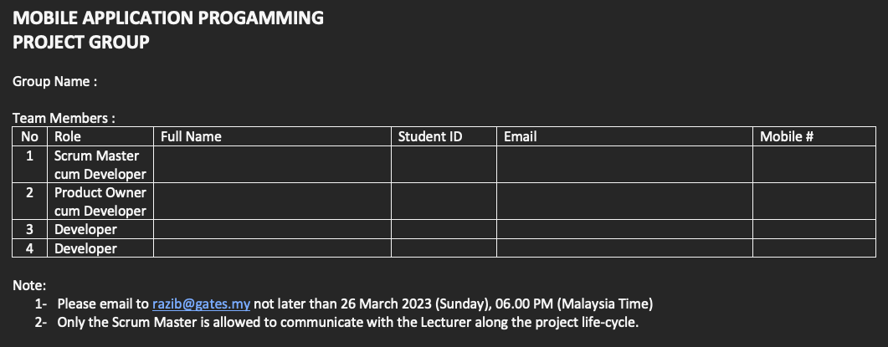

Slide 4
Project Specifications
Working on a real-world problem. You will need to gather requirements from actual users in the actual environment / workplace / domain.
The application you will be developing in this project must be a mobile app.
Regarding this, you will need to develop a front-end application (using Flutter) and a backend (using Firebase).
The application will serve at least two types of users. For example, for an online shopping application, the users can be the buyers and sellers.
Adopting at least BLoC pattern.
Following the SCRUM methodology for the project management.
Using GitHub for the version control system.
The application shall have the following epics:
  Sprint#1 - Login and logout
  Sprint#1 - Register and forgot password
  Sprint#1 - User profile
  Sprint#2 & 3 - CRUD of 2 processes, for example: product browsing, cart
  Sprint#4 - Reporting, for example sales order report
  Sprint#4 - Add-on Features, for example share, notification

Slide 5
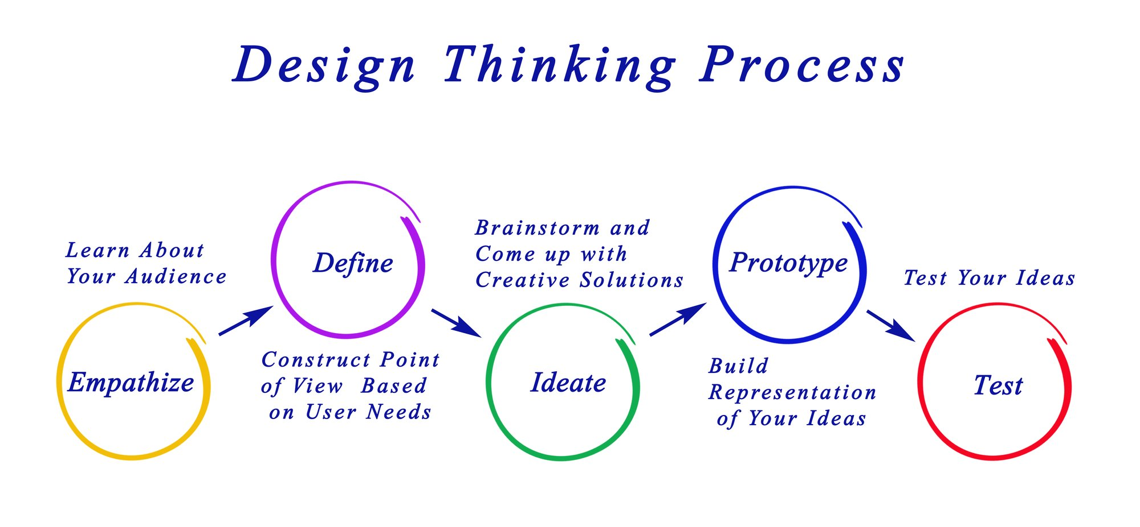
Start Your Project with Design Thinking Approach
Lean Biz Canvas
Project Pitching
Week 1
Week 2 & 3

Slide 6
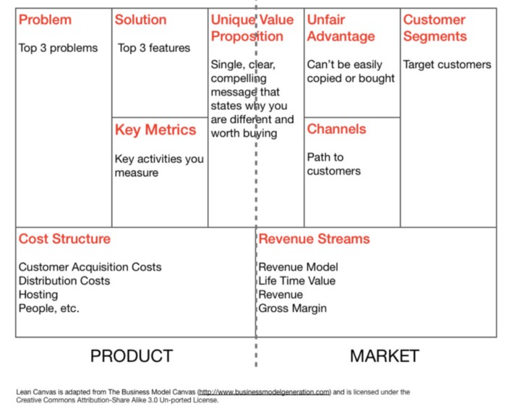
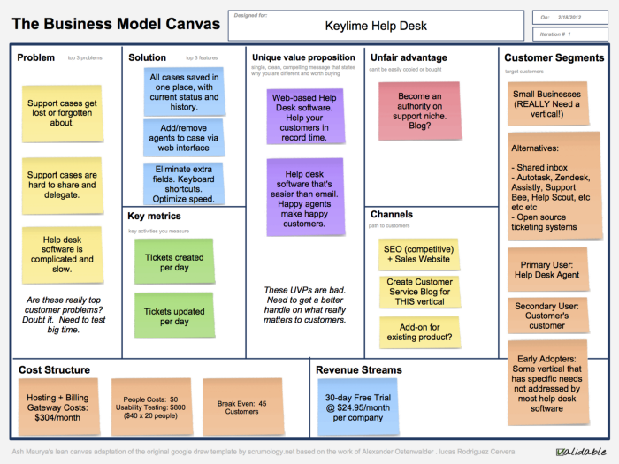
LEAN BUSINESS CANVAS
https://medium.com/@steve_mullen/an-introduction-to-lean-canvas-5c17c469d3e0

Slide 7
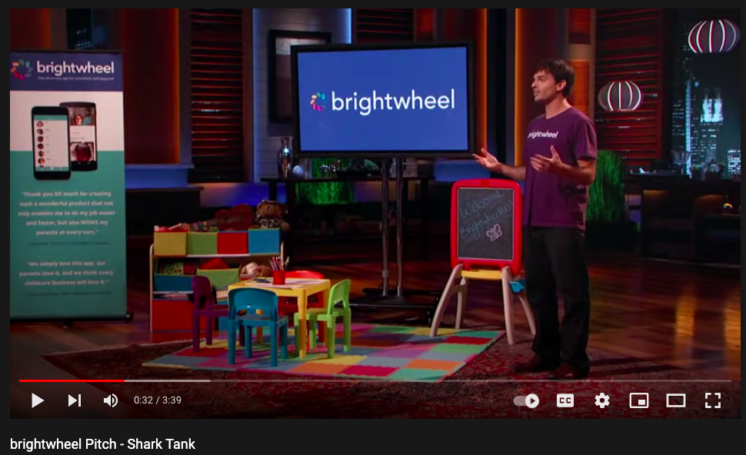
PROJECT PITCHING
Problem
Solution
Unique Value Proposition
Mockup Demonstration
SHARK TANK
https://www.youtube.com/watch?v=5iKitGJeAZ4
https://www.youtube.com/watch?v=yjyhXKOq0Jg&t=26s
https://www.youtube.com/watch?v=gCmTj2xOK6E

Slide 8
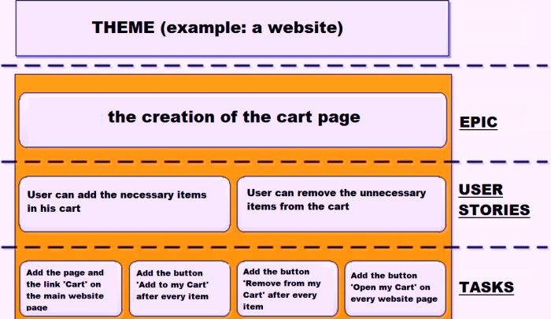
THEME, EPIC, USER STORY & TASK
CARDS
https://www.youtube.com/watch?v=ogV2r9579WI
https://www.youtube.com/watch?v=B_xQKX_x5Hs

Slide 9
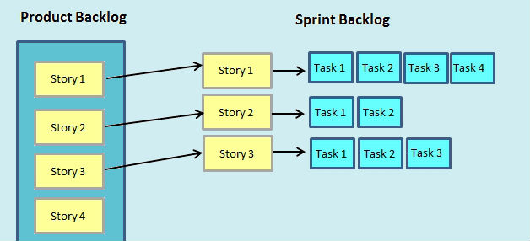
PRODUCT BACKLOG & SPRINT BACKLOG
Sprint #1 = minimum viable product
https://www.youtube.com/watch?v=jB3O-1AR7sM
https://www.youtube.com/watch?v=1hHMwLxN6EM
… more stories

Slide 10
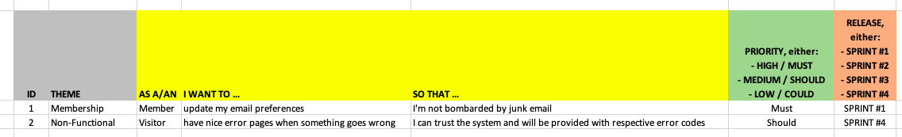
PRODUCT BACKLOG

Slide 11
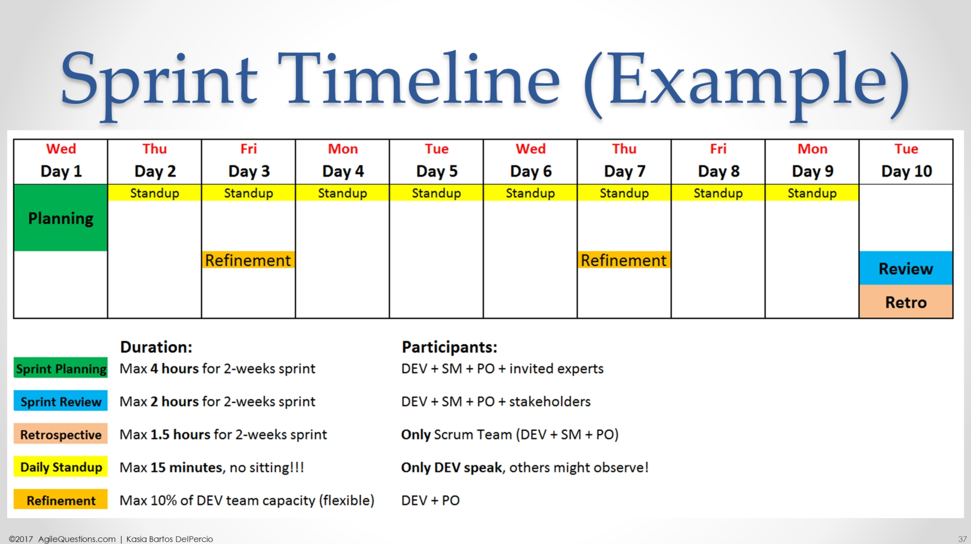
Using TRELLO or JIRA

Slide 12
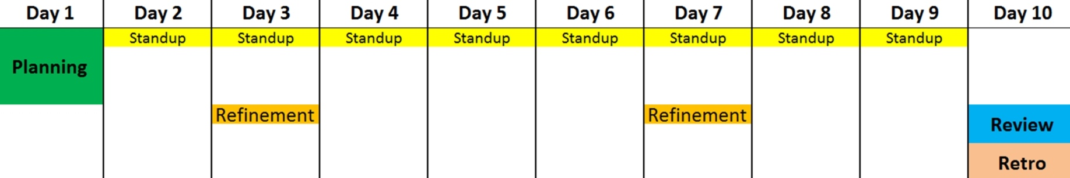
TRELLO or JIRA
Sprint Backlog
User Stories
Video-Record
Note of Discussion
Conduct Performance & Security Testing by SM
Conduct Testing Session with Client
Lead by SM
Lead by PO
Lead by PO
Lead by PO
Lead by SM
Monitoring by SM:
Burndown chart
GITHub or GITLab
Internal Testing by PO

Slide 13
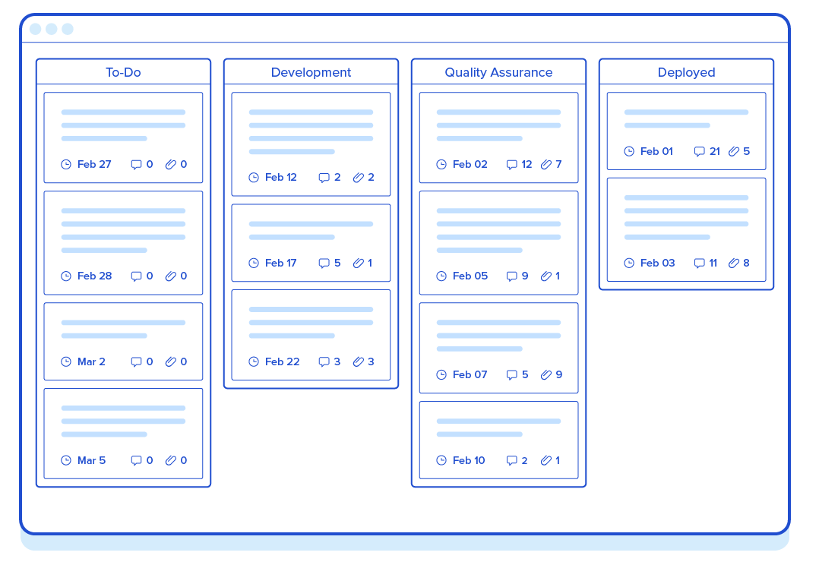
KANBAN
To-Do (Sprint Backlog) - feature is waiting for development
Development (In-Progress) - feature is assigned to a developer and he/she is working on it
Quality Assurance (Review) - feature is in review
Deployed (Completed) - feature is accepted and included in application release

Slide 14
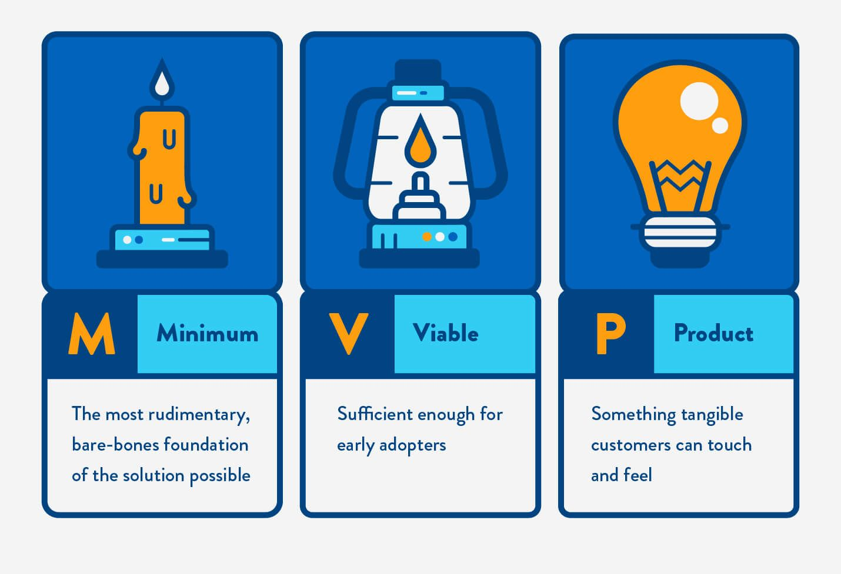
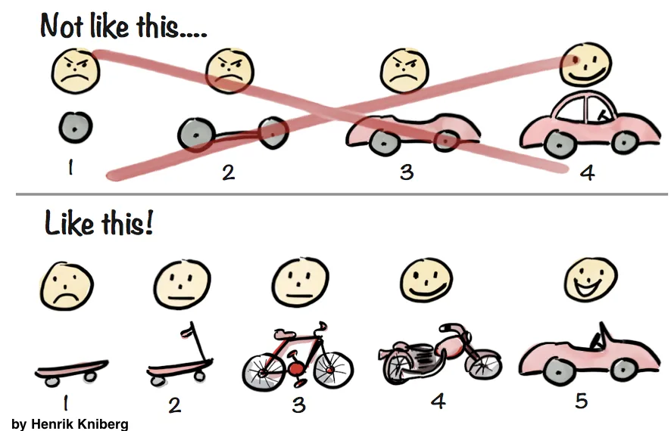
Release on Each Sprint a Minimum Viable Product

Slide 15
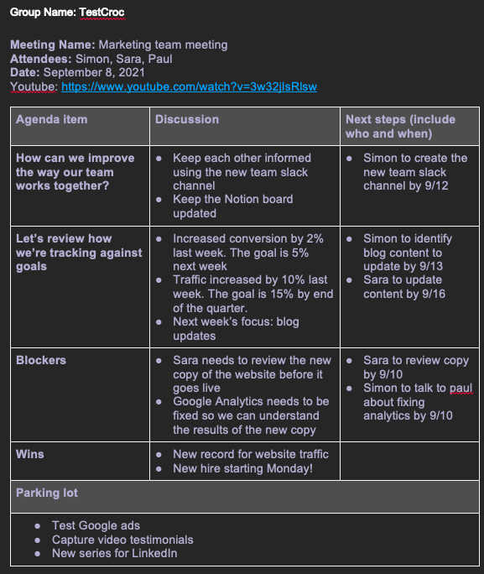
NOTE OF DISCUSSION
(NOD)
Video-record all discussions
Upload to Youtube
Provide link in the NOD
5 NODs from:
  Preparation of Lean Business Canvas, Project Pitching & Product Backlog
  Sprint #1
  Sprint #2
  Sprint #3
  Sprint #4

Slide 16
PROJECT DELIVERABLES
ARTIFACTS | Submission / Presentation Date
Project Group Information | Before Mid Term Exam
Lean Business Canvas
3-Min Project Pitching | Before Mid Term Exam
Product Backlog | Before Final Exam
Sprint Presentation
10-Min App Demo 30-Sec Product Video Digital Poster

