Slide 1
Introduction to JAVA Programming Language
Lecture 2
Based on Slides of Dr. Norazah Yusof

Slide 2
Origins of the Java Language
Java was created by Sun Microsystems team led by Patrick Naughton and James Gosling (1991)
Originally named Oak (Gosling liked the look of an oak tree that was right outside his window at Sun)
Intended to design a small computer language that could be used for consumer devices/appliances such as the cable TV switchboxes.
  It is a difficult task because these devices do not have a lot of power or memory, the language had to be small and generate very tight code. Also, because different manufacturers may choose different central processing units (CPUs), it was important that the language not be tied to any single architecture.
The team developed a two-step translation process to simplify the task of compiler writing for each class of appliances

Slide 3
Origins of the Java Language
Significance of Java translation process
  Writing a compiler (translation program) for each type of appliance processor would have been very costly
  Instead, developed intermediate language that is the same for all types of processors : Java byte-code
  Therefore, only a small, easy to write program was needed to translate byte-code into the machine code for each processor

Slide 4
Origins of the Java Language
Patrick Naughton and Jonathan Payne at Sun Microsystems developed a Web browser that could run programs over the Internet (1994) and evolved into the HotJava browser.
  Beginning of Java's connection to the Internet
  To show off the power of applets, they made the browser capable of executing code inside web pages.
Netscape Incorporated made its Web browser capable of running Java programs (1995)
  Other companies follow suit

Slide 5
The Java Language
Java is a full-featured, general-purpose programming language that is capable of developing robust mission-critical applications.
Today it is used for developing stand alone applications, desktops, web programming, servers, and mobile devices.
  Java can be run on the web browser called the applets.
  Java can also be used to develop applications on the server side, called Java servlets or Javaserver pages (JSP)
  Java can be used to develop applications for small hand-held devices, such as personal digital assistants and cell phones.

Slide 6
The Java Language Specification
Java language specification defines the Java standard and the technical definition of the language that includes the syntax and semantics of the Java programming language.
  stable
Java application program interface (API) contains predefined classes and interfaces for developing Java programs.
  Still expanding

Slide 7
Java API
Java 1.0 was introduced in 1995.
December 1998, Sun announced the Java 2 platform – the brand that applies to current Java technology.
There are 3 editions of the Java API:
  Java 2 standard edition (J2SE)
    client-side standalone applications or applets
  Java 2 Enterprise Edition (J2EE)
    server-side applications, such as Java servlets and JavaServer Pages
  Java 2 Micro Edition (J2ME)
    mobile devices, such as cell phones

Slide 8
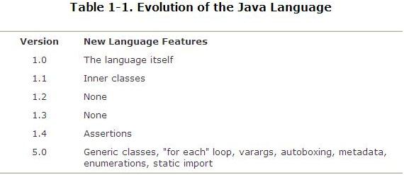
Java Language

Slide 9
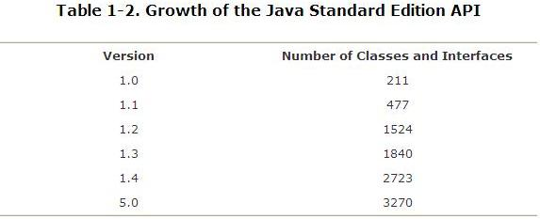
Java API

Slide 10
J2SE version
There are many versions of J2SE.
The latest version is J2SE 6.0.
Sun releases each version of J2SE with a Java Development toolkit (JDK)
For J2SE 5.0, the Java development toolkit is called JDK 5.0 – formerly was known as JDK1.5
JDK consists of a set of separate programs for developing and testing Java programs, each of which is invoked from a command line.

Slide 11
Java Development Tools
Java development tool is a software that provides an integrated development environment (IDE) for rapidly developing Java programs.
Other Java development tools on the market (besides JDK 5.0):
  JBuilder by Borland
  NetBeans Open Source by Sun
  Eclipse Open Source by IBM
Other useful tools:
  Code warrior by Metrowerks
  TextPad Editor
  JCreator LE
  JEdit
  JGrasp
  BlueJ
  DrJava

Slide 12
Java Program
Java program can be written in many ways:
  Applications
  Applets
  Servlets

Slide 13
Java Applications
A Java applications or "regular" Java programs are standalone programs that can be executed from any computer with a JVM.
It is a class with a method named main
  When a Java application program is run, the run-time system automatically invokes the method named main
  All Java application programs start with the main method

Slide 14
Java Applets
A Java applet (little Java application) is a Java program that is meant to be run from a Web browser
  Can be run from a location on the Internet
  Can also be run with an applet viewer program for debugging
  Applets always use a windowing interface

Slide 15
Java Servlets
A Java servlets are special kind of Java programs that run from a Web server to generate dynamic Web contents.

Slide 16
Objects and Methods in Java
Java is an object-oriented programming (OOP) language
  Programming methodology that views a program as consisting of objects that interact with one another by means of actions (called methods)
  Objects of the same kind are said to have the same type or be in the same class

Slide 17
The Compiler and the Java Virtual Machine
A programmer writes Java programming statements for a program.
These statements are known as source code.
A text editor is used to edit and save a Java source code file.
Source code files have a .java file extension.
A compiler is a program that translates source code into an executable form.

Slide 18
The Compiler and the Java Virtual Machine
A compiler is run using a source code file as input.
Syntax errors that may be in the program will be discovered during compilation.
Syntax errors are mistakes that the programmer has made that violate the rules of the programming language.
The compiler creates another file that holds the translated instructions.

Slide 19
Byte-Code and the Java Virtual Machine (JVM)
The compilers for most programming languages translate high-level programs directly into the machine language for a particular computer
  Since different computers have different machine languages, a different compiler is needed for each one
In contrast, the Java compiler translates Java programs into byte-code, a machine language for a fictitious computer called the Java Virtual Machine
  Once compiled to byte-code, a Java program can be used on any computer, making it very portable

Slide 20
The Compiler and the Java Virtual Machine
Byte code files end with the .class file extension.
The JVM is a program that emulates a micro-processor.
The JVM executes instructions as they are read.
JVM is often called an interpreter.
Java is often referred to as an interpreted language.

Slide 21
Program Development Process
Text editor
Saves Java statements
Source code
(.java)
Is read by
Byte code
(.class)
Java compiler
Produces
Is interpreted by
Program
Execution
Java
Virtual
Machine
Results in

Slide 22
Portability
Portable means that a program may be written on one type of computer and then run on a wide variety of computers, with little or no modification.
Java byte code runs on the JVM and not on any particular CPU; therefore, compiled Java programs are highly portable.
JVMs exist on many platforms:
Windows
Macintosh
Linux
Unix
BSD
Etc.

Slide 23
Portability
With most programming languages, portability is achieved by compiling a program for each CPU it will run on.
Java provides an JVM for each platform so that programmers do not have to recompile for different platforms.

Slide 24
Portability
Byte code
(.class)
Java Virtual
Machine for Windows
Java Virtual
Machine for Unix
Java Virtual
Machine for Linux
Java Virtual
Machine for Macintosh

