Slide 1
Anatomy of a Java Program
Lecture 3
Based on Slides of Dr. Norazah Yusof

Slide 2
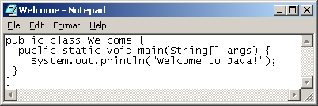
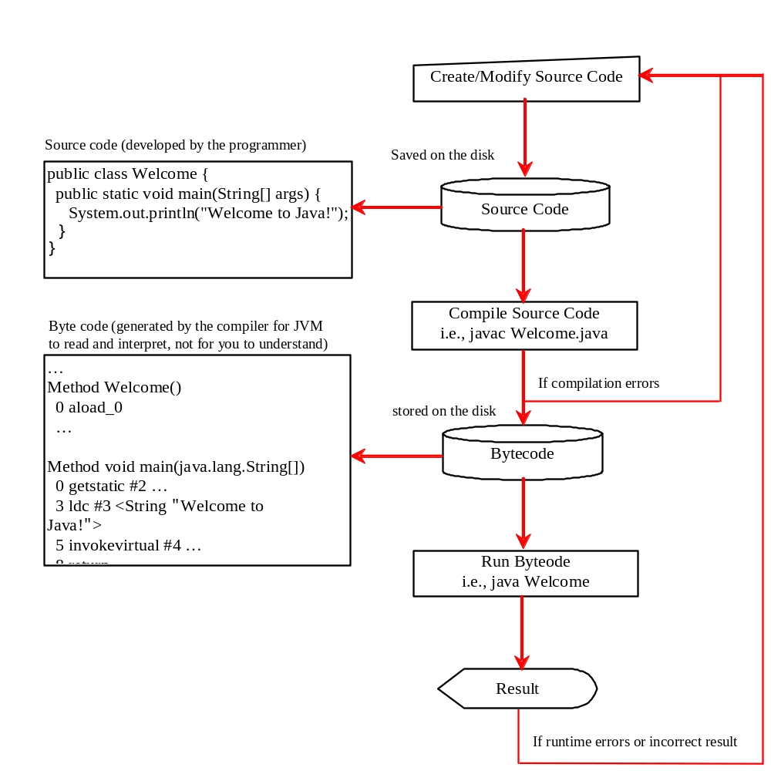
Creating, Compiling, and Running Programs

Slide 3
Parts of a Java Program
A Java source code file contains one or more Java classes.
If more than one class is in a source code file, only one of them may be public.
The public class and the filename of the source code file must match.
    ex: A class named HelloApp must be in a file named HelloApp.java
Each Java class can be separated into parts.

Slide 4
Parts of a Java Program
Example: HelloApp.java
To compile the example:
  javac HelloApp.java
    Notice the .java file extension is needed.
    This will result in a file named HelloApp.class being created.
To run the example:
  java HelloApp
    Notice there is no file extension here.
    The java command assumes the extension is .class.
Department of Software Engineering, FSKSM, UTM.

Slide 5
Analyzing the Example
This is a Java comment. It is ignored by the compiler.
// This is my first Java program.
This is the class header
for the class HelloApp
public class HelloApp
{
}
This area is the body of the class HelloApp.
All of the data and methods for this class
will be between these curly braces.

Slide 6
Analyzing the Example
// This is my first Java program.
This is Java main method. Every Java application must have a main method
public class HelloApp
{
}
public static void main(String [] args)
{
}
This area is the body of the main method.
All of the actions to be completed during
the main method will be between these curly braces.

Slide 7
Analyzing the Example
// This is my first Java program.
public class HelloApp
{
}
public static void main(String [] args)
{
}
System.out.println("Programming is great fun!");
This is the Java Statement that
is executed when the program runs.

Slide 8
Anatomy of a Java Program
Comments
Keywords
Modifiers
Statements
Blocks
Classes
Methods
The main method
Package

Slide 9
Comments
Help the programmers to communicate and understand the program.
Not a programming statement, thus ignored by the compiler.
Preceded with // on a line
Enclosed between /* and */ on one or several lines.

Slide 10
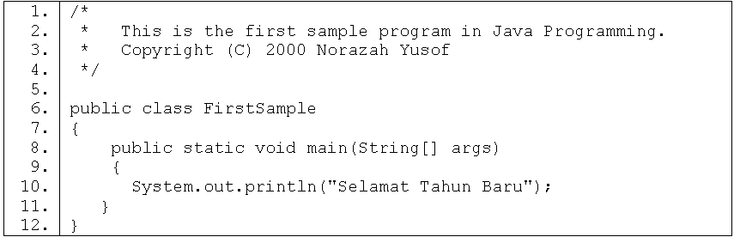
Comments on several lines

Slide 11
Key Words
Words that have a specific meaning to the compiler
Key words in the sample program are:
Key words are lower case (Java is a case sensitive language).
Key words cannot be used as a programmer-defined identifier.
  public
  class
  static
  void
  int
  double
  boolean
  continue
  return
  private
  protected
  package
(See Appendix A, “Java Keywords” from your textbook)

Slide 12
Java reserved keywords
abstract
boolean
break
byte
case
catch
char
class
const
continue
default
do
double
else
extends
final
finally
float
for
goto
if
implements
import
instanceof
int
interface
long
native
new
package
private
protected
public
return
short
static
strictfp
super
switch
synchronized
this
throw
throws
transient
try
void
volatile
while

Slide 13
Modifiers
Specify the properties of the data, methods, and classes and how they can be used.
Example of modifiers:
  public – data, method or class can be accessed by other classes.
  private – data, method or class cannot be accessed by other classes.
  protected
  final
  static
  abstract

Slide 14
Example:
public class ClassA {
public static void main (String[] args) {
System.out.println ("Try your best");
}
}

Slide 15
Statements
represents an action or a sequence of actions.
Example of statement:
System.out.println("Welcome to Java!")
is a statement to display the greeting
"Welcome to Java!"
Every statement in Java ends with a semicolon (;).

Slide 16
Blocks
Groups the components of the program using the braces { and } in the program.
Every class has a class block that groups the data and the methods of the class.
Every method has a method block that groups the data and the methods of the class.
Block may be nested, meaning that one block can be placed within another.
public class Test {
public static void main(String[] args) {
Class block
System.out.println("Welcome to Java!");
Method block
}
}

Slide 17
Classes
class is the essential Java construct.
Classes are central to Java
Programming in Java consists of defining a number of classes:
  Every program is a class (A program is defined by using one or more classes.)
  All programmer-defined types are classes

Slide 18
Classes
Example 1:
public class ClassA {
public static void main (String[] args) {
System.out.println ("Try your best");
}
}

Slide 19
Classes
Example 2: Program named ClassA.java below has two classes i.e. ClassA and ClassB.
public class ClassA {
private int yearborn=1988;
public String methodA() { return "Aim High"; }
public int getYearBorn() { return yearborn; }
}
class ClassB {
public static void main (String[] args) {
ClassA obj1 = new ClassA();
System.out.println (“Your age: “ + (2009 - obj1.getYearBorn()));
System.out.println (“My message: “ + obj1.methodA());
}
}

Slide 20
Methods
A collection of statements that performs a sequence of operations.
Contained in a class.
If a method is intended to be used to communicate with or pass information to an object, it should be declared public.
Example: Method println() is an instance method that belongs to an object instance and is applied to an object (System.out).

Slide 21
Methods
methodA is a class method in ClassA. public modifier indicates it can be accessed from anywhere.
String indicates it return a value of String.
getYearBorn is a class method in ClassA. public modifier indicates it can be accessed from anywhere.
int indicates it return a value of type integer.
Example:
public class ClassA {
private int yearborn=1988;
public String methodA() { return "Aim High"; }
public int getYearBorn() { return yearborn; }
}
class ClassB {
public static void main (String[] args) {
ClassA obj1 = new ClassA();
System.out.println (“Your age: “ + (2009 - obj1.getYearBorn()));
System.out.println (“My message: “ + obj1.methodA());
}
}
getYearBorn method is invoked from instance of the class, obj1.
main method is in ClassB.
methodA method is invoked from instance of the class, obj1.
create an instance of a class.

Slide 22
main Method
Every Java application must have a main method that is declared in the following way:
public class ClassName
{
public static void main(String[] args) {
// Statements;
}
}
This is the parameter of the main method. It takes arguments of an array of Strings. The data type String starts with an upper case S. The square brackets indicate an array.
Keyword void indicates the data type returned from this method is nothing or no value.
The main method in Java is always static, meaning that this method can be run without creating an instance of the class.
This method is public, i.e. visible from anywhere that can see this class.

Slide 23
Command-Line Arguments
C:\norazah> javac Greetings.java
C:\norazah> java Greetings Aqilah Ahmad
Hello, Aqilah Ahmad
Command-line arguments are passed to main
as an array of Strings.
public class Greetings
{
public static void main(String[] args)
{
String firstName = args[ 0 ];
String lastName = args[ 1 ];
System.out.println("Hello, " + firstName + " " + lastName);
}
}
Notes:
Command-line arguments are not specific to Java: C and C++ have them, as well as other languages under Unix, MS-DOS, etc. In Windows, use the Command Prompt application.
The Java source file name is a command-line argument for javac. Likewise, the HTML file name is a command-line argument for appletviewer.

Slide 24
Libraries
Java programs are usually not written from scratch.
There are hundreds of library classes for all occasions.
Library classes are organized into packages. For example:
  java.util — miscellaneous utility classes
  java.awt — windowing and graphics toolkit
  javax.swing — GUI development package
Notes:
Go to Java API docs and examine the list of packages in the upper-left corner. We will mostly use classes from java.lang, java.util, java.awt, java.awt.event, javax.swing, and java.io.

Slide 25
import
Full library class names include the package name. For example:
  java.awt.Color
  javax.swing.JButton
import statements at the top of the source file let you refer to library classes by their short names:
  import javax.swing.JButton;
  ...
  JButton go = new JButton("Go");
Fully-qualified name
Notes:
A package name implies the location of the class files in the package. For example, java.awt.event implies that the classes are in the java/awt/event subfolder. In reality, packages are compressed into .jar files that have this path information for classes saved inside. A .jar file is like a .zip file; in fact, it can be opened with a program that normally reads and creates .zip files (for example, rename x.jar into x.zip).
import is simply a substitution directive that says: Whenever you see JButton, treat it like javax.swing.JButton. No files are moved or included. If you want a parallel to C++, import is more like #define than #include.

Slide 26
import (cont’d)
You can import names for all the classes in a package by using a wildcard .*:
  import java.awt.*;
  import java.awt.event.*;
  import javax.swing.*;
java.lang is imported automatically into all classes; defines System, Math, Object, String, and other commonly used classes.
Imports all classes from awt, awt.event, and swing packages
Notes:
Some programmers do not like .* and prefer to list all imported classes individually. Once the number of library classes used becomes large, this becomes too tedious. It is also harder to change the class: you need to add import statements for each library class added.

Slide 27
Package
Java is a package-centric language; for good organization and name scoping, put all classes into packages.
A class with default access can be seen only by classes within the same package.
If class A and class B are in different packages, and class A has default access, class B won't be able to create an instance of class A, or even declare a variable or return type of class A.

Slide 28
Package
Example: class Sludge and class Goo are both in different packages.
package cert;
public class Sludge {
public void testIt() {
System.out.println("sludge");
}
}
package book;
import cert.*; // Import all classes in the cert package class Goo {
public static void main(String[] args) {
Sludge o = new Sludge();
o.testIt();
}
}

Slide 29
Source File Declaration Rules
A source code file can have only one public class.
If the source file contains a public class, the filename must match the public class name.
A file can have only one package statement, but multiple imports.
The package statement (if any) must be the first (non-comment) line in a source file.
The import statements (if any) must come after the package and before the class declaration.

Slide 30
Source File Declaration Rules (cont.)
If there is no package statement, import statements must be the first (non-comment) statements in the source file
package and import statements apply to all classes in the file.
A file can have more than one nonpublic class.
Files with no public classes can have a name that does not match any of the classes in the file.

