Slide 1
Identifiers and Variables
Lecture 4
Based on Slides of Dr. Norazah Yusof

Slide 2
Identifiers
All the Java components —classes, variables, and methods—need names.
In Java these names are called identifiers, and, there are rules for what constitutes a legal Java identifier.
Beyond what's legal, Java programmers (and Sun) have created conventions for naming methods, variables, and classes.

Slide 3
Rules for naming Identifiers
Identifiers must start with a letter, a currency character ($), or a connecting character such as the underscore ( _ ). Identifiers cannot start with a number!
After the first character, identifiers can contain any combination of letters, currency characters, connecting characters, or numbers.
Identifier can be any length. In practice, there is no limit to the number of characters an identifier can contain.
You can't use a Java keyword as an identifier. (See Appendix A, “Java Keywords,” for a list of reserved words).
Identifiers in Java are case-sensitive; utm and Utm are two different identifiers.
Identifier cannot be true, false or null.

Slide 4
Legal/illegal identifier?
int _a;
int $c;
int 2_w;
int .f;
int -d;
int _$;
int this_is_a_detailed_name_for_identifier;
int :b;
int e#;
int 7g;

Slide 5
Sun's Java Code Conventions
The naming standards that Sun recommends:
Classes and interfaces The first letter should be capitalized, and if several words are linked together to form the name, the first letter of the inner words should be uppercase (a format that's sometimes called "camelCase").
  For classes, the names should typically be nouns. For example:
    Animal
    Account
    PrintWriter
  For interfaces, the names should typically be adjectives like
    Runnable
    Serializable

Slide 6
Sun's Java Code Conventions
Methods The first letter should be lowercase, and then normal camelCase rules should be used.
  In addition, the names should typically be verb-noun pairs. For example:
    getBalance
    doCalculation
    setCustomerName
    calcArea

Slide 7
Sun's Java Code Conventions
Variables Like methods, the camelCase format should be used, starting with a lowercase letter.
Sun recommends short, meaningful names, which sounds good to us. Some examples:
  nama
  buttonWidth
  accountBalance
  myString

Slide 8
Sun's Java Code Conventions
Constants Java constants are created by marking variables static and final.
They should be named using uppercase letters with underscore characters as separators:
  MIN__HEIGHT

Slide 9
Programming Style and Documentation
Appropriate Comments
Naming Conventions
Proper Indentation and Spacing Lines
Block Styles

Slide 10
Appropriate Comments
Include a summary at the beginning of the program to explain what the program does, its key features, its supporting data structures, and any unique techniques it uses.
Include your name, class section, instructor, date, and a brief description at the beginning of the program.

Slide 11
Proper Indentation and Spacing
Indentation
  Indent two spaces.
Spacing
  Use blank line to separate segments of the code.

Slide 12

Block Styles
Use end-of-line style for braces.

Slide 13
Variables
Variables are used to store data in a program.
There are two types of variables in Java:
  Primitives
  Reference variables

Slide 14
Primitives Variables
A primitive can be one of eight types: char, boolean, byte, short, int, long, double, or float.
Once a primitive has been declared, its primitive type can never change, although in most cases its value can change.
Primitive variables can be declared as class variables (statics), instance variables, method parameters, or local variables.
One or more primitives, of the same primitive type, can be declared in a single line.
Examples of primitive variable declarations:
  i. char huruf;
  ii. boolean myBooleanPrimitive;
  iii. int x, y, z; // declare three int primitives
  iv. double area;

Slide 15
Declaring primitive type
Example of declaring Java variables with primitive types
    int numberOfBeans;
    double oneWeight, totalWeight;
The declaration of a variable can be combined with its initialization via an assignment statement
    int count = 0;
    double distance = 55 * .5;
    char grade = 'A';
Note that some variables can be initialized and others can remain uninitialized in the same declaration
  int initialCount = 50, finalCount;

Slide 16
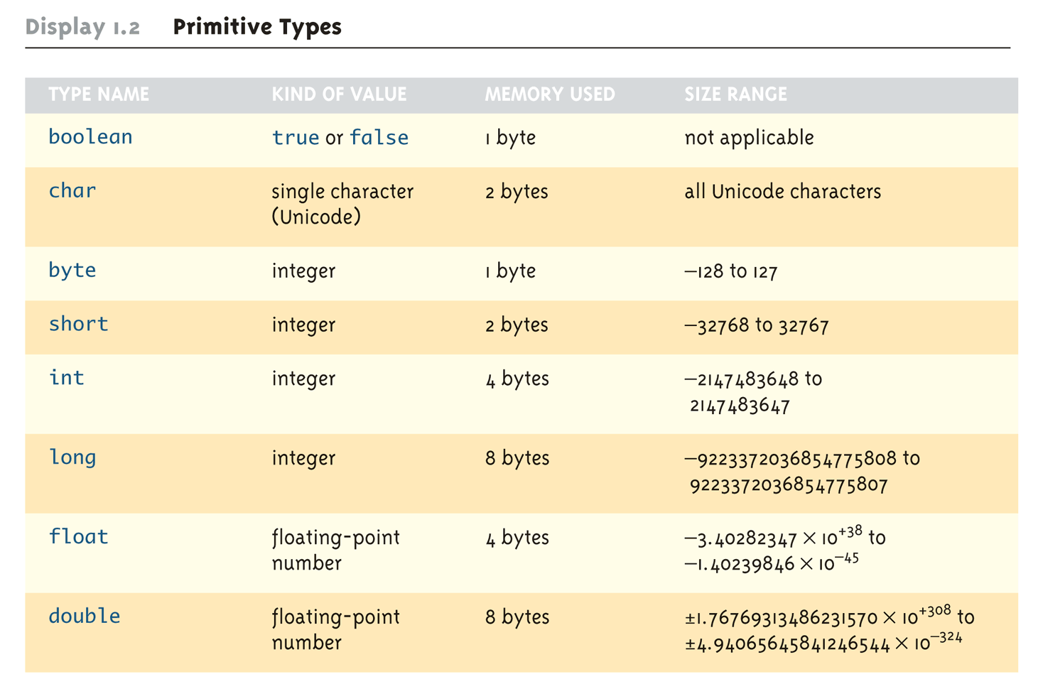

Slide 17
Reference Variables
A reference variable is used to refer to (or access) an object.
A reference variable is declared to be of a specific type and that type can never be changed.
A reference variable can be used to refer to any object of the declared type, or of a subtype of the declared type (a compatible type).
Reference variables can be declared as static variables, instance variables, method parameters, or local variables.
One or more reference variables, of the same type, can be declared in a single line.
Examples of reference variable declarations:
i. Object o;
ii. Animal myNewPetReferenceVariable;
iii. String s1, s2, s3; //declare three String vars.

Slide 18
Instance Variables
Instance variables are defined inside the class, but outside of any method, and are only initialized when the class is instantiated.
Instance variables are the fields that belong to each unique object.
For example, the following code defines fields (instance variables) for the radius of circle objects:
Each circle instance will know its own radius. In other words, each instance can have its own unique values for this field.
The term "field," "instance variable," "property," or "attribute," mean virtually the same thing.
public class Circle extends Object //Class header
{
private double radius;

Slide 19
Local Variables
Local variables are variables declared within a method.
That means the local variable starts its life inside the method, it's also destroyed when the method has completed.
Local variables are always on the stack, not the heap.
Although the value of the variable might be passed into, say, another method that then stores the value in an instance variable, the variable itself lives only within the scope of the method.
Before a local variable can be used, it must be initialized with a value. For example:
class TestServer {
public void logIn() {
int count = 10;
}
}

Slide 20
Local Variables
Local variable declarations can't use most of the modifiers that can be applied to instance variables, such as public (or the other access modifiers private, protected), transient, volatile, abstract, or static.
But local variables can be marked final.

Slide 21
Local Variables
A local variable can't be referenced in any code outside the method in which it's declared.
For example,
It would be impossible to refer to the variable count anywhere else in the class except within the scope of the method logIn().
However, the value of count can be passed out of the method to take on a new life.
class TestServer {
public void logIn() {
int count = 10;
}
public void doSomething(int i) {
count = i; // Won't compile! Can't access
// count outside method login()
}
}

Slide 22
Local Variables
It is possible to declare a local variable with the same name as an instance variable. It's known as shadowing, as the following code demonstrates:
public class TestServer {
int count = 9; //An instance variable named count
public void logIn(){
int count = 10; // A local variable named count
System.out.println("local variable count is "
+ count);
}
public void count () {
System.out.println("instance variable count is "
+ count);
}
public static void main(String[] args) {
new TestServer().logIn();
new TestServer().count();
}
}

Slide 23
Local Variables
The code produces the following output:
local variable count is 10
instance variable count is 9

Slide 24
Final Variables
Declaring a variable with the final keyword makes it a constant.
Constant represent permanent data that never changes.
For primitives, this means that once the variable is assigned a value, the value can't be altered.
Syntax to declare a constant:
final datatype CONSTANTNAME = VALUE;
5. Example:
final double PI = 3.14159; //PI as constant
final int SIZE = 3;

Slide 25
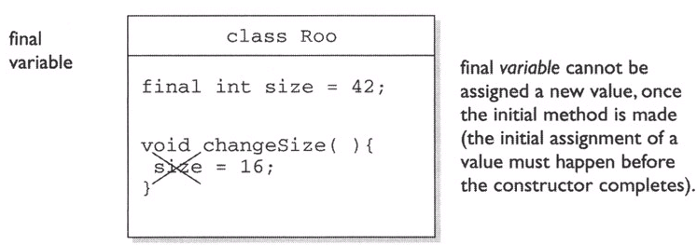
Final Variables (Is it legal?)
class Roo {
final int size = 42;
public void changeSize() {
size = 16;
}
}

Slide 26
Final Variables
A reference variable marked final can't ever be reassigned to refer to a different object.
The data within the object can be modified, but the reference variable cannot be changed.
In other words, a final reference still allows you to modify the state of the object it refers to, but you can't modify the reference variable to make it refer to a different object.

Slide 27
Variable scoping
Once a variable is declared and initialized, a natural question is "How long will this variable be around?"
public class Layout { // class
static int s = 343; // static variable
int x; // instance variable
{ x = 7;
int x2 = 5; } // initialization block
public Layout() {
x += 8;
int x3 = 6;} // constructor
public void doStuff() { // method
int y = 0; // local variable
for(int z = 0; z < 4; z++) { // 'for' code block
y += z + x; }
}
}

Slide 28
Variable scoping
s is a static variable.
x is an instance variable.
y is a local variable (sometimes called a "method local" variable).
z is a block variable.
x2 is an init block variable, a flavor of local variable.
x3 is a constructor variable, a flavor of local variable.

Slide 29
Variable scoping
There are four basic scopes:
  1. Static variables have the longest scope; they are created when the class is loaded, and they survive as long as the class stays loaded in the JVM.
  2. Instance variables are the next most long-lived; they are created when a new instance is created, and they live until the instance is removed.
  3. Local variables are next; they live as long as their method remains on the stack. As we'll soon see, however, local variables can be alive, and still be "out of scope".
  4. Block variables live only as long as the code block is executing.

Slide 30
Scoping errors
One common mistake happens when a variable is shadowed and two scopes overlap.
  1. Attempting to access an instance variable from a static context (typically from main() ).
  2. Attempting to access a local variable from a nested method.
  3. Attempting to use a block variable after the code block has completed

Slide 31
Scoping errors
One common mistake happens when a variable is shadowed and two scopes overlap.
  1. Attempting to access an instance variable from a static context (typically from main() ).
  Example:
class ScopeErrors1 {
int x = 5;
public static void main(String[] args) {
x++; // won't compile, x is an 'instance' variable
}
}

Slide 32
Scoping errors
  2. Attempting to access a local variable from a nested method.
  Example:
public class ScopeErrors2 {
public static void main(String [] args) {
ScopeErrors s = new ScopeErrors();
s.go() ; }
void go() {
int y = 5;
go2() ;
y++; // once go2() completes, y is back in scope }
void go2() {
y++; // won't compile, y is local to go()
}
}

Slide 33
Scoping errors
  3. Attempting to use a block variable after the code block has completed.
  Example:
void go3() {
for(int z = 0; z < 5; z++) {
boolean test = false;
if(z == 3) { test = true; break;
}
} System.out.print(test); // 'test' is an ex-variable,
// it has ceased to be...}

