Slide 1
String, Scanner and JOptionPane class
Lecture 6
Based on Slides of Dr. Norazah Yusof

Slide 2
The String Class
Java has no primitive data type that holds a series of characters.
The String class from the Java standard library is used for this purpose.
In order to be useful, the a variable must be created to reference a String object.
  String name;
Notice the S in String is upper case.
By convention, class names should always begin with an upper case character.

Slide 3
String Objects
A variable can be assigned a String literal.
  String ucapan1 = “Selamat”;
Strings are the only objects that can be created in this way.
A variable can be created using the new keyword.
  String ucapan2 = new String(“Sejahtera”);
This is the method that all other objects must use when they are created.

Slide 4
String Objects
Example:
public class StringDemo {
public static void main(String[] args) {
String ucapan1 = "Selamat";
String ucapan2 = new String("Sejahtera");
System.out.print(ucapan1+" ");
System.out.println(ucapan2);
}
}

Slide 5
Reference Variables
Objects are not stored in variables, however. Objects are referenced by variables.
When a variable references an object, it contains the memory address of the object’s location.
Then it is said that the variable references the object.
  String cityName = "Johor Bahru";
The object that contains the
character string “Johor Bahru”
Johor Bahru
cityName
Address to the object

Slide 6
The String Methods
Since String is a class, objects that are instances of it have methods.
One of those methods is the length method.
  int stringSize;
  stringSize = value.length();
This statement runs the length method on the object pointed to by the value variable.

Slide 7
The String Method: length()
Example:
public class StringDemo1 {
public static void main(String[] args) {
String ucapan = "Selamat Datang";
String nama = "Farhana";
int saizRentetan;
saizRentetan = ucapan.length();
System.out.println("Panjang "+ucapan+" ialah "
+saizRentetan+" perkataan.");
saizRentetan = nama.length();
System.out.println("Panjang "+nama+" ialah "
+saizRentetan+" perkataan.");
}
}

Slide 8
String Methods
The String class contains many methods that help with the manipulation of String objects.
String objects are immutable, meaning that they cannot be changed.
Many of the methods of a String object can create new versions of the object.
See example: StringMethods.java

Slide 9
The String Method: toLowerCase(), toUpperCase() and charAt()
Example:
public class StringDemo2 {
public static void main(String[] args) {
String tempat = "Johor Bahru";
String upper = tempat.toUpperCase();
String lower = tempat.toLowerCase();
char huruf = tempat.charAt(2);
int saizRentetan = tempat.length();
System.out.println(tempat);
System.out.println(upper);
System.out.println(lower);
System.out.println(huruf);
System.out.println(saizRentetan);
}
}

Slide 10
The Scanner Class
To read input from the keyboard we can use the Scanner class.
The Scanner class is defined in java.util, so we will use the following statement at the top of our programs:
import java.util.Scanner;

Slide 11
The Scanner Class
Scanner objects work with System.in
To create a Scanner object:
Scanner keyboard = new Scanner (System.in);
Based on Java API, list the Scanner class methods?

Slide 12
The JOptionPane Class
The JOptionPane class is not automatically available to your Java programs.
The following statement must be before the program’s class header:
  import javax.swing.JOptionPane;
This statement tells the compiler where to find the JOptionPane class.

Slide 13
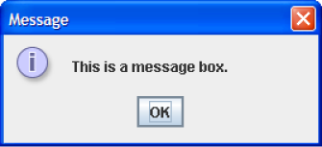
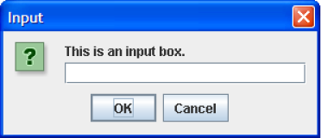
The JOptionPane Class
The JOptionPane class provides methods to display each type of dialog box.

Slide 14
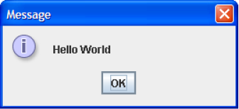
Message Dialogs
JOptionPane.showMessageDialog method is used to display a message dialog.
  JOptionPane.showMessageDialog(null, "Hello World");
The first argument will be discussed in Chapter 7.
The second argument is the message that is to be displayed.

Slide 15
Input Dialogs
An input dialog is a quick and simple way to ask the user to enter data.
The dialog displays a text field, an Ok button and a Cancel button.
If Ok is pressed, the dialog returns the user’s input.
If Cancel is pressed, the dialog returns null.

Slide 16
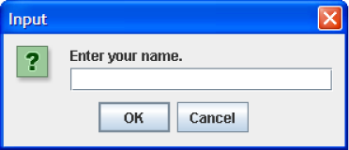
Input Dialogs
  String name;
  name = JOptionPane.showInputDialog(
  "Enter your name.");
The argument passed to the method is the message to display.
If the user clicks on the OK button, name references the string entered by the user.
If the user clicks on the Cancel button, name references null.

Slide 17
The System.exit Method
A program that uses JOptionPane does not automatically stop executing when the end of the main method is reached.
Java generates a thread, which is a process running in the computer, when a JOptionPane is created.
If the System.exit method is not called, this thread continues to execute.

Slide 18
The System.exit Method
The System.exit method requires an integer argument.
  System.exit(0);
This argument is an exit code that is passed back to the operating system.
This code is usually ignored, however, it can be used outside the program:
  to indicate whether the program ended successfully or as the result of a failure.
  The value 0 traditionally indicates that the program ended successfully.

Slide 19
Converting a String to a Number
The JOptionPane’s showInputDialog method always returns the user's input as a String
A String containing a number, such as “127.89” can be converted to a numeric data type.

Slide 20
The Parse Methods
Each of the numeric wrapper classes, (covered in Chapter 10) has a method that converts a string to a number.
  The Integer class has a method that converts a string to an int,
  The Double class has a method that converts a string to a double, and
  etc.
These methods are known as parse methods because their names begin with the word “parse.”

Slide 21
The Parse Methods
  // Store 1 in bVar.
  byte bVar = Byte.parseByte("1");
  // Store 2599 in iVar.
  int iVar = Integer.parseInt("2599");
  // Store 10 in sVar.
  short sVar = Short.parseShort("10");
  // Store 15908 in lVar.
  long lVar = Long.parseLong("15908");
  // Store 12.3 in fVar.
  float fVar = Float.parseFloat("12.3");
  // Store 7945.6 in dVar.
  double dVar = Double.parseDouble("7945.6");

Slide 22
Reading an Integer with an Input Dialog
int number;
String str;
str = JOptionPane.showInputDialog(
"Enter a number.");
number = Integer.parseInt(str);

Slide 23
Reading a double with an Input Dialog
double price;
String str;
str = JOptionPane.showInputDialog(
"Enter the retail price.");
price = Double.parseDouble(str);

