Slide 1
Static Variable and Method
Lecture 9
Based on Slides of Dr. Norazah Yusof

Slide 2
Static Modifier
The static modifier is used to create variables and methods that will exist independently of any instances created for the class.
In other words, static members exist before you ever make a new instance of a class, and there will be only one copy of the static member regardless of the number of instances of that class.

Slide 3
Reason for using Static Modifier
Need to have a method that always run the same way without having dependency on the instance variable values.
  Therefore, need to ask the class itself to run the method, and not instance-specific.
Need to count all instances instantiated from a particular class.
  It won't work to keep it as an instance variable within the class whose instances you're tracking, because the count will just be initialized back to a default value with each new instance.
Variables and methods marked static belong to the class, rather than to any particular instance.
You need only have the class available to be able to invoke a static method or access a static variable.
Static variables, too, can be accessed without having an instance of a class. But if there are instances, a static variable of a class will be shared by all instances of that class; there is only one copy.
If you want all the instances of a class to share data, use static variables.
  static variables stored values of a variables in a common memory location

Slide 4
Example 1: Static variable
public class Kira {
// Declare and initialize static variable
static int kaunterKira = 0;
public Kira() {
kaunterKira += 1; // Modify the value in
// the constructor
}
public static void main (String [] args) {
new Kira();
new Kira();
new Kira();
System.out.println ("Kiraan Kira ialah " +
kaunterKira);
}
}

Slide 5
Example 1: Static variable
In the preceding code, the static kaunterKira variable is set to 0 when the Kira class is first loaded by the JVM, before any Kira instances are created!
Whenever a Kira instance is created, the Kira constructor runs and increments the static kaunterKira variable.
When this code executes, three Kira instances are created in main(), and the result is:
    Kiraan kira ialah 3

Slide 6
Example 2: using instance variable
public class Kira {
int kaunterKira = 0; // Declare and initialize
// instance variable
public Kira() {
kaunterKira += 1; // Modify the value in
// the constructor
}
public static void main (String [] args) {
new Kira();
new Kira();
new Kira();
System.out.println ("Kiraan Kira ialah " + kaunterKira);
}
}

Slide 7
Example 2: using instance variable
When this code executes, it should still create three Kira instances in main() , but the result is…a compiler error!
Kira.java:11: non-static variable kaunterKira cannot be referenced from a static context
  System.out.println ("Kiraan Kira ialah " + kaunterKira);
  ^
  1 error
  Tool completed with exit code 1

Slide 8
Static Modifier
Things you can mark as static:
  Methods
  Variables
  A class nested within another class, but not within a method
  Initialization blocks

Slide 9
Static Modifier
Things you can't mark as static:
  Constructors (makes no sense; a constructor is used only to create instances)
  Classes (unless they are nested)
  Interfaces
  Method local inner classes (will cover in later chapter)
  Inner class methods and instance variables
  Local variables

Slide 10
Static nested class
A static nested class is simply a class that's a static member of the enclosing class:
    class BigOuter {
    static class Nested { } }
The static modifier in this case says that the nested class is a static member of the outer class.
  That means it can be accessed, as with other static members, without having an instance of the outer class.

Slide 11
Using Static Nested Classes
You use standard syntax to access a static nested class from its enclosing class. The syntax for instantiating a static nested class from a non-enclosing class is a little different from a normal inner class, and looks like this:
class BigOuter {
static class Nest {
void go(){System.out.println("hi");}
} }
class Broom {
static class B2 {
void goB2() {System.out.println("hi 2"); }
}
public static void main(String[] args) {
BigOuter.Nest n = new BigOuter.Nest();
n.go();
B2 b2 = new B2(); // access the enclosed class
b2.goB2();
}}

Slide 12
Static variable
Static variables store values for the variables in the common memory location.
All object of the same class are affected if one object changes the value of a static variable.
Public static variables are referred to using “dot notation” (if in other classes):
    ClassName.staticVar
Notes:
The continuation of the Snack Bar lab is to add a static field that would keep track of the total sales for all machines.

Slide 13
Static variables
double area = Math.PI * r * r;
setBackground(Color.BLUE);
c.add(btn, BorderLayout.NORTH);
System.out.println(area);
Notes:
Static fields are also called “class” fields because they belong to the whole class and you access them using the class’s name, not a particular object’s name. The latter is allowed (when the class can be instantiated) but it is bad style.

Slide 14
Static final
A static final can hold a constant shared by all objects of the class:
public class RollingDie
{
private static final double slowDown = 0.97;
private static final double speedFactor = 0.04;
...
Reserved words:
static
final
Notes:
The continuation of the Snack Bar lab is to add a static field that would keep track of the total sales for all machines.

Slide 15
Static Methods
Static methods can access and manipulate a class’s static fields.
Static methods cannot access non-static fields or call non-static methods of the class.
Static methods are called using “dot notation”: ClassName.staticMethod(...)
double x = Math.random();
double y = Math.sqrt (x);
System.exit();
Notes:
It is only natural that static methods cannot access instance variables: the latter belong to a particular object, and a static method doesn’t know which object to use.

Slide 16
Lab 3 Exercise 1
Now, let’s do Question 1(v) on page 63 :
Determine the output of Program 3.6. What type of argument passed by max?

Slide 17
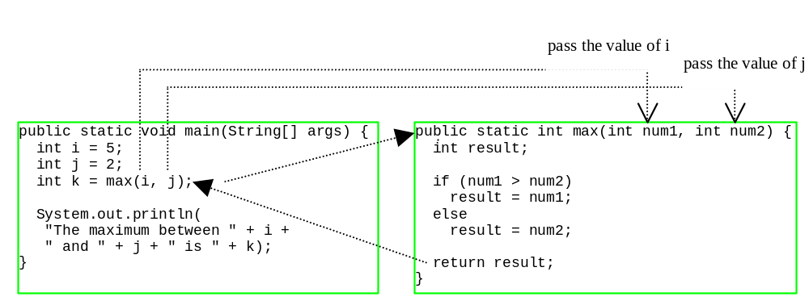
Example of Static Methods
The above program contains the main method and the max method (which is a static method) which demonstrates calling a method max to return the largest of the int values.
In this example, the main method invokes max(i,j), which is defined in the same class with the main method.

Slide 18
Example of Static Methods
When the max method is invoked, variable i’s value 5 is passed to num1, and variable j’s value 2 is passed to num2 in the max method.
The flow of control transfers to the max method.
The max method is executed. When the return statement in the max method is executed, the max method returns the control to its caller.

Slide 19
Call Stacks
Each time a method is invoked, the system stores parameters and variables in an area of memory, known as stack, which stores elements in last-in-first-out fashion.
When a method calls another method, the caller’s stack space is kept intact, and new space is created to handle the new method call.
When a method finishes it work and returns to its caller, its associated space is released.

Slide 20
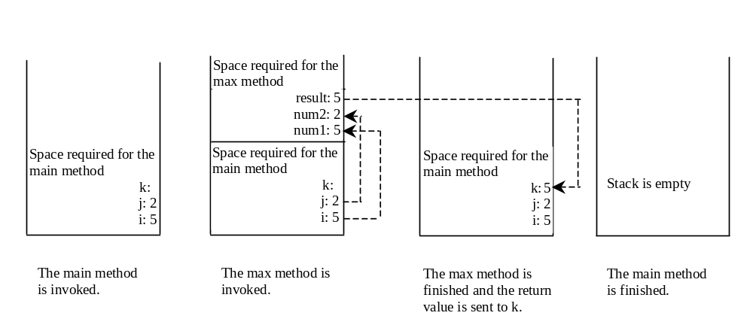
Call Stacks

Slide 21


Trace Call Stack
animation
i is declared and initialized

Slide 22
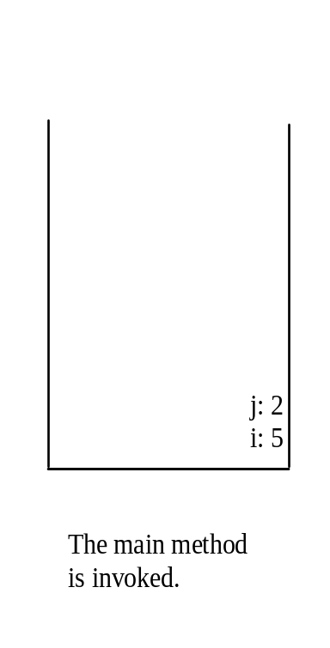
Trace Call Stack
animation
j is declared and initialized

Slide 23

Trace Call Stack
animation
Declare k

Slide 24
Trace Call Stack
animation
Invoke max(i, j)

Slide 25

Trace Call Stack
animation
pass the values of i and j to num1 and num2

Slide 26

Trace Call Stack
animation
pass the values of i and j to num1 and num2

Slide 27
Trace Call Stack
animation
(num1 > num2) is true

Slide 28

Trace Call Stack
animation
Assign num1 to result

Slide 29

Trace Call Stack
animation
Return result and assign it to k

Slide 30

Trace Call Stack
animation
Execute print statement

Slide 31
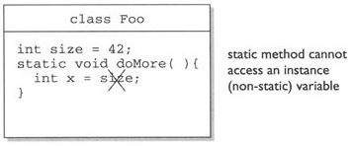
Static method cannot access an instance variable

Slide 32
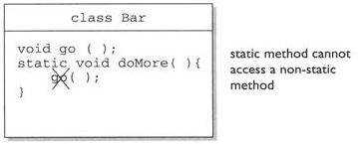
Static method cannot access a non-static method

Slide 33
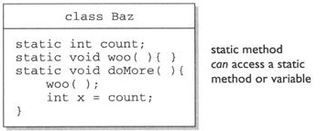
Static method can access a static method or variable

Slide 34
Scope of Local Variables
A local variable: a variable defined inside a method.
Scope: the part of the program where the variable can be referenced.
The scope of a local variable starts from its declaration and continues to the end of the block that contains the variable.

Slide 35
Scope of Local Variables, cont.
You can declare a local variable with the same name multiple times in different non-nesting blocks in a method, but you cannot declare a local variable twice in nested blocks.

Slide 36

Scope of Local Variables, cont.
A variable declared in the initial action part of a for loop header has its scope in the entire loop. But a variable declared inside a for loop body has its scope limited in the loop body from its declaration and to the end of the block that contains the variable.

Slide 37

Scope of Local Variables, cont.

Slide 38
Scope of Local Variables, cont.
// Fine with no errors
public static void correctMethod() {
int x = 1;
int y = 1;
// i is declared
for (int i = 1; i < 10; i++) {
x += i;
}
// i is declared again
for (int i = 1; i < 10; i++) {
y += i;
}
}

Slide 39
Scope of Local Variables, cont.
// With errors
public static void incorrectMethod() {
int x = 1;
int y = 1;
for (int i = 1; i < 10; i++) {
int x = 0;
x += i;
}
}

Slide 40
Method Overloading
Method overloading is two or more methods have the same name, but different parameter lists within one class.
The Java compiler determines which method is used based on the method signature.
Overloaded methods must have different parameter lists. You cannot overload methods based on different modifiers or return type.

Slide 41
Overloading Methods
Listing 5.3 Overloading the max Method
public static int max(int num1, int num2) {
if (num1 > num2)
return num1;
else
return num2;
}
public static double max(double num1, double num2) {
if (num1 > num2)
return num1;
else
return num2;
}
public static double max(double num1, double num2, double num3) {
return max(max(num1, num2), num3);
}

Slide 42
Ambiguous Invocation
Sometimes there may be two or more possible matches for an invocation of a method, but the compiler cannot determine the most specific match.
This is referred to as ambiguous invocation. Ambiguous invocation is a compilation error.

Slide 43
Ambiguous Invocation
public class AmbiguousOverloading {
public static void main(String[] args) {
System.out.println(max(1, 2));
}
public static double max(int num1, double num2) {
if (num1 > num2)
return num1;
else
return num2;
}
public static double max(double num1, int num2) {
if (num1 > num2)
return num1;
else
return num2;
}
}

Slide 44
Lab 3 Exercise 1
Answer Question 1 on page 61 :
Determine the output of Program 3.1 & 3.2. Does the values of i and j for t1, t2 and t3 are same? Why?
Determine the output of Program 3.3. What is the value of the first, second and third of kaunterTest2? Why this happen?
Determine the output of Program 3.4. What is the value of the first, second and third of kaunterTest3? Why this happen?
Determine the output of Program 3.5. What is the value of kaunterTest4? Why this happen?
Answer Question 2 on page 63

Slide 45
Answer : Lab 3 Exercise 1
Answer Question 1 on page 61 :
Determine the output of Program 3.1 & 3.2.
    t1's static i= 1 and instance j=1
    t2's static i= 2 and instance j=1
    t3's static i= 3 and instance j=1
Determine the output of Program 3.3.
    Kiraan Test2 ialah 1 2 3
Determine the output of Program 3.4.
    Kiraan Test3 ialah 1 1 1
Determine the output of Program 3.5.
    Kiraan Kira ialah 25
Answer Question 3 on page 64 :
    System.out.print("Year of start working=" );
    startYear = kb.nextInt();
    temp = calcYears(thisYear, startYear);
    System.out.println("You have been worked for=" + temp);

