Slide 1
Passing Array to Methods
Lecture 13
Based on Slides of Dr. Norazah Yusof

Slide 2
Passing Array Elements to a Method
When a single element of an array is passed to a method it is handled like any other variable.
See example: PassElements.java
8-<number>

Slide 3
Example 1
public class PassElements {
public static void main (String[] args) {
int[] numbers = {5, 10, 15, 20, 25, 30, 35, 40};
for (int i=0; i<numbers.length; i++) {
showValue(numbers[i]);
}
System.out.println();
}
public static void showValue(int num) {
System.out.print((num+2) + " ");
}
}

Slide 4
Passing Arrays as Arguments to Methods
More often you will want to write methods to process array data by passing the entire array, not just one element at a time.
An array can be passed as an argument to a method.
To pass an array, you pass the value in the variable that references the array.
See example: PassArray.java
8-<number>

Slide 5
Example 2
import java.util.*;
public class PassArray {
public static void main (String[] args) {
final int SIZE = 4;
int[] numbers = new int[SIZE];
getValues(numbers);
System.out.println("Here are the numbers.");
showArray(numbers);
System.out.println();
}

Slide 6
Example 2
public static void getValues(int[] arr) {
Scanner kb= new Scanner(System.in);
System.out.println("Enter a series of " + arr.length +
" numbers.");
for (int i=0; i<arr.length; i++) {
System.out.print("Enter number " + (i+1) + ":");
arr[i] = kb.nextInt();
}
}
public static void showArray(int[] arr) {
for (int i=0; i<arr.length; i++) {
System.out.print(arr[i] + " ");
}
}
}

Slide 7
Pass By Value
Java uses pass by value to pass parameters to a method.
There are important differences between passing a value of variables of primitive data types and passing arrays.

Slide 8
Pass By Value
For a parameter of a primitive type value, the actual value is passed. Changing the value of the local parameter inside the method does not affect the value of the variable outside the method.
For a parameter of an array type, the value of the parameter contains a reference to an array; this reference is passed to the method. Any changes to the array that occur inside the method body will affect the original array that was passed as the argument.

Slide 9
Lab 5 – Exercise 1 – Question 1(i)
public class Lab7Ex1_1i {
public static void main(String[] args) {
int x = 1; // x represents an int value
int[] y = new int[10]; // y represents an array of int values
m(x, y); // Invoke m with arguments x and y
System.out.println("x is " + x);
System.out.println("y[0] is " + y[0]);
}
public static void m(int number, int[] numbers) {
number = 1001; // Assign a new value to number
numbers[0] = 5555; // Assign a new value to numbers[0]
}
}
x is 1
y[0] is 5555

Slide 10
Heap
The Java Virtual Machine stores the array in an area of memory called the heap.

Slide 11
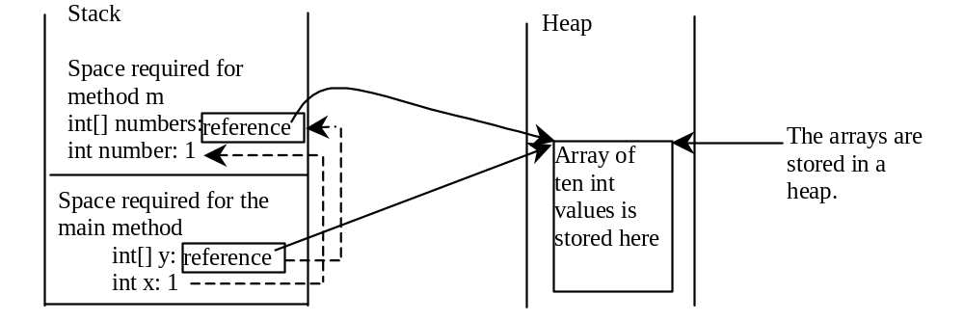
Call Stack and Heap
When invoking m(x, y), the values of x and y are passed to number and numbers. Since y contains the reference value to the array, numbers now contains the same reference value to the same array.
The JVM stores the array in an area of memory, called heap, which is used for dynamic memory allocation where blocks of memory are allocated and freed in an arbitrary order.

Slide 12
Example:
Passing Arrays as Arguments
Objective: Demonstrate differences of passing primitive data type variables and array variables.

Slide 13
Passing Arrays as Arguments
Lab 5 – Exercise 1 – Question 1(ii)
public class Lab5a {
public static void main(String[] args) {
int[] a = {1,2}; // a represents an array of int values
System.out.println("Before invoking swap");
System.out.println("aray is {" + a[0] + ", " + a[1] + "}");
swap(a[0],a[1]);
System.out.println("After invoking swap");
System.out.println("aray is {" + a[0] + ", " + a[1] + "}");
System.out.println("Before invoking swapFirstTwoInArray");
System.out.println("aray is {" + a[0] + ", " + a[1] + "}");
swapFirstTwoInArray(a);
System.out.println("After invoking swap");
System.out.println("aray is {" + a[0] + ", " + a[1] + "}");
}

Slide 14
Passing Arrays as Arguments
Lab 5 – Exercise 1 – Question 1(ii)
public static void swap(int n1, int n2) {
int temp = n1;
n1 = n2;
n2 = temp;
}
public static void swapFirstTwoInArray(int[] array) {
int temp = array[0];
array[0] = array[1];
array[1] = temp;
}
}

Slide 15
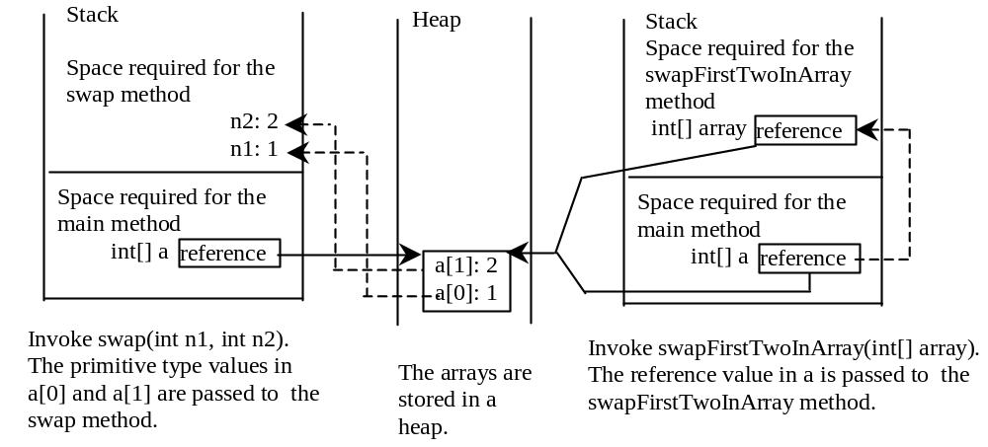
Example, cont.

Slide 16
Returning an Array Reference
Lab 5 – Exercise 1 – Question 1(iii)
A method can return a reference to an array.
The return type of the method must be declared as an array of the right type.
  public static int[] reverse(int[] list) {
  int[] result = new int[list.length];
  for (int i = 0, j = result.length - 1;
  i < list.length; i++, j--) {
  result[j] = list[i];
  }
  return result;
The reverse() method is a public static method that returns an array of int.
8-<number>

Slide 17
Create a new class
Create a main method
Create an array with size 5
Print the values of the array
Call method reserve and pass the array
Again, print the values of the array

Slide 18
Returning an Array from a Method
Lab 5 – Exercise 1 – Question 1(iii)
public static int[] reverse(int[] list) {
int[] result = new int[list.length];
for (int i = 0, j = result.length - 1;
i < list.length; i++, j--) {
result[j] = list[i];
}
return result;
}
list
result
int[] list1 = new int[]{1, 2, 3, 4, 5, 6};
int[] list2 = reverse(list1);

Slide 19
Anonymous Array
  The statement
    printArray(new int[]{3, 1, 2, 6, 4, 2});
  creates an array using the following syntax:
    new dataType[]{literal0, literal1, ..., literalk};
  There is no explicit reference variable for the array. Such array is called an anonymous array.

Slide 20
Variable-Length Argument Lists
JDK 1.5 enables you to pass a variable number of arguments of the same type to a method.
The parameter in the method is declared as follows: typeName ... parameterName
Only one variable-length parameter may be specified in a method, and this parameter must be the last parameter.
Java treats variable-length parameter as an array.

Slide 21
Variable-Length Argument Lists
Lab 5 – Exercise 1 – Question 1(iv)
public class Lab7 {
public static void main(String[] args) {
printMax(21.8,32.2,13.0,45.2,25.8,36.5);
printMax(new double[]{1,4,5,2});
}
public static void printMax(double ... numbers) {
if (numbers.length == 0) {
System.out.println("No argument passed");
return;
}
double result = numbers[0];
for (int i=1; i < numbers.length; i++)
if (numbers[i] > result)
result = numbers[i];
System.out.println("The max value is " + result);
}
}

