Slide 1
Two Dimensional Array
Lecture 15
Based on Slides of Dr. Norazah Yusof

Slide 2
Two-dimensional Arrays
Arrays can be extended to several dimensions (Two or more).
A two dimensional array, for example, is a repetition of one-dimensional arrays (i.e. array of arrays).
int[][] labMarks = {
{14, 13, 11, 9, 5},
{17, 18, 15, 13, 11},
{12, 11, 17, 20, 14}
}
array of three rows and five columns
14
13
11
9
5
0
17
18
15
13
11
1
rows
labMarks
12
11
17
20
14
2
0
1
2
3
4
columns
labMarks[2][3]
labMarks is a two dimensional array of marks of three students in five
lab tests. Student numbers are represented along rows from 0 to 2.
Lab tests are numbered along five columns. Each array cell contains
student’s marks.

Slide 3
Declaration of Two-dimensional Arrays
// Declare array ref var
dataType[][] refVar;
// Create array and assign its reference to variable
refVar = new dataType[5][5];
or
// Combine declaration and creation in one statement
dataType[][] refVar = new dataType[5][5];
// Alternative syntax
dataType refVar[][] = new dataType[5][5];

Slide 4
Declaring Variables of Two-dimensional Arrays and Creating Two-dimensional Arrays
Example:
int[][] matrix = new int[5][5];
or
int matrix[][] = new int[5][5];
Accessing Two-Dimensional Array
for (int i = 0; i < matrix.length; i++)
for (int j = 0; j < matrix[i].length; j++)
matrix[i][j] = (int)(Math.random() * 100);

Slide 5
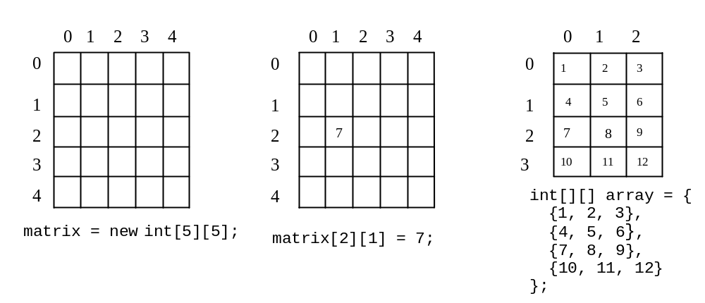
Two-dimensional Array Illustration
matrix.length? 5
matrix[0].length? 5
array.length? 4
array[0].length? 3

Slide 6
Declaring, Creating, and Initializing Using Shorthand Notations
You can also use an array initializer to declare, create and initialize a two-dimensional array. For example,
int[][] array = {
{1, 2, 3},
{4, 5, 6},
{7, 8, 9},
{10, 11, 12}
};
int[][] array = new int[4][3];
array[0][0] = 1; array[0][1] = 2; array[0][2] = 3;
array[1][0] = 4; array[1][1] = 5; array[1][2] = 6;
array[2][0] = 7; array[2][1] = 8; array[2][2] = 9;
array[3][0] = 10; array[3][1] = 11; array[3][2] = 12;
Same as

Slide 7
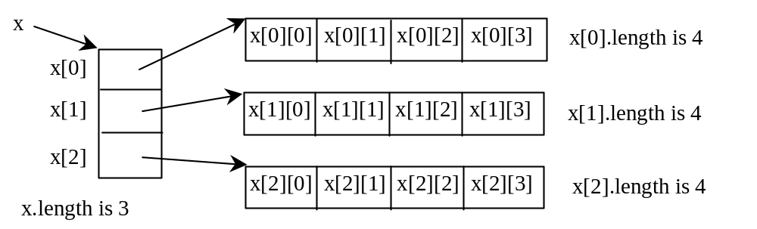
Lengths of Two-dimensional Arrays
int[][] x = new int[3][4];

Slide 8
Lengths of Two-dimensional Arrays, cont.
int[][] array = {
{1, 2, 3},
{4, 5, 6},
{7, 8, 9},
{10, 11, 12}
};
array.length
array[0].length
array[1].length
array[2].length
array[3].length
array[4].length ArrayIndexOutOfBoundsException

Slide 9
Processing Two-Dimensional Arrays
Declare a two-dimensional array named matrix of type integer with 3 rows and 4 columns:
Some processing examples:
Input arrays with values read from the keyboard.
Printing arrays.
Summing all elements.
Summing elements by column
Finding which row has the largest sum.

Slide 10
Processing Two-Dimensional Arrays
Declare a two-dimensional array named matrix of type integer with 3 rows and 4 columns:
int[][] matrix = new int[3][4];
Some processing examples:
Input arrays with values read from the keyboard.
Printing arrays.
Summing all elements.
Summing elements by column
Finding which row has the largest sum.

Slide 11
Accessing Two-Dimensional Array Elements
Programs that process two-dimensional arrays can do so with nested loops.
To fill the matrix array:
  for (int row = 0; row < matrix.length; row++)
  {
  for (int col = 0; col < matrix[row].length; col++)
  {
  System.out.print("Enter a value: ");
  matrix[row][col] = keyboard.nextInt();
  }
  }
Number of rows, not the largest subscript
Number of columns, not the largest subscript
keyboard references a Scanner object
8-<number>

Slide 12
Accessing Two-Dimensional Array Elements
To print out the matrix array:
  for (int row = 0; row < matrix.length; row++)
  {
  for (int col = 0; col < matrix[row].length; col++)
  {
  System.out.println(matrix[row][col]);
  }
  }
8-<number>

Slide 13
Summing The Elements of a Two-Dimensional Array
  int[][] numbers = { { 1, 2, 3, 4 },
  {5, 6, 7, 8},
  {9, 10, 11, 12} };
  int total;
  total = 0;
  for (int row = 0; row < numbers.length; row++)
  {
  for (int col = 0; col < numbers[row].length; col++)
  total += numbers[row][col];
  }
  System.out.println("The total is " + total);
8-<number>

Slide 14
Ragged Arrays
Each row in a two-dimensional array is itself an array. So, the rows can have different lengths. Such an array is known as a ragged array. For example,
int[][] matrix = {
{1, 2, 3, 4, 5},
{2, 3, 4, 5},
{3, 4, 5},
{4, 5},
{5}
};
matrix.length is 5
matrix[0].length is 5
matrix[1].length is 4
matrix[2].length is 3
matrix[3].length is 2
matrix[4].length is 1

Slide 15
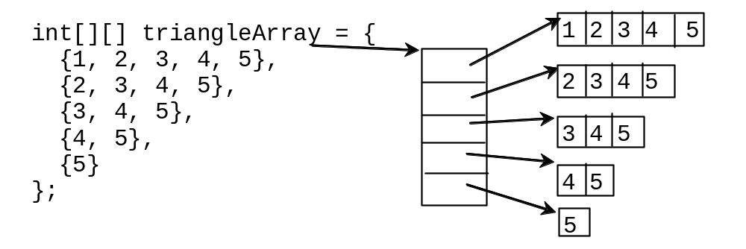
Ragged Arrays, cont.

Slide 16
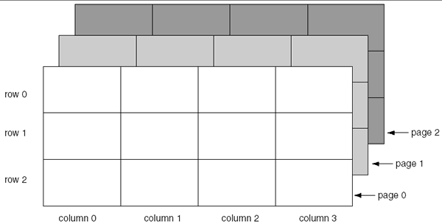
More Than Two Dimensions
Java does not limit the number of dimensions that an array may be.
More than three dimensions is hard to visualize, but can be useful in some programming problems.
8-<number>

Slide 17
Using the Arrays Class
Arrays class
  Contains many useful methods for manipulating arrays
  static methods
    Use with class name
    Without instantiating Arrays object
  binarySearch() method
    Convenient way to search through sorted lists of values of various data types
    List must be in order
Java Programming, Fourth Edition

Slide 18
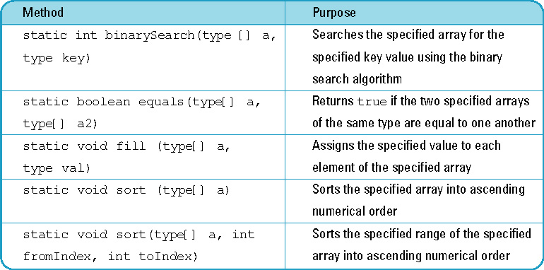
Useful Methods of the Arrays Class
Java Programming, Fourth Edition

Slide 19
Exercises
Write two java program to create and print this array:
1 2 3 4 5
6 7 8 9 10
11 12 13 14 15
16 17 18 19 20
Using one statement to declare, create and initialize the array and nested for loop to print the output
Using Scanner class to get the input values from the user to initialize the array and nested for loop to print the output

Slide 20
public class Array {
public static void main(String[] args) {
int[][] a = {{1, 2, 3, 4, 5},
{6, 7, 8, 9, 10},
{11, 12, 13, 14, 15},
{16, 17, 18, 19, 20}};
for(int i=0; i<a.length; i++) {
for(int j=0; j<a.length;j++) {
System.out.print(a[i][j]+" ");
}
System.out.println("");
}
}
}

Slide 21
Exercises
Do Exercise 3, Question 5, page 112
Correction:
int[][] triangle = new int[5][];
for(int i = 0;i<triangle.length; i++)
triangle[i] = new int[i+1];

Slide 22
import java.util.Scanner;
public class RaggedArray {
public static int[][] buildRagged(int n){
int[][] triangle = new int[n][];
for(int i = 0;i<triangle.length; i++)
triangle[i] = new int[n+1];
Scanner input = new Scanner(System.in);
System.out.println("Please enter: " +n+" integer
numbers");
for(int i=0; i<n; i++) {
for(int j=0; j<n;j++) {
triangle[i][j] = input.nextInt();
}
}
return triangle;
}

Slide 23
public static void printArray(int a[][]){
System.out.println("Ragged Array: ");
for(int i=0; i<a.length; i++) {
for(int j=0; j<a.length;j++) {
System.out.println(a[i][j]);
}
System.out.println();
}
}
public static void main(String[] args) {
Scanner input = new Scanner(System.in);
System.out.print("Enter data for the array, begin with the
number of rows:");
int rows = input.nextInt();
int[][]array = buildRagged(rows);
printArray(array);
}
}

