Slide 1
SUMMARY OF COOLING
Requirements Analysis & Specification
Dayang Norhayati Abang Jawawi
Department of Software Engineering
Faculty of Computing Universiti Teknologi Malaysia
email : dayang@utm.my

Slide 2
Software Engineering for Real-Time Systems
The Structure
Requirements Analysis & Specification
    The important of the requirements stage
    Making mistake
    Practical approaches
    Communication aspects

Slide 3
The Importance of the Requirements Stage
Why???
  Because they have a propound effect on the overall software error rates and productivity => related to system cost.
Cost of rectifying software errors
Distribution of software errors
Other
Design
Code
Other
Code
10%
13%
1%
4%
7%
Design
Requirements
27%
56%
Requirements
82%

Slide 4
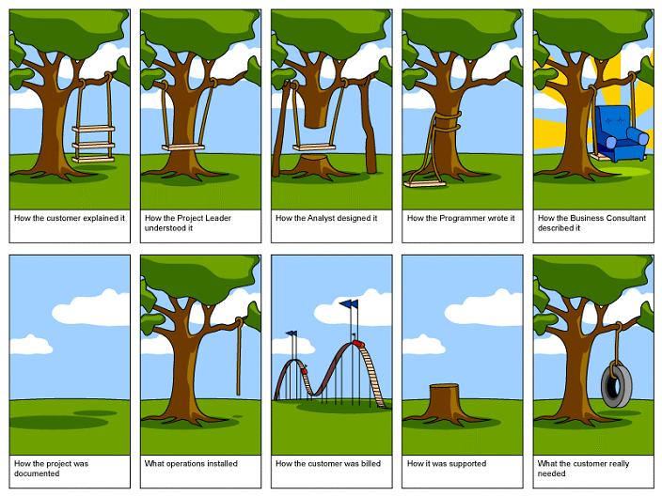
Making Mistakes

Slide 5
Problems in formulating specifications
Customer
Supplier
Information
Problem requirements formulation
Problem evaluation
Communication
Knowledge
Design solution
Problems in formulating specifications
Problems in communicating requirements
Problems in understanding requirements

Slide 6
Practical approaches
The Requirement Phases
System req.
Analyse system requirements
Specify software requirements
Software spec.
Additional factor (constraints)

Slide 7
Practical approaches
Analysis & Specification
Overall system description
Function
What it’s supposed to do
Interfaces
How it fits in its environment
Performance
How well it must do it
Constraints
Do’s and don’t’s
Real world
1. Man-machine
2. Plant
Software world
1. OS
2. Database

Slide 8
Practical approaches
Tool Support & Automation
Difficulty in all software development
To deal with the difficulty:
  Consistent => no mistake & conflict
  Correct => not wrong
  Complete => not omitting
Automated tools are needed. Include in your assignment 1 report.
Complexity

Slide 9
Functional, non-functional & development requirements
Functional – What it does
FUNCTIONAL REQUIREMENT SPECIFICATION FOR MRCA AVIONICS:
SYSTEM: Flight Control.
SUBSYSTEM: Autopilot.
1. Process: | The autopilot, when in hard mode, is required to control altitude to 150 metres, plus or minus 3 metres. at airspeeds up to 500 knots.
2. Inputs: | Altitude, airspeed and groundspeed. Terrain-following radar. Angle of attack. Roll, pitch and yaw gyros. Stick demand.
3. Outputs: | Aileron, rudder and elevator servo commands.
4. Major error: | Loss of altitude or radar signals.
5. Exception response: | Disengage autopilot normal mode, engage emergency mode.

Slide 10
Functional, non-functional & development requirements
Non-functional requirements – What it has: Attributes
NON-FUNCTIONAL REQUIREMENT SPECIFICATION FOR MRCA AVIONICS:
SYSTEM: flight Control. SUBSYSTEM: Autopilot.
1. PERFORMANCE:
Computation: The control algorithm is of the form
Ka[(1 +ST,)( 1 +ST 2)]/[( 1 +ST 3)(1 +ST.)]
Computation time: This must be achieved in 5 milliseconds.
Computation accuracy: Calculations must be accurate to within 0.01%. Control loop update rates: 100 per second.
Variation on loop sampling time: 1 millisecond from sample to sample. Response to loss of altitude signal: 100 microseconds maximum. Redundancy: Quad redundant processor system.
System fault handling: Majority voting on processor outputs.
Mean Time Between Failures (MTBF) per control channel: 5000 hours. Reliability per control channel: 99.98%.
Mean Time To Repair (MTIR) per control channel: 1 hour.
Storage capacity: 1 MByte.

Slide 11
Functional, non-functional & development requirements
2. INTERFACES.
2.1 Interfaces - MMI.
The pilots will be able to select hard, medium or soft rides via a touch screen facility on the head down display.
2.2 Interfaces - Aircraft.
(a) Analogue input signals: These are derived from the following sources:
Altitude, airspeed and groundspeed. Terrain-following radar.
Angle of attack.
Roll. pitch and yaw gyros. Stick demand.
All are digitized using a 12 bit analogue-to-digital converter having a conversion time of 10 microseconds.
(b) Analogue output signals: These are fed to the following items:
Aileron, rudder and elevator servo controllers.
A 12 bit digital-to-analogue converter is used on the output of the controller.
(c) Avionics data bus: All state information is to be fed out onto the aircraft Mil-Std 1553 data bus.
2.3 Interfaces - Software.
The application software will be designed to interlace to the VRTX32 real-time executive.

Slide 12
Functional, non-functional & development requirements
Development requirements – How it should be built
3. DESIGN CONSTRAINTS.
Programming language: Ada95.
Operating system: VRTX32.
Avionic's data bus communication protocols: Mil-Std 1553b.
Processor type: Motorola PC604.
Maximum memory capacity (including expansion capability): 500 Kbytes. Spare processor performance capacity on delivery: 50% min.
Documentation: JSP188.
4. OTHER CONSTRAINTS.
Maximum size: Half ATR case size.
Maximum weight: 10 lb.
Temperature range: -55 to + 125 degrees centigrade.
Servicing policy: Line replaceable unit.
Test: Built-in test to identify faults to unit level.

Slide 13
Requirement Analysis & Specification
Problem Solving 3.1 Group Investigation
Answer test paper – question 2

Slide 14
Communication Aspects
Prototyping
In engineering a prototype – a pre-production version of a manufactured product (component, subsystem or system)
What to evaluate during prototyping?
  Is the product actually feasible?
  Are there unforeseen high-risk technical & cost aspect?
  Are the design & build correct?
  Can it be built in a manufacturing environment?
  Can it be built for the right price?

Slide 15
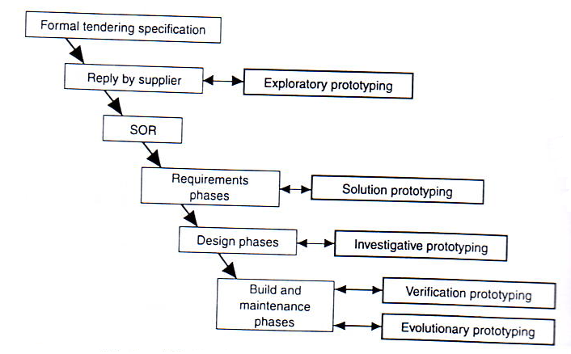
Prototyping
Prototyping within the software lifecycle

Slide 16
Prototyping
Terminology & Types
Software prototyping
  Exploratory
  Solution
  Investigative
  Verification
  Evolutionary
Requirements prototyping
Rapid prototyping
Animation prototyping

Slide 17
Requirement Analysis & Specification
Problem Solving 3.2 Group Investigation
Compare the given prototype categories. Select any 2.
Software prototyping (Exploratory) vs. Software prototyping (Solution)
  Software prototyping (Investigative) vs. Software prototyping (Verification)
  Software prototyping (Exploratory) vs. Software prototyping (Evolutionary)
Requirements prototyping vs. Rapid prototyping
Animation prototyping vs. Rapid prototyping
Submit online 06 October 2013

Slide 18
SUMMARY OF COOLING
Design Concepts
Dayang Norhayati Abang Jawawi
Department of Software Engineering
Faculty of Computer Science and Information System
Universiti Teknologi Malaysia
email : dayang@utm.my

Slide 19
The Structure
Design Concept
    Design Fundamentals
    The elements of modular design
    Program control structure
    Functional structuring
    Object-oriented design
    Data flow design

Slide 20
Design fundamentals
Transformation from specification to conceptual solution
Creativity & knowledge
Expending the basic ideas
Method & organization
Identify realistic alternatives & then assess their qualities (cost, performance, technology level ect.)
Identification & evaluation of design options
Assess information when dealing with an abstract model
Postponement of detailed design decisions

Slide 21
Design fundamentals
Expend descriptive model into something specific by tackling the following factors:
Identify subsystems
Identify interface between subsystems
Evaluate subsystem interaction
Identify work-loading and allocation
Assess man-power req.
General design evolution
Solve the right problem
Top-down & bottom-up

Slide 22
The elements of modular design
Important elements & building blocks of the design process
  Modules
  Coupling
  Cohesion (Coincidental, logical, temporal, procedural, communication, sequential, functional)
  Size & Complexity
Design methodologies
  Functional structuring of software design
  Object-oriented design
  Data flow design

Slide 23
Design Methodologies: Problem Solving 4
Group Investigation
Refer to text book pg. 127 – 190.
Answer the following questions
  SMART case study - model the case study using either using OOmodel or structured/functional (use any modeling tool available)
Submit online 13 October 2013

Slide 24
Thank You.

