Slide 1
Concurrency - Mechanism to support concurrency
Dr. Dayang Norhayati Abang Jawawi
&
Assoc. Prof. Dr. Rosbi bin Mamat

Slide 2
1. Introduction
In multiprogramming and multithreading - either process or thread may run simultaneously with other processes or threads.
2 forms of concurrency
  Interleaving
  Overlapping

Slide 3
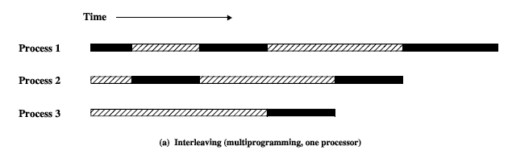
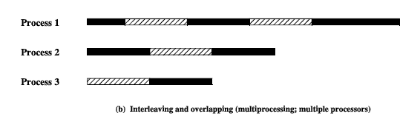

1. Introduction

Slide 4
1. Introduction - Simple Example 1
Procedure in a process with 2 thread T1 & T2
void echo() {
char_in = getchar();
char_out = char_in;
putchar(char_out);
}
global variables
To show non-deterministic & unpredictable

Slide 5
1. Introduction - Simple Example 1
Sequence 1: Multiprogramming with single processor (execution sequence )
 | T1 | T2
1 | char_in = getchar(); | .
2 | char_out = char_in; | .
3 | putchar(char_out); | .
4 | . | char_in = getchar();
5 | . | char_out = char_in;
6 | . | putchar(char_out);

Slide 6
1. Introduction - Simple Example 1
Sequence 2: Multiprogramming with single processor
 | T1 | T2
1 | char_in = getchar(); | .
2 | . | char_in = getchar();
3 | char_out = char_in; | .
4 | putchar(char_out); | .
5 | . | char_out = char_in;
6 | . | putchar(char_out);

Slide 7
1. Introduction - Simple Example 1
Sequence 3: Multiprocessor with 2 processor
 | T1 | T2
1 | char_in = getchar(); | .
2 | . | char_in = getchar();
3 | char_out = char_in; | char_out = char_in;
4 | putchar(char_out); | .
5 | . | putchar(char_out);

Slide 8
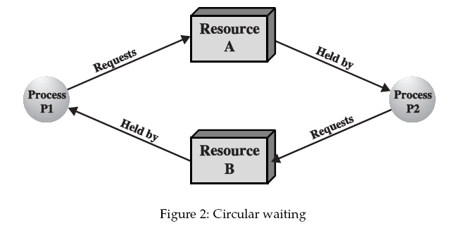
1. Introduction - Simple Example 2
To show deadlock.

Slide 9
1. Introduction
Competition among processes for resources lead to 3 problems
Mutual exclusion
  resource cannot be accessed by more than one process at the same time
Deadlock
  always involves more than one process and more than one resource.
Starvation/Indefinite
  Waiting for event that may not occur

Slide 10
2. Mutual exclusion
to provide support for mutual exclusion (MUTEX) should meet the following requirements:
Only one process at a time is allowed into its critical section to guarantee the exclusive access to shared resources.
...
enter_critical();
/* critical section */
exit_critical();
...
programming structure

Slide 11
2. Mutual exclusion
When no process is in a critical section, any process that requests entry to its critical section must be permitted to enter without delay.
A process remains inside its critical section for a finite time only.
No assumptions should be made about relative process speeds or number of processors to provide powerful solution & without any limit on the nature of concurrent

Slide 12
2. Mutual exclusion
3 ways to satisfy these requirements
software approaches
special-purpose machine instructions or hardware support
operating system or programming languages
  Semaphore
  Monitors
  Message Passing

Slide 13
2. Group Investigation
Given the topic selected prepare 10 min presentation for each topic.

Slide 14
3. Concurrent Prog Constructs
3 fundamental facilities that must be provided for CP:
  (1) the expression of concurrent execution through the notion of process.
  how do you specify concurrent processes?
  (2) process synchronization.
  how do processes maintain consistency?
  (3) interprocess communication.
how do processes exchange information?

Slide 15
3. Concurrent Prog Constructs
Some examples of concurrent languages:
  Ada
  OCCAM
  Java
  Modula 2, Oberon
  Erlang etc
Modified Seq to concurrent lang
  Concurrent Pascal
  Concurrent C

Slide 16
3. Concurrency with OCCAM
CP language for parallel processing HW called transputer
SEQ keyword is use to execute SEQuential processes.
PAR keyword is use to execute PARallel processes.
SEQ PAR
proc1 proc1
proc2 proc2

Slide 17
3. Concurrency with Ada
Execute sequential processes.
begin
proc1; -- process/task 1
proc2; -- process/task 2
end;
Execute parallel processes.
declare task body t2 is
task t1; begin
task t2; proc2;
task body t1 is end;
begin begin
proc1; null;
end; end;

Slide 18
3. Concurrency with Java
Creating & executing threads are provided by Java class Thread in package java.lang.
Must create an object for each procedure which implements the Runnable interface.
public class Proc1 implements Runnable
{
public void run()
{
// code for proc1
}
}

Slide 19
3. Concurrency with Java
public class Proc2 implements Runnable
{
public void run()
{
// code for proc2
}
}
// create processes
Proc1 P1 = new Proc1();
Proc1 P2 = new Proc2();
// create threads
Thread T1 = new Thread(P1);
Thread T2 = new Thread(P2);
// run concurrent threads
T1.start(); T2.start();

Slide 20
3. Concurrency with Java
start() causes the thread to call its run() method.
new Thread()
start()
Created
Alive
stop(), or
run() returns
stop()
Terminated

Slide 21
3. Concurrent C
Few dialects exist. Will concentrate on Concurrent C-- of BACI system (more later).
Processes/functions enclosed in a cobegin block will be executed concurrently.
cobegin
{ // create 4 tasks S1()..S4()
S1(); // run S1()..S4() in parallel
S2();
S3();
S4();
}

Slide 22
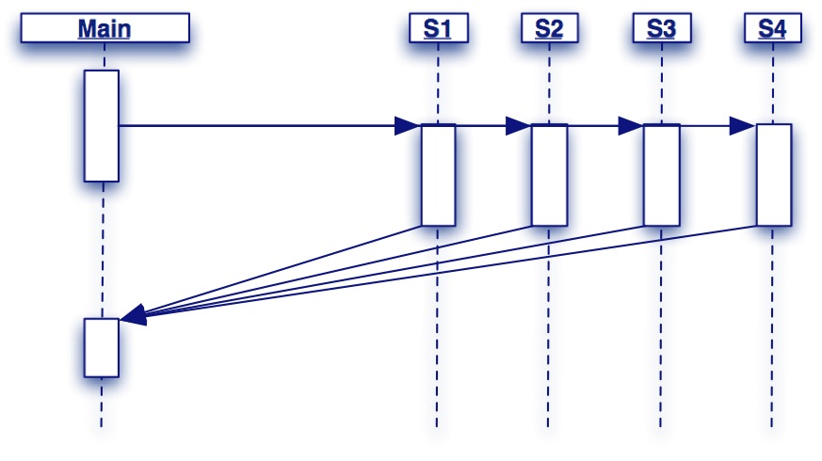
3. Concurrent C
main() continues when all of the tasks in cobegin block have terminated.

Slide 23

3. Run-Time Support
Question: How does CP in Ada / Java/ OCCAM or C-- execute concurrently on a single processor ?
Answer: processes are created, terminated & dispatched to the processor by the Run-time Support System (RTSS) or Run-Time Kernel. RTSS scheduler in OS.
In OCCAM the RTSS is provided by transputer HW.

Slide 24
3. Run-Time Support
In Ada, the RTSS is generated together with CP machine codes.
CP → Ada Compiler → machine codes of CP + RTSS → executed on machine.
In Java & C-- the RTSS is provided by the interpreter running the bytecodes or pseudocodes.

Slide 25
3. Multi-Tasking/Multi-Threading
Concurrent execution on a single processor is called multi-tasking or multi-threading of processes or threads.
The scheduler in RTSS/OS switched the execution of each process/thread in turn to give the illusion of concurrent execution
This process switching is typically implemented by time-slicing.

Slide 26
3. Time-Slicing
1 process is chosen to run for a certain amount of time (a ‘time-slice’) — the period is not determined by the process.
When the time-slice is over, the process is stopped and the process states (vars. + CPU Reg) are stored in memory.
Another process is chosen to run & its process states are restored from memory.
This procedure is repeated until no more processes to be executed.

Slide 27
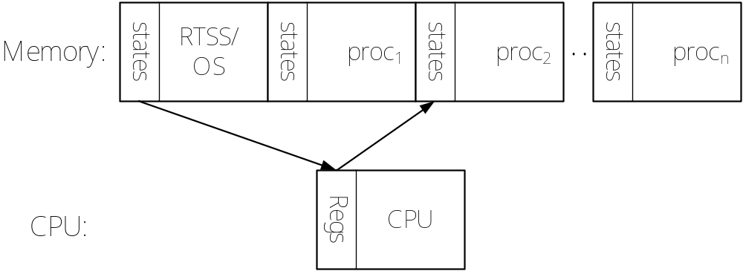
3. Time-Slicing
Discussion: what is the effect to the system with respect to size of time-slice & number of concurrent processes ?

Slide 28
3. Sequential Language + RTOS
How do you provide concurrency supports for sequential lang. (C, Pascal etc) ?
(i) use facilities of OS such as POSIX & Unix threads fork-joint calls.
(ii) use RTOS or real-time kernels (RTK) to provide tasks scheduler, sync. & comm.
Seq lang calls the procs/functions in RTK for concurrency services.
RTOS/RTK e.g: RTLinux,QNX Neutrino, VxWorks,XThreads,μc/COS,PowerPac etc.

Slide 29
3. Sequential Language + RTOS
Example using μc/COS kernel with C:
#include “ucos2.h”
void main( void )
{
OSInit(); /* init RTK */
/* create 3 concurrent tasks keypad, rdTemp & oven */
OSTaskCreate(keypad, (void *)0, (void *)&keyStk[128], 1);
OSTaskCreate(rdTemp, (void *)0, (void *)&tempStk[64], 2);
OSTaskCreate(oven, (void *)0, (void *)&ovenStk[64], 3);
OSStart(); /* start multitasking */
while (1); /* run forever */
}

Slide 30
another mechanism to support concurrency
CONCURRENT PROGRAMMING &
REAL-TIME OPERATING SYSTEMS

